Slide 1
Sustainable Agriculture and Natural Resource Use
Causes of food insecurity in developed nations
Climate change impacts on agricultural output
Resource depletion
Overcoming ‘food deserts’
Shifts in global and urban land use
Urban Agriculture: Renewing the Urban Landscape

Slide 2

Some causes of food insecurity:
1. Demographic shifts, population growth & economic development
Global population is expected to reach 9 billion by 2050 – just 35 years from now - from the current level of just under 7.2 billion.
With economic development, the global consumption of calories rises, with more demand for fats and animal products as economies become more prosperous.

Slide 3
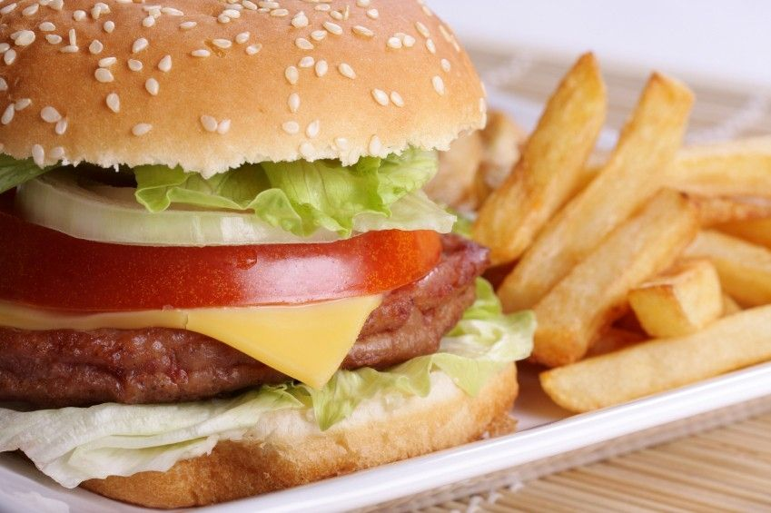
There is a strong connection between the growth of living standards, income, and wealth and the demand for food that represents this higher standard of living.
www.foxnews.com
…“Western” dietary preferences (i.e., of U.S., Europe) become increasingly desirable to economies that are industrializing and becoming more prosperous.
“Dietary changes are highly significant for the future food system: per calorie, some food items (such as meat protein) require considerably more resources (land, water and energy) to produce than others¹.”

Slide 4
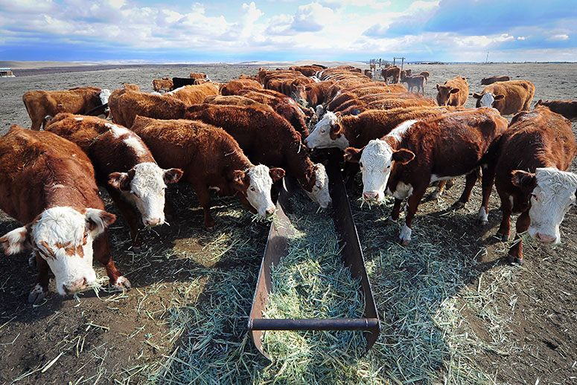
This shift in food preferences is associated with an increased demand for energy and land intensive food sources – so it takes more of both to produce food.
The Commission on Sustainable Agriculture and Climate Change cites evidence predicting a significant increase in per capita meat consumption by 20150 from the current 15 percent of the global human diet.² This corresponds with shifts away from vegetable products that require less land and less energy to produce.

Slide 5
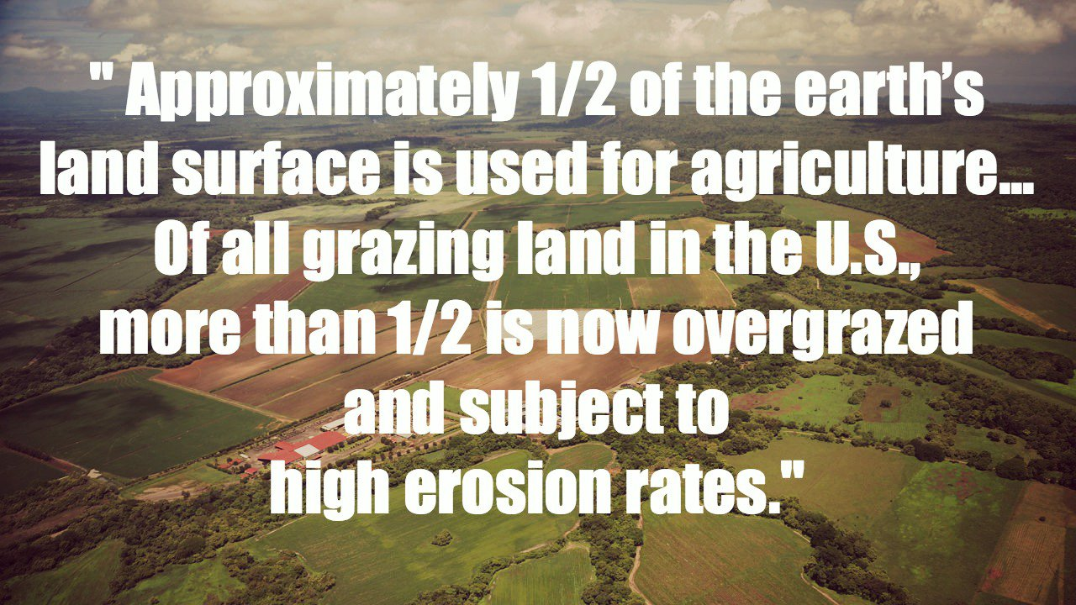
This production exacerbates greenhouse gas emissions (more animal manure management, farm machinery, the need for more fertilizers, and more fuel to produce, land clearing for grazing, and deforestation.
The depletion of natural forests erodes their role in helping to retain water and prevent soil erosion and droughts².
www.onegreenplanet.org
²Commission on Sustainable Agriculture and Climate Change

Slide 6
According to a report by the Commission on Sustainable Agriculture, the increase in extreme weather will exacerbate already fragile food production systems and strain natural resource use especially in areas already prone to drought.
These areas are already highly sensitive to climate change.
It is increasingly difficult for farmers to plan future food production in afflicted areas when rain patterns are unpredictable.
Changes in climate in are also associated with loss of biodiversity (threatened species that are important to the ecosystem; growth of invasive species and pests that destroy crops.
It is estimated that even modest climate change (as measured by a rise of 2⁰ centigrade will lead to the loss of agricultural output in some areas even as such output rises in other areas.

Slide 7
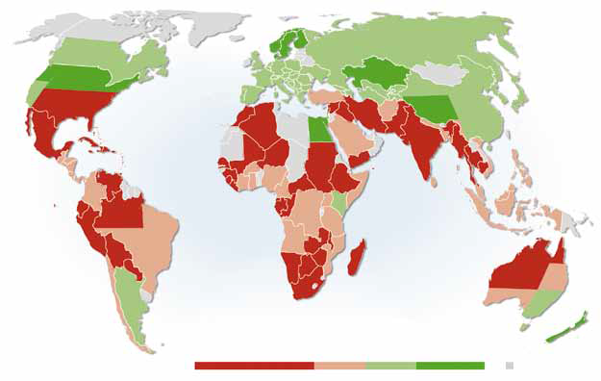
Figure 6. Projected changes in agricultural production in 2080 due to climate change. Source: Cline. 2007. Projections assume a uniform 15% increase in yields due to the fertilization effect of rising carbon dioxide in the atmosphere on some plant species. (Note that this coarse-grain analysis does not project local-scale impacts which require geographically-specific analysis.) Source: www.ccafs.cgiar.org/commission

Slide 8
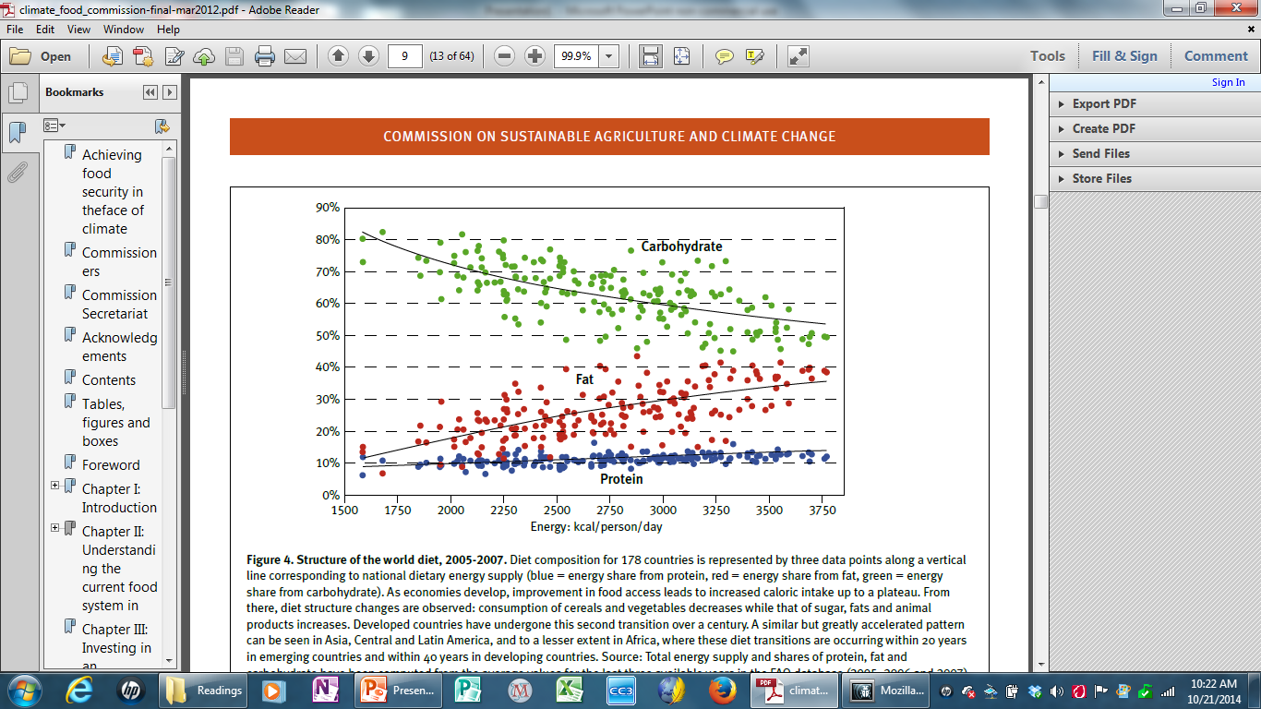
Source: Figure 4: Structure of the world diet, 2005-2007, Commission on Sustainable Agriculture and Climate Change. 2012 CGIAR Research Program on Climate Change, Agriculture and Food Security (CCAFS).

Slide 9
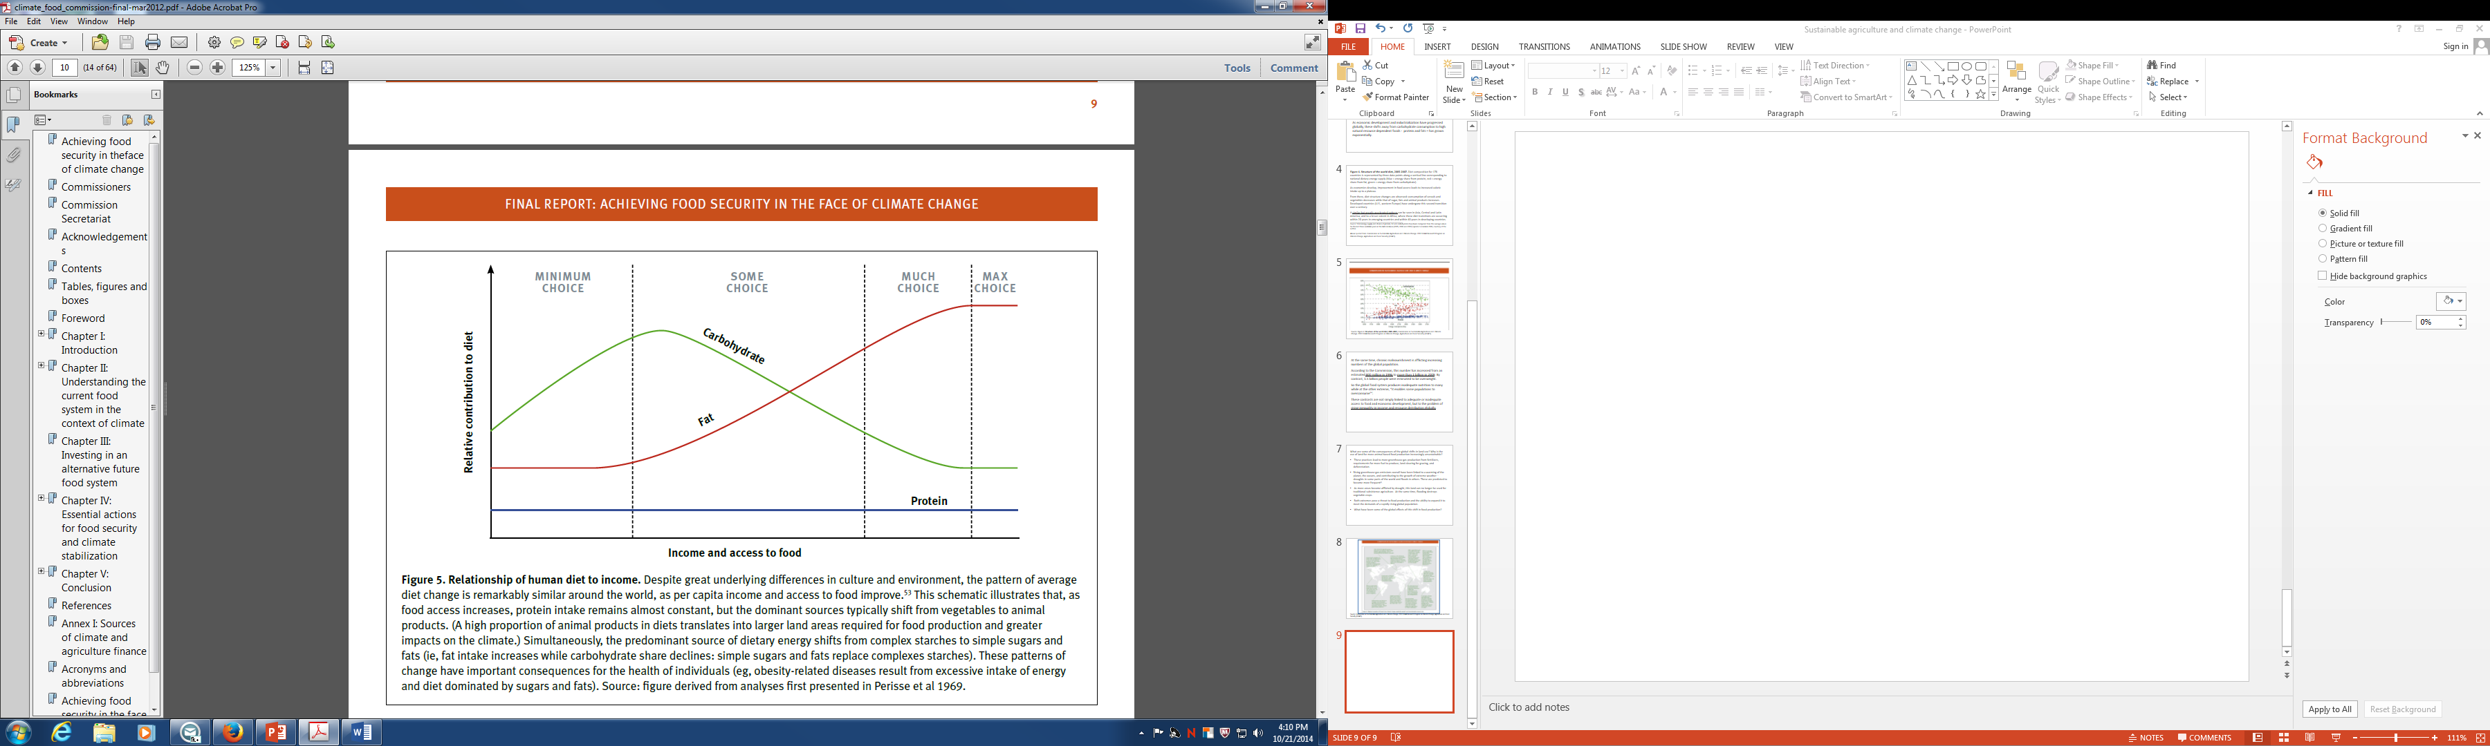
As global incomes rise, people have more choices about food sources; they also have more ability to attain them.
Source: Commission on Sustainable Agriculture and Climate Change. 2012 CGIAR Research Program on Climate Change, Agriculture and Food Security (CCAFS).

Slide 10
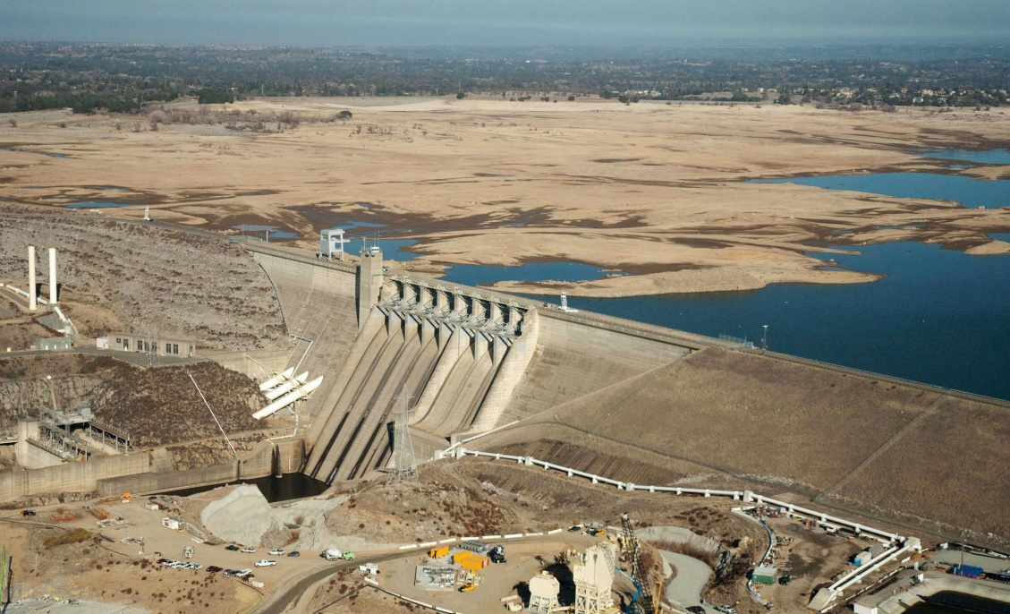
What is the impacts of this shift in agriculture on climate change?
Why is the use of more land for animal based food production increasingly unsustainable?
More greenhouse gas production from fertilizers, requirements for more fuel to produce, land clearing for grazing, and deforestation.
Rising greenhouse gas emissions - linked to a warming of the planet, the oceans, and contributing to the growth of extreme weather – droughts in some parts of the world as rainfall levels drop and floods in others; severe storms. These are predicted to become more frequent⁴.
www.zmescience.com

Slide 11
As more areas become afflicted by drought, this land can no longer be used for traditional subsistence agriculture. At the same time, flooding destroys vegetable crops.
Both extremes pose a threat to food production and the ability to expand it to meet the demands of a rapidly rising global population.
What have been some of the global effects of this shift in food production?
One key trend has been the shift to sustainable, resource efficient production of crops…
A model for this is the urban farming trend that is taking off in densely populated urban areas.

Slide 12
Nathan McClintock: “Why farm the city? Theorizing urban agriculture through a lens of metabolic rift”
What does McClintock mean by the term “metabolic rift” or “ecological rift”?
2. Why does McClintock advocate farming the city? What are the benefits?
Reduces dependence on fossil-fuel based food production
Reduces dependence on fertilizers that contribute to greenhouse gases and contaminated run-off
Social benefits – people/communities come together to participate in cultivating their own food.

Slide 13
Provides access to nutritionally rich foods that might be unavailable to low income families.
Connects individuals to land and to the benefits of their work
Re-establish a connection between humans and our biophysical environment
In sum – urban farming is a sustainable economically, environmentally

Slide 14
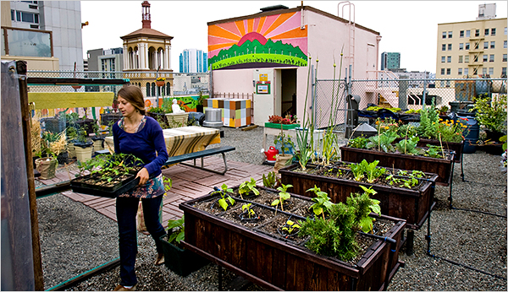
Rooftop Urban Farming:
How can local communities become more independent producers of their own Food sources?
Are there models for this?
Have they been successful?
Where are novel approaches to cultivating local food sources being tried?
Actually, many examples of rooftop gardening – growing and cultivation of local food sources can be found nationwide and globally:
rooftop garden of Glide Memorial Church in San Francisco. “Urban Farming, a Bit Closer to the Sun,” New York Times. June 16, 2009 Marian Burros

Slide 15
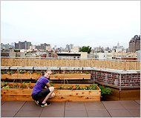
In cities including Washington D.C. and Chicago, there are incentives for businesses and residents to plant green roofs, offering tax subsidies to those who cover their roofs with plants.
Notes the New York Times story on rooftop gardening:
“City dwellers have long cultivated pots of tomatoes on top of their buildings. But farming in the sky is a fairly recent development in the green roof movement, in which owners have been encouraged to replace blacktop with plants, often just carpets of succulents, to cut down on storm runoff, insulate buildings and moderate urban heat”.
The story on rooftop gardening cites a 2008 survey conducted by the organization, Green Roofs for Healthy Cities, which estimated “the number of projects its members had worked on in the United States grew by more than 35 percent last year” [2008]. In total, green roofs installed were believed to cover 6 million to 10 million square feet.”
A rooftop garden on the Lower East Side, Manhattan, Urban Farming, a Bit Closer to the Sun,” New York Times. June 16, 2009 Marian Burros

Slide 16
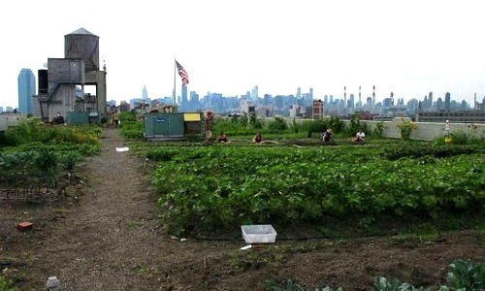
New York State also offers tax subsidies for roofs planted with vegetation and with edible plants.
A report published in 2013 entitled 10 Urban Farming Projects in New York City, noted the Brooklyn Grange Farm (below), along with other large projects scattered throughout the City.
Brooklyn Grange at the Brooklyn Navy Yard and Long Island City, Queens.
Brooklyn Grange operates three different rooftop farms in New York City, including this one. Photo credit: Food Tank. 10 Urban Farming Projects in New York City, November 8, 2013 Kay Spector. http://ecowatch.com/2013/11/08/urban-farming-projects-new-york-city/

Slide 17
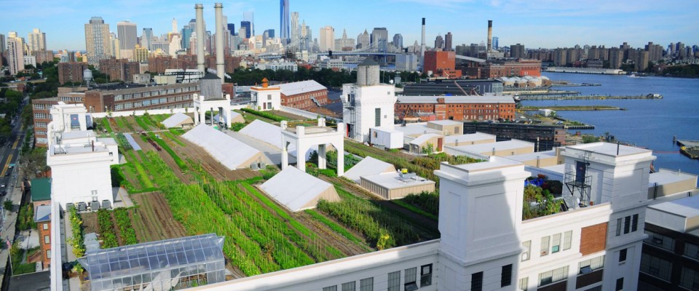
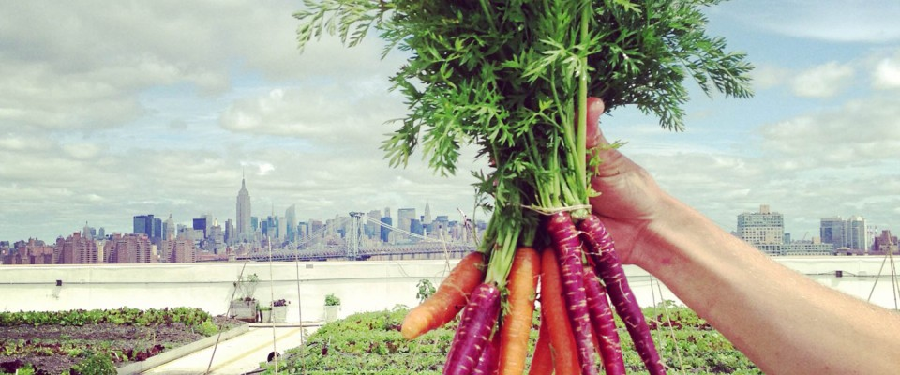
A statement on the organization’s website states: “Brooklyn Grange is the leading rooftop farming and intensive green roofing business in the US”.
The Grange’s two locations are estimated to grow over 50,000 lbs. of organically cultivated produce per year.

Slide 18
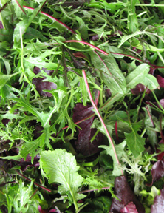
The Brooklyn Grange project also:
“provides urban farming and green roof consulting and installation services to clients worldwide’.
Partners with local non profit organizations
Composting
Raises bee colonies for harvesting honey
Raise hens for locally produced eggs
Operate a local farmer’s market in Greenpoint Brooklyn where the local produce is sold.
Sells their produce to local restaurants and markets in
Brooklyn, Queens and Manhattan.
http://brooklyngrangefarm.com/
Source: Brooklyn Grange, http://brooklyngrangefarm.com/produce/wholesale/

Slide 19
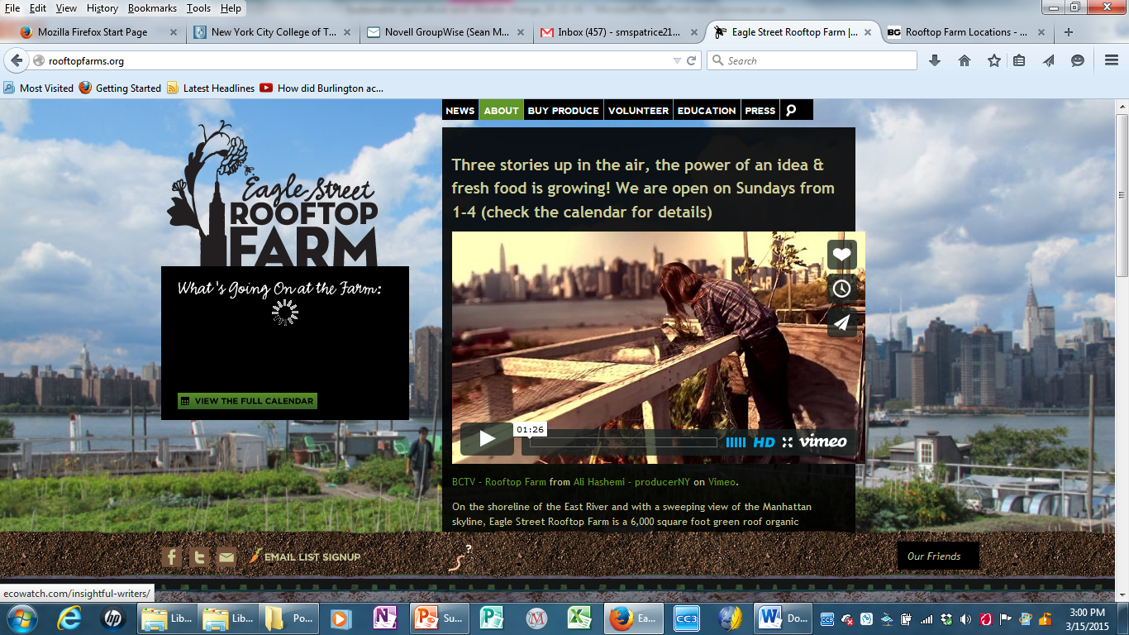
Eagle Street Rooftop Farm – Brooklyn: 6,000 square feet.
The farm
operates its own farmers market
provides produce to local restaurants
invites local residents to get involved in planting and cultivating.
rooftopfarms.org/

Slide 20
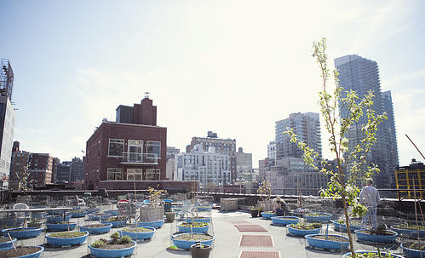
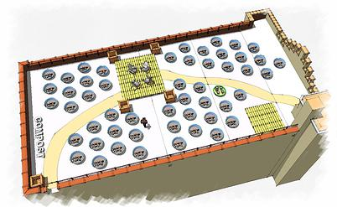
Hell’s Kitchen Farm Project
This rooftop garden occupies 4,000 square feet on top of a local church.
They also do composting (recycling of food scraps)
Plants grown include Basil, Beans, Blueberries, Cabbage, Collard Greens, Chives, Cucumbers, Eggplant, Garlic, Kale, Lettuce, Oregano, Peas, Peppers, Potatoes, Radishes, Rosemary, Scallions and Tomatoes
Source: Hell’s Kitchen Farm Project, http://www.hkfp.org/#!rooftop-farm/c22ve

Slide 21
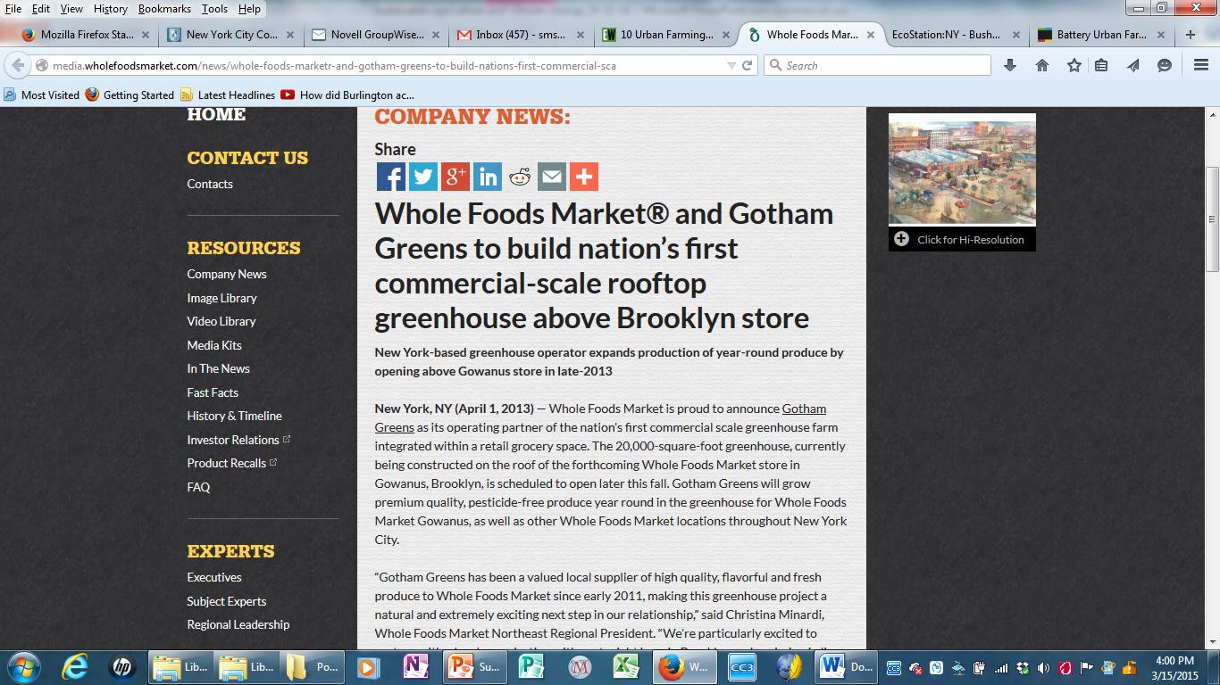
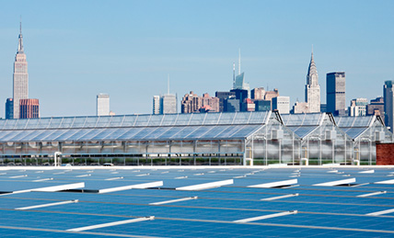
Whole Foods rooftop greenhouse – Gowanus, Brooklyn
Whole Foods partnered with Gotham Greens to develop the greenhouse and cultivate produce year-round on the roof of its store in Brooklyn.
http://gothamgreens.com/
Video

Slide 22
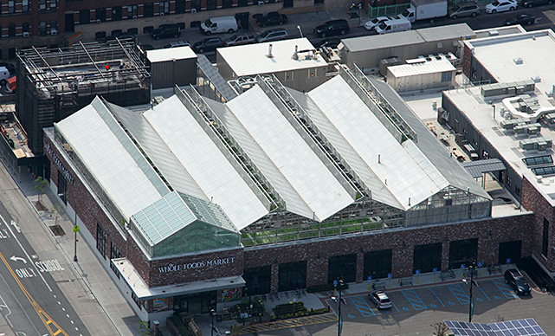
Gotham Greens Greenhouse on Rooftop of Whole Foods Market in Gowanus, Brooklyn

Slide 23
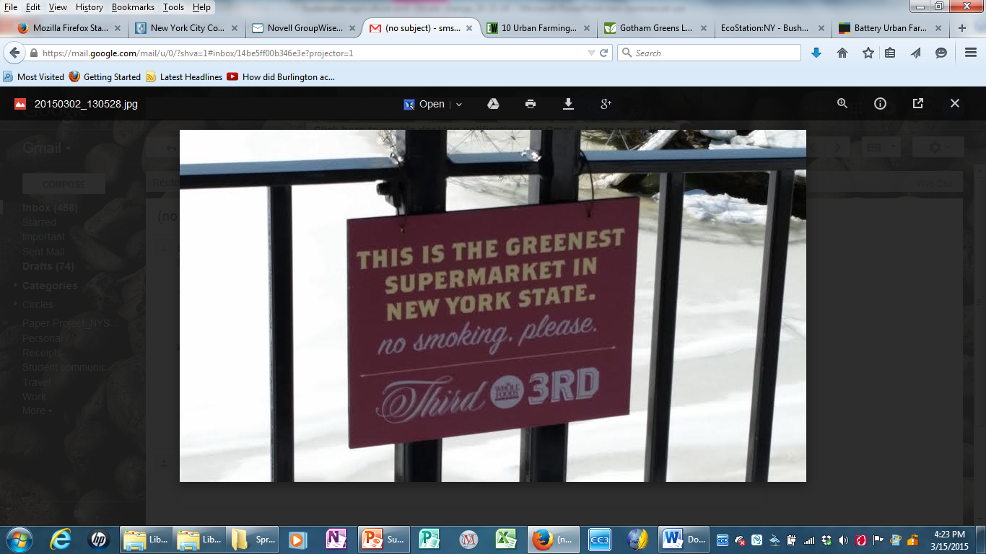
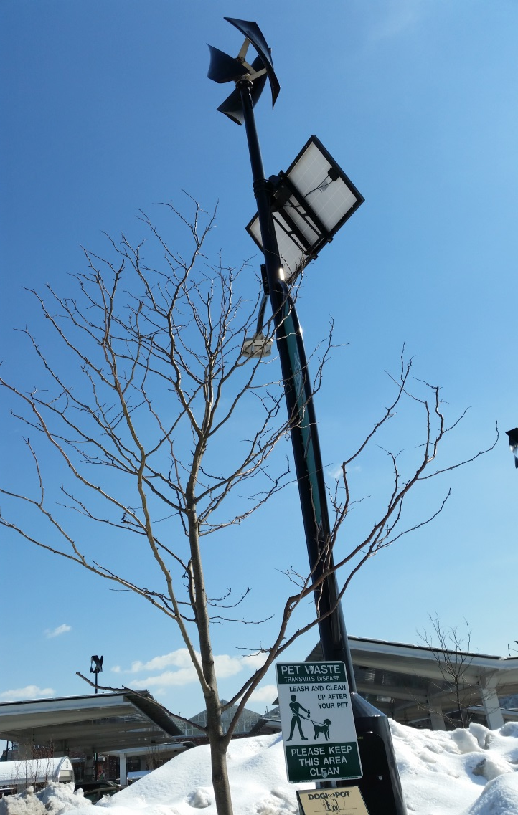
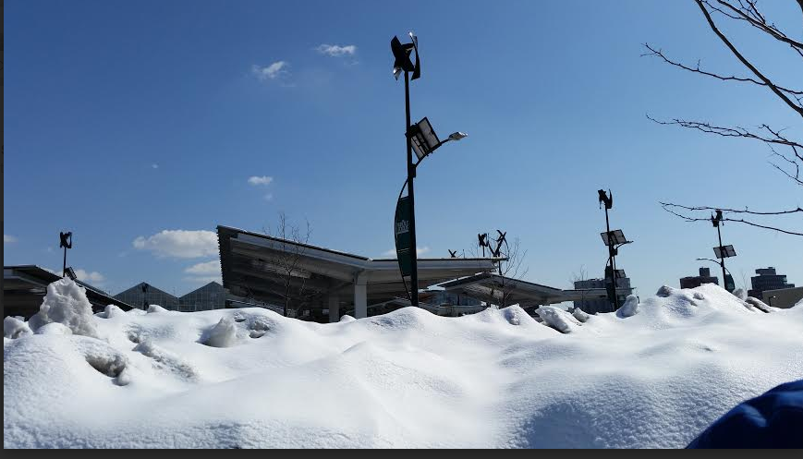
More images from the Whole Foods Market in Brooklyn

Slide 24
How Economically Efficient is Rooftop Gardening?
According to a recent article, “Urban Ag Grows Up: World’s Largest Rooftop Farm In Chicago,” (October 8th, 2014 by Tina Casey)
The irrigation methods use significantly less land and water, eliminate the need for pesticides and minimize the risk of food-borne pathogens such as e-coli and salmonella.
Thus, it needs fewer natural resources to produce.
They serve to naturally cool the buildings on top of which they are located, reducing the demand for energy - heat in winter and air conditioning in summer.
The soil naturally absorbs rainwater runoff.
Gotham Greens is now working with a planned large-scale urban rooftop agriculture project in Chicago that will grow and cultivate an estimated 500 tons of fresh produce annually. It is a combination of indoor and outdoor urban farming.

Slide 25
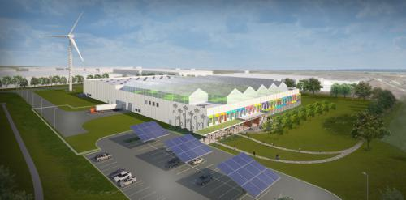
Gotham Greens location in Chicago, Il.: World’s largest rooftop farm
Rooftop farm for new Method facility - image courtesy of WM+P (William McDonough and Partners).
Source: “Urban Ag Grows Up: World’s Largest Rooftop Farm In Chicago,” (October 8th, 2014 by Tina Casey) http://cleantechnica.com/2014/10/08/urban-agriculture-grows-into-worlds-largest-rooftop-farm/

Slide 26
How Significant is rooftop farming internationally?
Urban farming is becoming a global trend:**
http://popupcity.net/top-5-of-the-greatest-urban-rooftop-farms/
Brooklyn Grange Documentary:http://www.growingagreenworld.com/episode322/
_________________________________________________________________________
http://news.nationalgeographic.com/news/2014/04/140429-farming-rooftop-gardening-brooklyn-grange-vegetables-science-food/
National Geographic Video on Brooklyn Grange
END

Slide 27
Figure 4. Structure of the world diet, 2005-2007. Diet composition for 178 countries is represented by three data points along a vertical line corresponding to national dietary energy supply (blue = energy share from protein, red = energy share from fat, green = energy share from carbohydrate).
As economies develop, improvement in food access leads to increased caloric intake up to a plateau.
From there, diet structure changes are observed: consumption of cereals and vegetables decreases while that of sugar, fats and animal products increases. Developed countries (U.S., western Europe) have undergone this second transition over a century.
A similar but greatly accelerated pattern can be seen in Asia, Central and Latin America, and to a lesser extent in Africa, where these diet transitions are occurring within 20 years in emerging countries and within 40 years in developing countries.
_________________________________________________________________________
Source: Total energy supply and shares of protein, fat and carbohydrate have been computed from the average values for the last three available years in the FAO database (2005, 2006 and 2007) Update to Combris 2006, courtesy of the author.
Above quoted from Commission on Sustainable Agriculture and Climate Change. 2012 CGIAR Research Program on Climate Change, Agriculture and Food Security (CCAFS).

Slide 28
At the same time, chronic malnourishment is afflicting increasing numbers of the global population.
According to the Commission, this number has increased from an estimated 800 million in 1996 to more than 1 billion in 2009. By contrast, 1.5 billion people were estimated to be overweight.
So the global food system produces inadequate nutrition to many while at the other extreme, “it enables some populations to overconsume³”.
These contrasts are not simply linked to adequate or inadequate access to food and economic development, but to the problem of rising inequality in income and resource distribution globally.

Slide 29
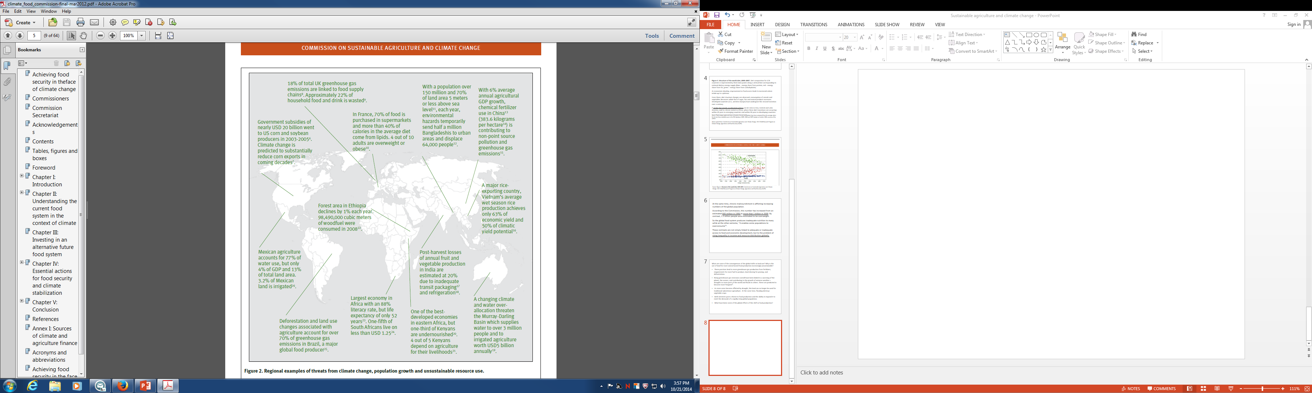
Source: Commission on Sustainable Agriculture and Climate Change. 2012 CGIAR Research Program on Climate Change, Agriculture and Food Security (CCAFS).

Slide 30
III. Food production, supply chains and the environment
Impact on reduced food output on the environment and economy: lower productivity
The report notes that: “Activities relating to the production of food currently contribute between a quarter and a third of the GHG emissions that cause global climate change”.
The energy and resources needed to farm, process, refrigerate, transport and distribute food products further add to greenhouse gas emissions.

Slide 31
IV. Global Trade and food
The Commission’s report estimates that global food prices will rise significantly and become more volatile
Why more volatile prices? Less dependency on global output levels
Resources that were once plentiful become increasingly scarce.
Necessity of making choices about what to produce? How to produce? And how this output gets distributed?

Slide 32
What are the recommendations made in the rest of the article to address the growing threat of food insecurity and unsustainable agricultural practices?
Recommendation 1: Integrate food security and sustainable agriculture into global
and national policies
Recommendation 2: Significantly raise the level of global investment in sustainable
agriculture and food systems in the next decade
Recommendation 3: Sustainably intensify agricultural production while reducing
greenhouse gas emissions and other negative environmental impacts of agriculture
Recommendation 4: Develop specific programmes and policies to assist populations
and sectors that are most vulnerable to climate changes and food insecurity
Recommendation 5: Reshape food access and consumption patterns to ensure basic
nutritional needs are met and to foster healthy and sustainable eating patterns
Worldwide
Recommendation 6: Reduce loss and waste in food systems, targeting infrastructure,
farming practices, processing, distribution and household habits

Slide 33
What are some of the measures that are proposed to achieve these recommended changes?
Discuss: How can these produce economic and environmental benefits?
Film:
Brooklyn Grange Farm: sustainable resource use of urban space and its benefits http://www.growingagreenerworld.com/episode322/

Slide 34
  2. Decisions about resource use – shifting land away from agriculture and toward a built environment
  Rising inequality of access to food
  International investment, trade policies and food price volatility

Slide 35
According to the Commission on Sustainable Agriculture and Climate Change, the global food system will be increasingly strained as global population grows.

Slide 36
“Dietary changes are highly significant for the future food system: per calorie, some food items (such as meat protein) require considerably more resources (such as land, water and energy) to produce than others¹.”
This production exacerbates greenhouse gas emissions (more animal manure management and land use changes that require fertilizers and other sources.
Also contributes to the depletion of natural forests that help retain water and prevent soil erosion and droughts.
As economic development and industrialization have progressed globally, these shifts away from carbohydrate consumption to high natural resource dependent foods - protein and fats – has grown exponentially.
Gl

