Slide 1
What Makes a Hotel Green Certified and Does this Effect Consumer Decision?
Louis Vilardi
ECON 2505

Slide 2
Why this topic?
Going green and becoming more sustainable is becoming a reoccurring theme in the United States.
A major trend in the hospitality industry is eco-tourism and hotels becoming green certified.
As a hotel employee, multiple guests have asked me “What makes this hotel a green certified?”
What are the standards that a hotel must meet in order to become green certified?
Are consumers choices effected by these green certified hotels?

Slide 3
Who can Green Certify a Hotel?
Throughout the United States there are only a handful of major players in Green Lodging certifications.
These companies are Green Key Global, ENERGY STAR, Green Seal, Audubon Green Leaf, and Leadership in Energy and Environmental Design (LEED)
In the United States the Major companies that certify hotels are Green Seal, Audubon Green Leaf and LEED (Green Hotel News)

Slide 4
Green Seal
This is a non-profit company that uses a science based program to help consumers, purchasers, and companies to create a sustainable world since 1999 (Green Seal Standards)
There are three levels to which a Hotel and Lodging property can become certified.
They become Bronze, Silver, or Gold certified.
Major Focus
Waste Minimization
Energy Conservation
Waste Water Management
Pollution Prevention
Environmentally Sensitive Purchasing

Slide 5
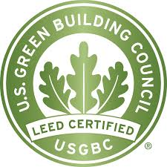
Leadership in Energy and Environmental Design (LEED)
LEED certification is given based off of the building and renovations of hotels (Green Hotel News).
The certification score is broken down into 110 point scale.
Three possible certification levels: Certified Silver, Gold, and Platinum.
During the hotel renovation and the building of the hotel LEED focuses on
Energy and Water Conservation
CO2 Emissions
Indoor Environmental Quality
Protection of Resources

Slide 6
Audubon Green Leaf
In order to obtain a Audubon Green Leaf Certification, a Green Leaf employee will go to the hotel that is trying to obtain the certification (Audubon International).
After your hotel is inspected, it is scored and based upon its overall score, the hotel is given an eco-rating.
This ranking is based on a scale of one to five Green Leafs
Green Leaf Focus
Hotels Current Practices
Ideas In Order To Improve The Hotel
Saving Energy
Reducing Waste
Conversing Water and Resources
Preventing Pollution

Slide 7
New York State Green Hotel Certification Pilot
In 2009, New York State participated with many companies such as I LOVE NY, NYS Hospitality & Tourism Association, and many other hotel and environmental companies (Green Hotel Certification Pilot Program)
This certification program used the same certification standards and eco-rating program that Audubon Green leaf uses as well as help from the Pollution Prevention Institute.
The criteria for this green certification focuses on a hotels carbon footprint, waste generation, conservation, and appropriate use of natural resources.
This Green Hotel Certification Pilot is no longer in use.

Slide 8
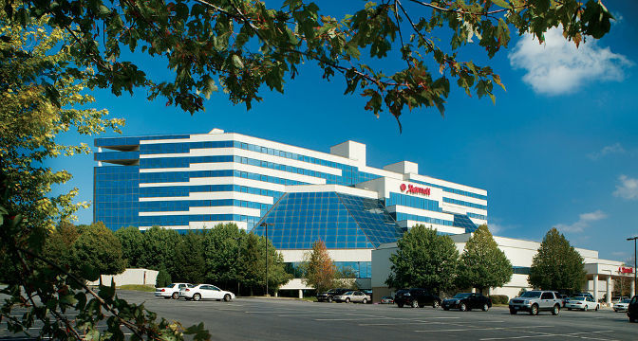
Field Visit: Islandia Marriott
The Islandia Marriott is located in Islandia, New York
I spoke to the General Manager Megan Weathersbee and Chief Engineer Eli Potak.
2015 Green Leader from TripAdvisor
This is a TripAdvisor Based Award
Linen and Towel Re-Use plan
Recycling
Tracking Energy Use
Education Staff and Guests on Green Practices
What does the Islandia Marriott do?
New recycling programs with sanitation company
Energy Saving Light Bulbs
Install faucets that use less water
Two Electric Shuttles: energy used is equivalent to 55 cent to the gallon
Working on getting a new dishwasher that uses less water
Re-use linen and towels
Buy local produce from local food purveyors

Slide 9
Do Green Certified Hotels Effect Consumer Decision?
A Forbes article states that according to TripAdvisor, 62% of travelers often consider the environment when they are choosing a hotel and transportation (Bender, 2013)
A study in the European Journal of Tourism showed that females are more incline to stay at eco-friendly hotels (Li-Hui,Yu-Chen, Nuryyev, & Mei-Ling, 2015).
Travelers with children often do not travel with the intent of staying at eco-friendly locations because they believe price would be an option (Li-Hui, Yu-Chen, Nuryyev, & Mei-Ling, 2015)
When traveling, people were more concerned about convenience than the environment. According to study on eco-friendly tourism in Turkey, travelers weren’t interesting in eco-friendly hotels if it was going to make their trip a hassle. These travelers were not interested in using mass transportation or learning about how they can help the environment (Can, Tucker, Ozturk, Alaeddinoglu, 2013)

Slide 10
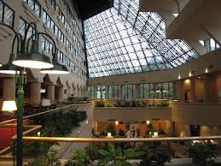
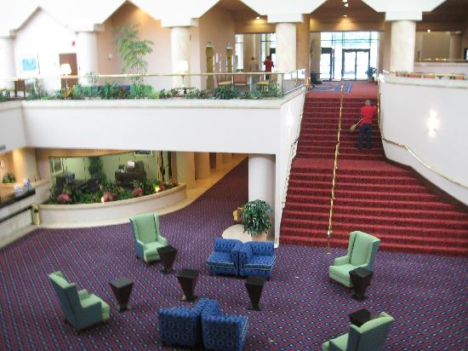
Does the fact your hotel is a 2015 Green Leader Effect consumer choices?
Ms.Weathersbee informed me that a couple of guests had mentioned it in guests surveys
There was no actual study conducted on whether or not people were choosing them because they were a green leader.
Occupancy had steadily risen in 2015 compared to 2014 and past years.

Slide 11
Conclusion and Recommendations
There are many different companies that give out green certifications, the main being Audubon Green Leaf, Green Seal and LEED
New York State tried to make a standardized Green Hotel Certification Program
According to TripAdvisor almost 2/3 of its travelers are environmentally conscious when they travel
Other travels are concerned with price and conveniences.
I believe that hotels should do a better job at exposing to its potential guests that they do participant in green practices
Educate the public on the topic

Slide 12
References
Audubon International - Green Lodging Program. (n.d.). Retrieved May 6, 20 fromhttp://www.auduboninternational.org/green-lodging
Bender, A. (2013, April 22). Survey: Two-Thirds Of Travelers Want Green Hotels. Here's How To Book Them. Retrieved May 6, 2015,fromhttp://www.forbes.com/sites/andrewbender/2013/04/22/survey-two thirds-of-travelers-want green-hotels-heres-how-to-book-them/
CAN, A. S., TURKER, N., OZTURK, S., & ALAEDDINOGLU, F. (2014). TOURISTS‘PERCEPTION OF GREEN PRACTICES IN ECO- FRIENDLY HOTELS: A CASE STUDY FROM THE ANTALYA REGION OF TURKEY. Journal Of Tourism Challenges & Trends, 7(1), 9-26.
Disclaimer. (2009). Retrieved May 6, 2015, from http://www.dec.ny.gov/chemical/58045.html
EcoFeature_Green_Certifications. (n.d.). Retrieved May 6, 2015, from https://www.ecogreenhotel.com/ecogreen newsletter/EGH_Jan/green_certifications.html
Green Seal Standards. (n.d.). Retrieved May 6, 2015, from http://www.greenseal.org/GreenBusiness/Standards.aspx?vid=ViewStandardDetail&ci =0&sid 19
Li-Hui, C., Yu-Chen, H., Nuryyev, G., & Mei-Ling, H. (2015). People's motivation, constraints and willingness to pay for green hotels. European Journal Of Tourism Research, 967-77
What are the levels of the GreenLeaders Program? (n.d.). Retrieved May 6, 2015, from https://www.tripadvisorsupport.com/hc/en-us/articles/200614097-What-are-the levels-of-the GreenLeaders- Program-

