Slide 1
The Practical Benefits of Urban Agriculture Brooklyn Grange, Building #3, 63 Flushing avenue , BKNY

Slide 2
21% Carbon Food Print
15% Goods and Services
3% Personal Transportation
3% Home Energy
Carbon Foot Print is defined as the total sets of greenhouse gas emissions caused by an organization, event, product or person.

Slide 3
Pre-Ag Rooftop of The Brooklyn Grange

Slide 4
The Brooklyn Grange
Located at 37-18 Northern Boulevard, Long Island City New York
The Worlds Largest Urban- Rooftop Farm, 65k sq. feet
Produced over 40k pounds of produce

Slide 5
New York City
Population of just under 8.5 Million (8,405,837 Census)
Food Supply of 28.6 Million tons of food (2010 Mayoral Report)
40k of produce equates to 0.000007% of NYC food consumption)

Slide 6
Vertical Farms

Slide 7
Actual Vertical Farming Centers
Artificial Light Sources
Air Conditioning
Heating
Water

Slide 8
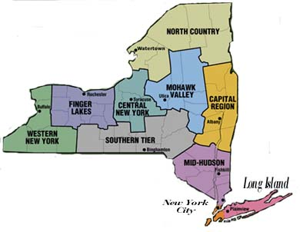
PERI-URBAN FARMING SOLUTIONS
Decrease
Transportation
Fuel Cost
Time
Labor
Increase
Efficiency
Nutrition
Employment
MAP OF NEW YORK STATE
NYS 55k Sq. Miles
NYC 469 Sq. Miles

Slide 9
Pre- Ag Edgemere Farm

Slide 10
Edgemere Farm 385 Beach 45th street, Far Rock NY

Slide 11
Social Benefits
Green Markets accept government subsidy programs as payment
Ingratiate children with food origins
Enhance community relationships
Provide organic alternatives to GMO products and pesticide latent produce

Slide 12
Economic Benefits
Provides employment opportunities to locals within the community
Lowers horticulture prices by providing a competitive alternative to commercially viable produce
Supports local business within the community by providing a source of organic produce
Enhances real estate value by optimizing otherwise dormant venues

Slide 13
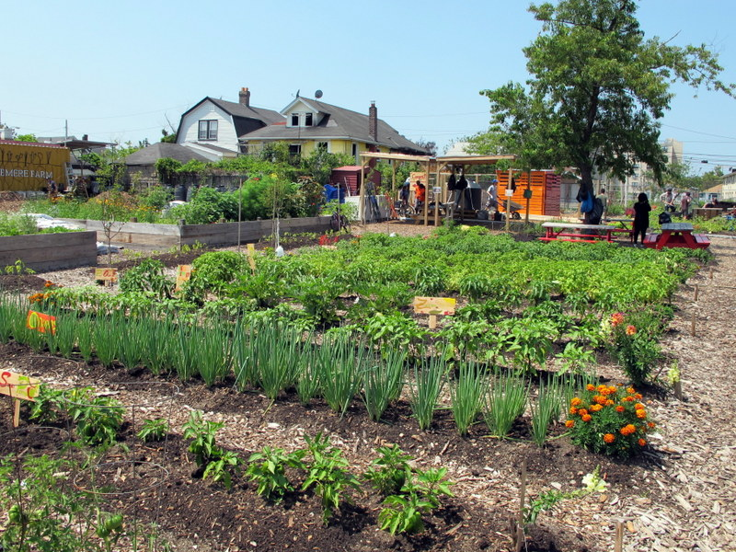
Government investment
Subsidies
Supply Public Facilities (i.e. Schools, Hospitals, Etc.
Government Policies
Repudiate Special Interest Agemdas

