Slide 1
The Cost and Benefit of
Genetically Modified Foods
By: Chris Kim

Slide 2
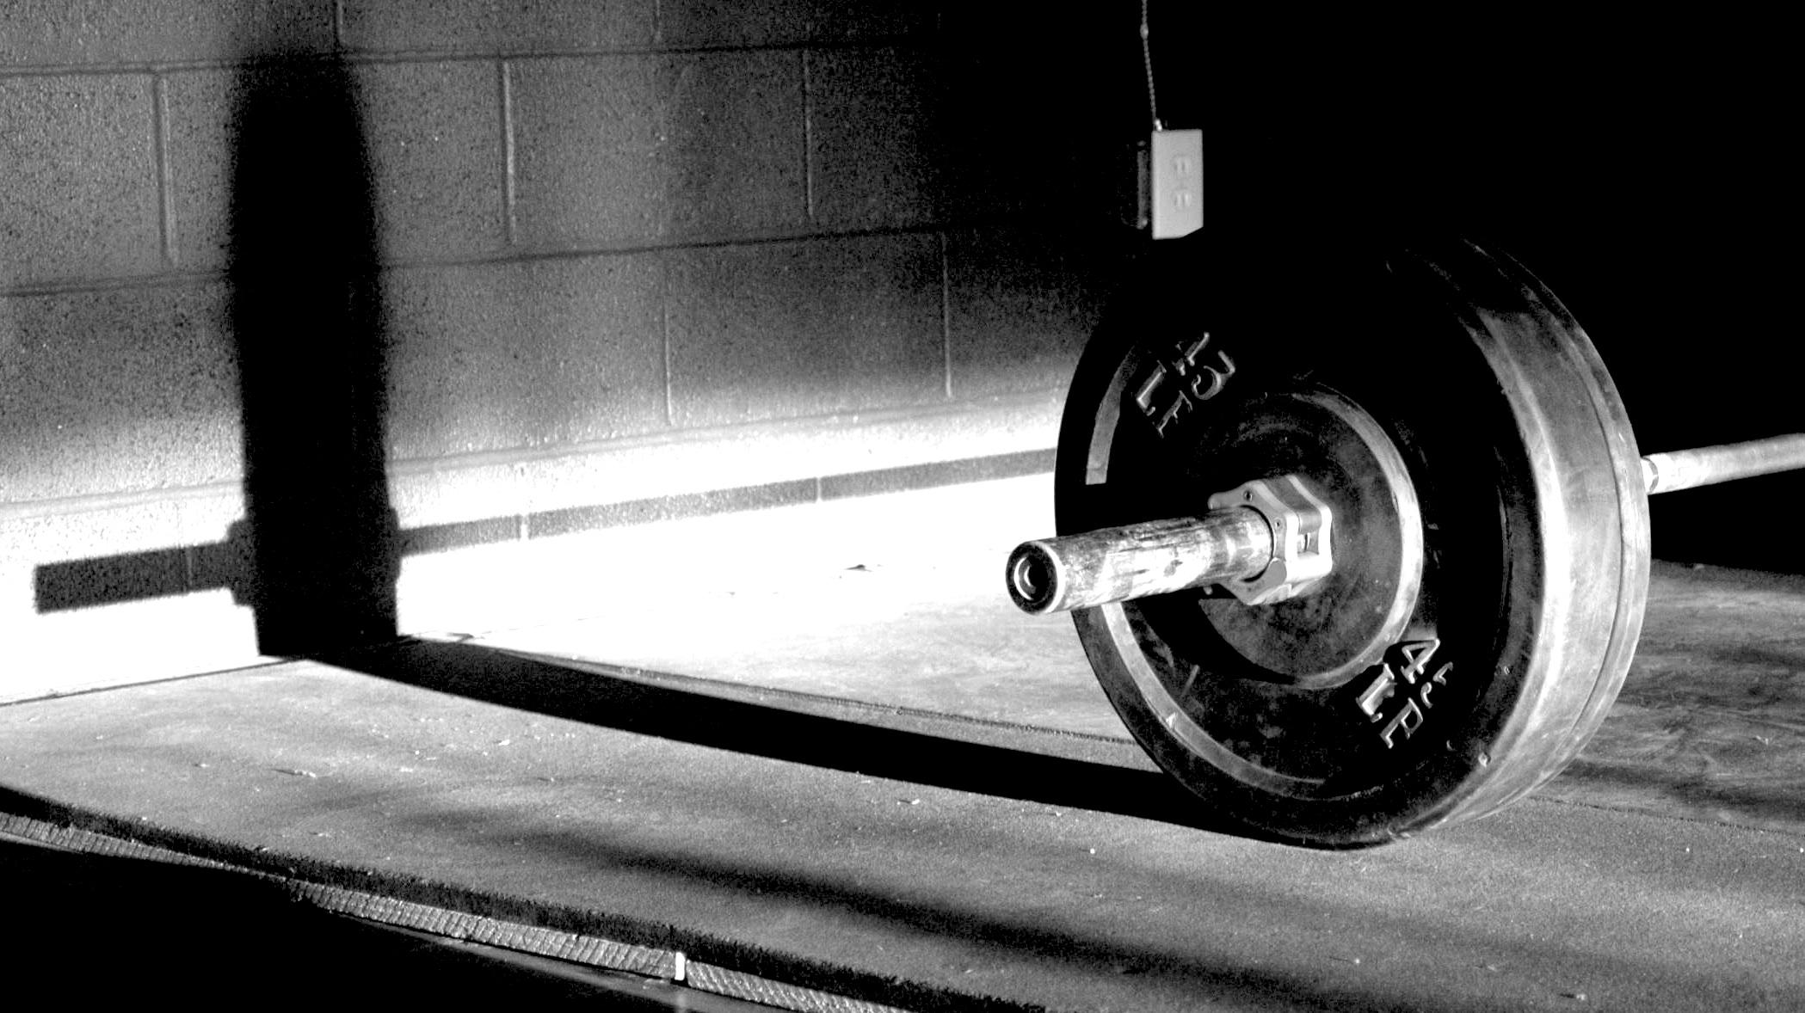
Grew up with an active lifestyle
Played basketball and football
2 years ago, I grew an interested for weightlifting
Bodybuilding
Nutrition + Weightlifting = Bodybuilding
This topic helped me learn more about nutrition and healthy dieting.
Why did I choose this topic?

Slide 3
What is Genetically Modified Food?
Genetically Modified Organism (GMO)
Organisms altered by inserting genes from an external source such as viruses, bacteria, animals, or plants.
Steroids and hormones
Genetically Modified Crop (GMC)
Plants used in agriculture, the DNA has been modified using genetic engineering techniques.
Genetically Modified Food (GMF)
Food containing or derived from genetically engineered organisms/crops.
YouTube: https://www.youtube.com/watch?v=riCQ8R3EG9U
Source: Maghari, B. M., & Ardekani

Slide 4
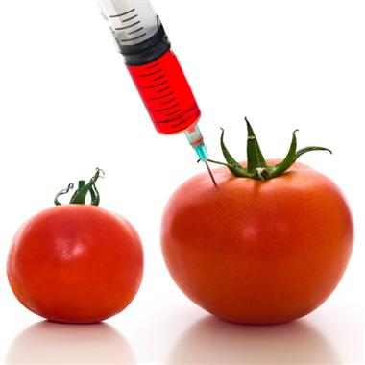
Genetically Modified Crops
An example: Crops altered DNA to grow larger and produce natural pesticides.

Slide 5
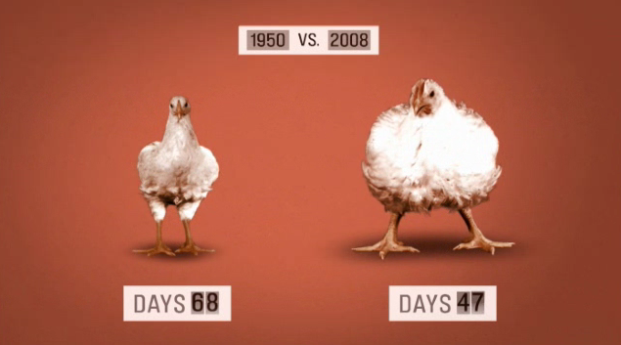
Genetically Modified Organisms
An example: Organisms injected with steroids to increase growth.

Slide 6
Cost/Benefit of GMF
Cost:
Health Problems
Animals fed by GM crops have been harmed or even died. (Maghari, B. M., & Ardekani)
Studies show people suffer from allergies caused by genetically modified foods.
Animals suffer from harsh conditions
Mass production/hormones and steroids
Benefit:
Developing countries are accepting the technology hoping to alleviate hunger and poverty.
Cheaper for farmers
Crops can be modified to be resistant to viruses/pests = farmers don’t need to spend money on pesticides
Source: Maghari, B. M., & Ardekani

Slide 7
Interesting Facts
By 2015, predicted that more than 200 hectares of land will be planted by biotech crops in 40 countries.
1 hectares = 10,000 square meters
Major producers of GM crops:
USA, Argentina, Canada, and China
In the US, 80% of maize, cotton, and soya are biotech varieties.
GMO are in as much as 80% of processed food.
Source: Maghari, B. M., & Ardekani

Slide 8
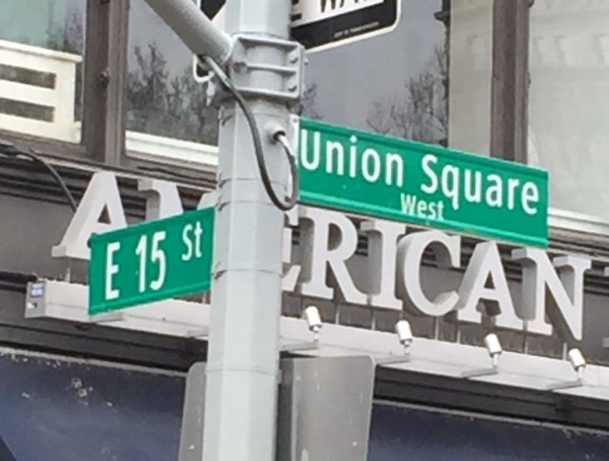
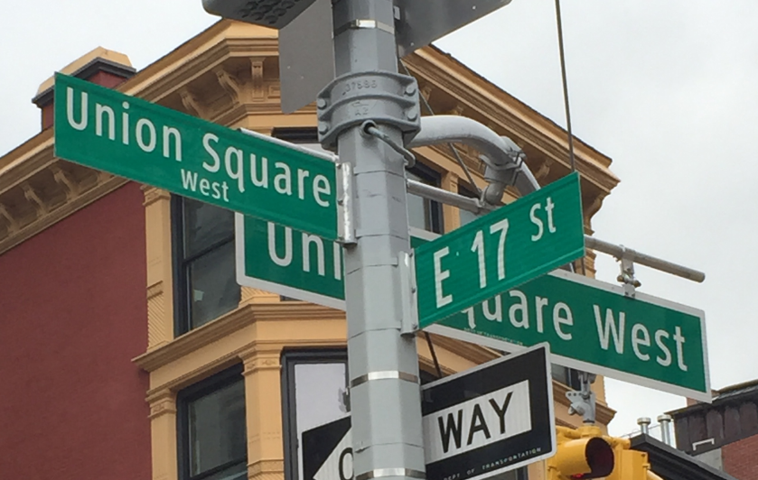
Site Visit
Union Square Farmers Market
Open Monday, Wednesday, Friday, and Saturday
Saturday: Open from 8:00am – 6:00pm

Slide 9
Farmers Market Interview
Farmers Market → AVOID GMF
Benefit of Quality Food
Nutritional value is higher when picked from farms day before.
Rather than picked weeks before → packaged → shipped → sitting on shelves for days.
Benefits to local community
Find products you normally can’t get
Get to know your farmers
Farmers markets affect our economy
Boosts farmers income → helping them shop more.
Source: Union Square Farmers Market Interview

Slide 10
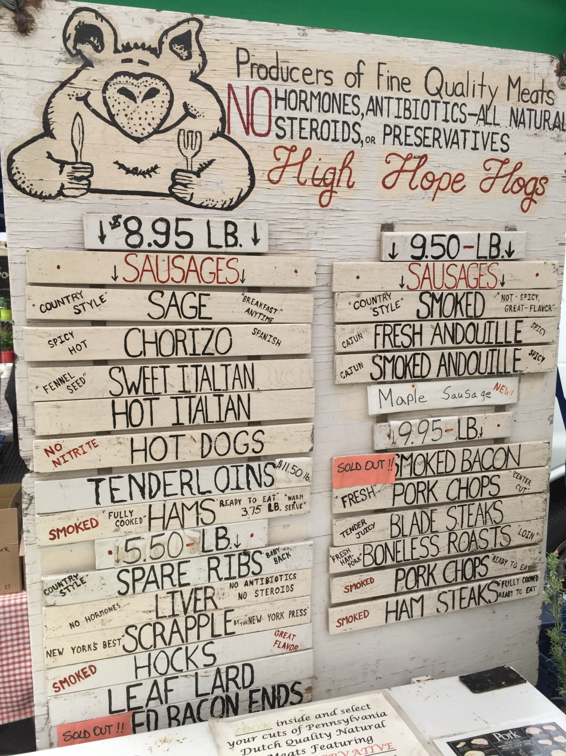
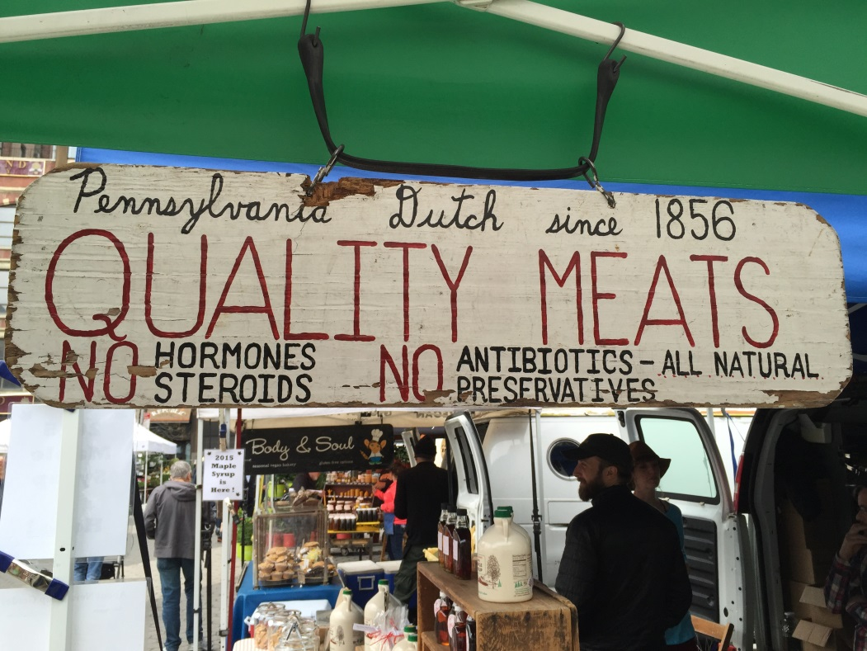
Quality Meat Options

Slide 11
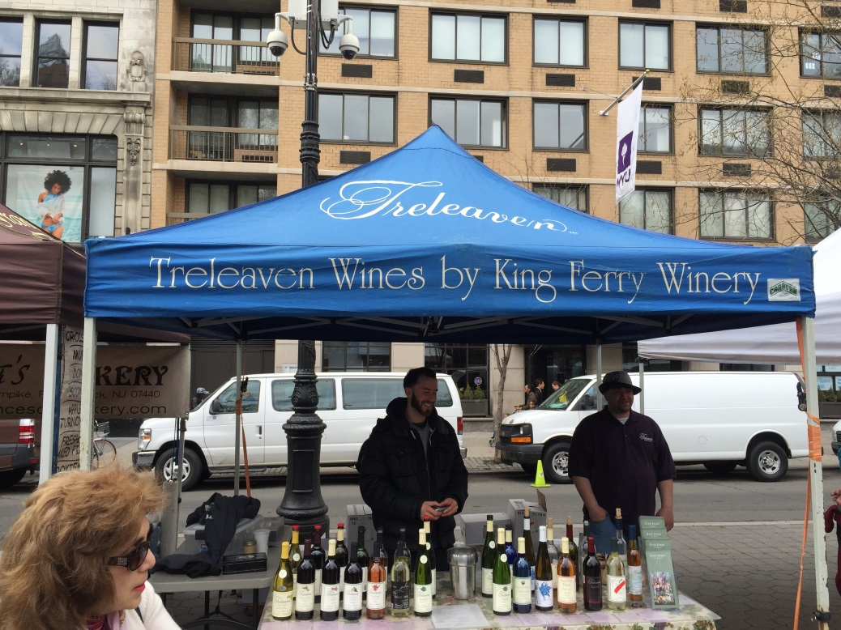
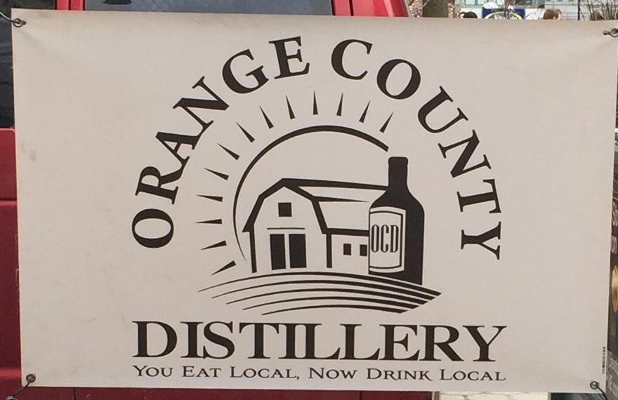
Wine/Liquor and Spices

Slide 12
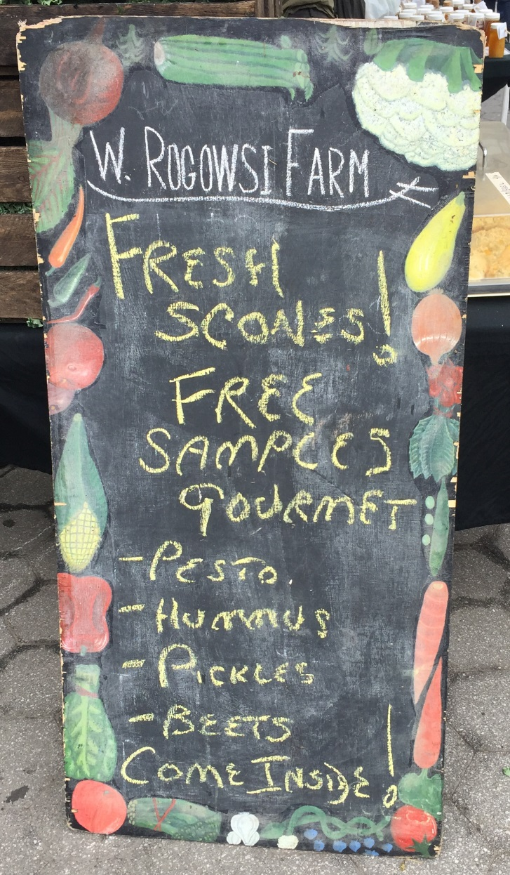
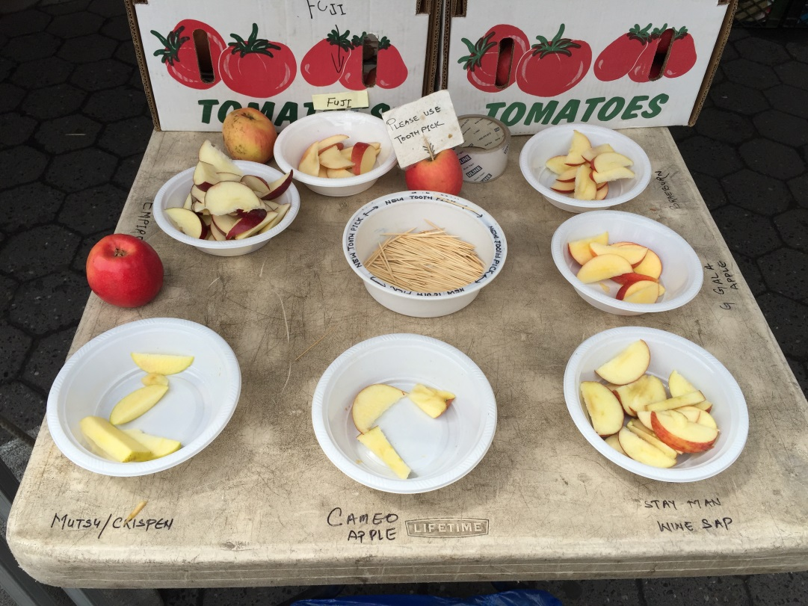
Free Samples!

Slide 14
Sources
Maghari, B. M., & Ardekani, A. M. (2011). Genetically Modified Foods and Social Concerns. Avicenna Journal Of Medical Biotechnology, 3(3), 109-117.
Photos: My Pictures and Google Images
Interview at Union Square Farmers Market

