Slide 1
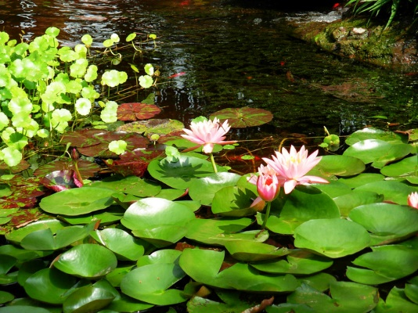
Graywater Treatment
Md Afzal Hossain, Sergey Bolotov
ECON 2505

Slide 2
Topics We will Discuss
What and Why bother with Graywater?
Example of Graywater system.
Usage of Graywater system
Irrigation .
High-rise residential buildings.
Sewer systems .

Slide 3
Graywater
Greywater is gently used water from your bathroom sinks, showers, tubs, and washing machines.
Blackwater: waste water from toilets.
potable water: Water safe enough to be consumed by humans or used with low risk of immediate or long term harm.

Slide 4
The Great California Drought

Slide 5
Global Warming and Sierra Snowpack
At list 24% Expected lose of Sierra Snowpack
2020-2049

Slide 6
Global Warming and Sierra Snowpack
At list 73% to 89% Expected lose of Sierra Snowpack
2070-2099

Slide 7
Water Used by American
We have more opportunity to save water than any other country.

Slide 8
Where We Use Our Water
Graywater system can be most effective to save our water.

Slide 9
Branched System
Can proses Shower, tubs and laundry water.
Easy to install, low cot.
Do not pump or store water .
Require permit.

Slide 10
Greywater recycling has significant potential as an alternative water service in high-rise residential buildings.

Slide 11
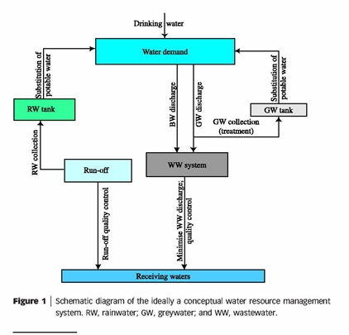
Greywater reuse has greater potential than rainwater tanks for centralized reducing potable water supply and it can also significantly reduce wastewater discharge.
Greywater reuse is more suited than rainwater use because of the steady, constant supply of greywater compared to the highly fluctuating, storm-event supply of rainwater and the high population density creating comparatively large volumes of greywater
Greywater from bathroom alone would still provide more than enough water needed for washing, toilet flushing, and outdoor use.

Slide 12
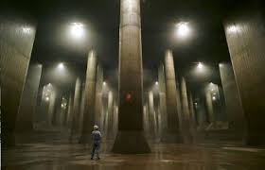
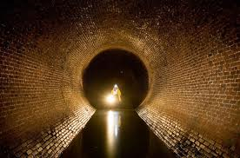
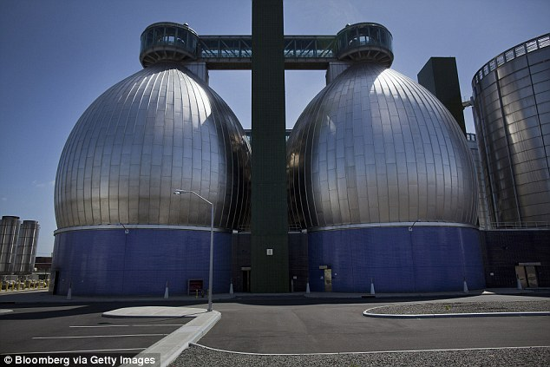
With GWR it might be possible to postpone the enlargement of existing sewer systems, to construct new sewers with smaller pipe diameter, and lower energy consumption for sewage pumping.
GW treatment and reuse changes the quantity and quality characteristics of domestic wastewater released to the sewer and eventually conveyed to the wastewater treatment plant (WWTP). This may lead to positive and negative effects that may influence sewer systems and WWTPs

Slide 13
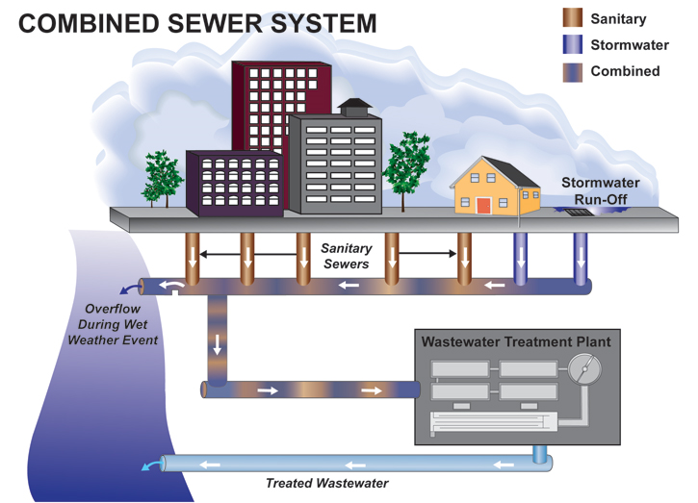
Research on GWR and WETs has generally overlooked their potential effects on municipal sewer systems: GWR and WETs affect the flow regime in sewers, and consequently also influence gross solids transport.
The pipes of a combined sewer system are larger than the pipes of a separate system, when flows are reduced the risk of sedimentation increases, leading to deposits in the sewer. This problem can increase in regions with steep population decrease.
However, it has been suggested that this problem should not be substantial in many (or the majority of) existing municipal separate sewers of mega-cities, since they are maintained close to or even above their design capacity, and since the specific water demand (and consequent WW generation) in many regions increases.

Slide 14
Using this water sustainably for irrigation in small-scale agriculture and in gardens is one possible way of alleviating water stress.
Suggested irrigation volumes
EWU = E0 x CF x HA
where:
EWU = maximum estimated water use (measured in ℓ·d-1)
E0 = reference evapotranspiration rate (location specific and season-specific; a meteorologically derived measure, measured in mm·d-1)
CF = crop factor, a measure of plant-specific water use (a unit-less ratio)
HA = area to be irrigated (measured in m2)
Using the excess amount of the light GW for garden irrigation can further reduce the daily water demand to an overall reduction of 41%.
Since greywater contains some nitrogen and phosphorus, it is also a potential source of nutrients for plant growth, particularly for users who cannot afford fertilizer. In the same vein, the soapy nature of greywater means that under some conditions it has pest-repellent properties, again of particular significance to users who cannot afford pesticides.

Slide 15
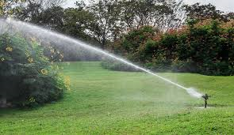
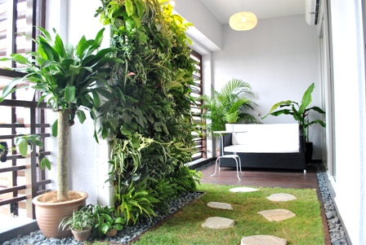
Greywater usually contains relatively high numbers of micro-organisms, some of which may be capable of causing disease in those who come into contact with the greywater or with plants and crops irrigated with greywater, particularly consumers of greywater-irrigated produce.
Greywater also contains substances that can reduce plant growth or crop yield if present at sufficiently high concentrations. The major concerns with regard to soil are salinity and sodicity, both of which are related to the concentration of sodium in greywater. Other greywater constituents which may affect soil adversely are detergents, oil and grease, and suspended solids.
• Possible adverse effects on human health
• Possible adverse effects on plant growth and yield
• Possible adverse effects on the environment, especially on the continued ability of the soil to support plant growth.

Slide 16
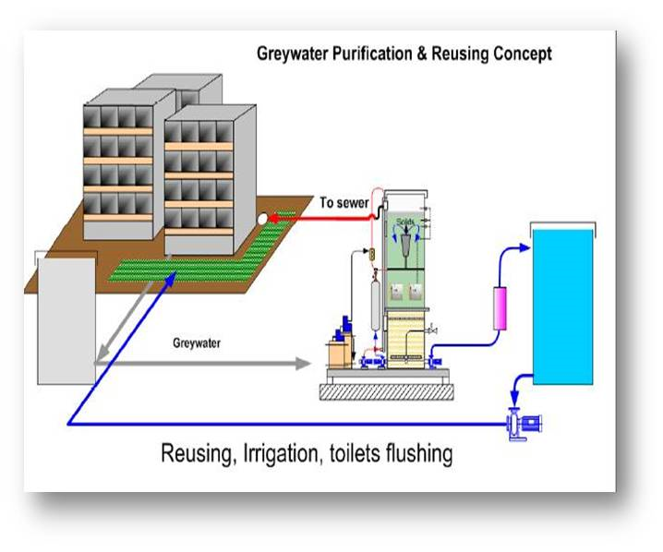
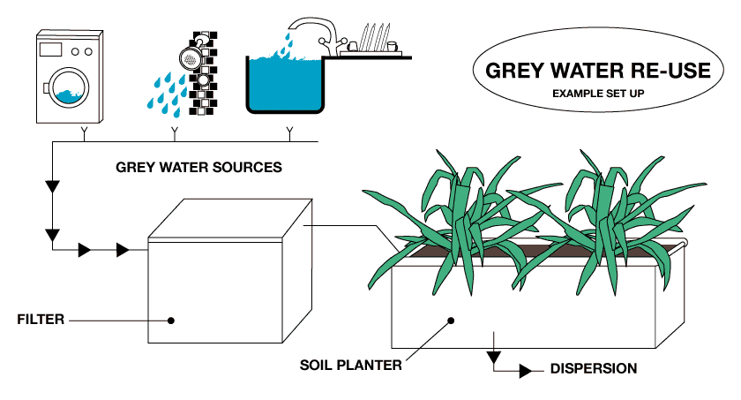
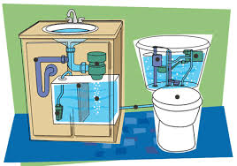
Domestic/residential consumers consume about 70% of the municipal water demand, while the rest is consumed for uses such as: tourism, offices, education, commerce, health services, recreation and sporting activities, and firefighting. Therefore, reducing domestic water demand by on-site water reuse has the potential to play a significant role in alleviating the stress from existing water sources, in reducing the urgent need for exploring new (and usually costly) water resources, and to increase the sustainability of urban water usage.

