Slide 1
Composting and the Environment/Economy
Samantha Bednarski
Urvik Patel
James Riordan

Slide 2
What is composting?
Naturally decomposing and recycling organic materials into a rich soil.
There are different types of composting such as:
  Aerobic Composting
  Anaerobic Composting
  Vermicomposting

Slide 3
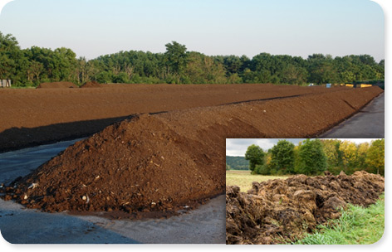
Aerobic Composting
Using air to compost.
Uses nitrogen rich waste to grow bacteria that creates high temperatures to break down organic material.
High maintenance.
Good for large amounts of compost.

Slide 4
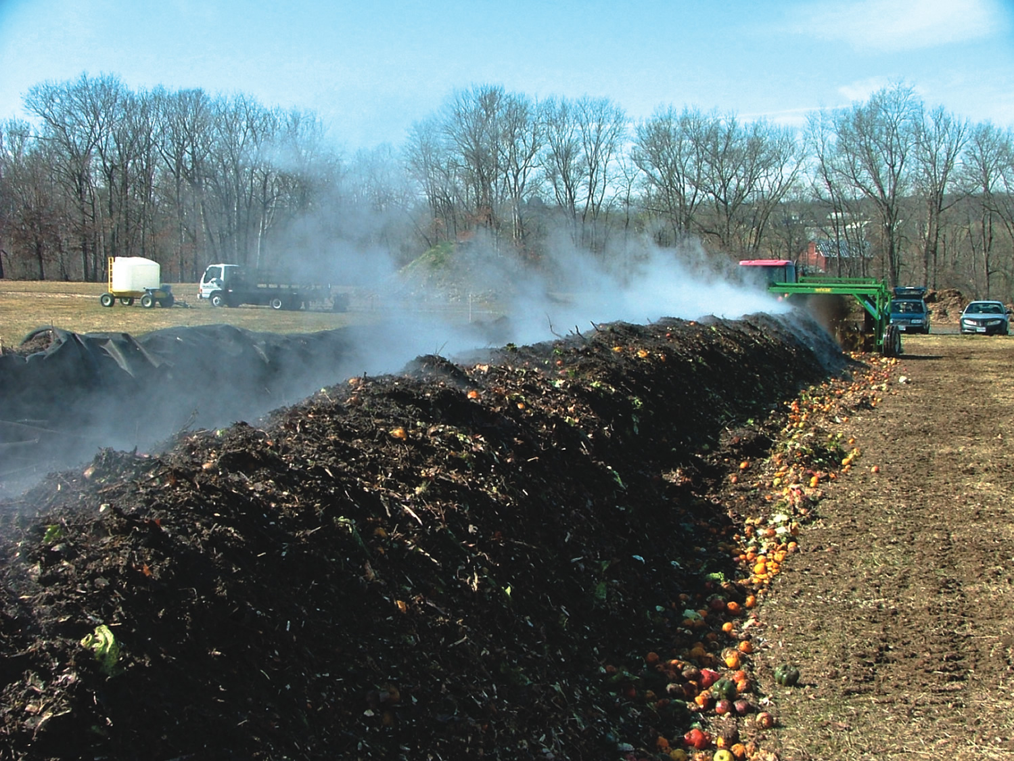
Anaerobic Composting
Composting without air.
The waste is compacted to a point where only slow growing bacteria can survive.
Takes years for organic material to break down.
Creates a foul odor and harmful compounds such as ammonia and methane.

Slide 5
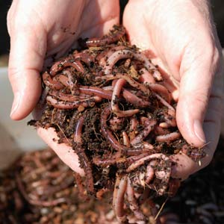
Vermicomposting
The use of organisms such as worms, insects, bacteria, and fungi to decompose organic material.
Oxygen and moisture are required
Medium maintenance

Slide 6
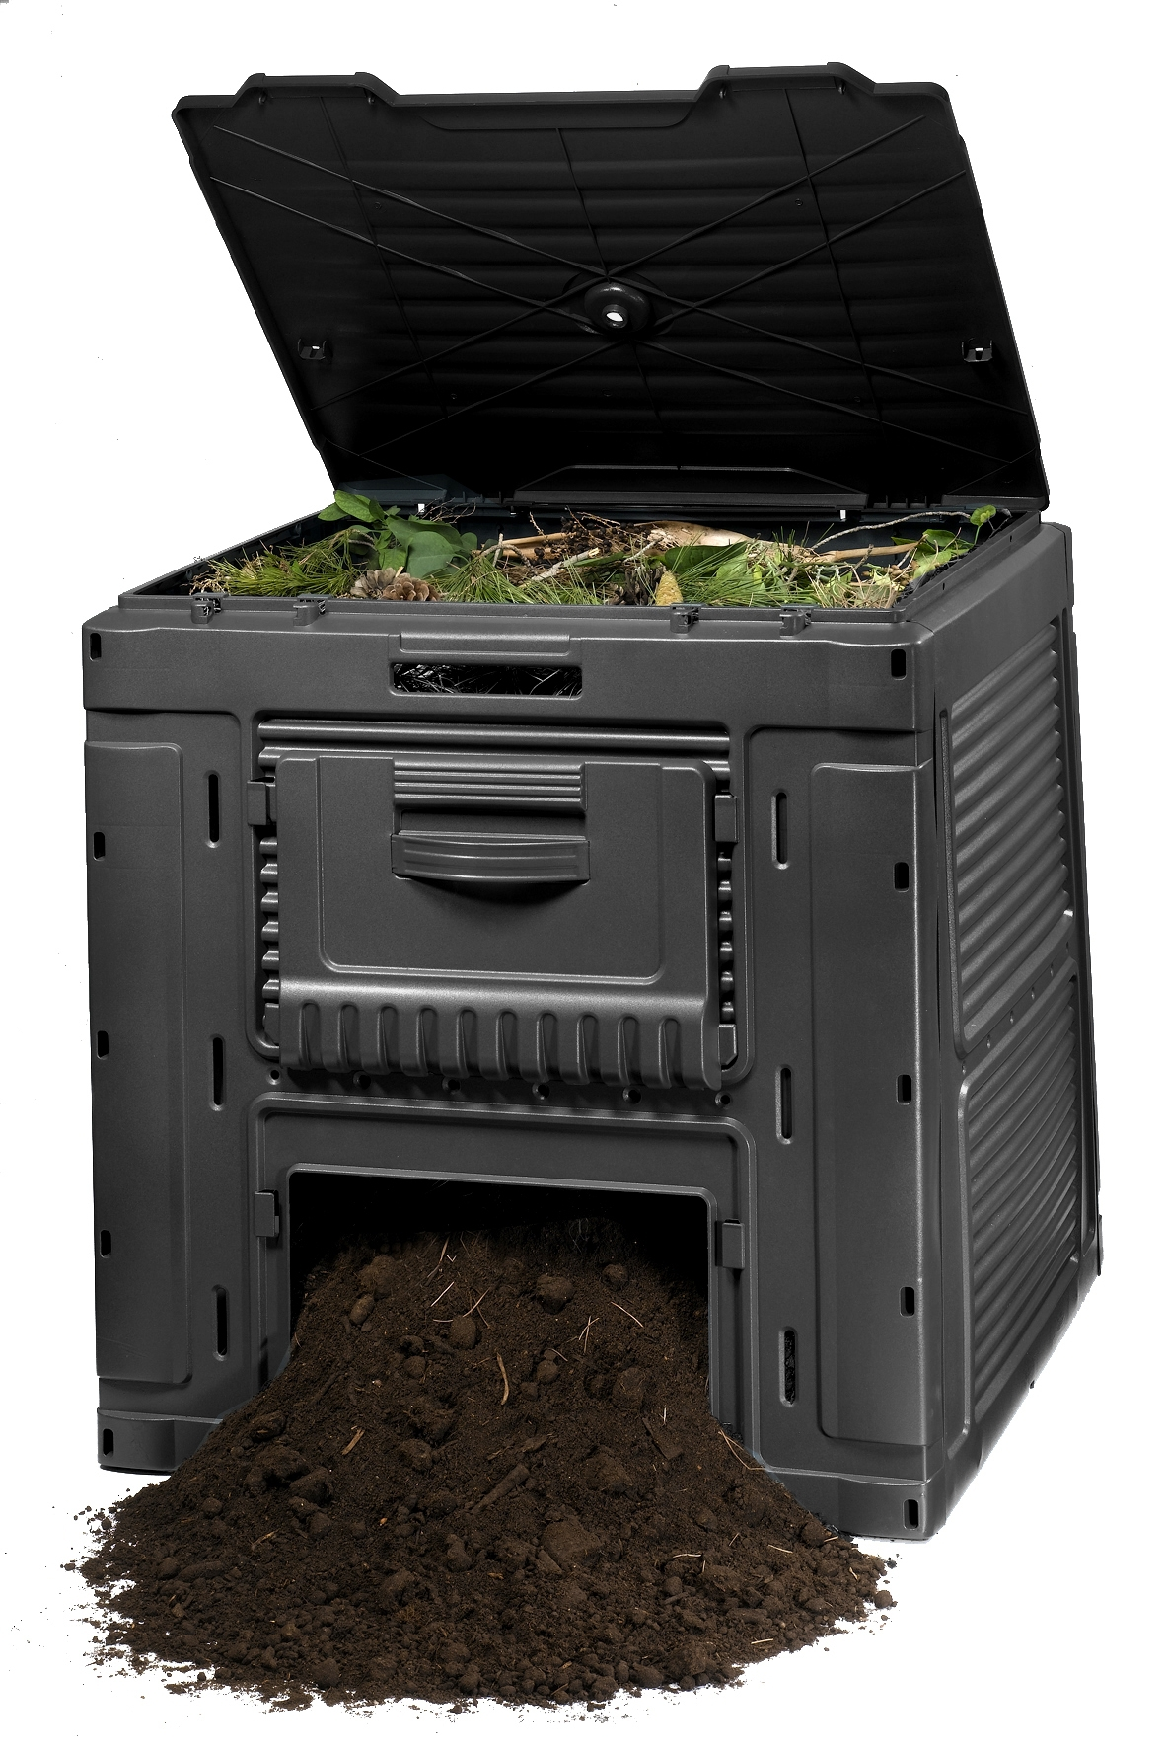
Composting bins
The bins include damp newspaper on the bottom of the bin. Then organic waste is placed in the bin followed by worms then more organic waste. Lastly covered by damped newspaper. Once all is placed in the bin is covered.

Slide 7
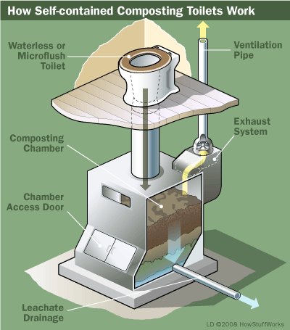
Composting toilet
A toilet that uses aerobic processing to compost human waste. These toilets are used in areas with little water supply or no sewer system.

Slide 8
Advantages and Disadvantages of Composting
Advantages
Disadvantages
Cheaper than other means of disposing organic waste
Reduces the need for water
Fertilizes and pesticides
Protects against erosion
Enhances the nutrient value of the soil
Protects against certain parasites and plant diseases
Time consuming
More land is needed
Low nutrient value compared to commercial fertilizer
Possible heavy metal contamination

Slide 9
Economic Advantages
Very affordable/do-able
Easily implementable
Lengthens the growth of crops
The amount of money spent on garbage handling can be reduced if composting is more widely used
Low cost alternative to conventional methods of cleaning contaminated soil

Slide 10
Environmental Advantages
Recycling organic waste
It revitalizes dried/ruined soil
Keeps the air clean as more materials are reused rather than polluting
Cleans up toxic waste from the dirt
Aids in healthier crops
Less space is needed in landfills if composting is used

Slide 11
References
Adamcová, D., & Vaverková, M. (2014). Biodegradation of degradable/biodegradable plastic material in controlled composting environment. Polish journal of environmental studies, 23(5), 1465-1474.
Ramezani, L., Arjmandi, R., Moharamnejad, N., & Monavari, S. M. (2015). Eco-efficiency of biowaste management: case study of a tehran composting operation. Polish journal of environmental studies, 24(2), 665-672.
Temporal-Lara, B., Gómez, I., Navarro-Pedreño, J., & Raya, S. (2015). One-step extraction procedure as an easy tool for monitoring a full-scale composting plant. Compost science & utilization, 23(2), 128-134. doi:10.1080/1065657X.2014.984367
Guidelines for the management of plant health risks of biowaste of plant origin. (2008). EPPO Bulletin, 38(1), 4-9. doi:10.1111/j.1365-2338.2008.01167.x

