Slide 1
Module 1: Topic
How Can Data on levels of Carbon Emissions Guide Economic and Public Policy on Reducing Emissions?
Introduction and Key Concepts
  What is CO2?
  What are the sources?
  What are the sinks?
  What are the normal variations of CO2?
  The positive/negative impact of CO2 on planet.
II. Using data as a key resource in guiding Economic Policy on Reducing Emissions

Slide 2
1. What is CO2?: The Business Dictionary defines CO2 as a “Colorless, odorless, non-combustible greenhouse-gas that contributes to global warming. Formed by complete combustion of fossil fuels (coal, charcoal, natural gas, petroleum) and carbon containing products (such as wood), it is released also through respiration by living organisms and by the gradual oxidation of organic matter in soil”¹.
2. What are the sources? CO2 emissions are caused by both human activity (anthropogenic sources) and by the naturally occurring organic activity of living organisms.
3. What are the sinks?
Sinkswatch defines a carbon sink as “anything that absorbs more carbon that it releases whilst a carbon source is anything that releases more carbon than they absorb. Forests, soils, oceans and the atmosphere all store carbon and this carbon moves between them in a continuous cycle. Consequently, forests can act as sources or sinks at different times²”.
(other sources and details here??)
Business Dicitonary. http://www.businessdictionary.com/definition/carbon-dioxide-CO2.html#ixzz3LPeZHNd7
Sinkswatch. http://www.sinkswatch.org/aboutX.html

Slide 3
4. What are the normal variations of CO2?
There are naturally occurring variations in global CO2 emissions with seasonal changes.
(Discuss process)
The Mauna Loa Observatory in Hawaii has been tracing such variations since 1958, producing measures that capture seasonal changes in the northern and southern hemispheres with seasonal changes.
The data predictably show declines in CO2 emissions as plants absorb more of it during Spring and Summer, and increases during winter months when plants shed their foliage.
The data suggest that despite the seasonal decrease in CO2 emissions when plants and trees are in full leaf, the overall levels of CO2 have been trending sharply upward over the past 50+ years.
(Source: “Carbon through the Seasons.” http://www.epa.gov/climatestudents/documents/carbon-through-the-seasons.pdf

Slide 4
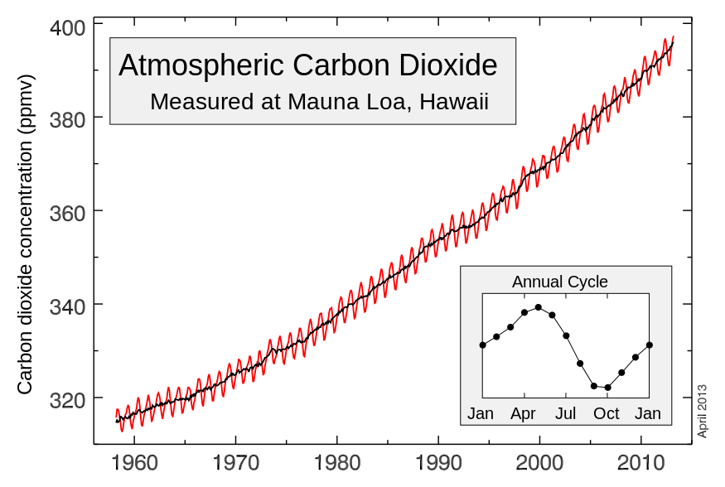
The Keeling Curve: Atmospheric CO2 concentrations as measured at Mauna Loa Observatory
Over just a 50-year period from 1960 – 2000, atmospheric CO2 has risen at an increasing rate, measured in parts per million by volume.
Source: Mauna Loa Observatory staff and accessible from:
http://www.esrl.noaa.gov/gmd/obop/mlo/) and w:File:Mauna_Loa_Carbon_Dioxide-en.svg (by Sémhur).

Slide 5
What regions and countries have been the primary global contributors to rapidly growing carbon emissions?
Four of the world’s largest economies – China, the U.S., India and Russia - and the nations of the European Union account for over 63.0 percent of global CO2 emissions.
This means both advanced economies and the largest rapidly industrializing nations are responsible for the greatest share.
Per capita emissions are the highest in the United States. (emissions per person)
China accounts for nearly one-quarter of emissions at 8.3 million kilotonnes annually.
The U.S. and China account for more than 5 Million tons of carbon emissions through the burning of fossil fuels*
*Source: Wikipedia. List of countries by 2010 CO2 emissions. http://en.wikipedia.org/wiki/List_of_countries_by_carbon_dioxide_emissions#cite_note-8

Slide 6
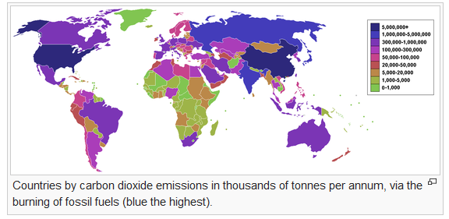
Source: Wikipedia. List of countries by 2010 CO2 emissions. http://en.wikipedia.org/wiki/List_of_countries_by_carbon_dioxide_emissions#cite_note-8

Slide 7
“87 percent of all human-produced carbon dioxide emissions come from the burning of fossil fuels like coal, natural gas and oil. The remainder results from the clearing of forests and other land use changes (9%), as well as some industrial processes such as cement manufacturing (4%)”².
China, U.S. European Union, India and Russia accounted for 63.01 percent of global emissions in 2010.
Table: Wikipedia. List of countries by 2010 CO2 emissions. http://en.wikipedia.org/wiki/List_of_countries_by_carbon_dioxide_emissions#cite_note-8
2. What are the main sources of carbon dioxide emissions? http://whatsyourimpact.org/greenhouse-gases/carbon-dioxide-sources

Slide 8
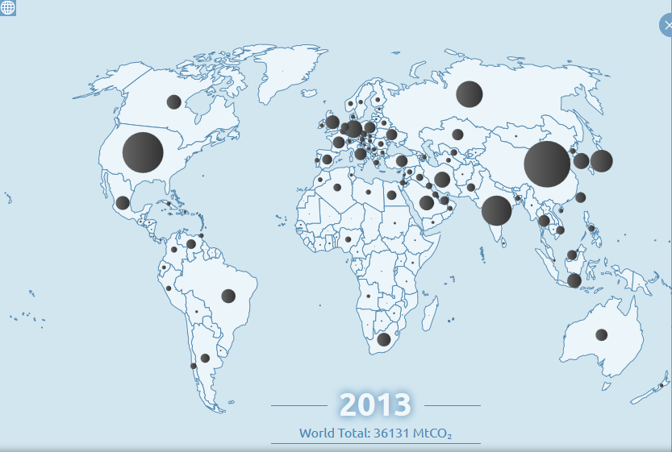
Viewed from another perspective, U.S. and China emissions compared to those of the rest of the world in 2013¹.
Bubbles represent metric tons of carbon output per capita.
U.S. = 5,233 per capita
China = 9,977 per capita
Global Carbon Atlas; http://www.globalcarbonatlas.org/?q=en/emissions

Slide 9
5. However, CO2 has positive as well as negative impacts on the planet. What are these and when does excess CO2 become a threat to the ecosystem?
What are the positive impacts for plant and human life?
  Plants absorb and produce oxygen – essential for plant growth, human and animal survival.
  This ensures a stable food source through increased agricultural output.
  What are the negative impacts?
  As CO2 levels rise from the burning of fossil fuels for energy, industrial production, transportation, land use changes (deforestation), plants will be unable to absorb the excess. This can be seen in the Keeling Curve graphic.
  As levels rise, a greenhouse effect is created, with more heat trapped in the atmosphere that cannot escape.
  The excess heat warms the oceans and contributes to increasing instability in climate patterns -droughts in some regions, excessive flooding in others – threatening food and water supplies.

Slide 10
II. How can the data available on emissions help to inform effective economic policy in reducing the negative impacts of CO2 emissions?
Monitor and update measures of aggregate emissions and their sources (types of emissions; countries)
Evaluate the effectiveness of the various proposals for reduction
Recommend an optimal pace and level of reduction of emissions over time
Recommend the most effective policy and time frame for reducing global anthropogenic emissions

Slide 11
Tradable emissions permits (cap and trade) policy
Tradable emissions permits are permits or licenses to emit limited amounts of pollutants that can be bought and sold by polluters.
• Permits are issued to polluting firms based upon a formula that reflects their polluting history.
• Firms facing different costs of reducing pollution can engage in a mutually beneficial transaction: those that find it easier to reduce pollution can sell some of their permits to firms that find it more difficult.
The ideal end result is that those with the lowest cost will reduce their pollution the most, while those with higher costs will reduce their pollution the least.
Where is this policy practiced? Does it really reduce carbon emissions?
Brief overview of EU ETS and data on reducing emissions since implemented.
The European Union Emissions Trading System (EU ETS) as a model on which to evaluate effectiveness of this policy. http://ec.europa.eu/clima/policies/ets/index_en.htm

Slide 12
2. What types of proposals have already been made for reducing global CO2 emissions? On what have nations based their goals for reduction?
Outline goals of Kyoto Protocol: 1997(more information): http://www.kyotoprotocol.com/
**REVIEW FOLLOWING SUMMARY http://en.wikipedia.org/wiki/Kyoto_Protocol
Tradable emissions permits (cap and trade) policy (EU ETA) – 28 nations
http://ec.europa.eu/clima/policies/ets/index_en.htm
2. Carbon taxes: several nations tax CO2 emissions: “Putting a price on Carbon with a Tax”
(Discuss Paulson article)
http://www.worldbank.org/content/dam/Worldbank/document/SDN/background-note_carbon-tax.pdf
What are the costs and benefits of a national carbon tax?
  What is the optimal tax per (amount) of emissions?
  What factors have gone into determining this?
  How would this affect the average individual in terms of life costs, etc
3. Government subsidies to industries and households to convert to renewable energy sources; which governments? What types of energy? The effectiveness?
https://www.youtube.com/watch?v=xXOYsYCukY8

Slide 13
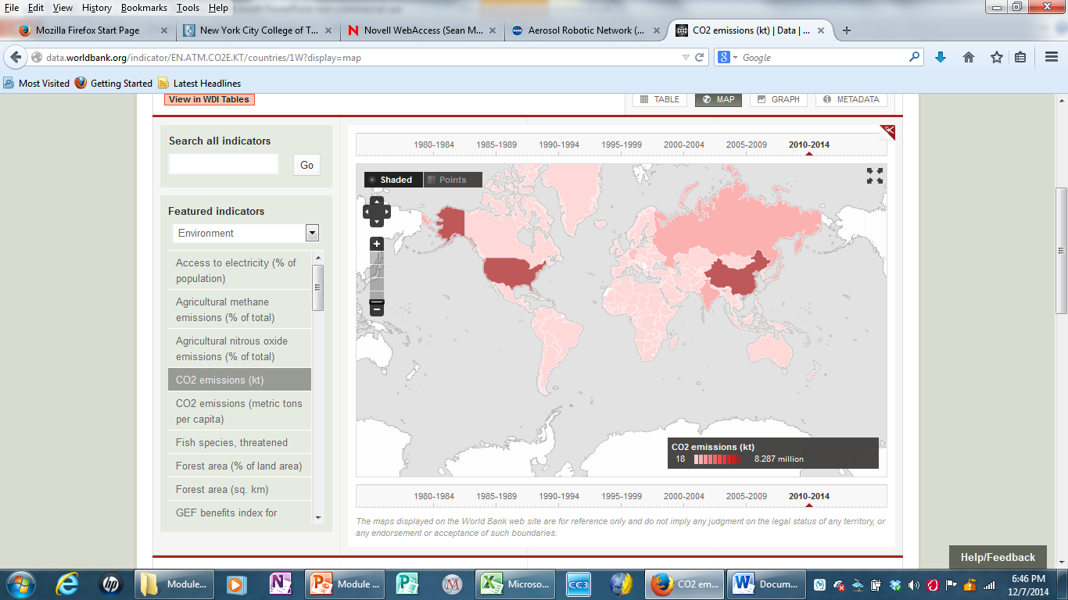
Source: World Bank. CO2 Emissions (kt). http://data.worldbank.org/indicator/EN.ATM.CO2E.KT/countries/1W?display=map

Slide 14
What are the costs and benefits of a national carbon tax?
  What is the optimal tax per (amount) of emissions?
  What factors have gone into determining this?
  How would this affect the average individual in terms of life costs, etc
  What are the costs and benefits of emissions trading?
  Subsidies for using and developing clean energy alternatives?

