Slide 1
WHY USE SOLAR PANELS
WHY SOLAR PANELS ARE USEFUL IN THE PROTECTOCTION OF ENVIROMENT AND WOULD ARE COST EFFECTIVE

Slide 2
Environmental Economics ECON2505 Professor Sean McDonald
SHAWN CLARKE
Jonathan Rivera

Slide 3
What is a solar Panel

Slide 4
What is a solar Panel?
Solar panels collect renewable energy from the sun; it is made up of an array of solar cells called Photovoltaic Cells. Photovoltaic cells convert sunlight into direct current electricity throughout the day. This conversion from Direct Current (DC) to Alternating Current (AC) is through an inverter. The inverter converts the direct current (DC) electricity into alternating current (AC) electricity, for your home energy usage. The inverter is connected to a device called a utility meter, which measures your electricity consumption. If your system generates more power than you currently need the meter will actually move backwards.
.

Slide 5
What is a solar Panel?
This newly converted AC then sends electricity to your electrical panel, which houses your circuit breakers. When your home is not producing electricity via solar panel, like at night, you will draw power from the city grid. Your expense will be offset by the amount of excess energy you produce during daytime hours. The end result of this entire process is, of course, to save you money! You will smile at your reduced electricity bill and also take pride in knowing that you are helping to save the Earth. .

Slide 6
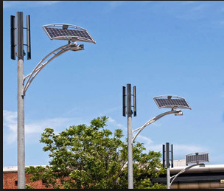
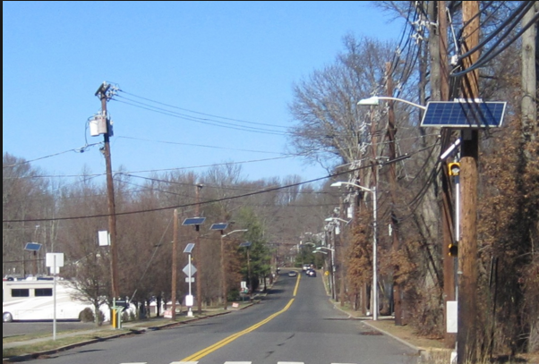
Street Solar Lamps
Brooklyn Navy Yard street lights
New Jersey Street Lights

Slide 7
New Jersey Solar street Lights
Public Service Electric and Gas Company (PSE&G), the electric and gas company in New Jersey is installing about 5,000 to 7,000 solar panels on utility poles around Hudson County as part of its Solar 4 All program. The local solar panels are part of a statewide plan to install more than 200,000 panels throughout more than 250 municipalities across New Jersey.

Slide 8
New Jersey Solar street Lights
Bayonne was first in Hudson County to get the solar panels. The solar panel is connected directly into the grid. PSE&G electric customers pay for the power they use, therefore the panels are a way of introducing solar energy into the mix of power that they pay for, providing all the customers with universal access to solar power.The solar power provides a renewable, carbon emission-free way to produce electricity. The solar panels, individually, will produce about 200 watts of energy from the sun's rays. All the panels around the state will produce 80 megawatts when the installations are complete next year, enough electricity for about 12,000 homes for a year

Slide 9
New Jersey Solar street Lights
These installations are part of PSE&G's $515 million Solar 4 All program that was approved by the Board of Public Utilities in July 2009. The cost of the program to a residential PSE&G customer is about 10 cents per month. Individual municipalities and counties have no costs directly associated with Solar 4 All. The solar panel units are 5-feet wide and 2.5-feet high and are mounted on utility poles more than 15 feet above the ground

Slide 10
Brooklyn navy Yard Street Lights
Duggal Visual Solutions company which is located in the Brooklyn Navy yard installed 160 street lights powered by wind and sunlight The company employs over 300 people and is renowned for its fine quality print and digital graphics displays. Lumi Solair, which installed in all of the street lights in the sprawling Navy Yard industrial campus

Slide 11
Brooklyn navy Yard Street Lights
These Lumi Solair street lamps that are designed and made right in NYC in the Brooklyn Navy Yard. Lumi Solair’s first-generation streetlights sport wind turbines and solar panels up top. Its newer Swan model features a panel with a concave curve that can power the streetlights for 12 to 14 hours without any help from the wind.

Slide 12
Brooklyn navy Yard Street Lights
The company is now setting its sights on Park Slope areaways, the cement front yards that surround brownstones’ stoops. One of the company’s heads grew up on Seventh Street, and says the newfangled lamps are designed to blend in with their surroundings.

Slide 13
Summary
From the visit of the Brooklyn Navy Yard and New Jersey to see how they are moving towards a cleaner environment. I always had the admiration of how useful the sun can be to us although it creates drought in certain areas. Both the Brooklyn Navy Yard and New Jersey are pushing for cleaner air and healthy life styles for the citizens. New Jersey is the first state in the United States of America to use Solar Panels to produce electricity and light the streets. Solar Panels are one of the most efficient ways in generating electricity with the least amount of maintenance.
From the time I saw my First Solar panel with one light bulb being lit I was fascinated by how technology can transform solar energy to electrical energy. Solar energy can be the future for the production of electrical energy which will eliminate the need for fossil fuels and coal. Why is so much money and emphasis being put into fossil fuel production and not into solar? Our report will show the use of Solar Panels and how it is beneficial to the environment and creation of jobs

Slide 14
Citations
Gruen Article (October 5, 2010) “Solar Panels Invented In New Jersey 55 years ago”.
Nastu Article (April 15, 2009 “Brooklyn Navy Yard Getting Wind, Solar powers lights”.
Sheftel Article (May 28, 2010) “A Greenhouse Grew In Brooklyn Navy Yard”.
Navarro Article (April 27, 2011) “Solar Panels Rise Pole By Pole, Followed by Gasps Of Eyesore”

