Slide 1
The Implications of Rooftop Gardening in Urban Areas
ECON 2505 Section D727
Professor Sean MacDonald
Chung Kim and Carlos Castro

Slide 2
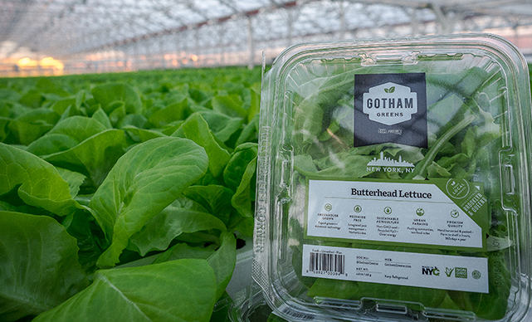
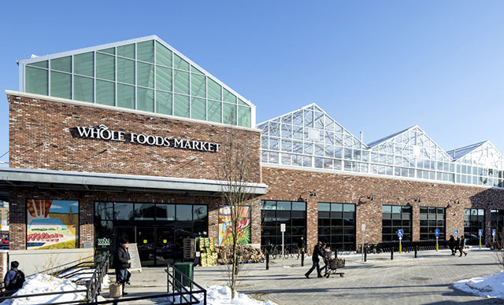

Slide 3
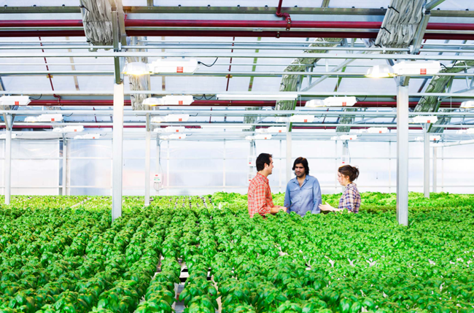
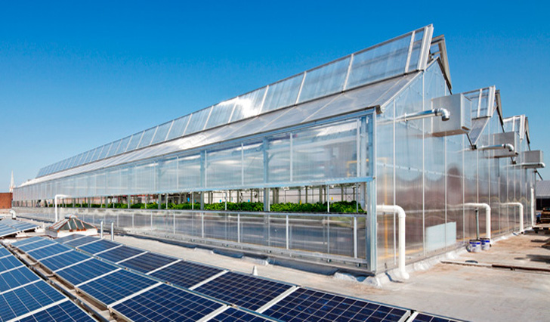

Slide 4
Gotham Greens Founders
Eric haley
Viraj Puri
Jennifer Frymark

Slide 5
Gotham Green
Located at 214 3rd St, Brooklyn, NY 11215.
The nation’s first commercial scale greenhouse farm.
Started in 2010 and began distributing crops in 2011.
Gotham Greens grows premium quality, pesticide-free produce in the 20,000 square foot greenhouse on the rooftop of Whole Foods Market Gowanus

Slide 6
Gotham Green
They have supplied high-quality and fresh produce to Whole Foods Market and other local markets and restaurant
Have 55 Kwatts of solar panel to provide energy in the facility
Uses 10x less than conventional farming
Eliminate the use of pesticides and fertilizer run-off - decreasing the global warming pollution
Use organic non-GMO seeds
Climate controlled facility can produce fresh products all year round

Slide 7
Benefits of Rooftop Gardenings
Energy
Climate
Stormwater Management
Economy

Slide 8
Climate Energy
Reducing heat loss through wind chill in winter.
Less need for air conditioning in summer.
Reduced the daily energy demand for air conditioning in the summer by over 75%.
The plants of green roof can capture airborne pollutants.
Reduce carbon footprints - designed to reduce CO2.
Reduce the Heat Island Effect.

Slide 9
Stormwater Management Economy
Green roofs can retain rainwater.
Reduce the amount of stormwater runoff.
Decrease stress on sewer systems at peak flow periods.
Buying farm goods from local rooftop gardens keep money within the local economy.
Create jobs and increase employment

Slide 10
Potential Danger of Consuming products from Urban Rooftop Gardens
Many urban growing areas are within 300 feet of high traffic areas
Urbn soils can be present with lead, arsenic, and other toxins.
Exposure to lead can cause organ damage, anemia, and a variety of neurological problems.
Solutions:
Phytoremediation project - can help remove lead and other toxins that are presents in the soil.
Growing and consuming fruit-bearing plants that tend to contain lower lead concentrations.

Slide 11
Conclusion
Advantages of rooftop gardens are many as compared to its disadvantages environmentally and economically.
Food access is a social justice issue; it is a human rights issue.
When urban communities lack access to affordable nutritious food, we must collectively help our fellow community members, and also educate and empower them to help themselves.
Rooftop agriculture provides the canvas for food access assistance and empowerment in cities. Bearing in mind the benefits of the roof gardens, the cost factor may be looked at the least in order for roof gardens to be widely adopted.
As long as people grow and consume products from the rooftop gardens with knowledge, it will give us enormous benefits maintaining a healthier lifestyle.
Therefore, it is highly recommended for the government to play their role to facilitate this kind of innovation in a way to promote as well as to achieve sustainable development.

Slide 12
References
Black, J. (2012). Rooftop Gardens. Fast Company. (167), 38.
Garry, M. (2009). Rooftop Farm to Grow for Grocers. SN: Supermarket News, 57 (38), 21-27.
Green, E. (2008). Urban Farming: Lead Problems and Remediation Solutions. 1-20.
Liu, K. (2002). National Research Canada. Energy Efficiency and Environmental Benefits of Rooftop Gardens, 44 (2), 20-23.
Miller, M. (2014). National Geographic. A Farm Grows In Brooklyn. From http://news.nationalgeographic.com/news/2014/04/140429-farming- rooftop-gardening- brooklyn- grange-vegetables- science-food/.
GSA. (2011). The Benefits and Challenges of Green Roofs on Public and Commercial Buildings, p. 59-62.

