Slide 1
Population and Space In New York City
ECON 2505 Environmental Economics
By:
Atif Bacchus
Dao li
Professor Sean MacDonald
Why is population and space a major problem in NYC?

Slide 2
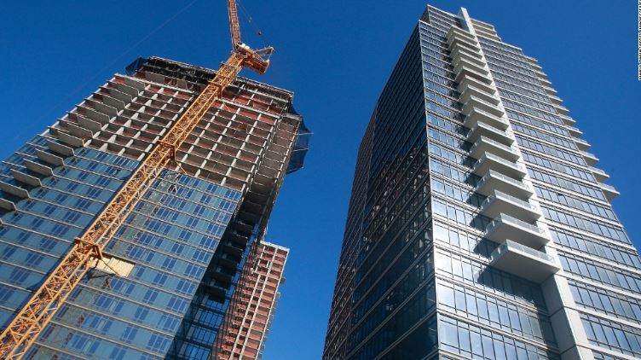
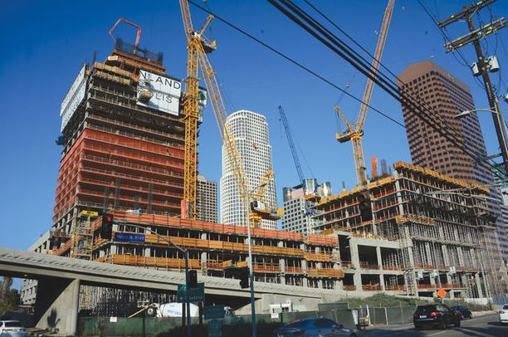
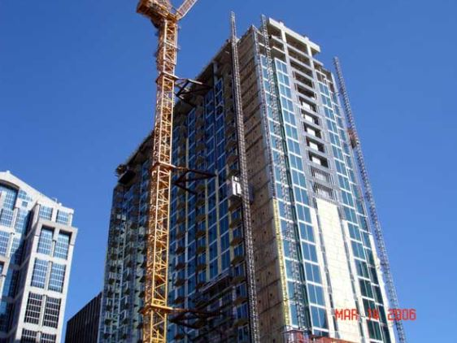
New Condos’ Building

Slide 3
Why the population is growing up in New York City?
One of the reasons is population growth was fueled by the continued surplus of births over deaths due to life expectancy in the city reaching a record high, coupled with a net influx of people into the city.

Slide 4
Each of the city’s five boroughs registered gains in population
Brooklyn saw the largest increase, up 4.7 percent or 117,100 persons, followed by Queens (4.1 percent or 90,900 persons), the Bronx (3.8 percent or 53,100 persons), and Manhattan (3.2 percent or 50,400 persons). Staten Island (1.0 percent or 4,500 persons) showed the smallest gain over the 51-month period.

Slide 5
The other reason is many foreigners or people from others states migrate to New York City
New York City last year gained more people than it lost through migration, reversing a trend that stretched to the mid-20th century. For the year ending July 1, 2013, an influx of foreigners combined with a continuing decline in the loss of migrants to other states increased the population by more than 61,000, nudging it past 8.4 million for the first time.

Slide 6
Hoursing Price and Rental Growing Up Continusely
A large number of New Yorkers live in poor-quality housing or pay extraordinarily high proportions of their incomes for rent.
The less desirable implication of low vacancy rates is that housing supply did not keep up with the demand for residence in the city.

Slide 7
Community Garden’s Being Replaced!
On May 5, 2014 New York’s Mayor Bill de Blasio laid out a 10-year plan to build or preserve 200,000 affordable apartments across all five boroughs-enough housing to serve more than a half-million New Yorkers.
But more than a dozen community gardens are threatened with demolition to make room for affordable housing.
As the amount of available land decreases and real estate prices continue to climb, some gardens have been targeted by the city, while developers are eyeing others.

Slide 8
But At What Cost?!
Approximately 194,000 construction jobs and nearly 7,100 permanent jobs will be generated by the housing plan, and the City will work with stakeholders to make sure they are quality jobs and integrated into the City’s workforce development ecosystem.
The housing plans to serve low and middle-income families with affordable housing options but many gardens in NYC will be demolished to make way for it.

Slide 9
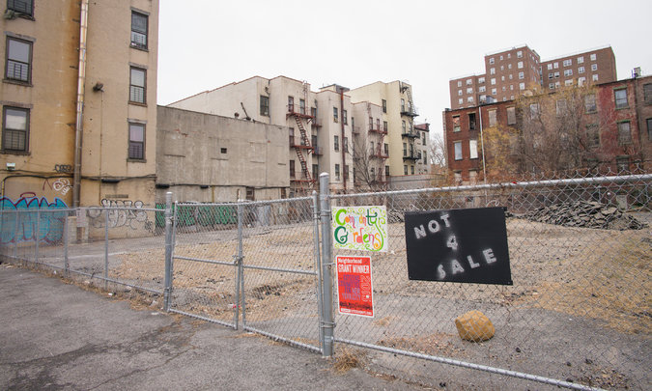
Community Gardens in NYC
Roger That community garden in Crown Heights, Brooklyn
Mandela Community Garden in Harlem

