Slide 1
Sustainable Electricity
ECON 2502 Environmental Economics
by: Haomin Pan
Prof. MacDonald

Slide 2
What is Sustainable Electricity?
Use electricity in the way of sustainable
Reduce the demands
Reduce the cost
Be Green

Slide 3
Why do we need Sustainable Electricity?
Electrification World – Electricity is Necessary!
High Consumption
High Load
High Cost

Slide 4
Method 1: Sustainable Architecture
High energy efficient building
Low emissions and pollutions
Green
Looking Cooooooooooool! (not all of them.)

Slide 5
Brooklyn Navy Yard

Slide 6
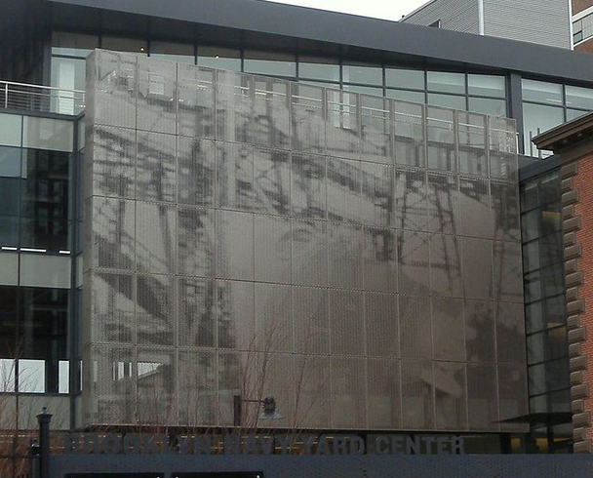
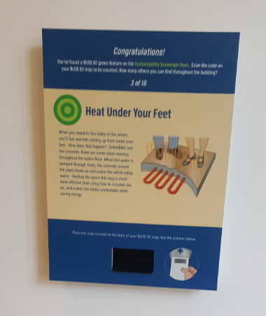
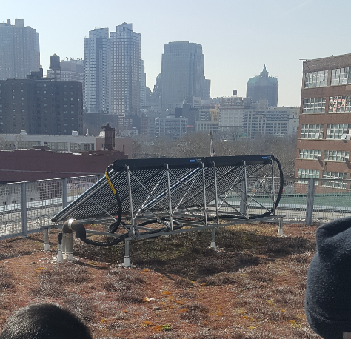
Building 92
Display Screen
Solar Panel
Rooftop farming
Sustainable water system

Slide 7
Queens Botanical Garden

Slide 8
Visitor & Administration Center
Natural Lighting
Solar Panel
Geothermal System
Sustainable Water System

Slide 9
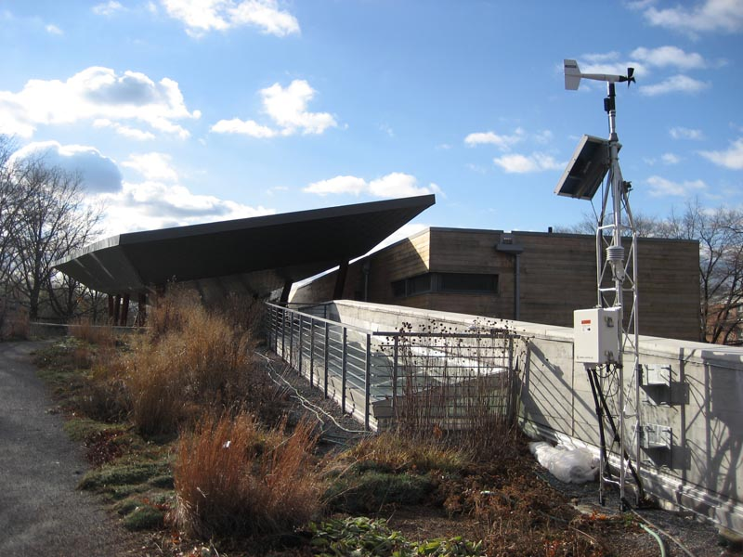
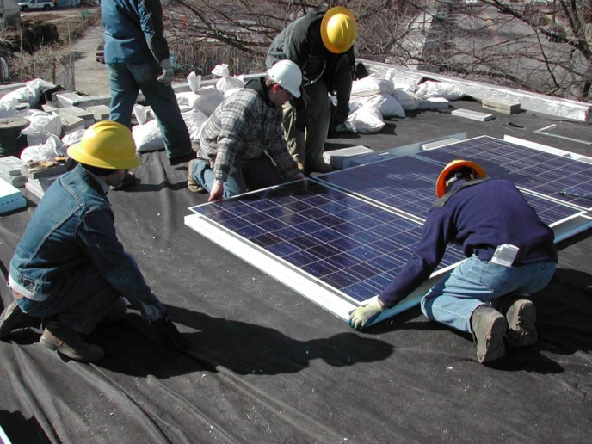

Slide 10
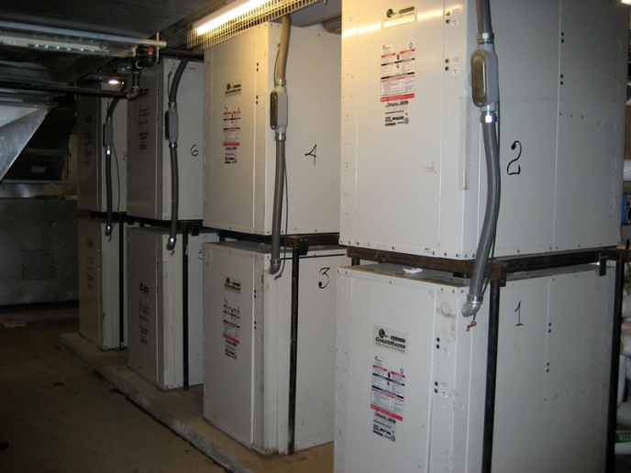
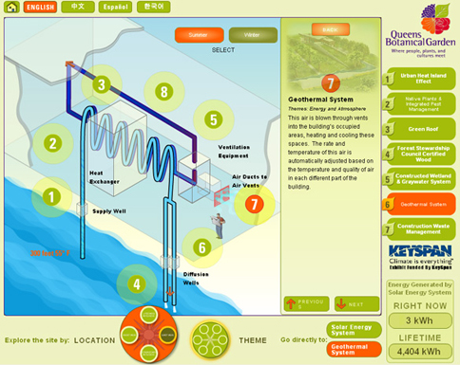
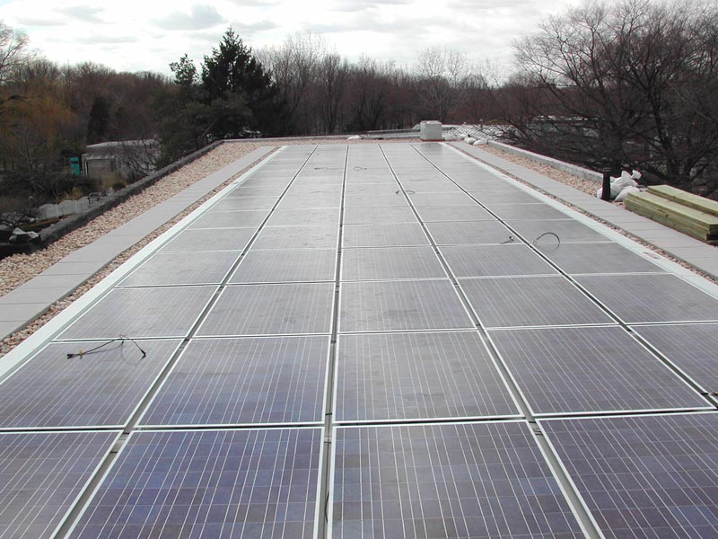

Slide 11
Solar Panel – Photovoltaic cells
Solar energy harnessed by rooftop photovoltaic cells will produce almost 20 percent of the electricity used in the Visitor & Administration Building.
Each of these cells is made of thin layers of silicon pressed together. When sunlight strikes the surface of the cell, it excites the electrons within, causing them to move from layer to layer. This movement generates electrical current.
The system as a whole contains 5,544 photovoltaic cells connected in modular panels covering 1,720 square feet of the building’s roof, capable of generating up to 16 kilowatts of electricity per hour.

Slide 12
Geothermal System
Seasonal heating and cooling is provided by a geothermal system in the Visitor & Administration Building.
Water from an aquifer 300 feet underground is pumped into the building from two on-site wells. Because it is buried so deep, this water remains approximately 55 degrees F year-round. In the building’s mechanical room, the well water flows through pipes within pieces of equipment called heat exchangers. At the same time other pipes carry water from the building’s heating and cooling system through the same heat exchangers. During the winter, the exchangers transfer heat energy from the well water into the system water, making it hot enough to heat the building. During the summer, heat energy is transferred from the system water to the well water, leaving the system water the right temperature to cool the building. After the transfer, the well water is pumped back into the underground aquifer.
The Visitor & Administration Building’s geothermal system uses much less energy than a conventional furnace or air conditioner, and eliminates the need to burn any fossil fuels on site.

Slide 13
Method 2: Improvements in Technology
Energy Saving Home Appliances, Lamps/Bulbs
Alternative Energy

Slide 14
Conclusion
Electricity is important
Sustainable make better future
Still having a long way to go

Slide 15
Source of Citation
http://www.queensbotanical.org Queens Botanical Garden
http://blogs.ei.columbia.edu/2010/03/26/ideas-for-the-sustainable-city-green-buildings/ Ideas for the Sustainable City: Green Buildings by Tristan Jones, Earth Institute, Columbia University
http://cityroom.blogs.nytimes.com/2007/09/27/citys-greenest-building-opens-in-queens/?_r=0 City’s ‘Greenest’ Building Opens in Queens, by Sewell Chan, City Room, New York Times

