Slide 1
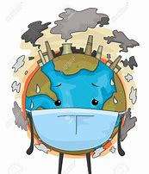
Effects of Air Pollution on Health
Stacey Carryl
Environmental Economics
ECON 2505ID – Section HD24

Slide 2
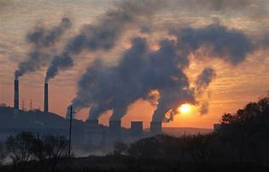
Air Pollution-Introduction
The air that we breathe is something that we all have in common since we are all inhabitants of this planet. Pollution is a major hazard that can cause many problems to people and to the environment. Pollution is the introduction of contaminants into a natural environment that causes instability, disorder, harm or discomfort to the ecosystem. It can be divided into three main categories which are air, water and noise. The thesis question for this research paper is what are the effects of air pollution on health?

Slide 3
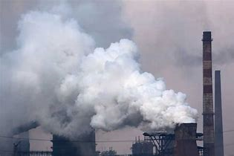
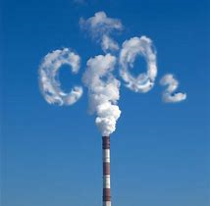
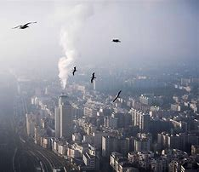
What is Air Pollution
Air pollution is a general term that usually describes a mixture of different chemicals that circulate in the air. Air pollution deals with the natural environment including the atmosphere and most gases. Air pollution entails the presence of chemicals or other harmful contents that can harm the living environment.
Carbon dioxide, a greenhouse gas, is the main pollutant that is warming the Earth. We as living things emit carbon dioxide when we breathe but carbon dioxide is widely considered to be a pollutant when associated with cars, planes, power plants, and other human activities that involve the burning of fossil fuels such as gasoline and natural gas. In the past 150 years, such activities have pumped enough carbon dioxide into the atmosphere to raise its levels higher than they have been for hundreds of thousands of years.

Slide 4
What is Air Pollution
Other greenhouse gases include methane which comes from such sources as swamps and gas emitted by livestock and chlorofluorocarbons (CFCs), which were used in refrigerants and aerosol propellants until they were banned because of their deteriorating effect on Earth's ozone layer, have negative effects on the atmosphere.
Invisible gases, like ozone or carbon monoxide, and tiny particles or droplets of liquids mix together in the atmosphere to create hazardous conditions. Each molecule is impossible to see with the naked eye, but when trillions gather together, you can see them as haze.

Slide 5
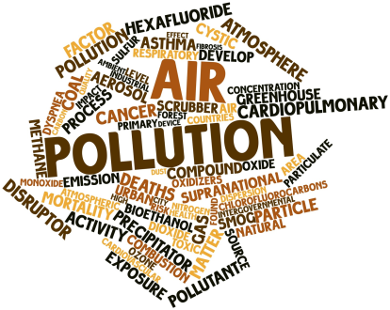
Air Pollution & Health
Millions of Americans live in areas where urban smog, particle pollution, and toxic pollutants pose serious health concerns. People exposed to high enough levels of certain air pollutants may experience irritation of the eyes, nose, and throat, wheezing, coughing, chest tightness, and breathing difficulties.
Air pollution can also worsen existing lung and heart problems, such as asthma and someone can run the increased risk of a heart attack. In addition, long-term exposure to air pollution can cause cancer and damage to the immune, neurological, reproductive, and respiratory systems. In extreme cases, it can even cause death

Slide 6
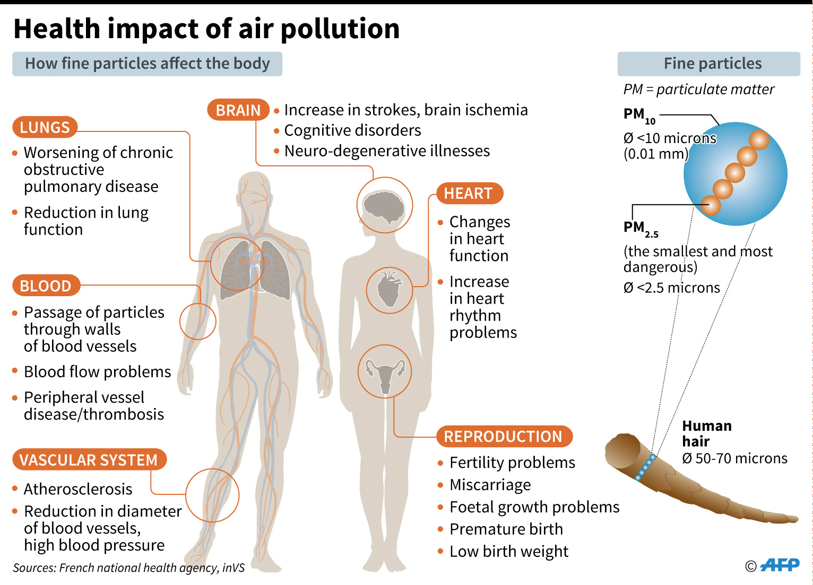
Air Pollution and Health

Slide 7
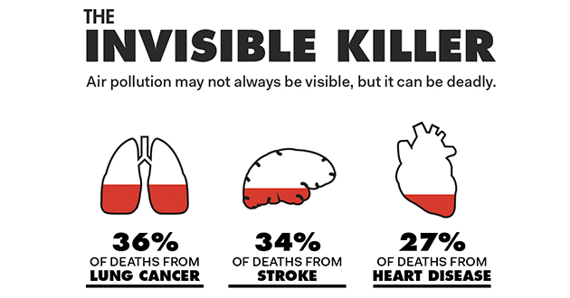
Air Pollution and Health
According to statistics by the WHO (World Health Organization), air pollution causes 1 in 9 deaths and most of those deaths are from non-communicable diseases. The information listed on their website refers to air pollution as the invisible killer. It is noted that 34% of all stroke deaths are attributed to air pollution causing about 2.2 million deaths. In terms of heart attacks, 27% of heart disease deaths are attributed to air pollution causing about 2 million deaths. It is also noted that 36% of lung cancer deaths are attributed to air pollution resulting in 1.7 million deaths.

Slide 8
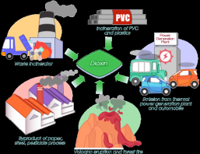

Air Pollution and Health
Some of the most hazardous and common air pollutants are mercury, lead, dioxins, and benzene. They are either deadly or have severe health risks even in small amounts. These are also most often emitted during gas or coal combustion, incinerating, or in the case of benzene, found in gasoline.
Dioxins, more typically found in food but also present in small amounts in the air, can affect the liver in the short term and harm the immune, nervous, and endocrine systems, as well as reproductive functions. Lead in large amounts can damage children’s brains and kidneys, and even in small amounts it can affect children’s IQ and ability to learn. Mercury affects the central nervous system.
Polycyclic aromatic hydrocarbons, or PAHs, are toxic components of traffic exhaust and wildfire smoke. In large amounts, they have been linked to eye and lung irritation, blood and liver issues, and even cancer. In one recent study, the children of mothers who’d had higher PAH exposure during pregnancy had slower brain processing speeds and worse symptoms of ADHD.

Slide 9
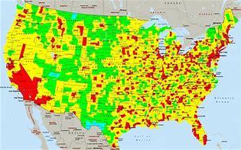
Most Polluted Cities in the U.S.
The top three most air polluted cities in the United States according to the State of the Air report by the American Lung Association are Fairbanks, AK, Visalia-Porterville-Hanford, CA and Bakersfield, CA. Fairbanks, AK is at the top of that list due to the fact that many of its residents burn a lot of wood in order to keep themselves warm since it’s so cold there. However, it has detrimental effects on the air since it creates a lot of smoke causing pollution. It can be noted that the state of California has 8 out of the top 10 most polluted cities by ozone in the country.

Slide 10
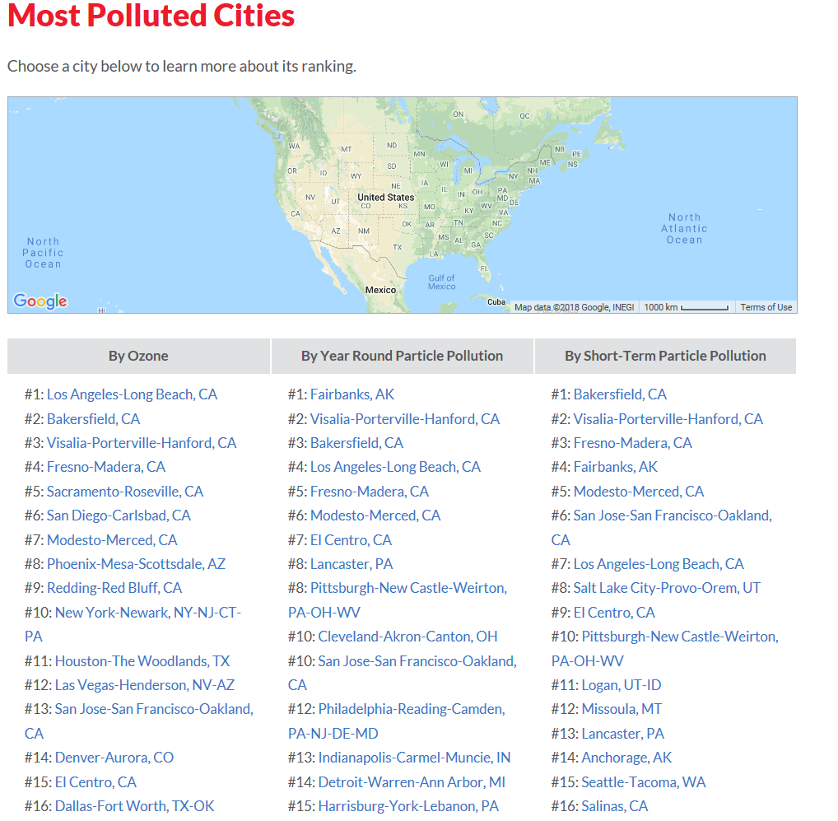

Slide 11
References
Peltier, R. E. (2018, May 07). How air pollution contributes to 8 million deaths each year. Retrieved from https://www.cbsnews.com/news/how-air-pollution-makes-people-sick-8-million-early-deaths-each-year/
Essick, P. (2017, October 17). Air Pollution Causes, Effects, and Solutions. Retrieved from
https://www.nationalgeographic.com/environment/global-warming/pollution/
Learish, J. (2017, February 03). The most polluted cities in the world, ranked. Retrieved from https://www.cbsnews.com/pictures/the-most-polluted-cities-in-the-world-ranked/
Mackenzie, J. (2018, January 09). Air Pollution: Everything You Need to Know. Retrieved from https://www.nrdc.org/stories/air-pollution-everything-you-need-know
Air pollution. (2018, May). Retrieved from http://www.who.int/airpollution/en/
Anon, (2018). Parliamentary History. [online] Available at: http://www.lung.org/assets/documents/healthy-air/state-of-the-air/sota-2018-full.pdf [Accessed 10 May 2018].
Air pollution. (2018, May). Retrieved from https://www.mass.gov/files/documents/2016/08/vl/health-and-env-effects-air-pollutions.pdf

