Slide 1
What steps do we need to take so we don’t run out of food by 2050?
Ali Akam
ECON 2505ID

Slide 2
ISSUES

Slide 3
Climate Impact on Food Security
Droughts - No water for crops.
Floods and Storms - Destroy crops and critical infrastructure.
High temperature - Low crop yields
Food accessibility - Lower crop output = higher prices.

Slide 4
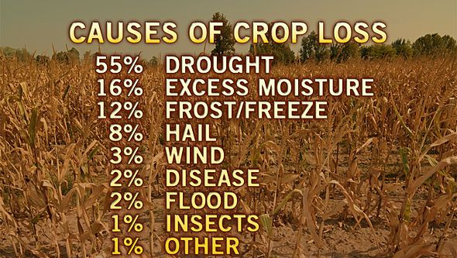

Slide 5
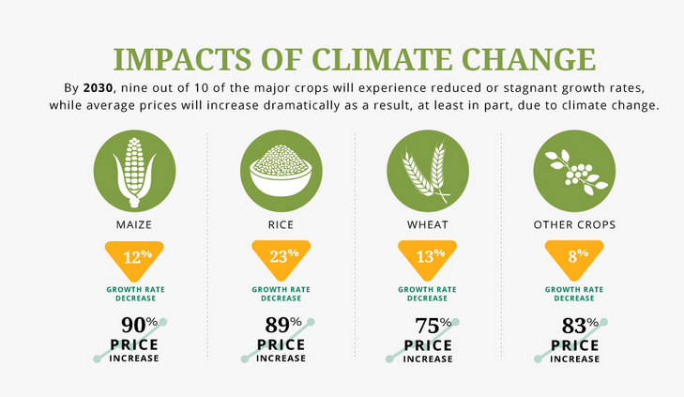

Slide 6
Reasons food supply is being threatened
Dependence of fertilizer – Too much fertilizer can deplete the quality of soil.
Salty soil – Water used for irrigation isn’t pure H20 so the minerals build up.
Diseases - New pathogens are emerging destroying crops.
Ex. Wheat rust fungus: Is a fungal disease that affects wheat, barley and grains which causes rust on the crops.

Slide 7
Damaged Wheat vs. Healthy Wheat

Slide 8
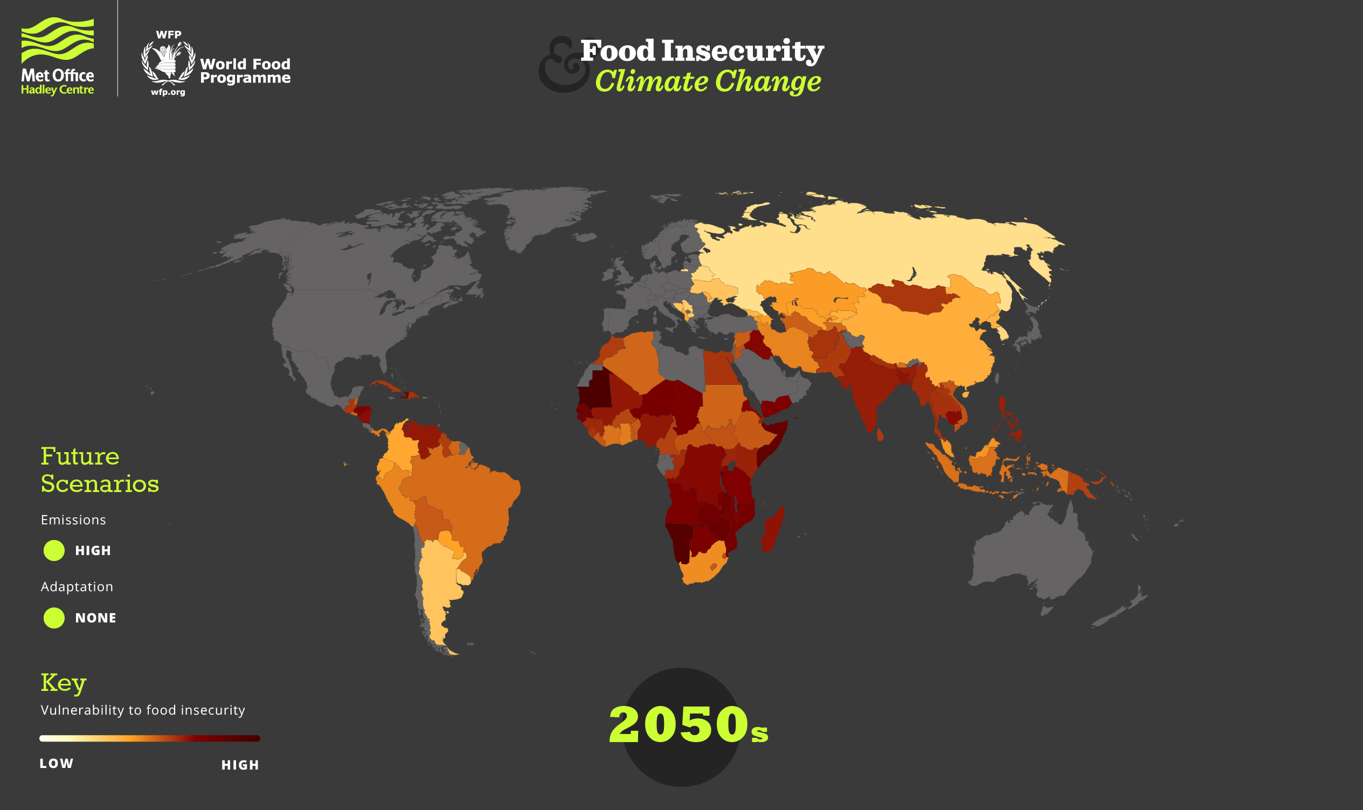

Slide 9
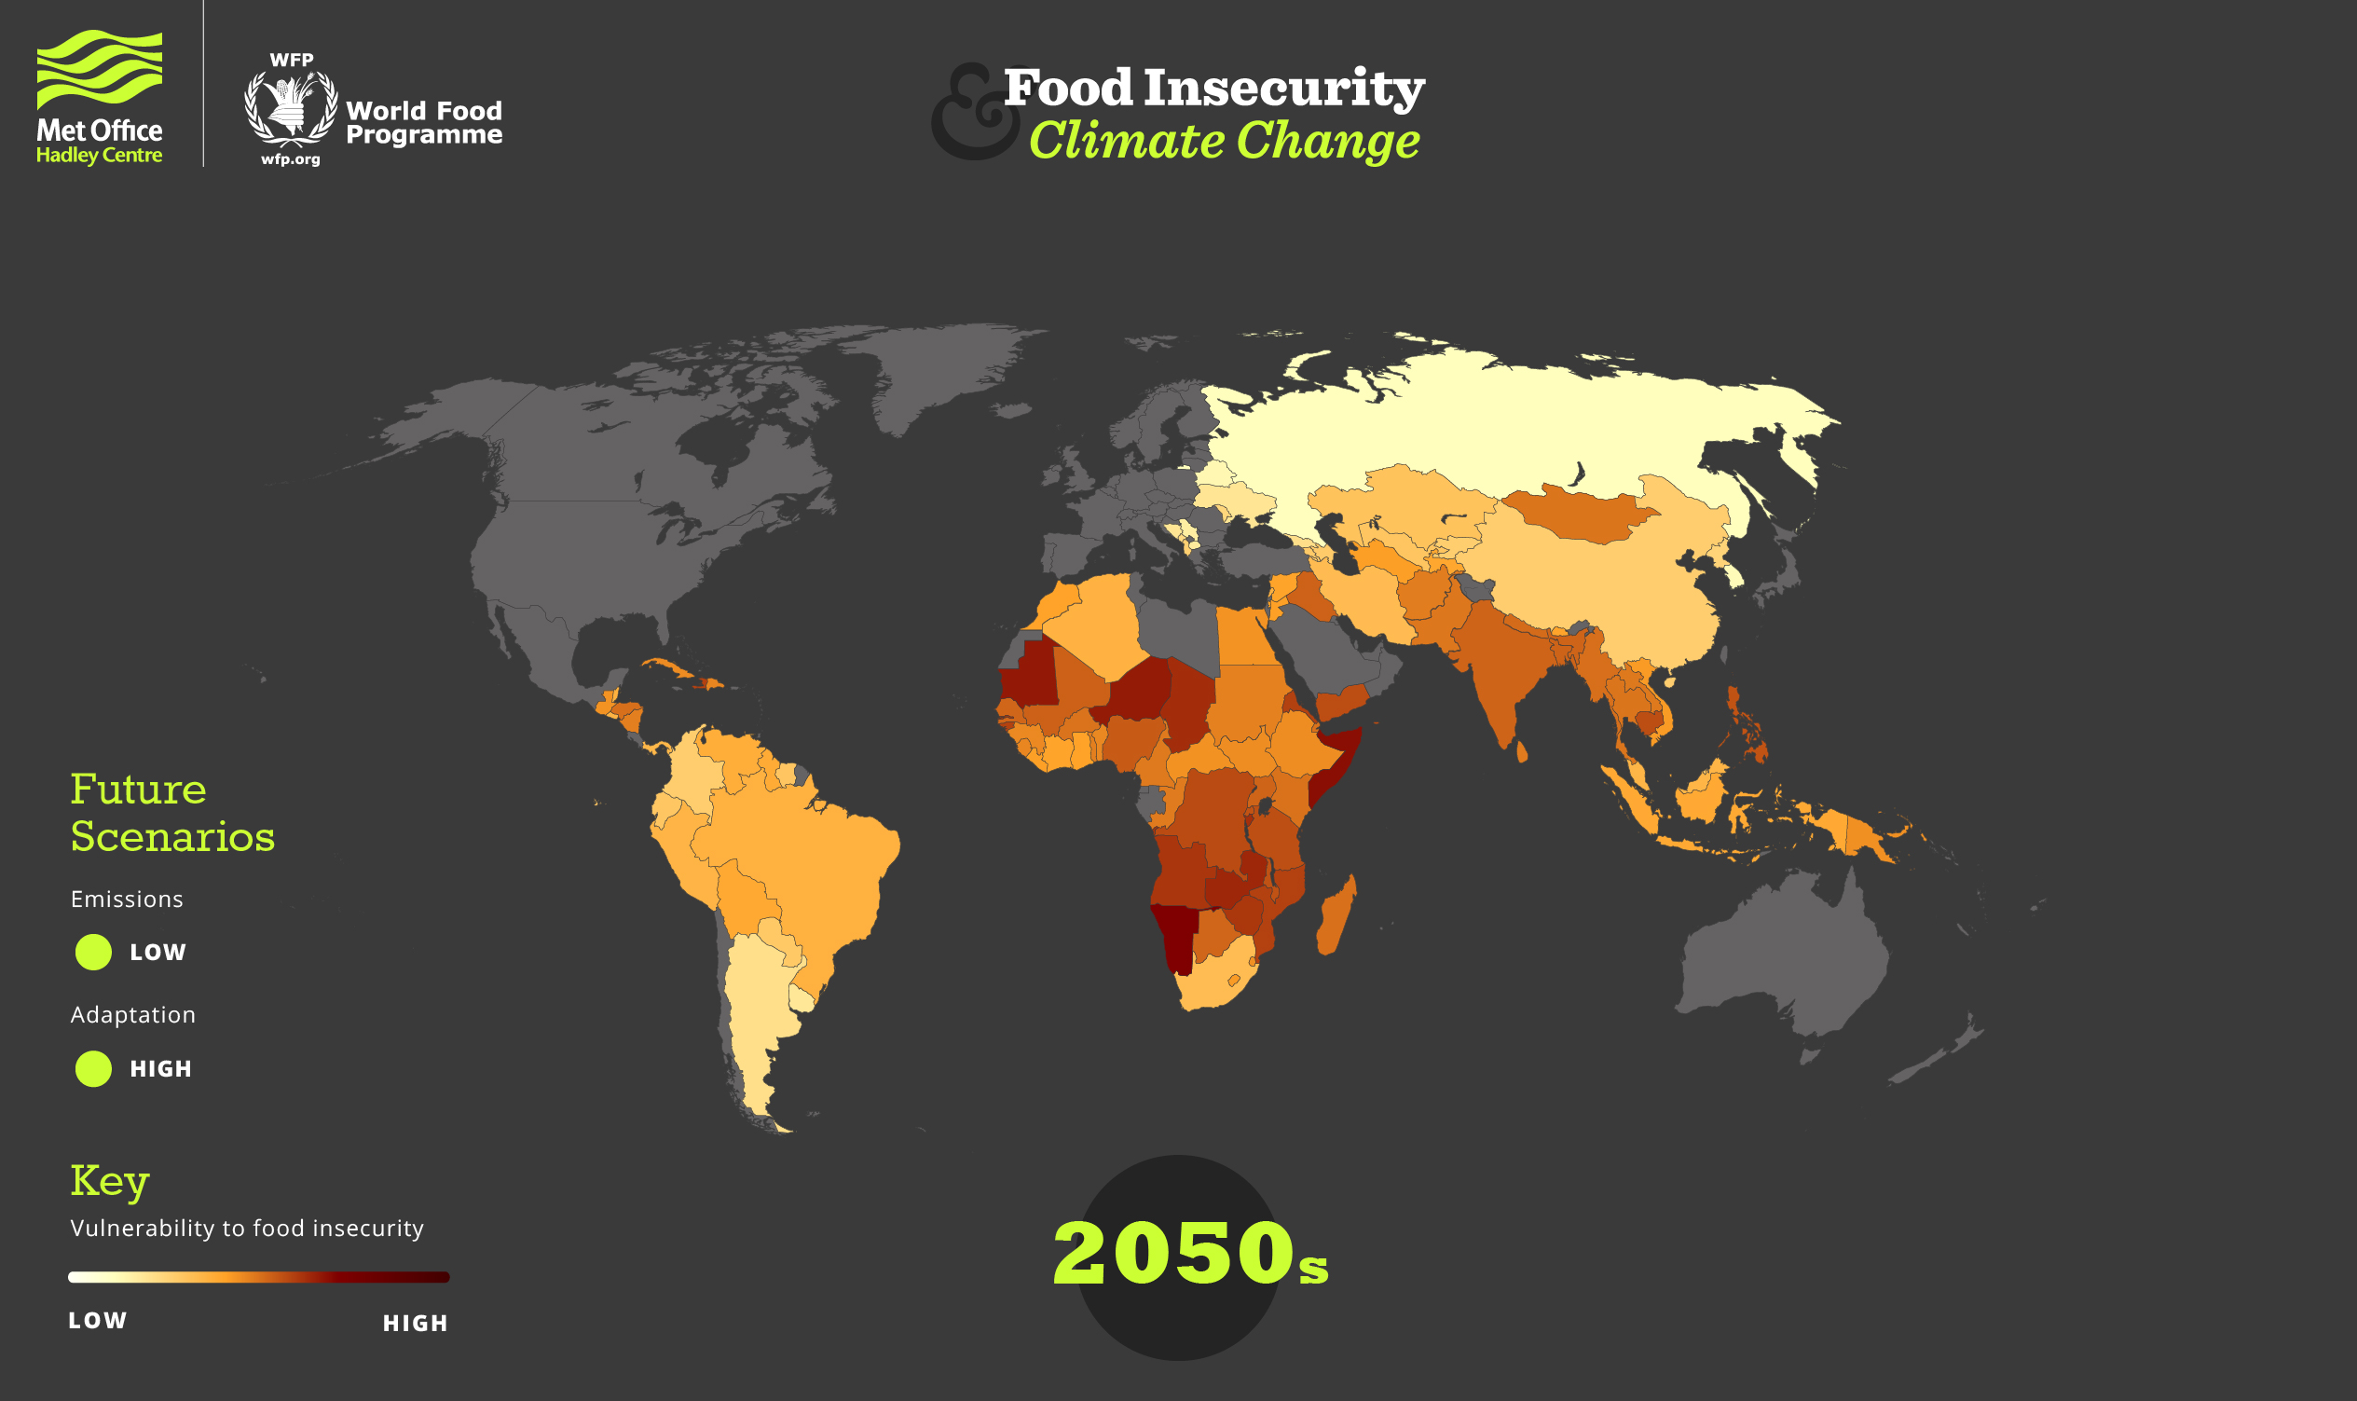

Slide 10
SOLUTIONS

Slide 11
Tracking Food Security
Track which countries are more vulnerable to food insecurities.
Find out why they are facing this problem and engage with them to fix their problem.
World Food Programme (WFP):
Meets face to face with countries and provides food security info.
Uses mVAM (Vulnerability Analysis and Mapping) to monitor places too remote or dangerous to visit.
WFP also works with national governments and UN partners to assess the situation.

Slide 12
Preventing Crop Diseases
Choose plants with built-in resistance
Space the plants properly for air circulation
Clean and sterilize tools and equipment
Rotate Crops annually(Less likely to get attacked by the same disease and it increases soil fertility and crop yield)
Remove and destroy the diseased plants (DO NOT COMPOST)

Slide 13
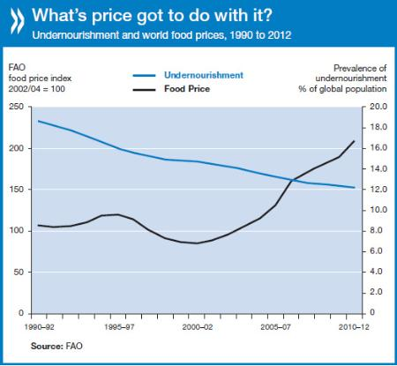

Slide 14
Policies and Changes in Law
Help educate smallholder farmers about fertile land, water, new farming techniques, and open markets ( small farms produce 80% of the worlds food).
Invest more in agriculture and make it easier to get into farming.
Create a white house office on Global Hunger ( In order to pull different agencies together and implement government wide strategies)

Slide 15
Citations
“Food Security in the U.S.” USDA ERS – Food Security in the U.S, 2016, www.ers.usda.gov/topics/food-nutrition-assistance/food-security-in-the-us/.
Ash, Ken. “Agriculture and Fisheries , Solving the Food Crisis.” Solving the Food Crisis - OECD, 2013, www.oecd.org/agriculture/solving-the-food-crisis.htm.
“Climate Impacts on Food Security | WFP | United Nations World Food Programme - Fighting Hunger Worldwide.” UN World Food Programme, www.wfp.org/climate-change/climate-impacts.
Arsenault, Chris. “Family Farms Produce 80 Percent of World's Food, Speculators Seek Land.” Reuters, Thomson Reuters, 16 Oct. 2014, www.reuters.com/article/us-foundation-food-farming/family-farms-produce-80-percent-of-worlds-food-speculators-seek-land-idUSKCN0I516220141016.
Thompson, Stuart. “Four Threats to Global Food Security and What We Can Do about Them.” The Conversation, The Conversation, 7 May 2018, theconversation.com/four-threats-to-global-food-security-and-what-we-can-do-about-them-65676.

