Slide 1
Compromising with Our
Environment
Giovanni Tomaino

Slide 2
Central Thesis
How does the accelerated development/ reconstruction of downtown Brooklyn impact the environment and can the environment be sustained while the real estate market is optimized?

Slide 3
Introduction
As our cities continue to develop our environment develops. We can see these changes in a larger scale just by looking around at what is happening to the city more specifically in downtown Brooklyn. The real estate market has changed this area dynamically.
This change in the market had a huge influence on new developments in the area which made the area much more desirable to live in while causing housing prices to increase dramatically.

Slide 4
Significant Marker of Change in the Market
Construction of the Barclays Center on Atlantic avenue in 2012.
The surrounding area becomes much more desirable because of amenities offered by the complex.
The area becomes a hot spot for large scale luxury housing developments.
Rent prices reach a all time high as a result.

Slide 5
Green Roofing
Improving air quality.
Lasting longer than traditional roofs.
Relocating lost vegetation.
Creating an appealing atmosphere.

Slide 6
Barclays Center’s Green Roofing Project
According to an article in the New York Times in 2015 Barclays center began constructing a three acre green roofing system which was all planted with sedum plants. When this project was completed it
Eventually became a hot spot for bees because of the sedums flower’s pollen.
Housed a huge population of bees.
Provided a safe place for bees to produce honey.
Provided a large space for a significant amount of “green” which improves air quality.
While
Set a standard for environmentally sustainable practices is large scale development projects in the area.

Slide 7
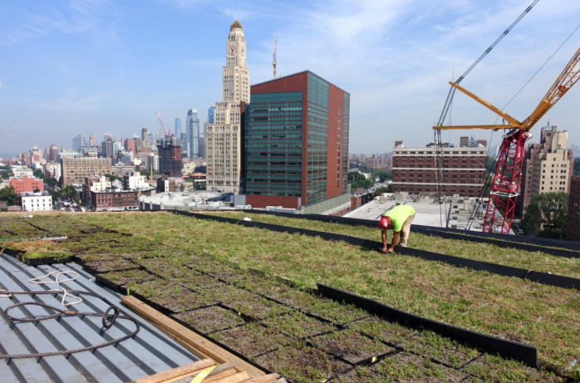
Barclays Center’s Green Roofing Project Cont’d
d
Fig. 1. A roof garden of sedum under construction at the Barclays Center in 2015. Photograph Chang W Lee, The New York Times, “A Hive of Activity Atop the Barclays Center.” The New York Times, The New York Times, 21 Dec.
2017,www.nytimes.com/2015/08/10/nyregion/a-sudden-buzzing-of-bees-descends-on-barclays-centers-roof.html.

Slide 8
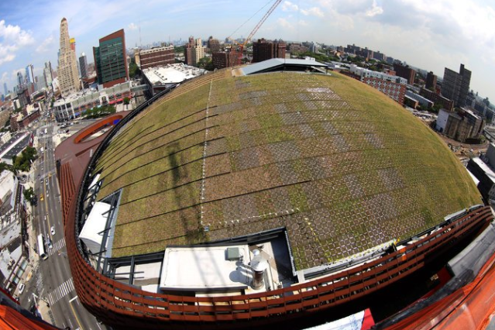
Barclays Center’s Green Roofing Project Cont’d
Fig. 2. A bird’s eye view of the completed sedum roof garden at Barclays Center. Photograph Chang W Lee, The New York Times, “A Hive of Activity Atop the Barclays Center.” The New York Times, The New York Times, 21 Dec.
2017,www.nytimes.com/2015/08/10/nyregion/a-sudden-buzzing-of-bees-descends-on-barclays-centers-roof.html.

Slide 9
33 Bond Street
This 25 story building was completed in 2017 and has 714 units all of which have been rented out at this point in time. It
incorporated environmental sustainability in its marketing strategy, offering residents
A fully landscaped roof garden/ common area with great city views.
An elevated park with great views of the city.
Environmentally friendly services such as
Dry cleaning/ laundry.

Slide 10
Conclusions
Defining & Mapping Sustainability
Sustainability is a characteristic of dynamic systems that maintain themselves over time; it is not a fixed endpoint that can be defined (Esty).
“Environmental sustainability refers to the long-term maintenance of valued environmental resources in an evolving human context” (Esty).
Sustainability and its definition are always changing, so it would be fair to assume that as sustainability changes its maintenance changes which makes mapping extremely difficult due to dynamics.

Slide 11
Conclusions Cont’d
Lack of Policy
Environmental sustainability is not a priority in regulations.
There are very bare minimum regulations for buildings/ developments in regard to environmentally safe practices. Most implementations would be optional.
Organizations like National Association of Homebuilders (NAHB) aim to help project managers implement green standards into their development projects.
- Statistical data.
- Tool kits.

Slide 12
Works Cited (MLA)
“A Hive of Activity Atop the Barclays Center.” The New York Times, The New York Times, 21 Dec. 2017, www.nytimes.com/2015/08/10/nyregion/a-sudden-buzzing-of-bees-descends-on-barclays-centers-roof.html.
Esty, Daniel C., Marc Levy, Tanja Srebotnjak, and Alexander de Sherbinin (2005). 2005
Environmental Sustainability Index: Benchmarking National Environmental Stewardship.
New Haven: Yale Center for Environmental Law & Policy.
Rowe, D. Bradley. “Green Roofs as a Means of Pollution Abatement.” Environmental Pollution, vol. 159, no. 8-9, 2011, pp. 2100–2110., doi:10.1016/j.envpol.2010.10.029.
“Surround Yourselfwith The.” 33Bond, www.33bond.com/.
“Sustainability.” NAHB,
www.nahb.org/en/research/nahb-priorities/green-building-remodeling-and-development.a

