Slide 1
The Environment benefits of Green space in urban areas
Omar Gani
ECON 2505ID
Prof. Macdonald

Slide 2
Changed from the forest to urban

Slide 3
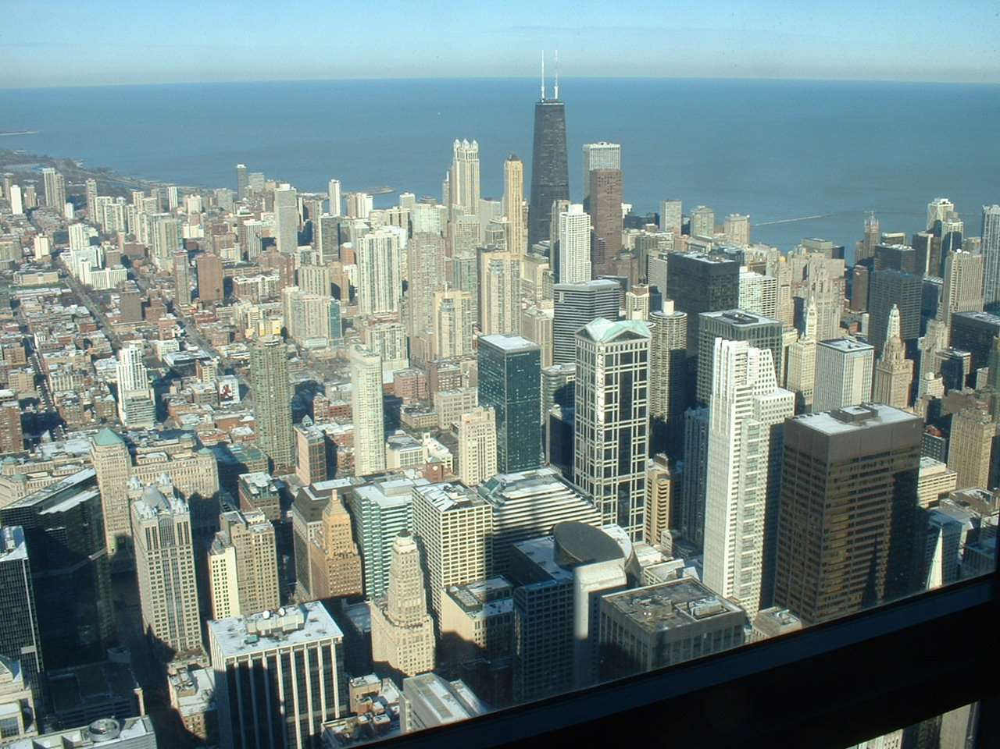
Stressed in the urban environment
–Urban climate:
Temperature
Wind
Soil
Water: 80% reduce
Health problem

Slide 4
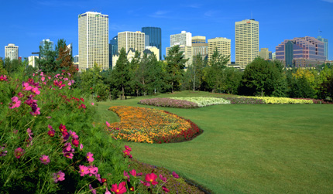
Green space benefits
Prevent Pollution and dust from the air
Trees are important for environment
Provide shade and lower temperature
Planting fruits and vegetables
Ecosystems (plants, animals, etc)

Slide 5
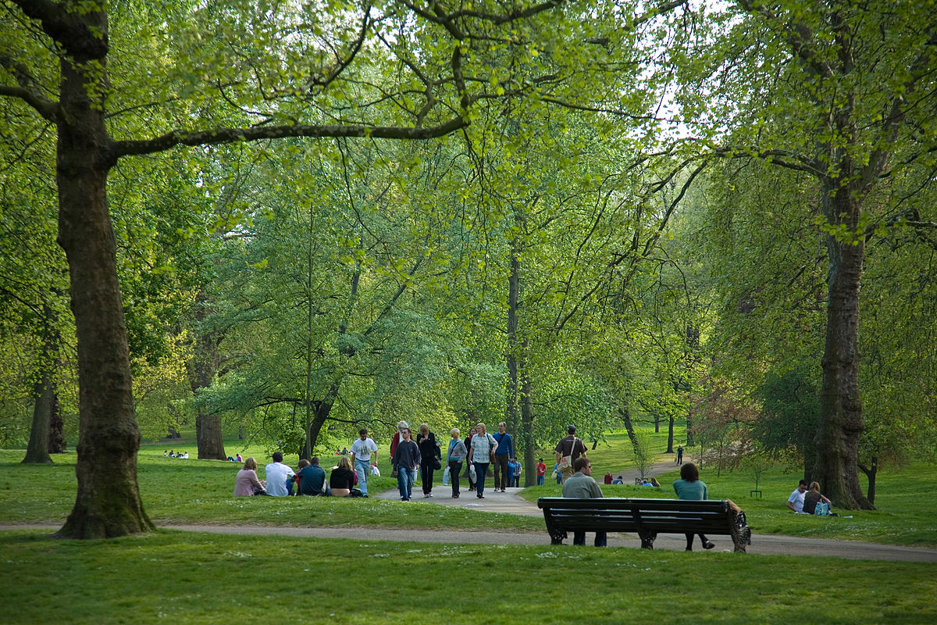
More Benefits
Parks, Green spaces, and playgrounds are perceived health, reduced stress levels, reduced depression and more
Access to public open space helps to increase levels of physical activity, mental health benefits and reduce healthcare and other costs
Help slow global warming

Slide 6
Interesting
Human survive (long term)
Less illness (allergy, headache, etc)
Health important
Comfortable
Maintain for future
Low temperature (summer, spring)

Slide 7
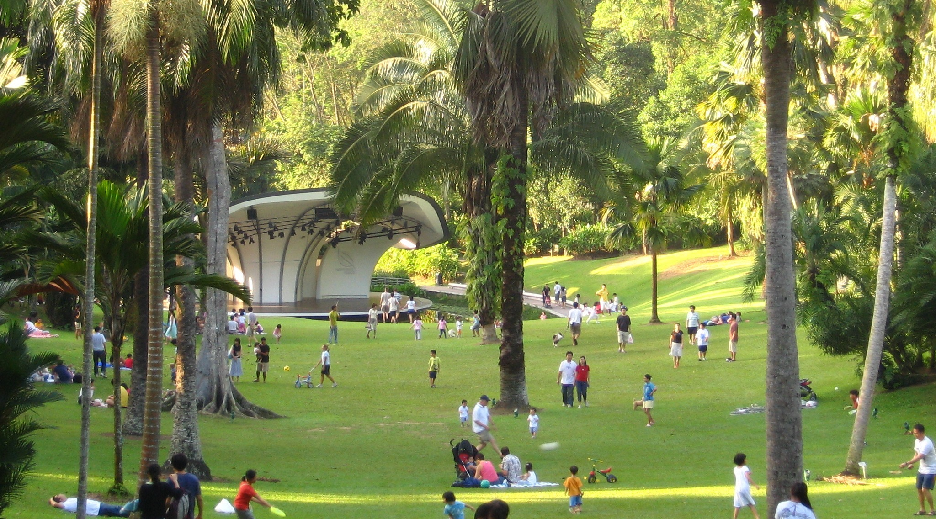
Why to improve the urban green space
Residents can play (kids), relax, meet with neighbors and enjoy the natural environment
Green space not just provide environment benefits in our life
Also social (communication), economy and personal benefits

Slide 8
Conclusions
Green space can help the cities by:
– Cleaning the air
– Adapt to the climate change
– Protect biodiversity and natural resources
Create sustainable cities >> including greens areas and trees
Biodiversity in cities >> resilience (shape)
More urban trees >> more happiness in cities

Slide 9
Reference
Anon, (2018). [online] Available at: http://www.environmentalpartnership.org/environmentalpartnership.org [Accessed 08 May 2018].
Environmental Benefits of Green Space. (2016, June 13). Retrieved April 05, 2018, from http://projectevergreen.org/resources/environmental-benefits-of-green-space/
Home. (n.d.). Retrieved April 05, 2018, from https://www.treesaregood.org/treeowner/plantingatree
"LUGANA FOR THE ENVIRONMENT AND THE ENVIRONMENT FOR LUGANA NO MORE TREES SACRIFICED TO MAKE WAY FOR VINEYARDS." M2 Presswire, 3 Aug. 2016. General OneFile, http://link.galegroup.com/apps/doc/A459795788/ITOF?u=cuny_nytc&sid=ITOF&xid=a6d2eff1. Accessed 08 May 2018.
Perry, George L. W. "Urban Green Space." Encyclopedia of Geography, edited by Barney Warf, vol. 6, SAGE Reference, 2010, pp. 2942-2946. Gale Virtual Reference Library, http://link.galegroup.com/apps/doc/CX1788301175/GVRL?u=cuny_nytc&sid=GVRL&xid=02739cbd. Accessed 08 May 2018.

