Slide 1
Technological Investments That Individuals Can Make To Reduce Their Impact On The Environment
Bryan Tinjaca
Environmental Economics
ECON 2505
Prof. Sean P. MacDonald
December 7, 2016

Slide 2
Message To The Audience
The following presentation will contain zero concepts everything I will be showing you today will be available for you to purchase the moment you leave this room. By doing this I will not be discussing any product that has not been released or does not have a pending release date. All the products mentioned today are what I found to be the easiest for the average consumer to use.

Slide 3
Outline
Apartments & Homes
-Hydroponic Gardening
-Lighting
-Hybrid Car
Homes
-Thermostats
-Sprinkler
-Solar Roof
-Solar Battery
-Energy and Water Monitors
-Electric Car
Smart Hub
-Samsung SmartThings

Slide 4
Apartments & Homes

Slide 5
Hydroponic Gardening
-Excellent for small living spaces
-Can grow up to 5 times faster than soil
-Food grown by you free of pesticides and chemicals

Slide 6
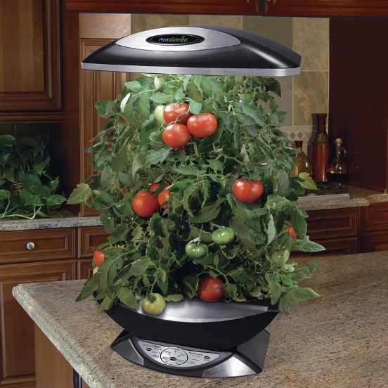
Aero Garden
Aeroponics
Roots are misted with a nutrient solution
Grow Anything Pod Kits(6-pods) cost $13
Miracle-Gro Nutrients 1 Quart $30
Aerogarden $70-$180

Slide 7
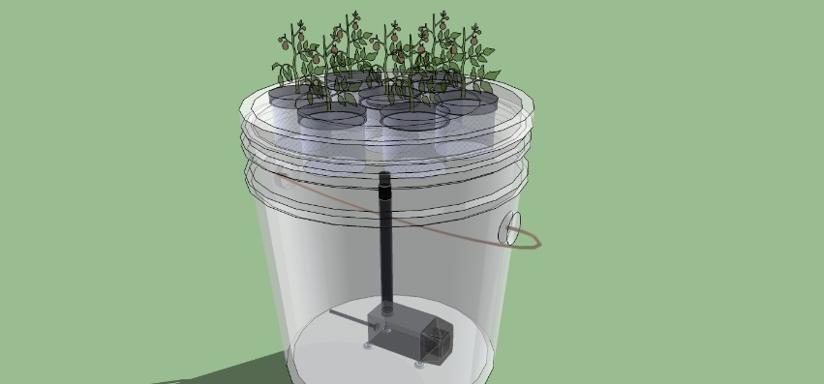
DIY Simple Aquaponics
Large Bucket or Tub $12-$30
Air Pump $10-$26
Chemical free sponge 6 Pack $17
Net pots 25 Pack $9
Miracle-Gro Nutrients 1 Quart $30
Led Lighting 5pack stick on $10
Aluminum Foil

Slide 8
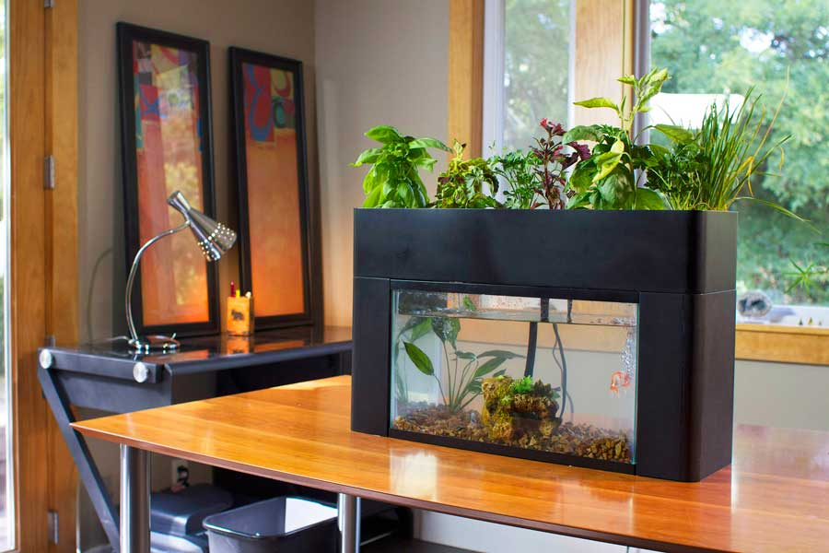
DIY Advanced Aquaponics
Aquarium ($10-$100)
Air Pump ($10-$26)
Comet Goldfish($0.29)
Sponge Filter ($10)
Tetra SafeStart ($5)
Led Lighting 5pack ($10)
Water Test Kit($25)
Aluminum Foil

Slide 9
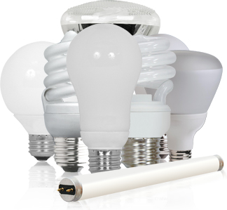
Lighting
Light Bulb Variations
Bulb Lifespan
Electricity Usage
Health Risks
Heat output and cooling systems

Slide 10
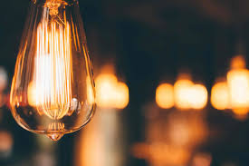
Incandescent
Lifespan 1,200 hours
Electricity 60 Watts
30 Bulbs operating cost $328.59/yr.
30 Bulbs Co2 emissions 4,500 pounds/yr.
Easily Breakable
Fire hazard they run hot

Slide 11
CFLs(Compact Fluorescents)
Lifespan 8,000 hours
Electricity 13-15 Watts
30 Bulbs operating cost 76.65/yr.
30 Bulbs Co2 emissions 1,051 pounds/yr.
Contains 1-5mg of mercury toxic to the environment
Easily Breakable and will pose a health risk
Less of a fire hazard than Incandescent

Slide 12
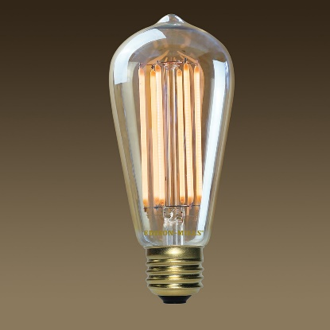
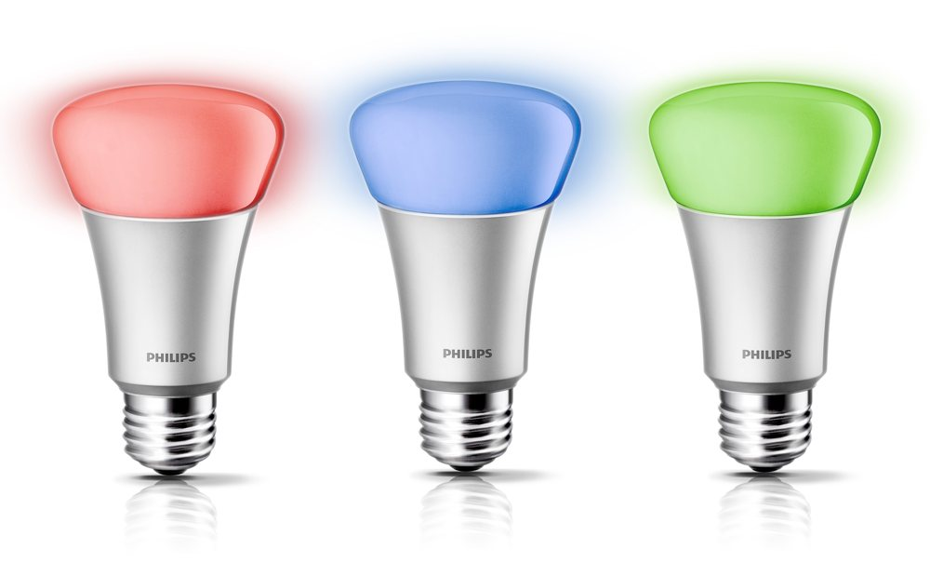
LEDs (Light Emitting Diodes)
Lifespan 50,000 hours
Electricity 6-8 Watts
30 Bulbs operating cost 32.85/yr.
30 Bulbs Co2 emissions 451 pounds/yr.
Very durable housed in plastic
Significantly lower heat output

Slide 13
Hybrid Car
Best of both worlds electric and gasoline working together
Price range $25,000 or higher
https://www.youtube.com/watch?v=m2qvGJwTuBo

Slide 14
Homes

Slide 15
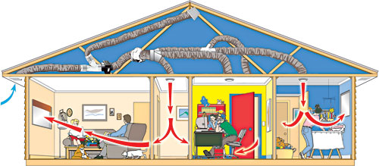
Smart Thermostats
Saving energy for your home
Convenient and intuitive interfaces
Control when away from home

Slide 16
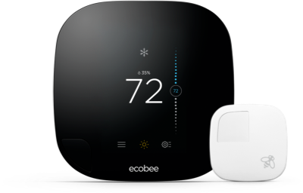
Ecobee3
Price 250.00
Learning Thermostats
Ecobee 3 in room monitoring

Slide 17
Smart Sprinklers
Intelligent irrigation control
Full control over your sprinklers

Slide 18
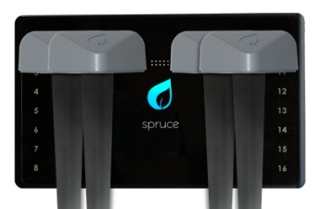
Spruce Irrigation Controller
Spruce 289.00
The difference Spruce provides soil moisture information

Slide 19
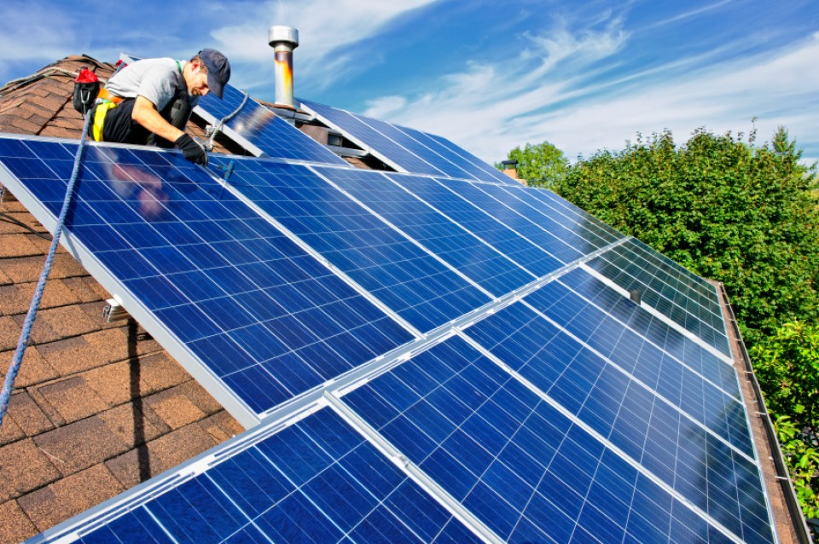
Solar Roof
Renewable energy for your home

Slide 20
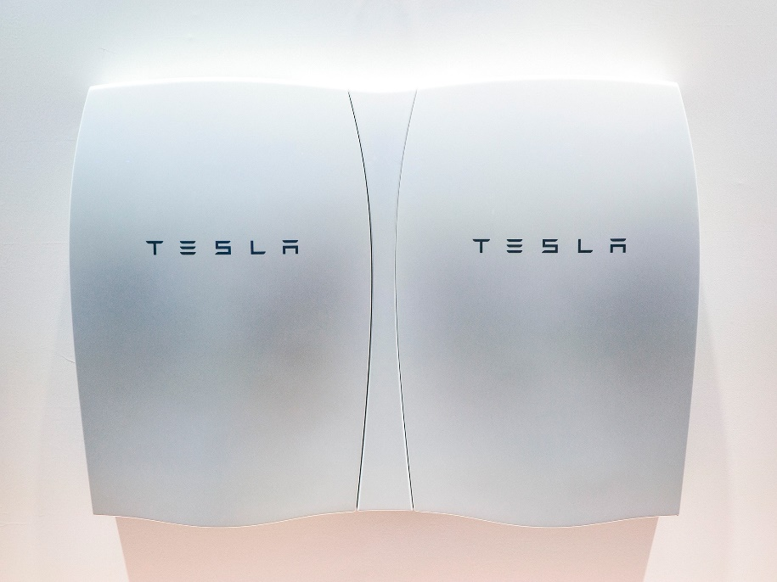
Solar Panels
5kW system estimate $10,000-$35,000
Tesla Powerwall 14kWh $7,000
Powerwall provides one day of usage for Lights outlets and Fridge

Slide 21
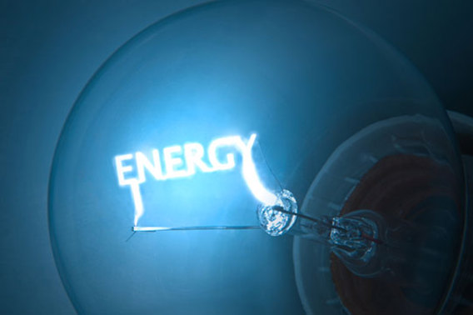
Energy and Water Monitors
Visualize your homes usage
Learn how you can save both energy and water in your daily routine

Slide 22
Neurio Monitor
Price $220.00
Track Electricity usage by the hour
Set monthly electricity budgets
No surprises on your monthly bill

Slide 23
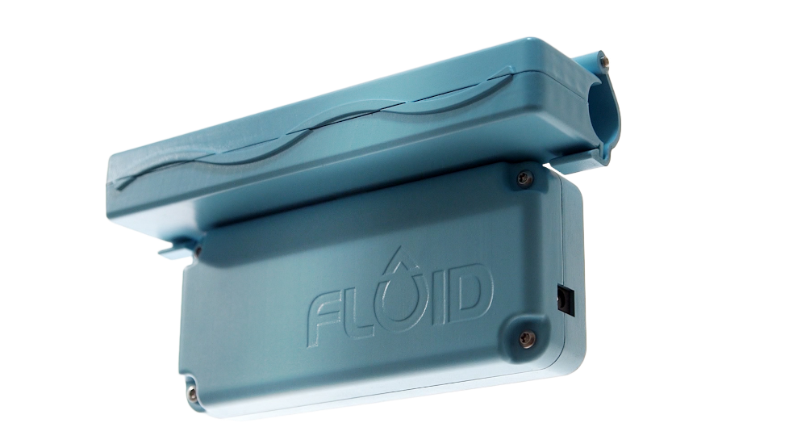
FLUID
Price 259.00
Track water usage by the hour
Get alerts on excess water usage
Detect leaks before the become a problem
Understand your water bill

Slide 24
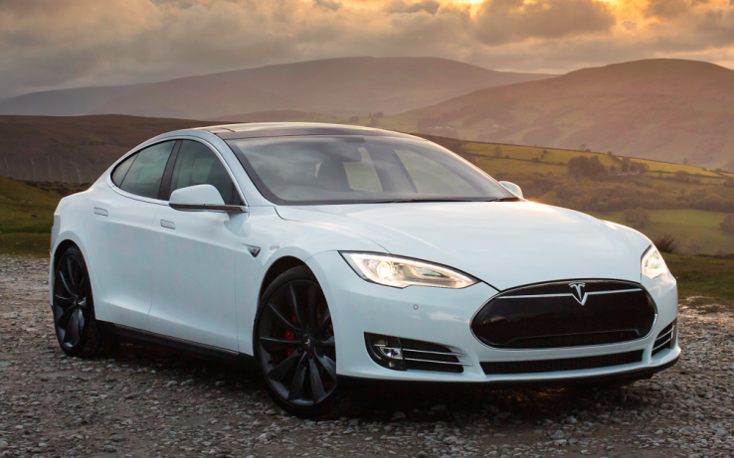
Electric Car
Price $25,000 or higher
Only convenient if electricity is not heavily reliant on coal
Putting an end to fluctuating gas prices
More storage and legroom space
Mileage can vary 70-315 Miles

Slide 25
The Smart Hub

Slide 26
Samsung Smart Things
Price $249
Convenience at your fingertips
Wide compatibility of products
Make any home a smart home

Slide 27
Conclusion
It’s not necessary for us to do everything I mentioned today to make a change so long as we all do one action from my presentation today we can help reduce our economic footprint
I urge everyone to educate and inform anyone you know, that we all have the power to make a difference

Slide 28
References
-Hydroponic Gardening
https://gardenpool.org/online-classes/how-to-make-a-simple-5-gallon-bucket-aeroponics-system
-Lighting
http://www.designrecycleinc.com/led%20comp%20chart.html
-Hybrid Car
https://www.youtube.com/watch?v=m2qvGJwTuBo
-Thermostats
https://www.ecobee.com/
-Sprinkler
http://spruceirrigation.com/
-Solar Roof
https://www.solarpowerauthority.com/how-much-does-it-cost-to-install-solar-on-an-average-us-house/
-Solar Battery
https://www.tesla.com/powerwall
-Energy and Water Monitors
http://neur.io/
http://www.fluidwatermeter.com/
-Electric Car
https://www.tesla.com/
-Samsung SmartThings
https://www.smartthings.com/

