Slide 1
Renewing Soil as a Way to Reduce CO2 Emissions
Juan Plasencia
Environmental Economics
ECON 2505
Prof. Sean P. MacDonald
Wednesday, December 07, 2016

Slide 2
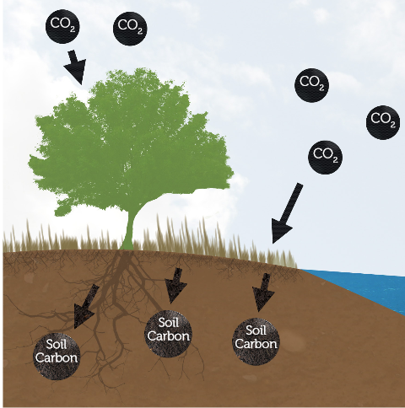
Soil is a very abundant natural resource and it can absorb a high percentage of the worlds CO2. New farming methods that renew and regenerate our soils have to be implemented and thought of.

Slide 3
The Earth’s soils store 2,500 billion tons of carbon—more carbon than the atmosphere (780 billion tons) and plants (560 billion tons) combined. Additionally, fossil fuels, formed from ancient, fossilized plants and animals, store another 5,000-10,000 billion tons of carbon. When burned, carbon molecules combine with two oxygen atoms to form CO2, a gas.
CENTER FOR FOOD SAFETY
SOIL & CARBON

Slide 4
In fact, from 1750 to 2011, about one-third of total human-caused emissions were released through deforestation and land use change(approximately 43 percent of which came directly from the Earth’s soils).
CENTER FOR FOOD SAFETY
Soil & Carbon

Slide 5
Industrial Farming and its consequences
Excess CO2 in our atmosphere
Climate change
Food scarcity
Food waste
Loss of forest land and tree population

Slide 6
Reason why We need to change our faming methods
Plant life can easily reduce the amounts of CO2 in the atmosphere.
Current farming methods are depleting our soils of their nutrients and ability to retain carbon dioxide.
A great percentage of our soils are classed as degraded or highly degraded.
As farming lands are degraded demand for new soil grows.
We need to slow down if not stop climate change

Slide 7
Organic and Agro Ecological Farming Methods
Crop rotation
Using organic fertilizer
Composting
Reducing water usage
Growing native plants

Slide 8
Why choose organic and Agro Ecological Farming
No use of synthetic pesticides
Don’t degrade soil due to natural cycle constraints and soil preservation methods
Higher biodiversity in organic farms
Better for ecosystem
Organic plants are better equipped to withstand climate change
Organic food is better for overall human health
Reduce CO2 release and better at food production
CENTER FOR FOOD AND SAFTEY
FOOD AND CLIMATE

Slide 9
Brooklyn Navy Yard
It was observed that ecofriendly farming methods are possible and they produce food with ought no harm the environment. In the Brooklyn Navy Yard, composting was used as a way to fertilize the soil. Crop rotation was also implemented in their farming methods. The main idea that I observed from visiting this cite is that, if ecofriendly farming such as crop rotation and composting work and yield profits in a small scale such as the setup in the Brooklyn Navy yard maybe scientist are right and ecofriendly faming may work on a world scale.

Slide 10
Summary
According to scientist, climate change is a harsh reality that is affecting the world and our daily lives. Humanity has known about climate change for many years yet we have not found a consensus as to what the solution is or even if it exists. Whether you agree or not that climate change is a reality, you better believe in the fact that humanity is destroying our food sources with its farming and food production methods. Renewable farming methods should be the goal of all nations producing and consuming food around the world. Current farming methods degrade soil, produce carbon dioxide, pollute water and in consequence increment the need for new farmlands. Producing new farmland is putting pressure on farmers to destroy rainforest and implements farming methods that are not safe for the environment.

Slide 11
Conclusion or key findings
Climate change is here and we can do something about it! The solution to climate change is right under our feet(soil) and beneath our noses(mouth). Humanity as a whole has to be educated as to the cost of the food they are consuming and where it came from. Maybe the cost of an apple or a pear is not just the Dollar that we pay at the store.

Slide 12
Works cited
Biello, D. (2007, May 25). Combating Climate Change: Farming Out Global Warming Solutions. Retrieved from https://www.scientificamerican.com/article/combating-climate-change-farming-forestry/
Donlon / CENTER FOR FOOD AND SAFETY, D. (2014, February 14). Food & Climate: Connecting the Dots, Choosing the Way Forward. Retrieved from http://www.centerforfoodsafety.org/reports/2947/food-and-climate-connecting-the-dots-choosing-the-way-forward
Donlon / CENTER FOR FOOD AND SAFETY, D. (2016). SOIL SOLUTIONS TO CLIMATE PROBLEMS 2015 SOIL & CARBON. SOIL & CARBON, 1-8.
Hickel, J. (2016, September 10). Our best shot at cooling the planet might be right under our feet. Retrieved from https://www.theguardian.com/global-development-professionals-network/2016/sep/10/soil-our-best-shot-at-cooling-the-planet-might-be-right-under-our-feet

