Slide 1
THE BIG U PROJECT
ERDEM UZUNOGLU
Environmental Economics
ECON 2505
Prof. Sean P. MacDonald
12/07/2016

Slide 2
The Big U is a protective system that encircles Manhattan, responding to the needs and concerns of the island’s diverse communities.
Stretching from West 57th Street south to The Battery and up to East 42nd Street, the Big U protects 10 continuous miles of the city.

Slide 3
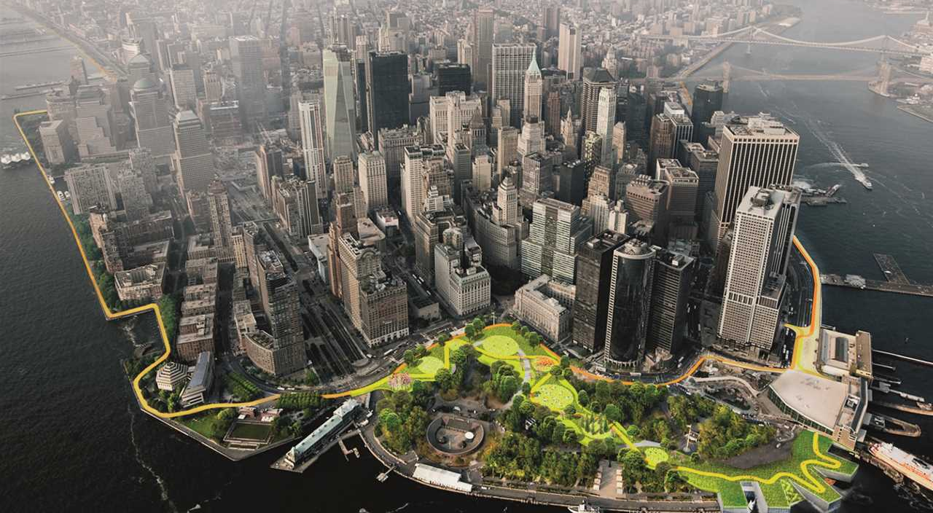
In collaboration with New York City, The BIG U proposal was developed to protect Lower Manhattan from floodwater, storms, and other impacts of a changing climate.

Slide 4
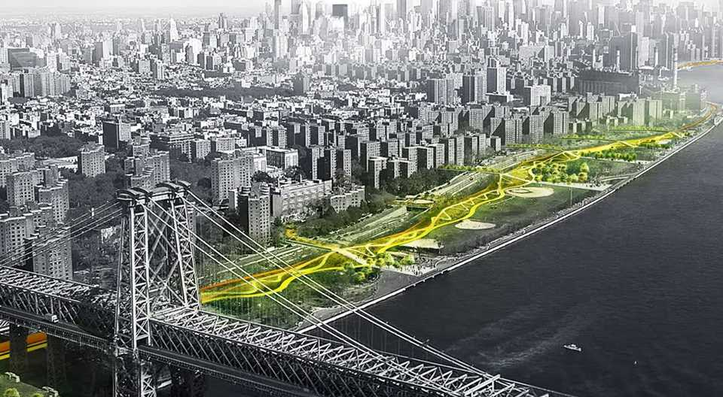
The shape looks like the hull of a ship, each can provide a flood-protection zone, Each compartment comprises a physically separate flood-protection zone.

Slide 5
Advantages of The Big U Project
The public zones include bike pathsand new bridges – as well as pop-up sea walls, possibly deployed only during storms.
Salt-resistant vegetation will be used to make the area more resilient to future flood events.
There will be direct and indirect job opportunities.
It might be a economic boost for local businesses.

Slide 6
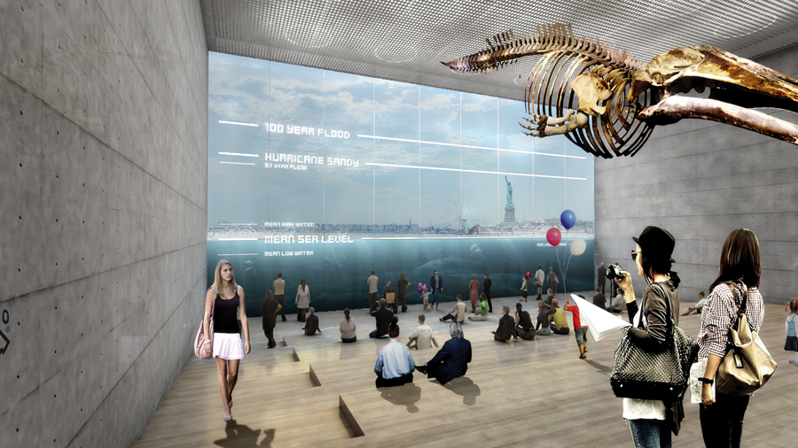
In place of the existing Coast Guard building, the plan envisions a new building programmed as a maritime museum or environmental education facility.

Slide 7
The team envisions three compartments that function independently to provide flood protection
1st compartment will be North-East River Park from east 23rd street to Montgomery street.
2nd will be Two bridges and Chinatown.
3rd will be Battery park and Financial District from the Brooklyn Bridge to the Battery Park.

Slide 8
Financial Costs
Mayor Bill de Blasio announced $170 million has been allocated from the 2017 city budget for the climate resiliency plan of New York City.
Construction is set to start in 2017 on the project, which has received $335 million from the US Federal Government.

Slide 9
Questions / Discussions
There are more than $500 billion business sector between east 57th to west 42nd street in Manhattan.
Hurricane sandy devastated not only Financial District but also 95000 low income, elderly and disabled city residents.
This project might be helpful for those people who lost their businesses and houses from the next hurricane.

Slide 10
As a conclusion, The Big U project not only shields the city against floods and storm water; it provides social and environmental benefits to the community, and fosters an improved public realm.

Slide 11
Resources
Quirk, V. (2014). The BIG U: BIG's New York City Vision for "Rebuild by Design" Retrieved November 02, 2016, from http://www.archdaily.com/493406/the-big-u-big-s-new-york-city-vision-for-rebuild-by-design/
Bergman, K. U., Angels, B., Bouw, M., & Christoffersen, T. (2016, May 04). The Dryline: Urban flood protection infrastructure, New. Retrieved November 02, 2016, from https://www.lafargeholcim-foundation.org/Projects/the-dryline
Rhodes, M. (2014, August 06). A $335M Project to Save NYC From Climate Catastrophe. Retrieved November 02, 2016, from https://www.wired.com/2014/06/a-335m-project-to-save-nyc-from-climate-catastrophe/
B. (n.d.). Archello - How It's Made. Discover the products, stories and building teams behind the project. Retrieved December 07, 2016, from http://us.archello.com/en/project/big-u
Cohen, M., York, M. N., Nonko, E., Schulz, D., Zimmer, L., Doge, A., & 6. (2016). NYC May Get a Big Ugly Wall Instead of Bjarke Ingels' Storm Protection System | 6sqft. Retrieved December 07, 2016, from https://www.6sqft.com/nyc-may-get-a-big-ugly-wall-instead-of-bjarke-ingels-proposed-big-u-storm-protection-system/

