Slide 1
Developing a Wind Project along NYC Highway
RIEO RAMLALL
ENVIRONMENTAL ECONOMICS
Econ 2505
PROF: SEAN MECDONALD
DEC 7, 2016

Slide 2
Thesis
Reducing Green House Gasses in NYC by implementing wind energy along highways.

Slide 3
Objectives
Is it feasible to implement in New York City?
Where can it be implemented?
Benefits of implementing wind energy in New York City.

Slide 4
What is a wind turbine?

Slide 5
Finding from Secondary Sources
Conditions for a successful wind energy project.
Reliable wind resource
Close proximity of existing transmission lines
Access to land
Access to Capital
Reliable Market
Addressing site and feasibility considerations
Establish Dialog with manufacturers
Secure operation and maintenance needs

Slide 6
Wind Resource
Low speed turbines require 3m/s to start = 6.7mph
Provides excellent production at an average speed of 13mph

Slide 7
Where ?
I-84
71 miles

Slide 8
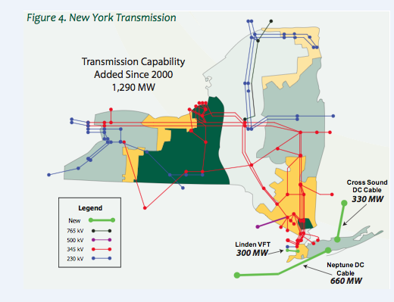
Where ?
I-84
71 miles

Slide 9
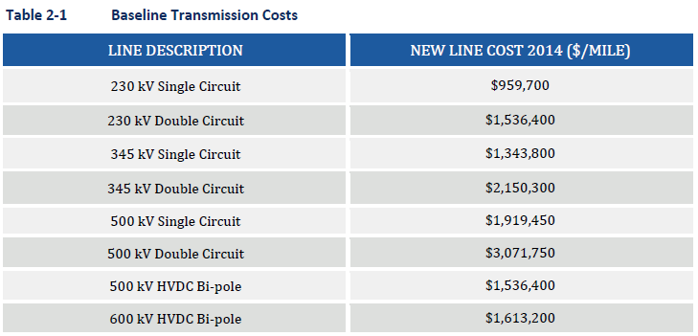
Why I-84
I-84
71 miles

Slide 10
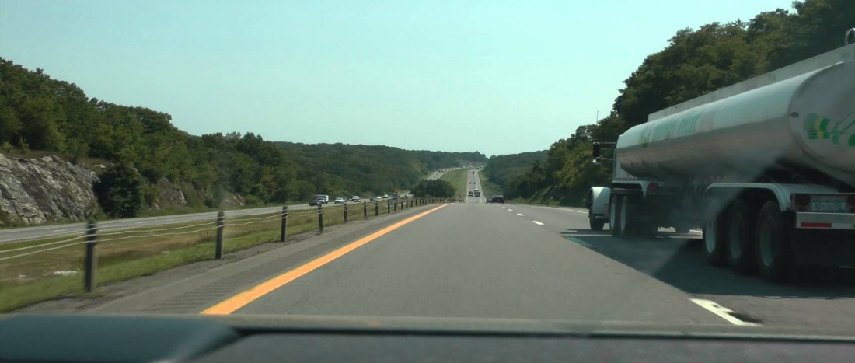
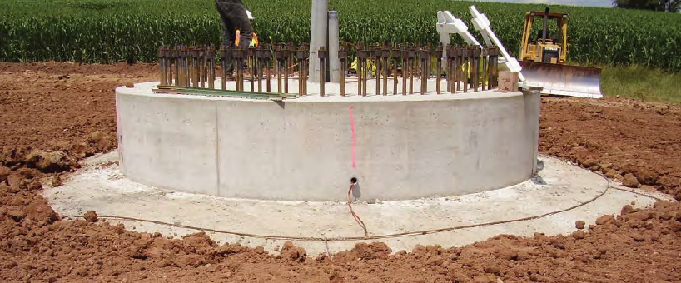
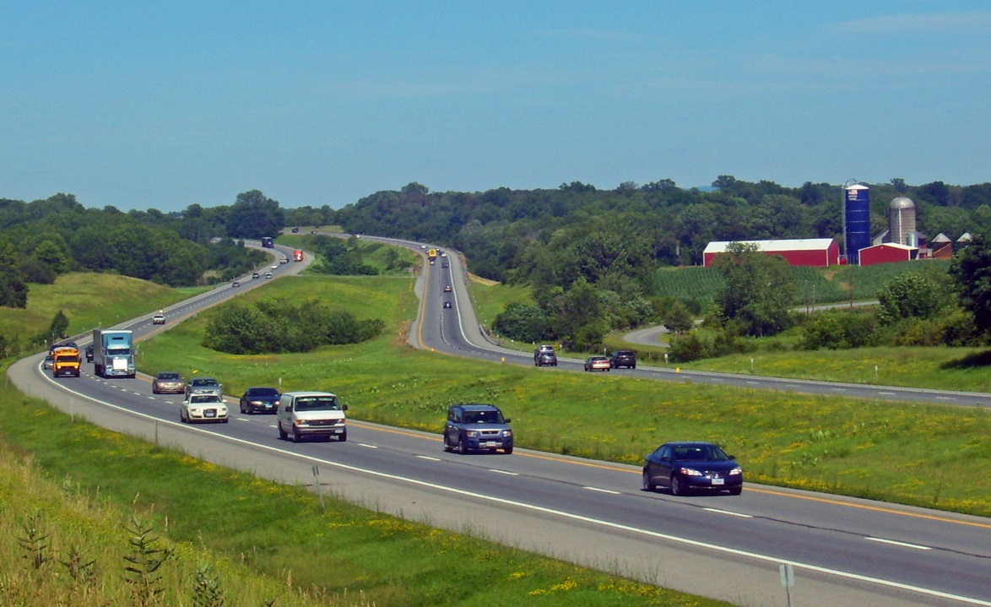
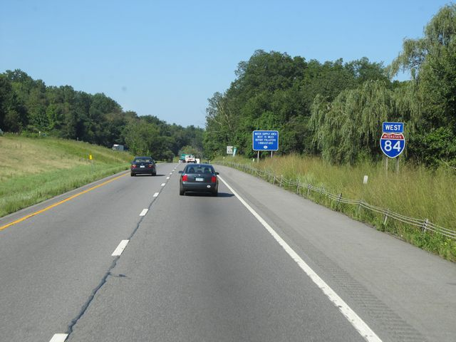
Site Location

Slide 11
Cost
On Average wind turbines cost 1.5M per MW installed
60 turbines at 3.45MW = 207MW = $310M
Energy produced = 60 *3.45MW *365days*24hours = 1813.32 x 10⁶ KWh
At 20% efficiency = 362.664 x 10⁶ KWh per year
At 7 cents per kwh = $25.38648M
25 Years life span return = $634.6M
Profit = $634M – $310M
Profit = $324M
Annual return for all 3.45MW turbines

Slide 12
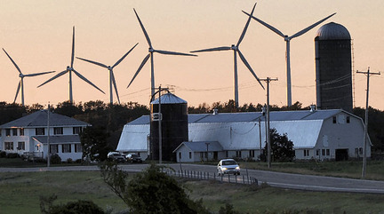
Contributions of Site
Maple Ridge Wind Farm(Lewis County, New York)
Similar Vestas Technology that will be used.
Located in similar conditions and wind speed resource.

Slide 13
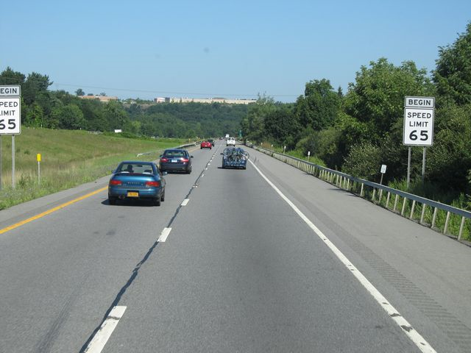
Contributions of Site
Maple Ridge Wind Farm(Lewis County, New York)
Noise level of 55dB (A) at 100 meters away.
Similar to the noise of a car travelling at a speed of 60km/h.

Slide 14
Contributions of Site
Maple Ridge Wind Farm(Lewis County, New York)
Effects on Wildlife
Over a 1 year period to include all seasons
53 incidents were recorded of species including;
23 Song bird species
3 Game bird species (Ruffled Grouse, American Woodcock and Wild Turkey)
3 Raptor species (American Kestrel, Cooper’s Hawk and Sharp-shinned Hawk)
2 Water bird/Shore bird species (Mallard, Killdeer)
The greatest number of incident occurred during the month of October.

Slide 15
Benefits of Wind Energy
Creates employment
Brings capital in to the local income through purchase of materials and supplies for construction.
Helps prevent carbon pollution, sulfur dioxide and nitrogen oxides which causes smog, acid rain, and respiratory illness.
Prevents mercury pollution, a neurotoxin that is harmful to people and wildlife.
Reduces the exposure of our economy to high fuel prices.

Slide 16
Conclusions/Finding
Wind resource is adequate enough for turbines.
Available land space.
Requires high capital but profits about 50%.
Endangers some species but with little effect.
Reduces CO2 emissions and global warming.
Controls the prices of fuel
Great for the economy by creating jobs and supporting local businesses.

Slide 17
References
Manwell, J. F., McGowan, J. G., Rogers, A., Ellis, A., Wright, S., Brown, M., & MacLeod, J. (2003). Wind turbine siting in an urban environment: The Hull, MA 660 kW turbine. Retrieved October, 26, 2005.
Wind energy frequently asked questions (FAQ)| EWEA. (n.d.). Retrieved November 17, 2016, from http://www.ewea.org/wind-energy-basics/faq/
Rautenstrauch, J. (n.d.). Siting of Wind Farms: Basic Aspects. Retrieved November 16, 2016, from http://www.wwindea.org/technology/ch02/en/2_4_1.html
Jain, A., Kerlinger, P., Curry, R., & Slobodnik, L. (2009). Annual report for the Maple Ridge wind power project post construction bird and bat fatality study–2006. Cell, 315, 560-8650.
Corbisier, C. (2003, August). Living With Noise. Retrieved November 10, 2016, from https://www.fhwa.dot.gov/publications/publicroads/03jul/06.cfm

Slide 18
Thank you

