Slide 1
Dangers of Rising Sea Levels in
New York City
By Mayveline Guzhnay
ENVIRONMENTAL ECONOMICS
ECON 2505
PROF. SEAN P. MACDONALD
DECEMBER 7TH 2016

Slide 2
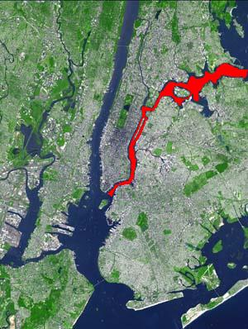
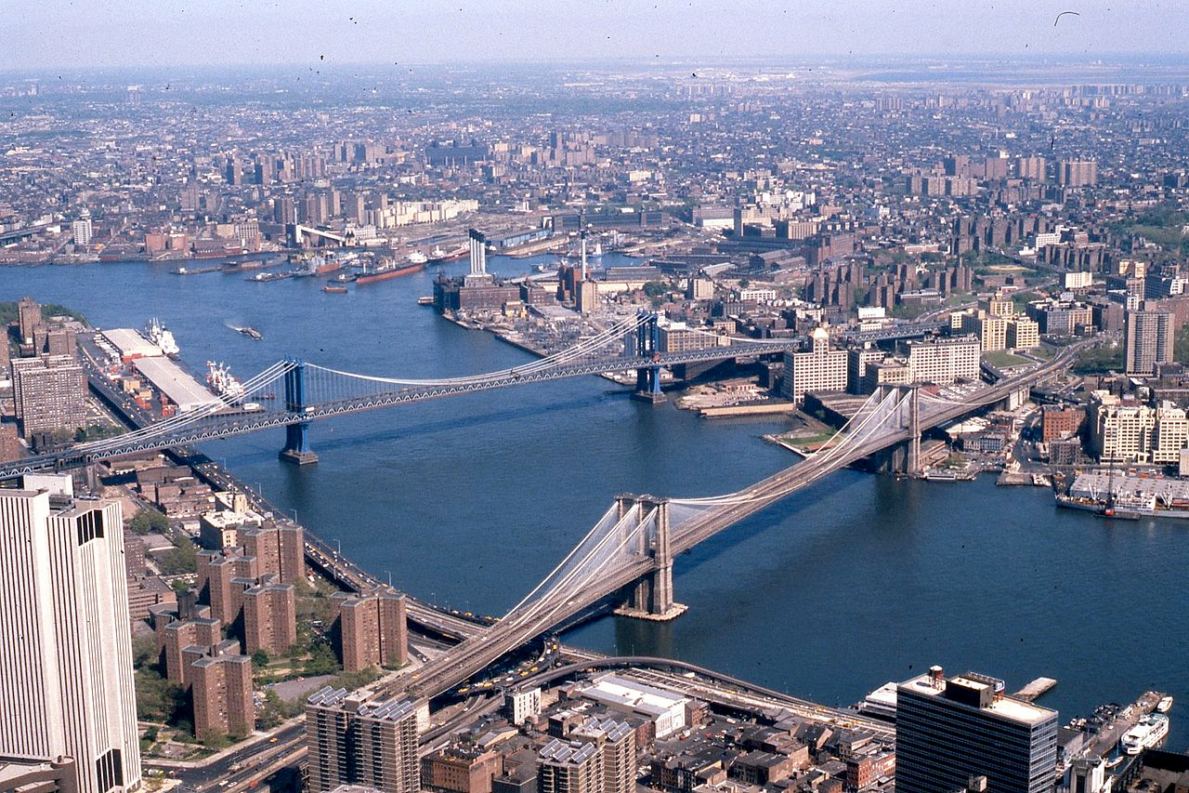
All my research has validated my hypothesis that most coastal areas that pertain to New York City will be flooded in the timespan of the coming century.
Water located around New York City: Hudson River, East River, Atlantic Ocean
8.4 million people reside in New York City and about 4 million live near the waterfronts of New York City.
Do you know if you live in a potential flooding area in New York City?

Slide 3
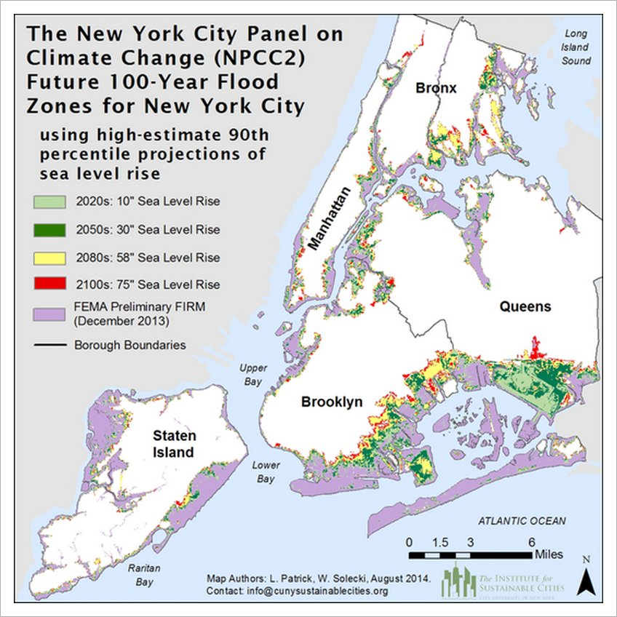
New York City Should See Up To Six Feet of Sea Level Rise This Century
Source: Huffington Post
The chart gives a visualization on how much land of New York City will be flooded after one century. Some of the neighborhoods which will be submerged are:
Bronx: Port Morris, Hunts Point, Soundview, Throgs Neck, Middletown- Pelham Bay
Manhattan: East Harlem, Battery Park City, the Lower East Side
Brooklyn: Waterfront in Dumbo, Greenpoint, Sheepshead Bay, Coney Island
Queens: Long Island City, Astoria, East Elmhurst, College Point, Flushing, and Rockaway
Staten Island: Old Place, Arrochar, Dongan Hills, Midland Beach, New Drop, Bay Terrace

Slide 4
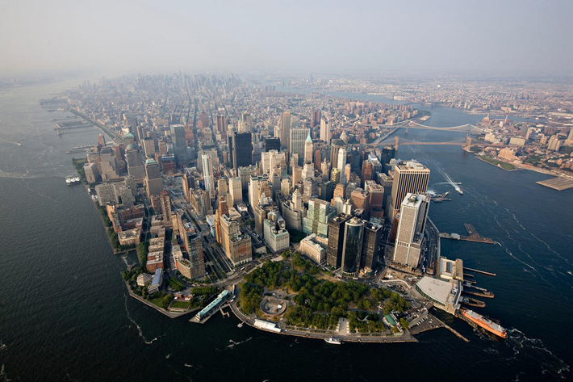
Department of Environmental Conservation
The source provides facts about the expected state of New York City, in terms of rapid sea level rise associated with the years to come, including risks and planning for the resilience to minimize damage. The Responding to Climate Change in New York State (ClimAID), the Community Risk and Resiliency Act (CRRA), and the Sea Level Rise Task Force, are all listed as information sources, and methods of prevention, for the rise of sea levels in New York City. Sea level rise is a significant risk to the inhabitants, economy, and resources of New York City.

Slide 5
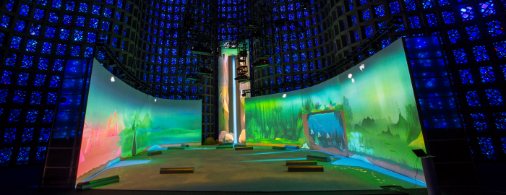
New York Hall of Science
The Connected Worlds Exhibit allows one to interact with six environments- jungle, desert, wetlands, river valley, reservoir, and grasslands and their actions, gestures, movements, and decisions affects the environment. The environments are all connected by one water supply and people can use logs to navigate water flow for each environment.
http://nysci.org/connected-worlds/

Slide 6
Dangers of Rising Sea Levels
Increased intensity and recurrence of severe flooding and storm surge damage to communities, buildings, ecosystems that helps against floods which protects drinking water and provide habitats
Erosion of beaches will increase
Saltwater will enter surface waters and aquifers
Damage to sewages, wastewater, transportation, communication, and energy building and systems
Considering the threat and significance of this reality, precautions must take place on behalf of the city in order to allow for a better future and provide living space. Although currently there is no solution yet, there are statistical data providing projected flood zones available for the public to acknowledge about areas they reside in.

Slide 7
Bibliography
Department of Environment Conservation. (n.d). Retrieved November 10, 2016, from http://www.dec.ny.gov/energy/45202.html
East River. (n.d) Retrieved November 01, 2016, from https://en.wikipedia.org/wiki/East_River
Exhibits. (n.d.). Retrieved November 20, 2016, from http://nysci.org/connected-worlds/
Gerken, J. (2015, February 17). New York City Could See Up To Six Feet Of Sea Level Rise This Century: Report. Retrieved November 01, 2016, from http://www.huffingtonpost.com/2015/02/17/new-york-city-sea-level-rise_n_6700320.html
Rice,A. (2016, September 07). When will New York City Sink? Retrieved November 01, 2016, from http://nymag.com/daily/intelligencer/2016/09/new-york-future-flooding-climate-change.html
Understanding Connected Worlds through Water. (n.d). Retrieved November 20, 2016, from http://www.nyc.gov/html/dep/html/environment_education/connected_worlds.shtml

