Slide 1
What can be a model for sustainable economic growth in emerging economies?
How can the growing urbanization of emerging economies be sustainable?
How can planning ensure that the rapid industrialization of these emerging economies be sustainable?

Slide 2
The International Council for Local Environmental Initiatives (ICLEI) outlined a series of recommendations at a recent United Nations conference on Sustainable Development
The council is a widely recognized network of local governments from across the globe.
Their goal is to promote sustainable growth and practices that emerge from the local governmental level.
One of the council’s goals is to work with local governments to attain goals.
Source: International Council for Local Environmental Initiatives, http://www.iclei-europe.org/topics/urban-governance/

Slide 3
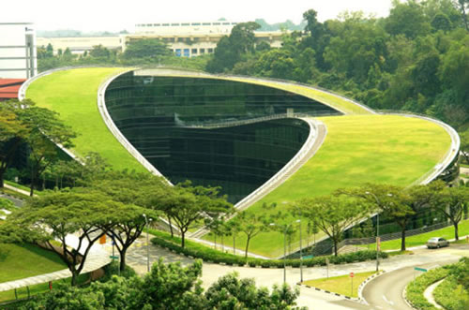
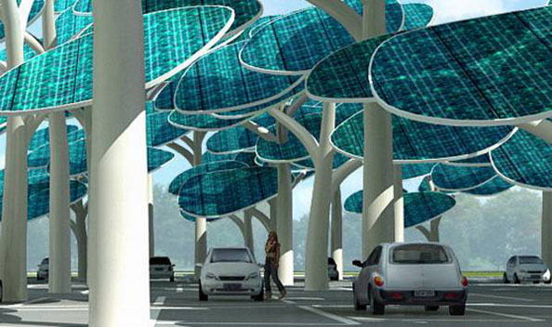
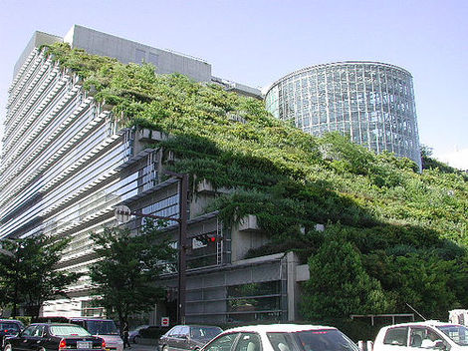
2. The significance of the Green Urban Economy for sustainable development and poverty reduction
The organization focuses on assisting emerging market cities with the goal of promoting renewable resources, sustainable growth and reduction in poverty rates.
Source: International Council for Local Environmental Initiatives, http://www.iclei-europe.org/topics/urban-governance/

Slide 4
The ICLEI identifies the geographic area globally that cities occupy, their share of global population and of energy consumption.
Based upon a 2012 analysis, they found the following:

Slide 5

Cities on the globe Account for-
0.12% of the Earth’s surface
50% of global population
75% of energy consumption
and CO2 emissions
Hubs of the global economy:
100 largest cities produce 30% of the global GDP
Close to 80% of GDP produced in cities
Source: International Council for Local Environmental Initiatives, http://www.iclei-europe.org/topics/urban-governance/

Slide 6
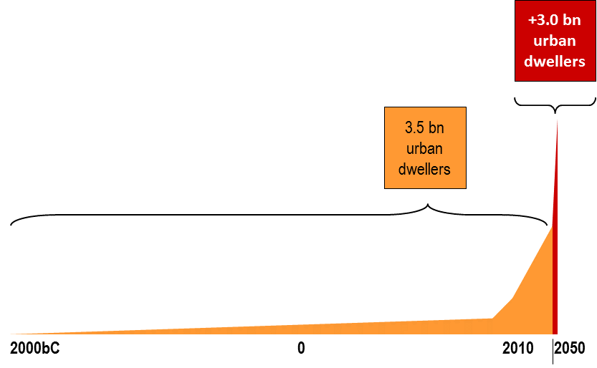
It is estimated that - given the current rate of industrial and population growth – that …
„By 2050, within 40 years, "we will have to build once more the same urban capacity as we have built over the last 4000 years.“
Through 2010, approximately 3.5 billion of the global population lived in cities;
By 2050, that number will have grown by another 3 billion.
Source: International Council for Local Environmental Initiatives, http://www.iclei-europe.org/topics/urban-governance/

Slide 7
The organization has outlined several steps to assist and advise local governments in moving toward a sustainable growth and development model
The role of local governments in the green economy(1) has included the following:
Local governments as actors
Steering municipal investments and purchasing power to influence the market.
Setting framework conditions for investments
Incentives and finance
Informing private behaviour
Driving local innovation
Scaling Up
Source: International Council for Local Environmental Initiatives, http://www.iclei-europe.org/topics/urban-governance/

Slide 8
A recent study conducted by the Center for Integrative Environmental Research finds that economic costs will be far-reaching and affect all geographic areas of the nation if nothing is done.
The CIER research finds that the impact of climate change events will affect both the natural environment and existing infrastructure
Their report reviews several economic studies…
And relates these to several predicted climate change impacts.
Source: Matthias Ruth, Dana Coelho, and Daria Karetnikov. A Review and Assessment by the Center for Integrative Environmental Research (CIER) at the University of Maryland, October 2007. Center for Integrative Environmental Research, University of Maryland.

Slide 9
Economic Sectors/Industries most directly affected
1. Agriculture
In some parts of the nation, growing conditions will improve as temperatures continue to rise (colder regions become warmer)
Other parts of the nation are projected to see worsening conditions as water resources dwindle, rainfall becomes more frequent (or infrequent), and land becomes unsuitable for farming.
Changes in climate are also associated with an increase in the spread of pests and plant diseases that previously would not have had an impact (CIER)

Slide 10
Other sectors of the economy affected?
2. Recreation – ski resorts: “Mountain snow packs are shrinking. In recent decades, rising winter temperatures have increasingly changed snows to rain.” Tourism dollars shrink
3. Population: Many densely populated cities & towns south of glaciers; including a very large number of businesses.
4. Wildlife/ecosystems: as habitats disappear, species die out or are threatened.

Slide 11
Impacts
  Effects experienced across all regions, but the severity will be “unevenly distributed across regions and within the economy and society.¹”
  It is estimated that for sectors of the economy that provide essential goods and services, the negative effects will be significantly greater than the positive.
  The impact of climate change will severely strain government budgets – local, state and federal.
  Secondary effects: higher prices, reduced income and job losses²
¹Matthias Ruth, Dana Coelho, and Daria Karetnikov. A Review and Assessment by the Center for Integrative Environmental Research (CIER) at the University of Maryland, October 2007. Center for Integrative Environmental Research, University of Maryland
² Ibid.

Slide 12
What are the main highlights/accomplishments of the Paris agreement, which was reached in December 2015 and took effect in November 2016?
Governments agreed:
A long-term goal of keeping the increase in global average temperature to well below 2°C above pre-industrial levels;
To aim to limit the increase to 1.5°C, since this would significantly reduce risks and the impacts of climate change;
On the need for global emissions to peak as soon as possible, recognizing that this will take longer for developing countries;
To undertake rapid reductions thereafter in accordance with the best available science. (The Paris Agreement on Climate Change – A Summary, April 4, 2016; retrieved from https://assemblyinbrief.wordpress.com/2016/04/04/the-paris-agreement-on-climate-change-a-summary/

Slide 13
What have some countries already done?
Costa Rica – has become nearly 100% free of fossil fuels
https://www.youtube.com/watch?v=8MhqAR8LlW8
2. Nine palm oil producing nations have formally agreed to produce this crop more sustainably, conserving rather than destroying natural habitats.
https://www.youtube.com/watch?v=rJUqlS9RR1k
3. South Korea – vertical farming using renewable energy
https://www.youtube.com/watch?v=y09vuzwg6Lk

Slide 14
What is the meaning of climate justice? What components of change should be included in meaningful change according to the agreement?
Think about the countries that you did footprints for in addition to the U.S. or choose one of these features and think about how it can be achieved in the U.S.
1.Equity – recognition of each of the countries’ contribution and actions
2. Public (government) finance/investment for reduction of carbon emissions to achieve the IPCC goals
3. Action to halt deforestation and to promote sustainable land use
4. Economic investment
5. Protecting ecosystems and biodiversity
6. Promoting food security
7. Addressing income inequality and poverty
8. Renewable energy and water conservation
9. Promoting health (clean air, water, land); sanitation; housing
10. Education
11. Addressing the problems that have increased the number of climate refugees

Slide 15
Think about the countries that you did footprints for in addition to the U.S. or choose one of these features and think about how it can be achieved in the U.S.
Assignment for Wed. Nov. 30
Choosing one of the climate change challenges, think about some concrete steps that (choose) country could take toward addressing that goal as part of the effort to comply with the IPCC agreement.
What steps should be taken?
What are the challenges and limitations facing efforts to change business as usual?
Who (stakeholders) should be involved in planning and decision making?
What would be a reasonable timeline?

Slide 16
Group Project: (more extra credit points)
Addressing one of the agreed upon goals of the recent climate agreement reached by 195 countries in December 2015, think about some concrete steps that one country could take toward addressing one of the goals identified here as step toward complying with the IPCC agreement
1.Equity – recognition of each of the countries’ contribution and actions
2. Public (government) finance/investment for reduction of carbon emissions to achieve the IPCC goals
3. Action to halt deforestation and to promote sustainable land use
4. Economic investment
5. Protecting ecosystems and biodiversity
6. Promoting food security
7. Addressing income inequality and poverty
8. Renewable energy and water conservation
9. Promoting health (clean air, water, land); sanitation; housing
10. Education
11. Addressing the problems that have increased the number of climate refugees

Slide 17
Last slide

Slide 18
Since most of the problem of resource overuse, pollution and demand for energy and resources is centered in cities, cities are also the most capable of creating solutions as well.
Where are there examples that can serve as models of local governments taking the initiative?
The City of Portland, Oregon began an initiative to encourage broader use of renewable energy sources and expand recycling activities
Established partnerships between businesses, residents and non-profit organizations.
Their goals: Energy Conservation, Greenhouse Gas Reduction, Green Building, Solid Waste & Recycling
Source: Bruce Walker City of Portland, Office of Sustainable Development, October 20, 2005

Slide 19
The City of Portland, Oregon is one recent example:
What initiatives have they taken toward more sustainable growth?
How has that success been measured?
Are there clear benefits from the actions that the city has taken?
  Boulder, Colorado
  Portland Oregon

Slide 20

I. Boulder’s Climate Action Plan:
How we got here
2006:
Climate Action Plan Committee shepherds CAP toward completion; adopted by city council in June 2006
Council determines carbon tax is best revenue source for implementation, places tax on November ballot
Measure passes, 60.5% in favor, 39.5% opposed
Steering municipal investments and purchasing power to influence the market.
Notes:
First carbon tax enacted in nation
Between 2002 and 2006, we saw development of CAP, programs were started that produced results and got us heading in the right direction; community support being nurtured for programs and, ultimately, a funding stream

Slide 21
Boulder’s Carbon Tax:
Specifics
Tax on electricity consumption
15%
Notes:
There has been tremendous interest in the carbon tax since its placement in the ballot and approval
Though emissions are indirect, strongest nexus to Boulder’s carbon footprint
2005 data

Slide 22
2005 Emissions by Sector
Notes:
Three primary sectors we will be focusing on this afternoon:
Residential – 17%
Commercial – 38%
Industrial – 9%

Slide 23
Boulder’s Carbon Tax:
Specifics
Maximize voluntary emissions reductions through:
  Education, outreach and marketing
  Reducing barriers to energy efficiency and renewable energy
  Connecting residents and businesses with available rebates and tax credits
Notes:
The implementation plan outlines what programs and actions would be implemented in 2007 and beyond.
The estimates are based on reasonable, achievable, and slightly conservative participation rates. It is important to note that staff based the analysis on what we think we can achieve in the various sectors through behavior shift and implementation of projects with reasonable paybacks, where reasonable is generally under three to four years. Staff will return to Council every year with any necessary adjustments to the budget or estimated results. Staff will also continue to prepare annual progress reports that track program results and annual emissions.
Sample services include subsidized energy audits,
neighborhood sweeps and light bulb giveaways.
It is recommended that the residential
program in particular include grassroots elements, where actions are promoted and implemented
on a neighborhood or block-by-block level.

Slide 24
Climate Action Plan
Strategies
Driving local innovation
Increase energy efficiency
Switch to renewable energy and vehicle fuels
Reduce vehicle miles traveled
Goal: Maximize voluntary emissions reductions through:
  Education, outreach and marketing
  Connecting residents and businesses with available rebates and tax credits
  Providing services not offered in the Boulder market

Slide 25
Boulder’s Carbon Tax:
Specifics
Applies to all electricity customers in the city
No tax charged for green power customers
Rates set in direct proportion to expected program sector expenditures
Rates can be re-set depending on program needs
Rates can be increased by 20%
Sunsets in 2012
Will raise approximately $1 million per year
Resulted in significant reductions across all sectors of the local economy by 2012.
Notes:
Residential, commercial, industrial sectors
% of tax based on % Windsource
Rates set in concert with expected program expenditures: 60/37/3
Explain current approach of Xcel DSM program spending
No need to go back to the voters – flexibility in rates
Kyoto target not ultimate goal – sunset puts the city’s feet to the fire to produce
For implementation of Climate Action Plan

Slide 26
GHG Emissions Reductions per sector by 2012 (mtCO₂e)
Sector | Energy Efficiency | Renewable Energy | Total
Residential | 30,228 | 16,914 | 47,142
Commercial | 30,852 | 32,088 | 62,940
Industrial | 10,896 | 21,000 | 31,896
City Operations | 4,248 | 4,002 | 8,250

Slide 27
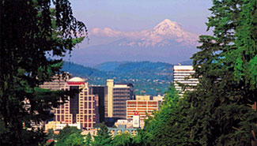
Portland Profile
II. Portland, Oregon
545,000 population
135,000 households
2,500 multifamily complexes
20,000 businesses
Source: Bruce Walker City of Portland Office of Sustainable Development
Solid Waste & Recycling Program, 721 NW 9th Avenue, Room 350
Portland, OR 97209 bwalker@ci.portland.or.us
http://www.sustainableportland.org

Slide 28
Portland’s Programs
Leadership: Establish Policies and Goals
Partnership: Businesses, Residents and Non-Profit Organizations
Action: Energy Conservation, Greenhouse Gas Reduction, Green Building, Solid Waste & Recycling
Source: Bruce Walker City of Portland Office of Sustainable Development
Solid Waste & Recycling Program, 721 NW 9th Avenue, Room 350 Portland, OR 97209 bwalker@ci.portland.or.us http://www.sustainableportland.org

Slide 29
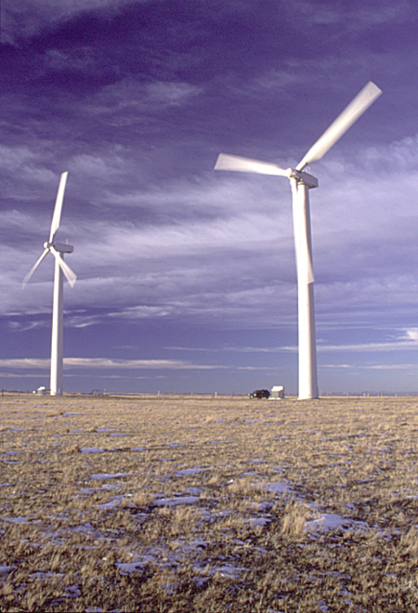
Energy Conservation
City energy conservation measures save $2.3 million annually–22% of total energy costs
Goal: 100% renewable power for city facilities
Source: Bruce Walker City of Portland Office of Sustainable Development
Solid Waste & Recycling Program, 721 NW 9th Avenue, Room 350 Portland, OR 97209 bwalker@ci.portland.or.us http://www.sustainableportland.org
PacifiCorp

Slide 30
State Financial Incentives for Energy Efficiency and Renewable Resources
Setting framework conditions for investments
Incentives and finance
Residential Energy Tax Credit - 25%
Business Energy Tax Credit - 35%
$60+ million annually available for energy efficiency and renewable resource investments
Source: Bruce Walker City of Portland Office of Sustainable Development
Solid Waste & Recycling Program, 721 NW 9th Avenue, Room 350 Portland, OR 97209 bwalker@ci.portland.or.us http://www.sustainableportland.org

Slide 31
What were the city’s measurable results:
Reductions in Greenhouse Gases
Since 1990, Portland has achieved:
A 12.5 percent per capita reduction in carbon dioxide emissions.
A 9 % per capita reduction in gasoline use
A 10 % reduction in household electricity use
Residential recycling has tripled
Source: Bruce Walker City of Portland Office of Sustainable Development
Solid Waste & Recycling Program, 721 NW 9th Avenue, Room 350 Portland, OR 97209 bwalker@ci.portland.or.us http://www.sustainableportland.org
Notes:
All together, these actions have helped Portland reduce per capita CO2 emissions 3% since 1990
. .. An accomplishment almost no other U.S. city can claim
and during a period of rapid economic growth: between 1992 and 1999, Portland-area GDP grew 66%

Slide 32
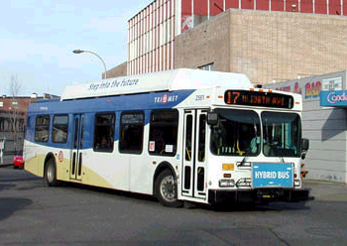
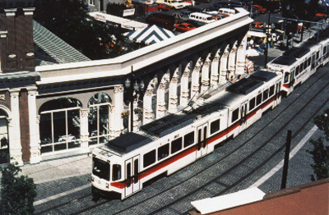
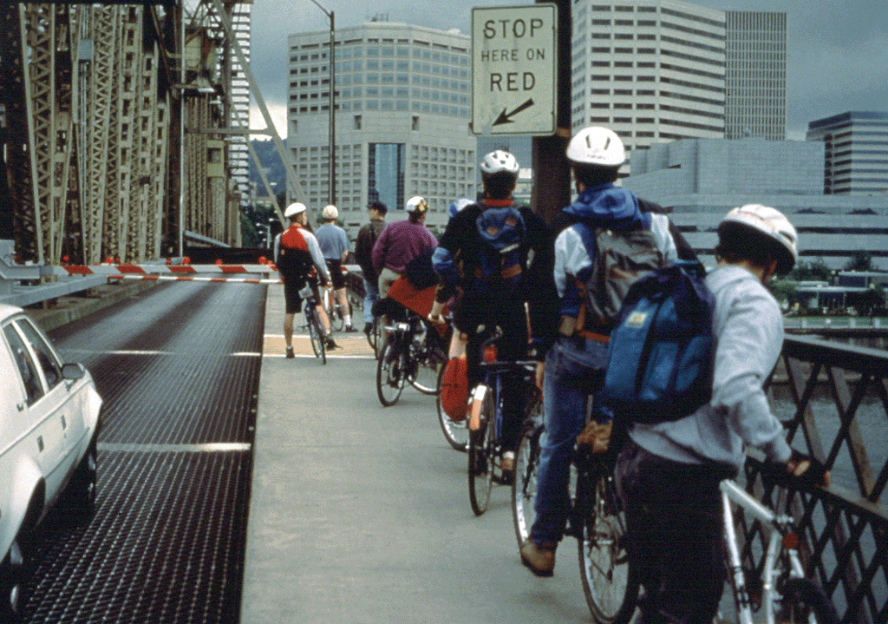
Transportation
Transit ridership has increased 75% since 1990.
Bicycle commuting has tripled.
Tri-Met
Source: Bruce Walker City of Portland Office of Sustainable Development
Solid Waste & Recycling Program, 721 NW 9th Avenue, Room 350 Portland, OR 97209 bwalker@ci.portland.or.us http://www.sustainableportland.org
Notes:
Two big areas of focus:
1. Land use and the shape and density of development
- keep City compact
- mix job with housing
- encourage development near transit arterials
2. Transit
- expanded light-rail system
Also promoting other alternatives to private vehicle travel. . .

Slide 33
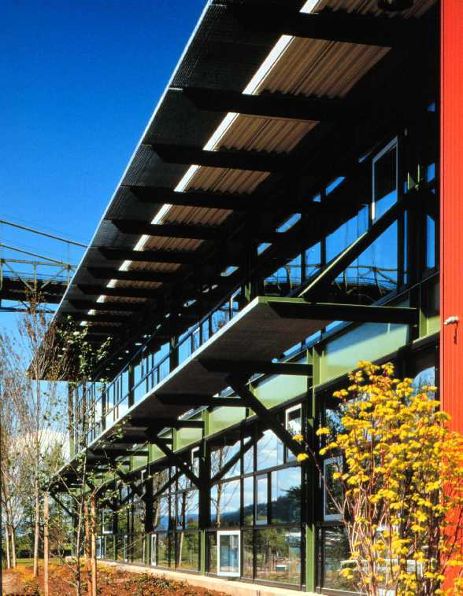
Green Building
More LEED Buildings than any U.S. city
Key barrier was lack of good information, so program focuses on:
  Technical assistance
  Training
  Resources
Source: Bruce Walker City of Portland Office of Sustainable Development
Solid Waste & Recycling Program, 721 NW 9th Avenue, Room 350 Portland, OR 97209 bwalker@ci.portland.or.us http://www.sustainableportland.org

Slide 34
Recycling Goals
In 1998, City Council set a goal of 60% of solid waste being recycled by 2005
Since 1998, the rate has been between 53% & 55%
Source: Bruce Walker City of Portland Office of Sustainable Development
Solid Waste & Recycling Program, 721 NW 9th Avenue, Room 350 Portland, OR 97209 bwalker@ci.portland.or.us http://www.sustainableportland.org

Slide 35
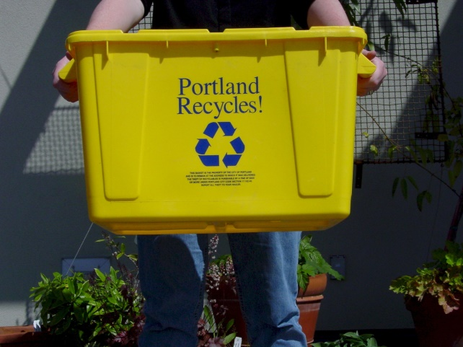
Residential Recycling
30 franchised haulers
Weekly, curbside collection
  Glass separate
  Paper, aluminum, plastic, cardboard, motor oil
Yard Debris bi-weekly
Source: Bruce Walker City of Portland Office of Sustainable Development
Solid Waste & Recycling Program, 721 NW 9th Avenue, Room 350 Portland, OR 97209 bwalker@ci.portland.or.us http://www.sustainableportland.org

Slide 36
Partnerships with Private Sector
Businesses
  provide assistance to increase recycling
Haulers
  assure service delivered to customers
MRFs
  independent monitoring of residuals
Source: Bruce Walker City of Portland Office of Sustainable Development
Solid Waste & Recycling Program, 721 NW 9th Avenue, Room 350 Portland, OR 97209 bwalker@ci.portland.or.us http://www.sustainableportland.org

Slide 37
Group Assignment: (more extra credit points)
The examples we have looked at are two in developed market economics:
Outline the components of a plan that could successfully address these same issues in an urban area in an emerging market (newly industrializing) economy in another country.
Using the five-point plan described on page 3 of the article, choose a city in an emerging economy and explain how the five-pat index of 18 indicators identified as necessary for sustainable development could be developed or improved through business-government-community partnerships (that is - all of these groups working together).
Describe how you see this being accomplished.

Slide 38
Economic Impacts of Climate Change in the U.S.
A recent study conducted by the Center for Integrative Environmental Research finds that economic costs will be far-reaching and affect all geographic areas of the nation if nothing is done.
The CIER research finds that the impact of climate change events will affect both the natural environment and existing infrastructure
Their report reviews several economic studies…
And relates these to several predicted climate change impacts.
Source: Matthias Ruth, Dana Coelho, and Daria Karetnikov. A Review and Assessment by the Center for Integrative Environmental Research (CIER) at the University of Maryland, October 2007. Center for Integrative Environmental Research, University of Maryland.

Slide 39
Economic Sectors/Industries most directly affected
1. Agriculture
In some parts of the nation, growing conditions will improve as temperatures continue to rise (colder regions become warmer)
Other parts of the nation are projected to see worsening conditions as water resources dwindle, rainfall becomes more frequent (or infrequent), and land becomes unsuitable for farming.
Changes in climate are also associated with an increase in the spread of pests and plant diseases that previously would not have had an impact (CIER)

Slide 40
Impacts in the U.S.
  Effects experienced across all regions, but the severity will be “unevenly distributed across regions and within the economy and society.¹”
  It is estimated that for sectors of the economy that provide essential goods and services, the negative effects will be significantly greater than the positive.
  The impact of climate change will severely strain government budgets – local, state and federal.
  Secondary effects: higher prices, reduced income and job losses²
¹Matthias Ruth, Dana Coelho, and Daria Karetnikov. A Review and Assessment by the Center for Integrative Environmental Research (CIER) at the University of Maryland, October 2007. Center for Integrative Environmental Research, University of Maryland
² Ibid.

