Slide 1
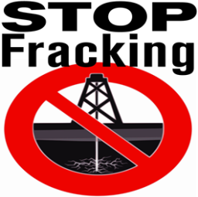
Should the Process of Fracking Be Banned?
Environmental Economics 2505
By Evan Mirzakandov Professor MacDonald

Slide 2
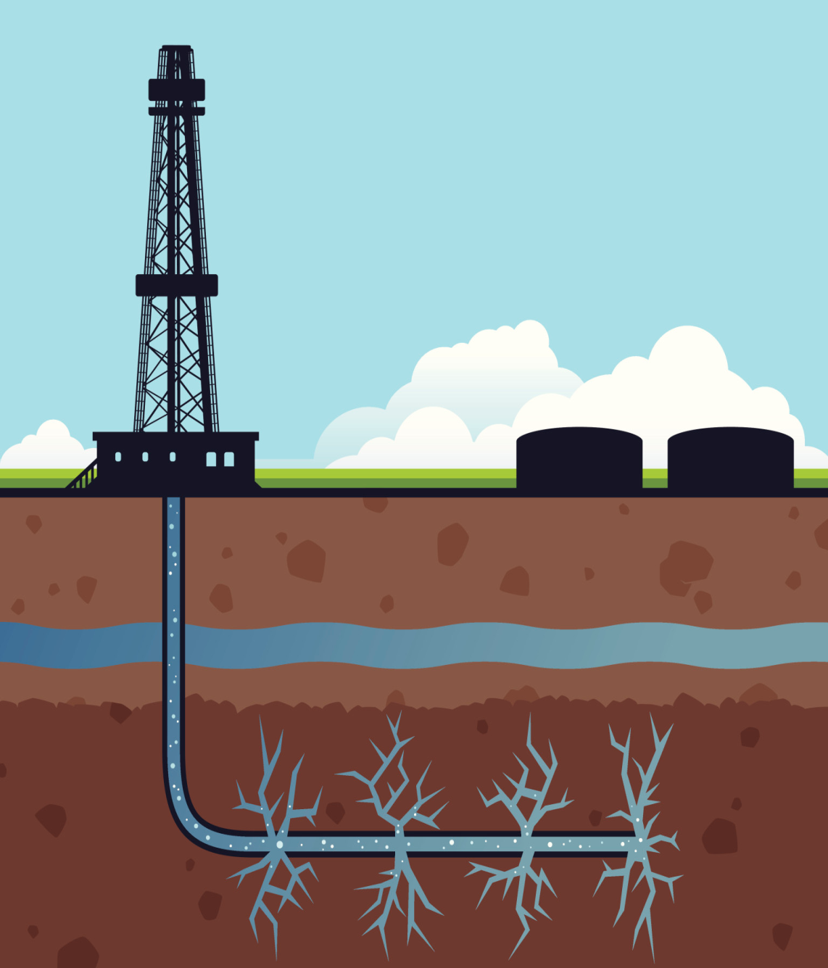
What is fracking?
Fracking is when there is a drilling that is taking place into the earth.
A high-pressure water mixture is impacted on a rock, which then releases off gas.

Slide 3
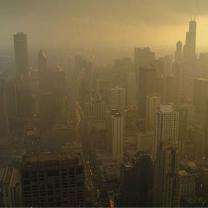
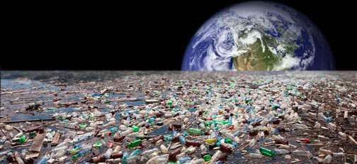
What are the effects of fracking?
Releases chemicals into the air
Pollutes water
Ruins the environment
Interferes with health

Slide 4
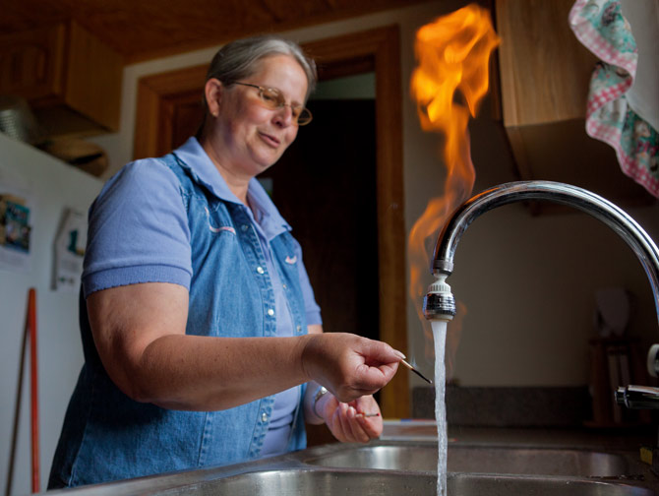
Fracking in Pennsylvania
Many residents in Pennsylvania were affected from fracking
Their water was polluted with oil
Once a lighter was put near the water , it caught on fire

Slide 5
What chemical comes from fracking that is harmful to the society?

Slide 6
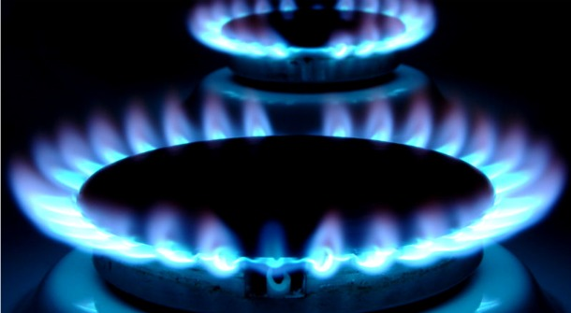
Methane
This chemical is the worst green house gas and can sicken anyone once in goes up into our atmosphere.

Slide 7
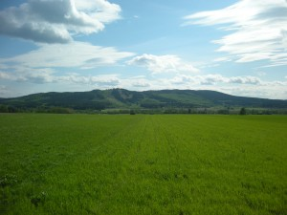
Fracking is very dangerous because it threatens our…
Water
Land
Air
Health

Slide 8
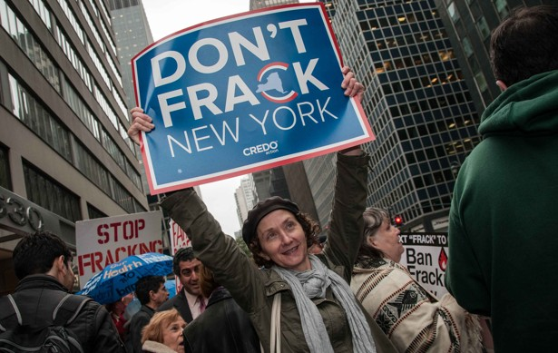
Fracking strikes
Many are going against fracking in New York
Governor Andrew Cuomo tried to ban it where he succeeded

Slide 9
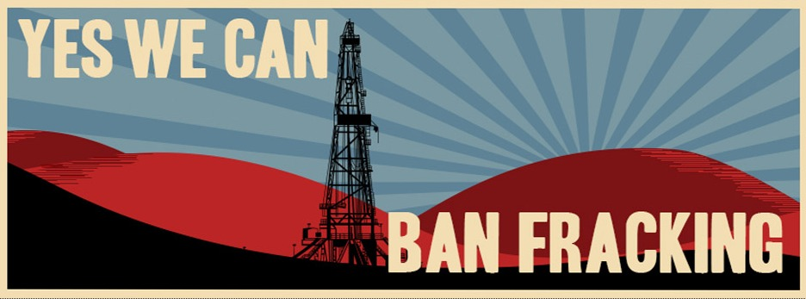
Where is fracking banned?
Arkansas
California
Colorado
Louisiana
Maryland
Michigan
New Jersey
New York
North Carolina
North Dakota
Oklahoma
Pennsylvania
Texas
West Virgina
Wyoming

Slide 10
If fracking is not allowed in most places so why not just ban it everywhere?

Slide 11
Fracking is serious issue to our environment where it should be banned

