Slide 1
Economic and Environmental Impact of Wind Turbine Energy
Xavier, Daoud, Yegor, Tassiann

Slide 2
WIND POWER VS. Other forms of renewable energy

Slide 3
Vs. Solar Energy
Can produce efficient electricity anytime
All countries have naturally windy areas
Solar power costs nearly twice more KWh than wind power
Requires less space than solar farm

Slide 4
Solar Farm ( CA)

Slide 5
Vs. Geothermal
Only effective near tectonic plates
Wind Turbines can be placed any where
Wind turbines produce 0 greenhouse gas emissions

Slide 6
Geothermal Plant

Slide 7
Vs. Biomass
Requires burning of crops
Produce CO and C02
Inefficient

Slide 8
Wind Turbine
How Does it Work?

Slide 9
History of Wind Energy

Slide 10
History of Wind Energy
Since early recorded history, people have utilized wind energy. It propelled boats along the Nile River as early as 5,000 B.C., and helped Persians pump water and grind grain between 500 and 900 B.C. As cultures harnessed the power that wind offered, the use of windmills spread from Persia to the surrounding areas in the Middle East, where windmills were used extensively in food production.

Slide 11
How the wind turbine works
How Do Wind Turbines Work? Wind turbines operate on a simple principle. The energy in the wind turns two or three propeller-like blades around a rotor. The rotor is connected to the main shaft, which spins a generator to create electricity.

Slide 12
How Wind Turbine Works cont.

Slide 13
How Wind Turbine Works cont.
A shaft and gearbox connect the rotor to a generator (1), so when the rotor spins, so does the generator. The generator uses an electromagnetic field to convert this mechanical energy into electrical energy.
The electrical energy from the generator is transmitted along cables to a substation (2). Here, the electrical energy generated by all the turbines in the wind farm is combined and converted to a high voltage. The national grid uses high voltages to transmit electricity efficiently through the power lines (3) to the homes and businesses that need it (4). Here, other transformers reduce the voltage back down to a usable level.

Slide 14
WIND TURBINE OPPORTUNITY COST AND LANDSCAPES
WIND TURBINE GROWTH GLOBALLY AND IN THE US
RESIDENTIAL AND COMMERCIAL OWNERSHIP OF WIND TURBINES
DIFFERENT WIND TURBINE TECHNOLOGIES
OPPORTUNITY COSTS
LANDSCAPE REQUIREMENTS

Slide 15
RESIDENTIAL AND COMMERCIAL OWNERSHIP
TAX INCENTIVES
FEDERAL AND STATE GRANTS
PROPERTY INVESTMENT
HIGHER APPRAISAL VALUE

Slide 16
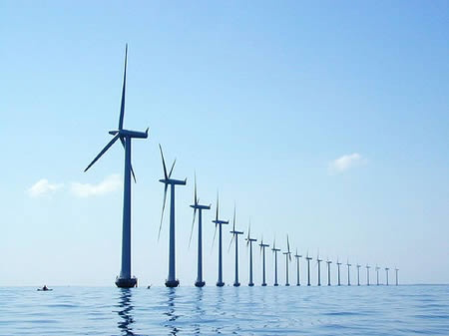
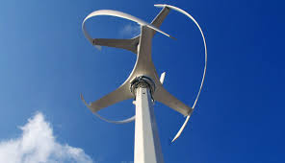
WIND TURBINE TECHNOLOGIES
HORIZONTAL AXIS WIND TURBINE
ADVANTAGES
DISADVANTAGES
VERTICAL AXIS WIND TURBINE
ADVANTAGES
DISADVANTAGES

Slide 17
OPPORTUNITY COST
WEST POINT ACADEMY (HUDSON VALLEY NY)
PRINCIPIA COLLEGE (ILLINOIS)
SIMS MUNICAP RECYLING CENTER (SUNSET PARK, BROOKLYN, NY)

Slide 18
LANDSCAPES
WIND SPEED
MOUNTAINS
BODIES OF WATER
FARMS
PARKS

Slide 19
PSYCHOLOGICAL ASPECTS OF WIND TURBINES

Slide 20
Aesthetics: is the area of philosophy that concerns our appreciation of things as they affect our senses in a pleasing way.

Slide 21
NOISE
Noise was an issue with early wind turbine designs, it has been eliminated as a problem through...
Improved engineering
Adjustment of the thickness of the blades trailing edges
By orienting blades upwind of the turbine towers
A small amount of noise is still generated but that’s by the mechanical components of the turbine. To put into perspective, a wind turbine 250 meters from a residence is no noisier than a kitchen refrigerator.
Wind farm noise will be masked by ambient noise, such as traffic, and wind rustling leaves or grass, therefore, “noise” should no longer be a significant impediment to gain public support for wind farms.

Slide 22
VISUAL
The larger aesthetic issue surrounding wind farms however concerns the visual perception of wind turbines and their impact on landscape.
From an aesthetic perspective, which would you prefer?…

Slide 23
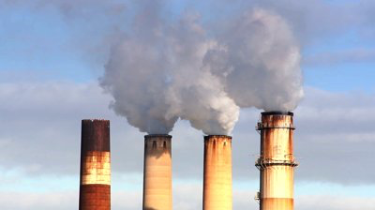
The Smoke Stacks of Coal Burners?

Slide 24
Or a more aesthetically pleasing wind turbine?

Slide 25
In order to use fewer turbines, the developer would have to use taller ones
The rotor on taller turbines moves more slowly than smaller ones, also, the slow rotational speed is less likely to cause aerodynamic noise.

Slide 26
WIND POWER IS THE FUTURE!!!!!!

