Slide 1
“Clean” and Efficient Public Transportation
Kapil Kanhai
Yik Ho

Slide 2
Overview
Public transportation is efficient, and saves money
Public transportation is great for environment and reduces our carbon footprint.
Public transportation drives the economy
Public transportation is always evolving and improving

Slide 3
Public Transportation; What is it?
Buses
Subways
Trains
Streetcars
Etc
That charge a set fare, run on fixed routes, and are open for use to the general public.

Slide 4
Efficient
Public transportation immensely reduces congestion.
A 2011 study has also shown that public transportation has saved 541 million hours in commute times.
Public transportation takes groups of people would otherwise be traveling separately, and puts them into a more efficiently used space.
Most cars carry a single person
That person consumes space, and fuel
A bus can carry many times for people that a car can, and use much less fuel PER PASSENGER

Slide 5
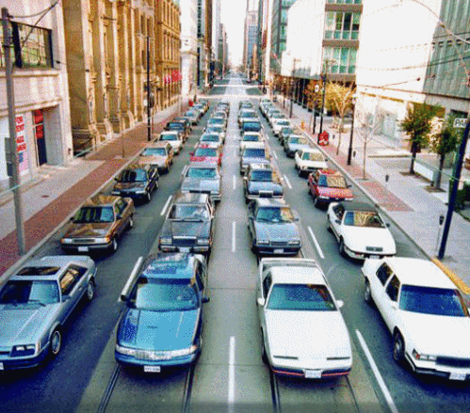
Group of 80 commuters

Slide 6
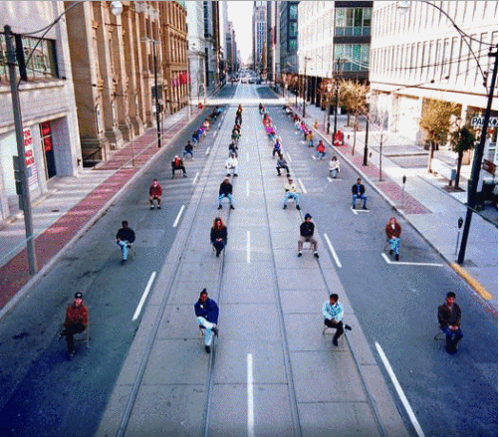
Remove them from their vehicles

Slide 7
Remove wasted space

Slide 8
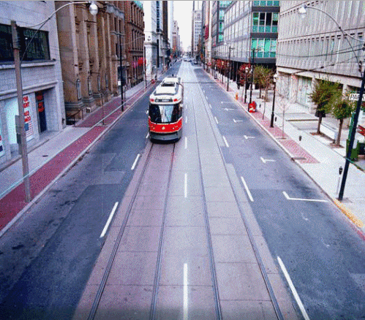
Enclose them in public transportation!

Slide 9
Efficiency Continued
Public transportation saves money!
According to the American Public Transportation Association(APTA):
Public transportation reduces annually gasoline usage by 4.2 BILLION gallons
Approximately 11 million gallons a day.
Public transportation using households save about $8000 annually.
Not this this amount will increase as gas prices increase.
Don’t drive? Don’t need to buy gas!
Don’t drive? Don’t need to pay insurance!
Don’t drive? Don’t need to pay yearly safety inspection fees!
Don’t drive? Don’t need to maintain car!
A 2011 study has also shown that public transportation has saved saved 865 million hours in travel time

Slide 10
Efficiency Continued
Public transportation helps with your health!
Don’t drive? Then you walk to and from bus/train stations!
Studies show that public transit riders lose 6.5lbs per year when compared to drivers!

Slide 11
Positively Affects Environment
Public transportation does a great job of reducing our carbon footprint.
Each year, Public transportation reduces our nation’s carbon emissions by 37 million metric tons.
A single person that switches to public transportation
Reduces their households carbon emissions by 10%.
Reduces their annual emissions by 4800 pounds.
Air quality improves when more people use public transportation.
This can affect our health

Slide 12
Positively Affects Environment
Vehicles used in public transportation are always improving to better the environment.
Many vehicles are Hybrids, running on electric power.
Transit systems are also constantly reducing the amount of their power that comes from burning of fossil fuels.
Always improving ; From 2000 to 2009, there was a 200% increase in the amount of buses in America that ran on alternative fuels.

Slide 13
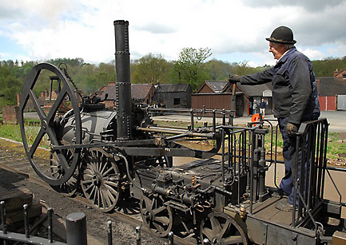
Public Transportation is always Evolving: Then
The first trains ran on steam engines, by burning coal.
The first steam locomotive was made by Richard Trevithick, in 1802.

Slide 14
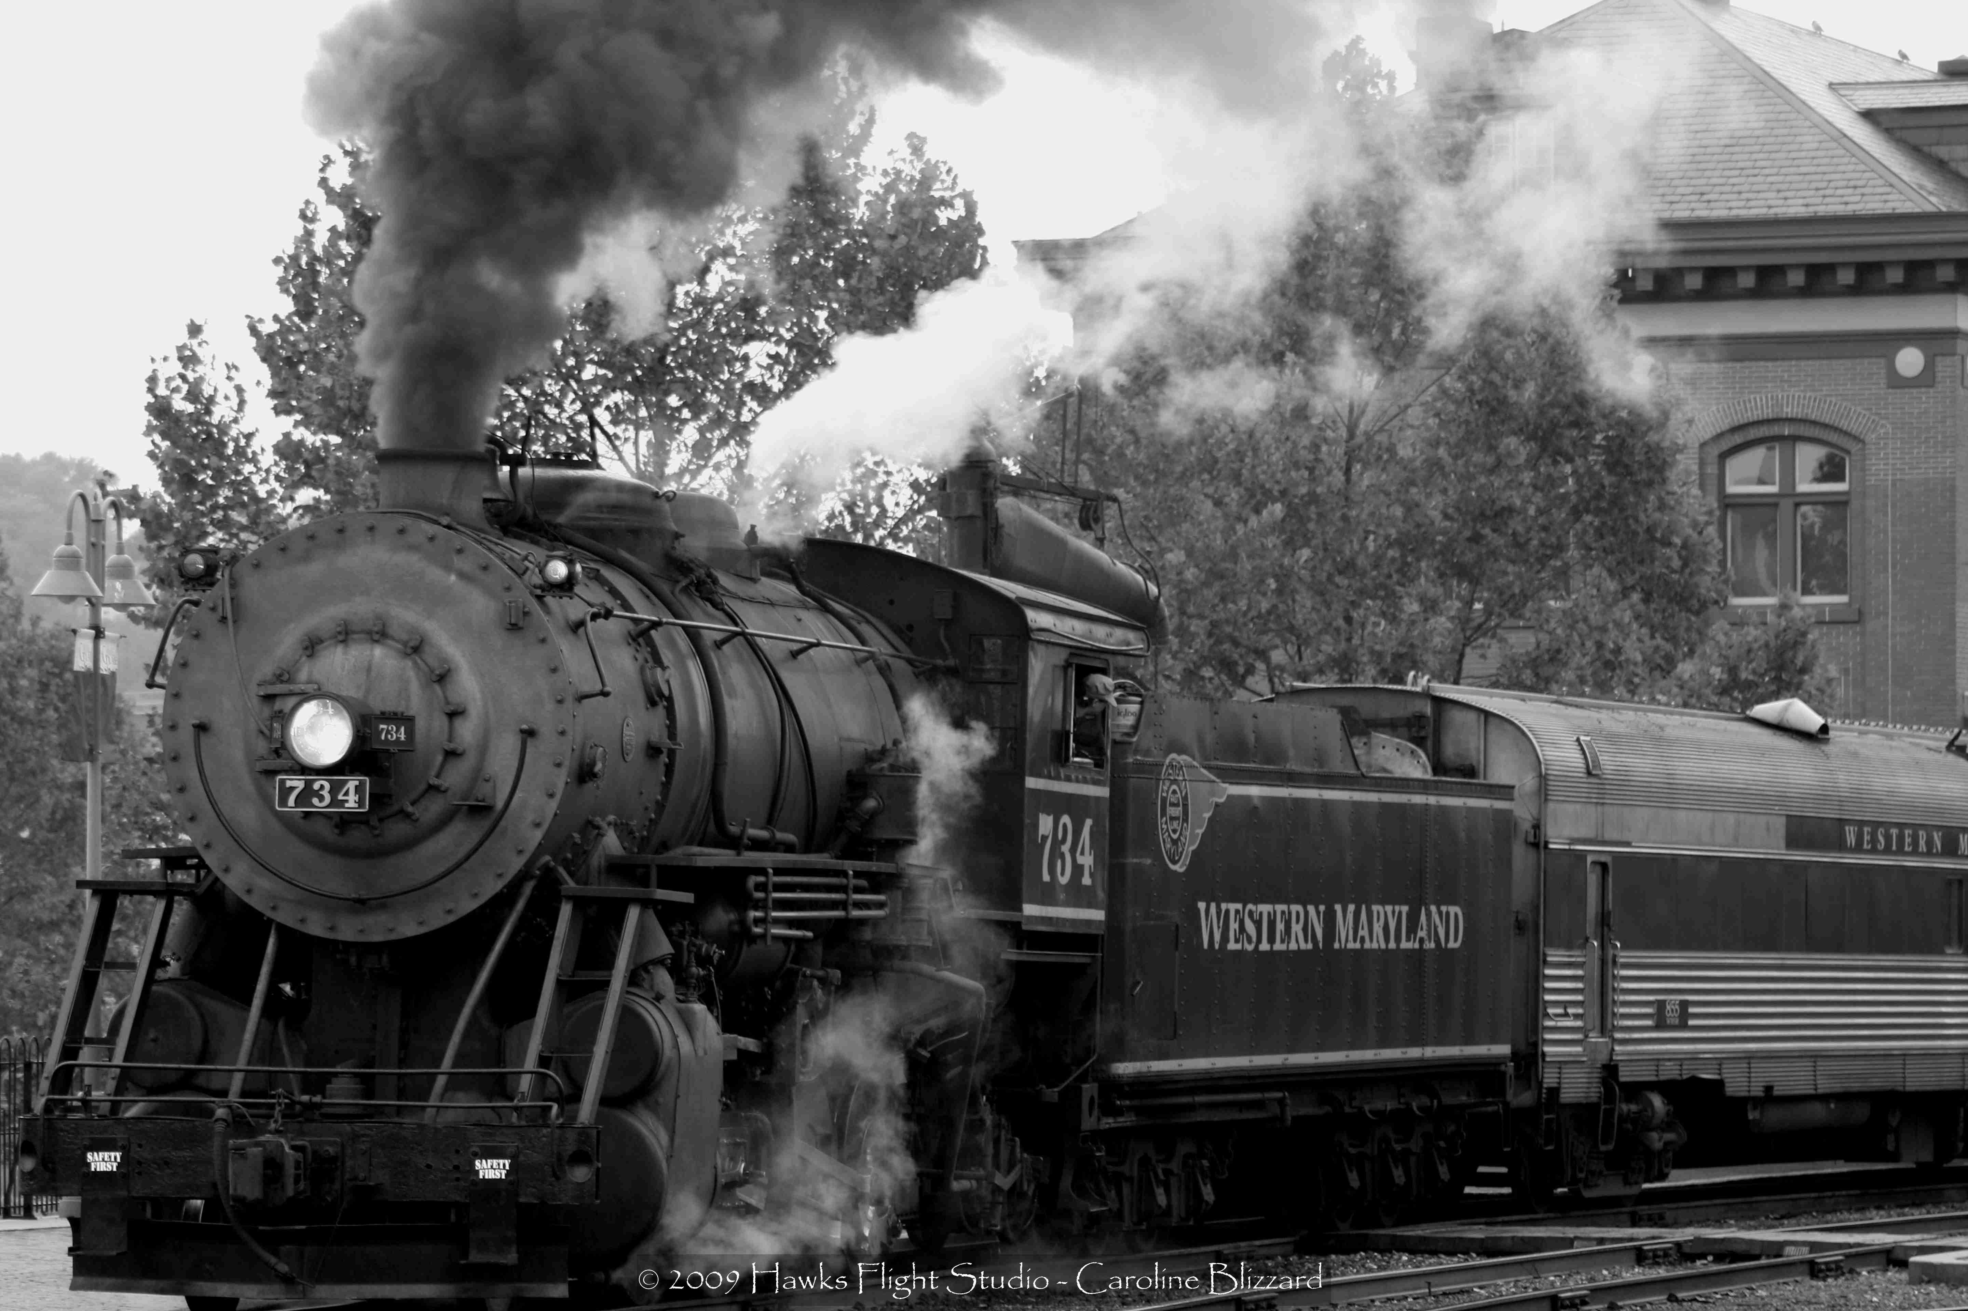

Slide 15
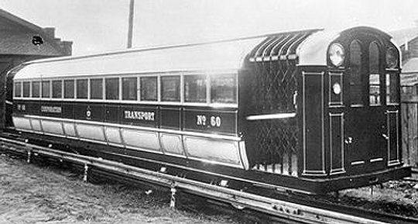
Then came the first electric trains
First Electric locomotive was made by Robert Davidson, 1837.
Electric trains didn’t become widespread in NYC until 1904

Slide 16
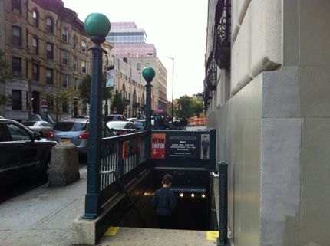
Public Transportation is always Evolving: Now
NYC Transit Museum

Slide 17
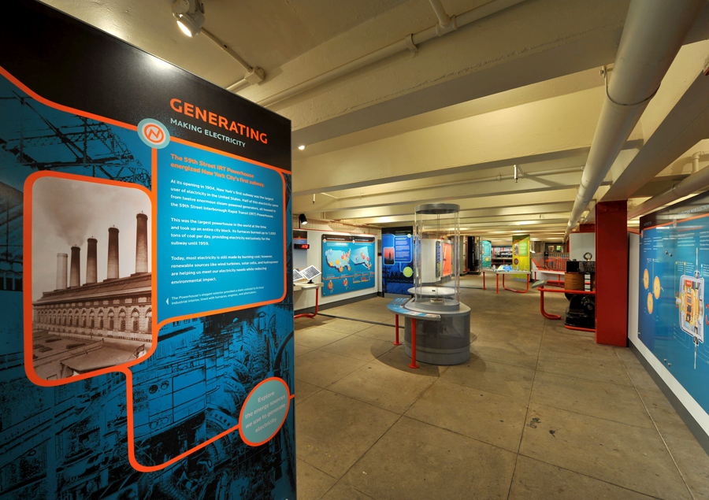

Slide 18
NYC Transit Museum
We visited the NYC Transit Museum
Trains today still get a majority of their electricity from burning of coal.
However, that amount is lower now than it was several years ago.
NYC Subway system is always increasing its renewable energy usage
Uses Wind Turbines, Hydropower, and Solar power to help do so

Slide 19
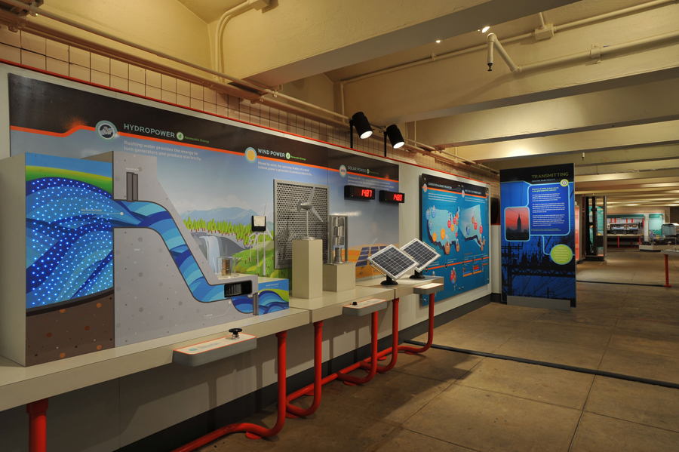

Slide 20
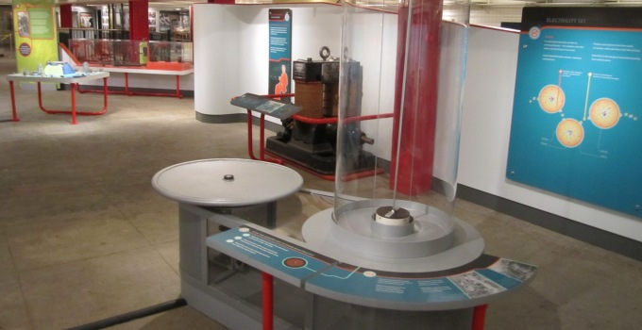
Generator

Slide 21
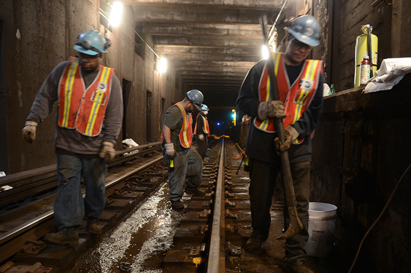
Drives Economy
Public transportation creates jobs
For every 1.25billion invested into transit infrastructure, 35000 jobs are supported.
These jobs create added business which leads to an increase in the GDP.
Business sales also increase with more public transportation investment

Slide 22
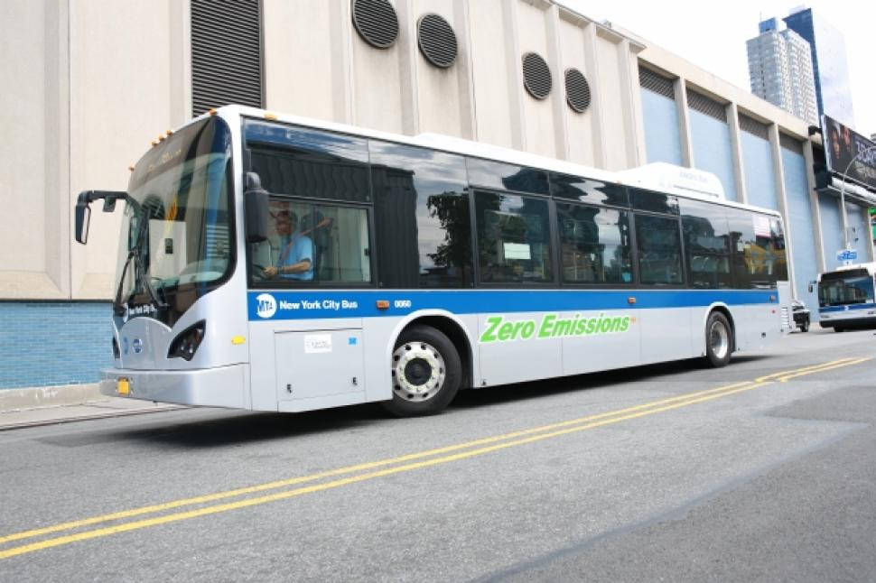
Improvements
MTA introduces the an all-electric, zero-emission electric bus in 2013. This 40-foot bus can travel 150 miles before its three batteries need to recharged.
The price for a electric zero emission bus is about $800,000.

Slide 23
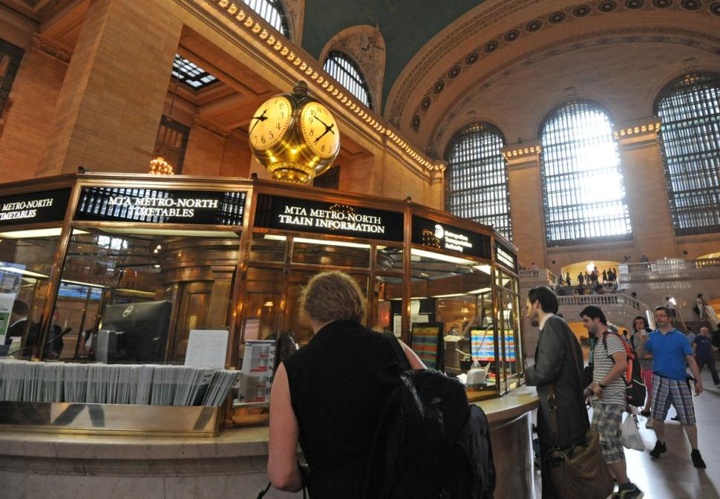
More Improvements
The MTA and New York Power Authority just finish a three year project at the Grand Central Terminal. The project consists of installing cooling towers, new temperature control, and other upgrades. Greenhouse gas emission will by approximately 11,200 tons a year.

Slide 24
The End

