Slide 1
Healthy Diet Healthy Planet Healthy You
By: Kristine Chan
“ We are all in a planetary emergency”
-Al Gore
Notes:
The topic of my presentation is to advocate toward a healthier diet to sustain a healthier planet

Slide 2
Which would you prefer?
Notes:
Well.. Did you know about the effects on the planet on choosing steak?
The goal of todays presentation isnt to change anyones mind, because I sure wouldn’t stop eating meat, but to be mindful that what you consume has many effects on the planet.

Slide 3
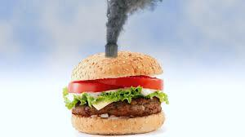
Did you know…
Producing a single burger uses enough fuel to drive 20 miles
Seven football fields’ worth of land is bulldozed every minute to create more room for farmed animals and the crops that feed them.
To produce a days food for one meat eater takes over 4,000 gallons of water and only 300 gallons for vegetarians
2,500 gallons of water are needed to produce 1lb of beef
Air pollutants generated by animal farms can cause respiratory illness, lung inflammation, and increase vulnerability to respiratory diseases, such as asthma.
Notes:
1) (emissions)Animal agriculture is responsible for 18% of green house gas emissions, which is more than the combined exhaust from all transportations. Their livestock and byproducts account for at least 32,000 million tons of carbon dioxide per year, or 51% of all worldwide greenhouse gas emissions
-The production of one calorie of animal protein requires more than ten times the fossil fuel input as a calorie of plant protein
2) (land) Of all the agricultural land in the U.S., 80% is used to raise animals for food and grow grain to feed them—that’s almost half the total land mass of the lower 48 states
- 2-5 acres of land are used per cow, and Cows produce roughly 150 billion gallons of methane per day
3) (water) Agriculture is responsble for 80-90 % of U.S. water cinsumption, & Growing feed crops for livestock consumes 56% of water in the U.S.
2,500 gallons of water are needed to produce 1lb of beef.

Slide 4
Environmental impact of agriculture
Climate change
Release of green house gas which leads to global warming
Deforestation
Clearing the Earths forest on large scale worldwide resulting in land damages
Pollutants
include nutrients, pathogens, pesticides, metals, & salts
Water Scarcity

Slide 5
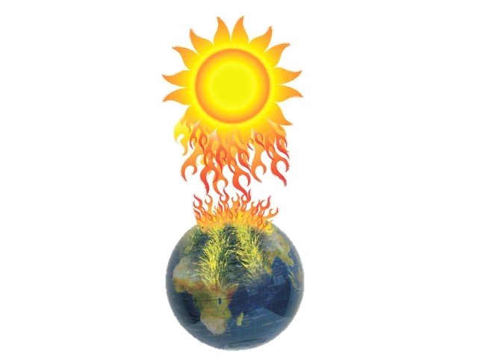
Climate Change
Since the industrial revolution, humans have been changing the global climate by emitting high amounts of greenhouse gases into the atmosphere, resulting in higher global temperatures
Production of livestock accounts for nearly one fifth of all global greenhouse emission
Notes:
2)It is generally agreed that about 25% of carbon dioxide emissions, are produced by agricultural sources, mainly deforestation, the use of fossil fuel-based fertilizers, and the burning of biomass.

Slide 6
Deforestation
Cause of deforestation is to clear land for pasture or crops
It is responsible for 20-50% of global warming as it increases greenhouse gas emissions due to release of CO2 stored in trees
24 hours of deforestation releases as much CO2 into the atmosphere as 8 million people flying from London to New York
Notes:
2) Trees act as a carbon sink, in which they absorb carbon dioxide, out of the atmosphere. By removing trees, the carbon dioxide is released into the atmosphere, and there is now less trees to absorb the increasing amount of carbon dioxide in the air. With no trees, landscapes that were once trees can potentially become barren deserts.

Slide 7
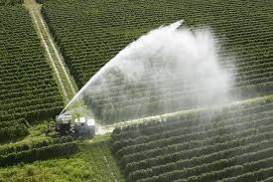
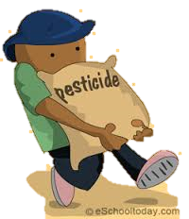
Pollutants
Synthetic pesticides are the most widespread method of controlling pests In agriculture
Pollutants from agriculture have a huge effect on water quality
Notes:
1) Pesticides can leach through the soil and enter the groundwater, as well as linger in food products and result in death in humans. Pesticides can also kill non-target plants, birds, fish and other wildlife

Slide 8
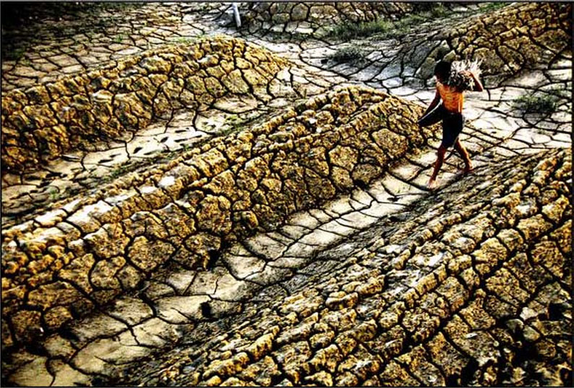
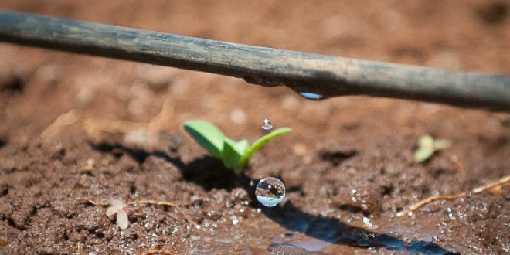
Water
Livestock production is the largest source of water pollutants
The consumption of animal products contributes to more than one-quarter of the water footprint of humanity.
Animals can negatively affect water quality by having free access to water sources where they are able to deposit waste and cause the water to become cloudy from stirring up mud.
Notes:
3) Waste from animals can be dangerous because it carries harmful bacteria which people may drink. Globally, 3.2 percent of human deaths are caused by unsafe water. This problem is especially prevalent in developing countries.

Slide 9
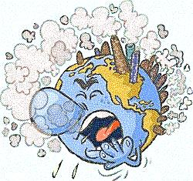
Greenhouse gases
“Greenhouse effect” is the exchange of incoming and outgoing radiation that warms, and gets trapped inside the Earth, leading to global warming.
Greenhouse gases: Carbon dioxide,
Methane, nitrous oxide
*Methane is 25-100x more destructive then CO2!
Leads to: big environmental challenges
Extreme weather, rising sea levels, plant and animal extinctions, and major climate shifts
Notes:
-So what exactly is Greenhouse gases?
Worldwide, the output of greenhouse gases is a source of grave concern. From the time indstrial revolution began to 2009, CO2 levels increased 38 percent, while methane increased 148 perfect.
The worst effects of global warming is:
Extreme weather, rising sea levels, plant and animal extinctions, and major climate shifts

Slide 10
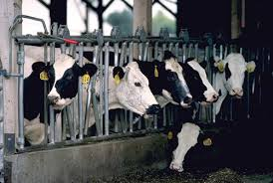
Impact of livestock
Methane emissions mostly occur as part of the natural digestive process of animals and manure management in livestock operations
Production of livestock accounts for nearly one fifth of all global greenhouse emission
In 1965, 10 billion livesttock animals were slaughtered each year, today that number is 55 billion
Confined farm animals generate more than 450 million tons of manure annually,
3 times more raw waste than
generated by Americans.
Notes:
-Manure can also contain traces of salt and heavy metals, which can end up in bodies of water and accumulate in the sediment, concentrating as they move up the food chain.
-When manure is repeatedly overapplied to farm land it causes dangerous levels of phosphorus and nitrogen in the water supply. In such excessive amounts, nitrogen robs water of oxygen and destroys aquatic life.

Slide 11
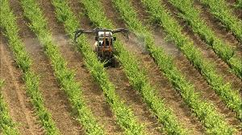
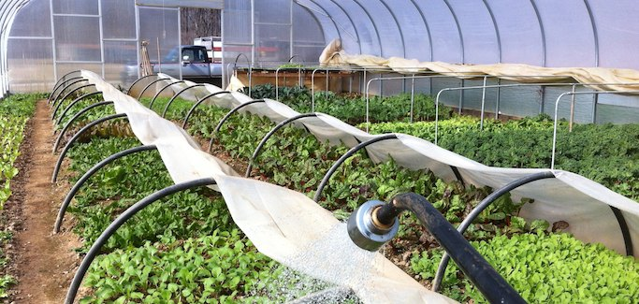
Industrial vs Sustainable Agriculture
Industrial
Sustainable
Health consequences
Decline in nutrients
Pesticides & fertilizers
Contamination
Drive out small businesses
Health benefits
Increase intake of nutrients and antidioxidants
Decreased exposure to harmful substances
Support environmental & socially responsible food system
Notes:
So after speaking about animal agriculture, we’re gonna go into industrail agriculture..
So what is the differnce between Indistrial and sustainable agriculture, and why should we slowly adapt to sustainable agriculture.
Industrial agricutlure is large farms that is run like factories with large imputs of fossil fuels.
1)Leads to obescity and and chronic diseases such as diabetes, heart diseases, and strokes
2)Industrial crops are bred for ease of transport, fast growth, which results in loss of nutrients. Has a decrease in protein, iron, potassium, calcium, and other nutritional contents
3) Pesticides is needed to generate large prouctions, which deteriorates and destroys natual soil. It is also linked to a number to health problems, especially in children, which can lead to delayed development, cancer, and damages to the organs.
4) The additives and contaminates used to feed the livestock can remain in the animals tissue, which then you consume.
5) By the large quantities of produce being produced by these industrial farms, it drives small businesses away, and lowers local economy revunue.
Sustainable
Sustainable agriculture is a way of growing or raising food, including animals, in a ecological way that helps protect the environment
Helps address many environmental and economial concerns.
Making the transition to sustainable agriculture is a process. reaching toward the goal of sustainable agriculture is the responsibility of all participants in the system, including farmers, laborers, policymakers, researchers, retailers, and consumers. Each group has its own part to play, its own unique contribution to make to strengthen the sustainable agriculture community.

Slide 12
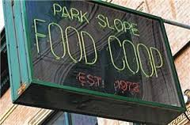
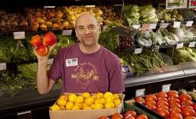
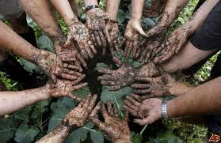
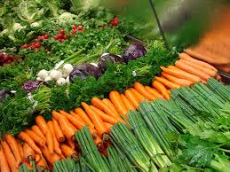
“Fresher than fresh”
“Model for cooperation and sustainability”
-Members of PSFC
(782 Union St, Brooklyn NY)
Notes:
Park slope food coop is a nonprofit organization in Brooklyn, New York that advocates for healthy eating with respect for the environment. They are a member owned and operated food store. They are a buying agent for our members and not a selling agent for any industry
-offer a diversity of products with an emphasis on organic, minimally processed and healthful foods.
-membeers save up to 20-40% off their weekly grocery bill
$25 joining fee, and contribute $100 investment.
Work 2 hrs and 25 mins every 4 months ( 13x a year)

Slide 13
Park Slope Food Coop
Maximize provision of foods and cosmetics which are organically and/or regionally grown, cruelty-free
Make every effort to sell as much food and as many products as possible in bulk, and continue to educate members about bringing reusable bags and containers with them when they shop.
Avoiding toxic substances
Minimizing disposable products
Reducing energy use in transportation, by seeking comparable, locally grown products
Notes:
majority of the Coop's grown and raised product comes from within the 100- to 200-mile range. At the Coop, they define local as within 500 miles, because 500 miles is approximately a one-day-truck-drive away.

Slide 14
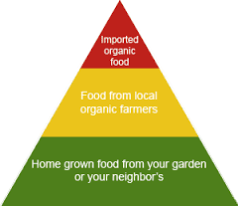
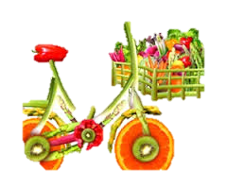
Solution?
Eat less red meat and switch to
other forms of proteins and vegetables
Buy organic
Watch your waste
Eat locally
Notes:
So, what is the solution to greenhouse gases?

