Slide 1
Environmental Impact of Computer Technology
By Stefan Falciglia & Sabin Visan

Slide 2
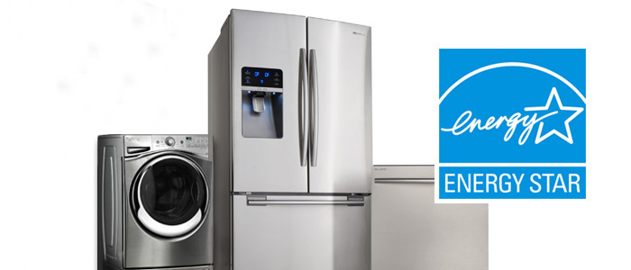
Energy Star
Energy Saving Techniques
20-30% Less Energy
Required By Law
Outside Computer Industry

Slide 3
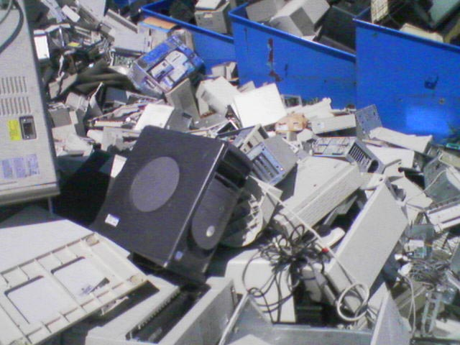
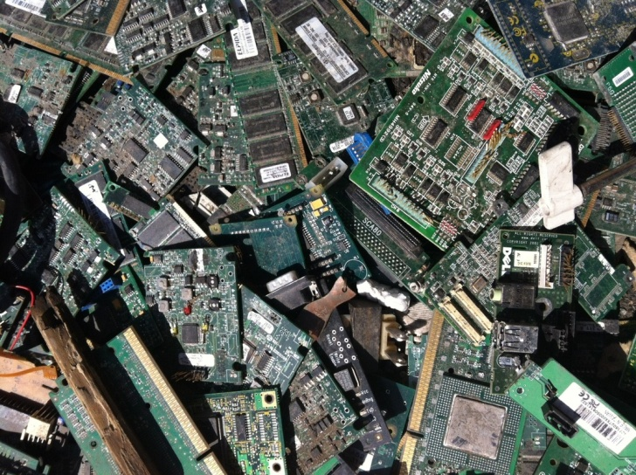
Environmental Degradation
Old technology in Landfills
Toxic Materials
Pollutes Air and Water
Required By Law

Slide 4
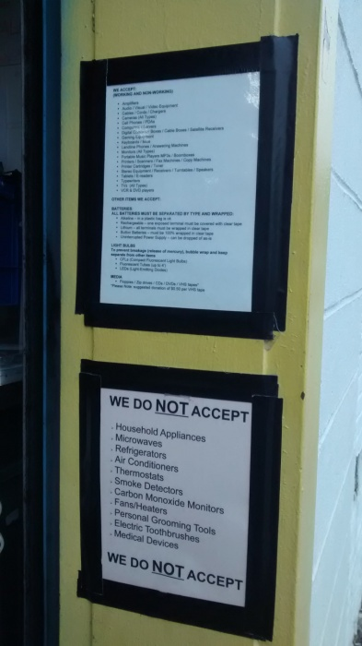
Electronic Waste Recycling
What cannot be recycled at these facilities?
Microwaves
Refrigerators
Clothes washers & dryers
Air Conditioners
Smoke detectors & carbon monoxide detectors
Large scale servers
Note: The NYS Electronic Equipment Recycling and Reuse Act requires manufacturers to provide free and convenient recycling of electronic waste to most consumers in the state.

Slide 5
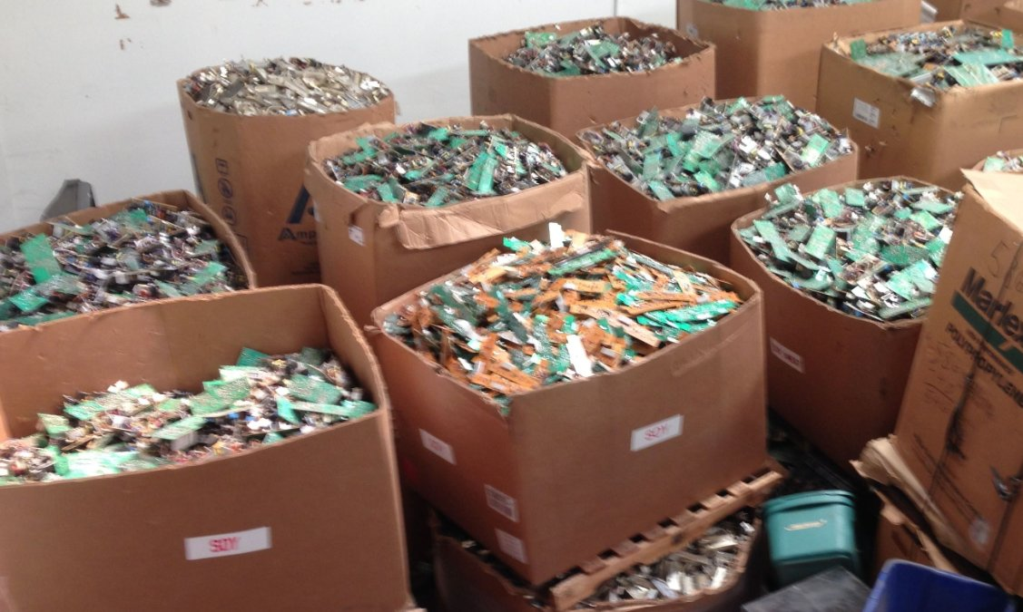
Electronic Waste Recycling
What can we recycle?
Computers
Monitors
Printers, Scanners, Fax Machines, etc.
Network Devices
Peripherals
Tablets, e-readers
Components
TV, VCRs, DVDs
Digital Converter Boxes
Audio-Visual Equipment
Video-Games
Cell Phones
Telecommunication
Small scale servers

Slide 6
Lower East Side Recycling Center
Sims Recycling Solutions is an R2 certified recycler and the world’s largest recycler of e-waste.
R2 standard requires that recyclers process all of the collected material domestically and responsibly.
Sustainable Electronics Recycling International (SERI) is a non-profit organization dedicated to the responsible reuse, repair, and recycling of electronic products.
https://sustainableelectronics.org

Slide 7
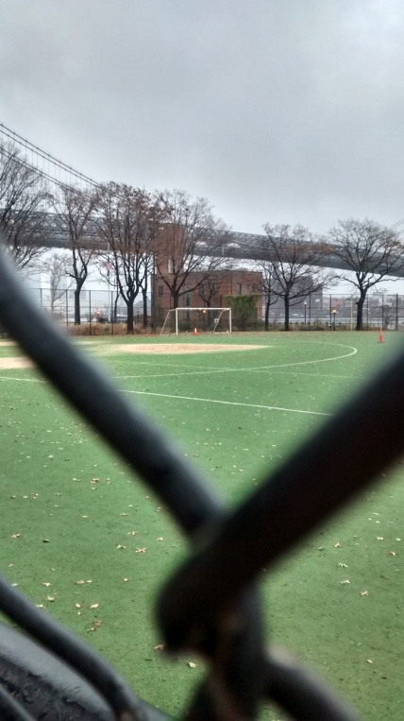
Lower East Side Ecology Center
Composting
Conservation of East River Park Promenade
In-Vessel Composting System
Green Roof

Slide 8
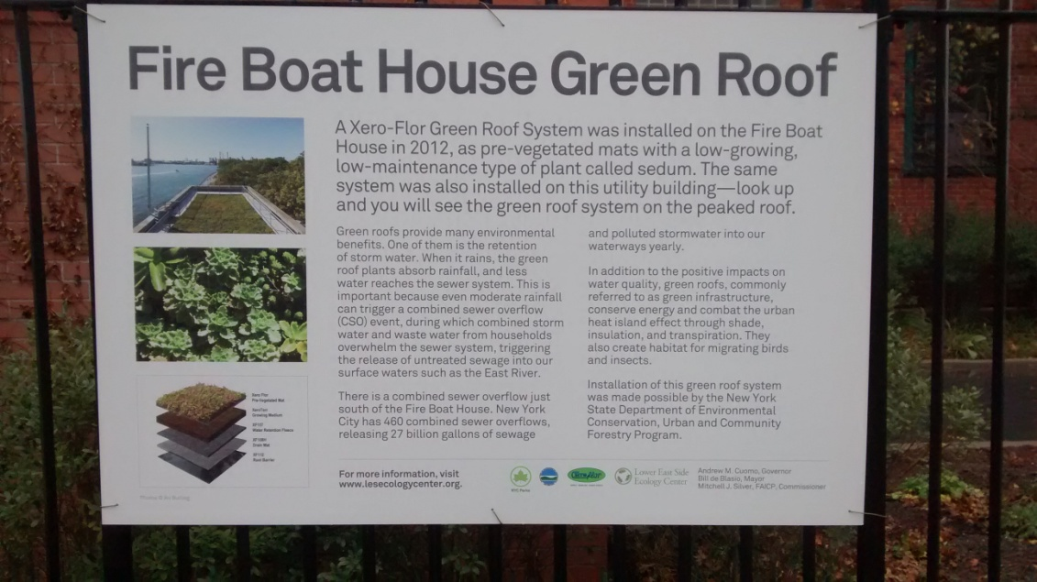
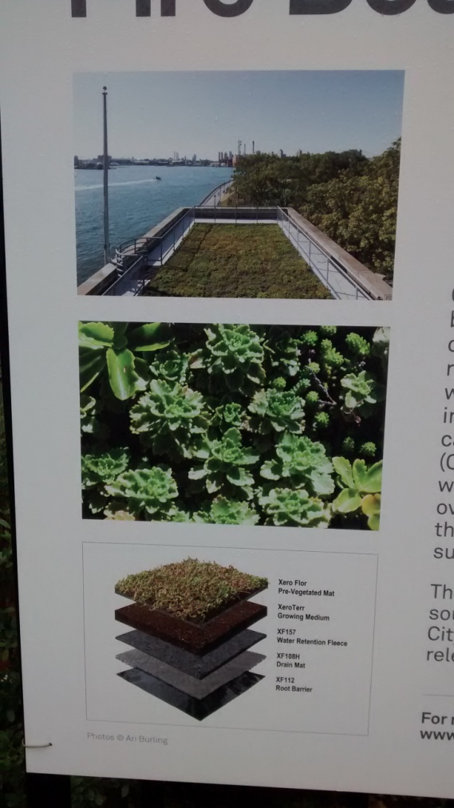
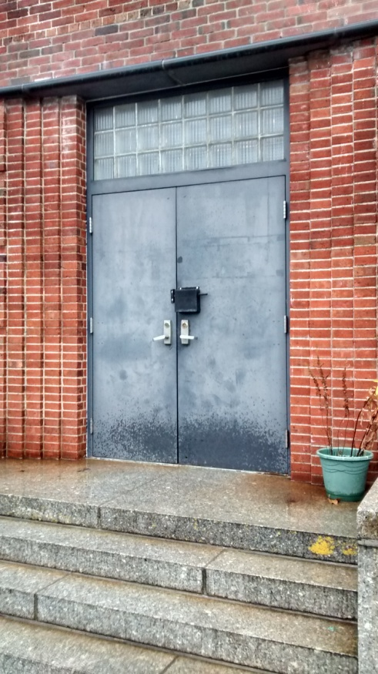
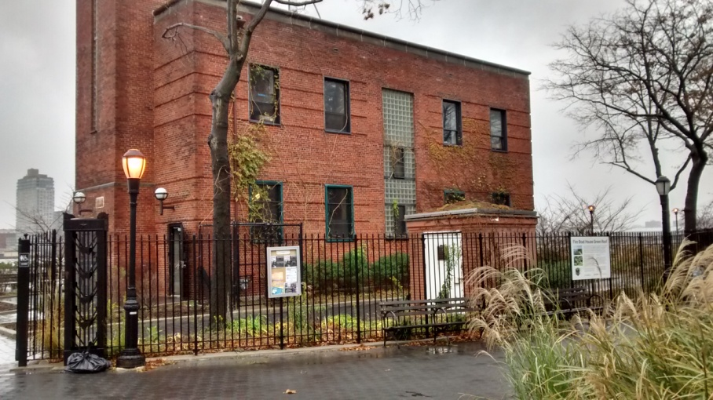
Lower East Side Ecology Center

Slide 9
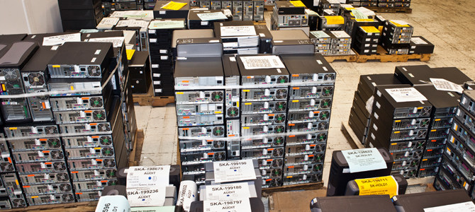
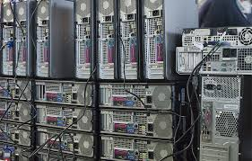
Electronic Waste Recycling
Process of Recycling
Materials Recycled
Hazardous Chemicals
Lead
Mercury
Cadmium
Phosphors
Flame Retardants

Slide 10
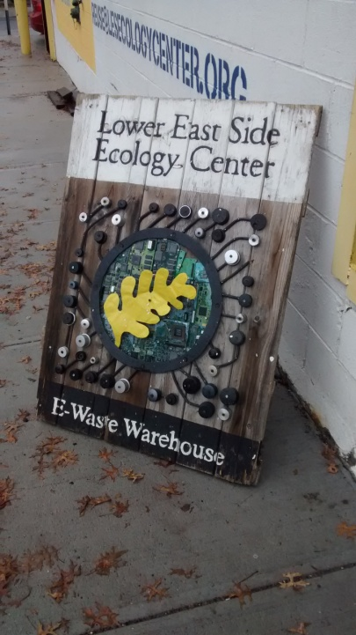
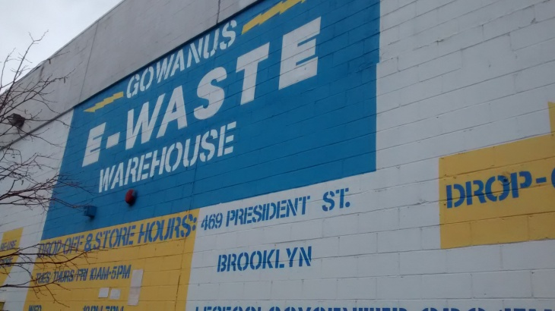
Gawanus E-Waste Warehouse
Sorts electronics in different categories
Fixes electronics that can be fixed
Ceran wraps the rest to be shipped to an off site recycling center like Sims Municipal Recycling Plants
Re-Sells fixed electronics of value

Slide 11
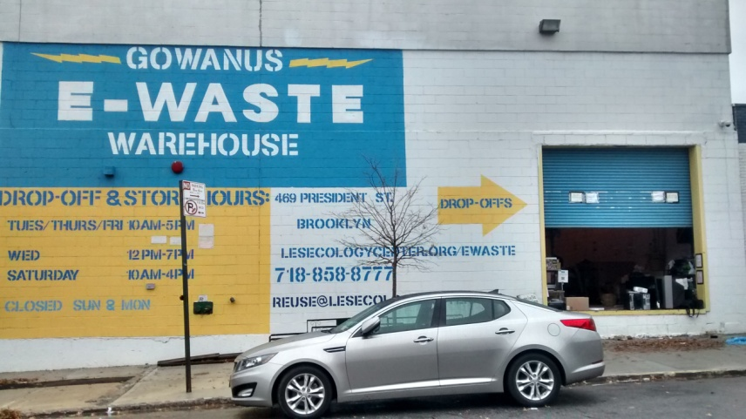
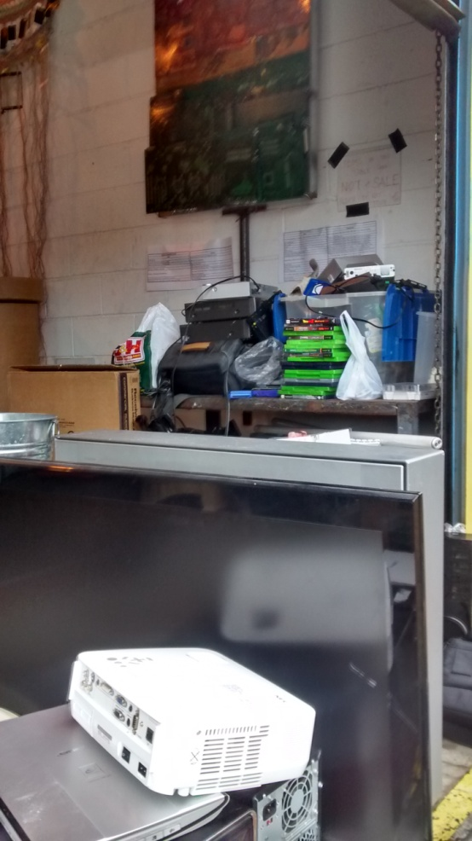
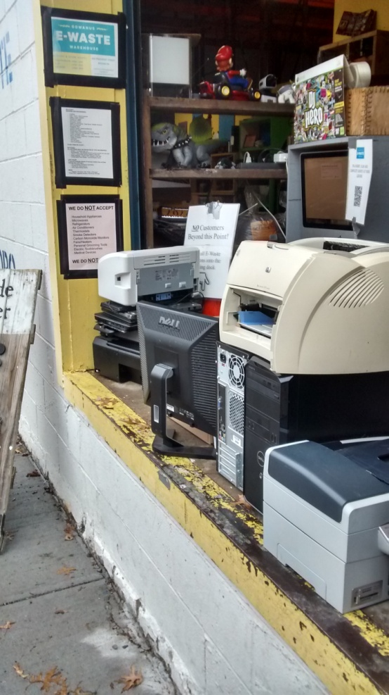
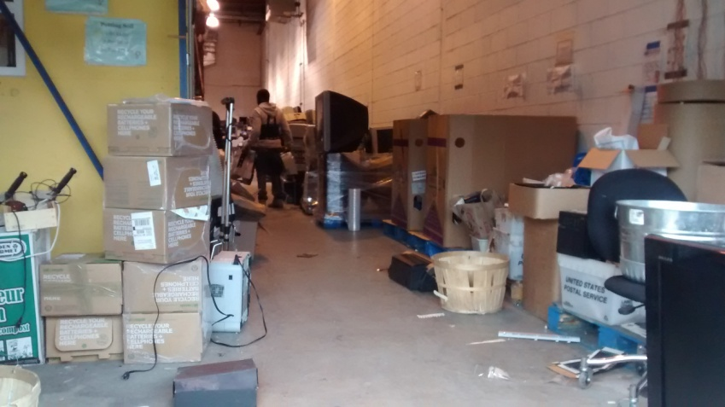
Gawanus E-Waste Warehouse

Slide 12
John A. Mendoza
“Green” Practices
Re-selling & Recycling Old Computers
Energy Star & Office Renovations
Green Server Farms

Slide 13
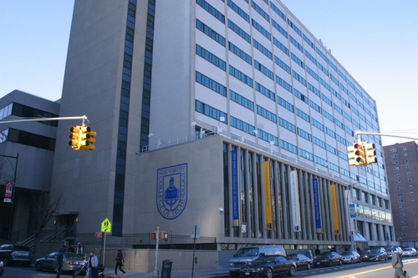
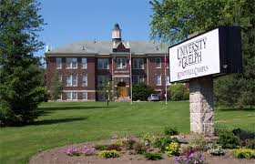
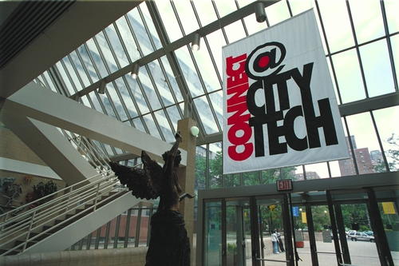
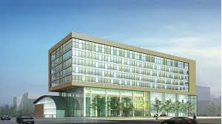
New York City College of Technology
Ways to improve City Tech

Slide 14
THE END

