Slide 1
Alternative Energy Sources
Michael Dejesus

Slide 2
Transitioning To Alternative Energy
The Big question is how can we as a society make that jump to a new energy source?
Will This energy source be efficient ?
What challenges do we face in making this transition?

Slide 3
Things to consider
The World Population
Economic Dependance on fossil fuel
Fuel Consumption around the world
Price of oil
Difficult for society to make the change

Slide 4
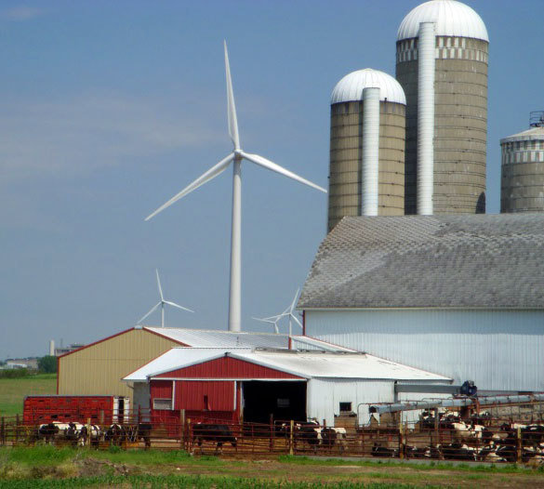
Wind Turbines
Wind Energy is one of the fastest growing alternative sources
It is a clean renewable source of energy
It is a sustainable source of energy
Cost Effective
Creates Jobs
Notes:
http://apps2.eere.energy.gov/wind/windexchange/slideshows/wind-energy-benefits/wind-energy-benefits/1564506-image5-edited.jpg

Slide 5
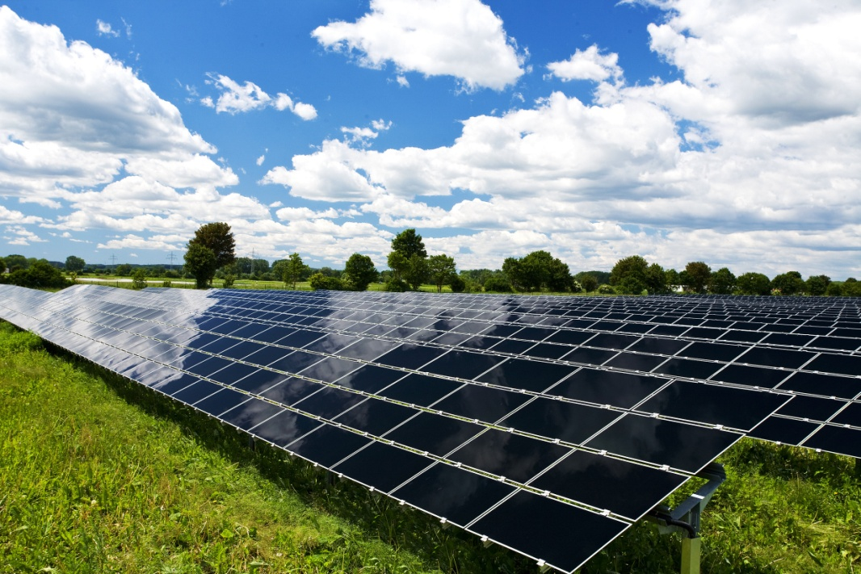
Solar Energy
The energy that our sun gives us.
Made from solar radiation that gives us electricity.
A silent producer of energy
Little or no maintenance required
Notes:
http://doyourpart.com/wp-content/uploads/2010/07/Solar-Panel-Fields_32333476.jpg

Slide 6
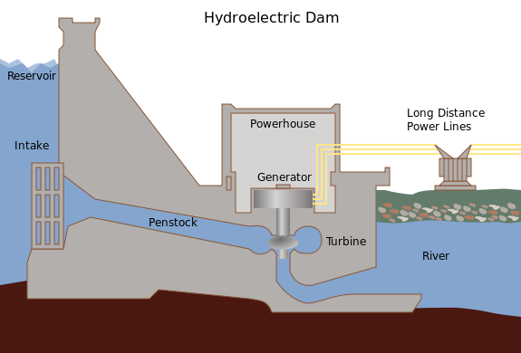
Hydropower and Pumped-Storage
Hydropower is created from falling water or water with fast currents.
Clean fuel source as it won’t pollute the air or plants.
It is domesticated so you can deal with your energy locally.
Provides flood control , irrigation and water supply
Notes:
https://lh5.googleusercontent.com/z4hANehk3Y9VdStPinxhjakixXuaFfDKRx0oK_0jVA3Jymzu6kApFXouEXIgrkSodF5zizWmmd6I0WF9K5doVo3-2w3c6zdAAKb1G7oa9kqvqtUDuF220286h0EhZtB5mWa7sozhQK9KiQS3

Slide 7
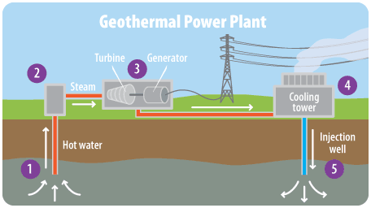
Geothermal Energy
When you dig deep into the earth, the earth gets hotter. This is known as Geothermal Energy
Geothermal power plants can use this energy to create steam and electricity.
Clean and Safe
Cost Efficient
System Life Span
Notes:
http://www3.epa.gov/climatechange/kids/images/4-1-5-geopower.gif

Slide 8
Video
How Renewable Energy Works

Slide 9
Conclusion

