Slide 1
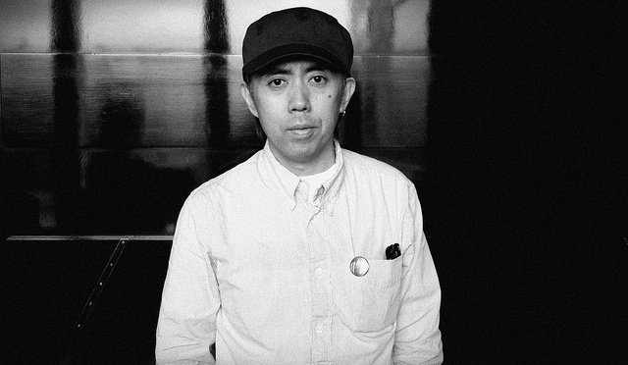
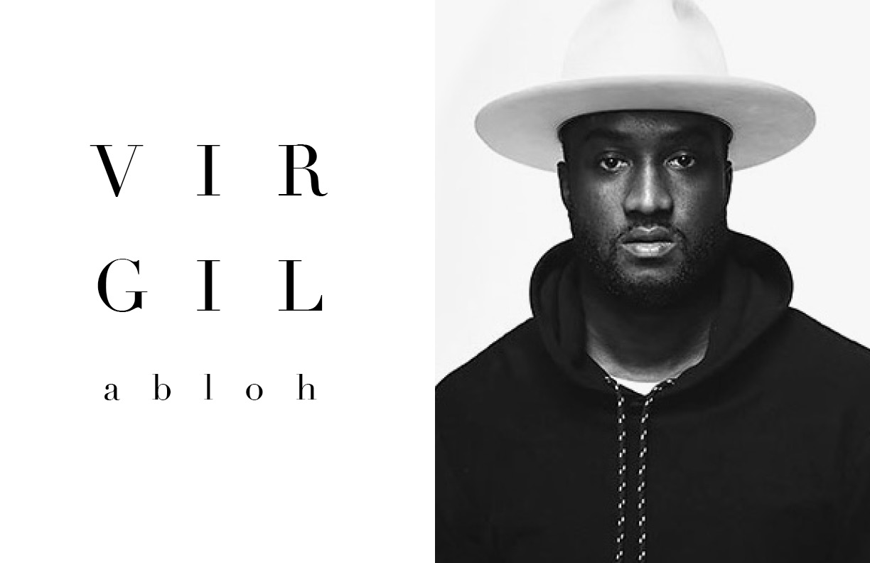
Fujiwara hiroshi&virgil abloh
Designer project
By Lifeng Wu

Slide 2
Table of contents
Back ground info
The collections
Why they are important
Similarities and differences

Slide 3
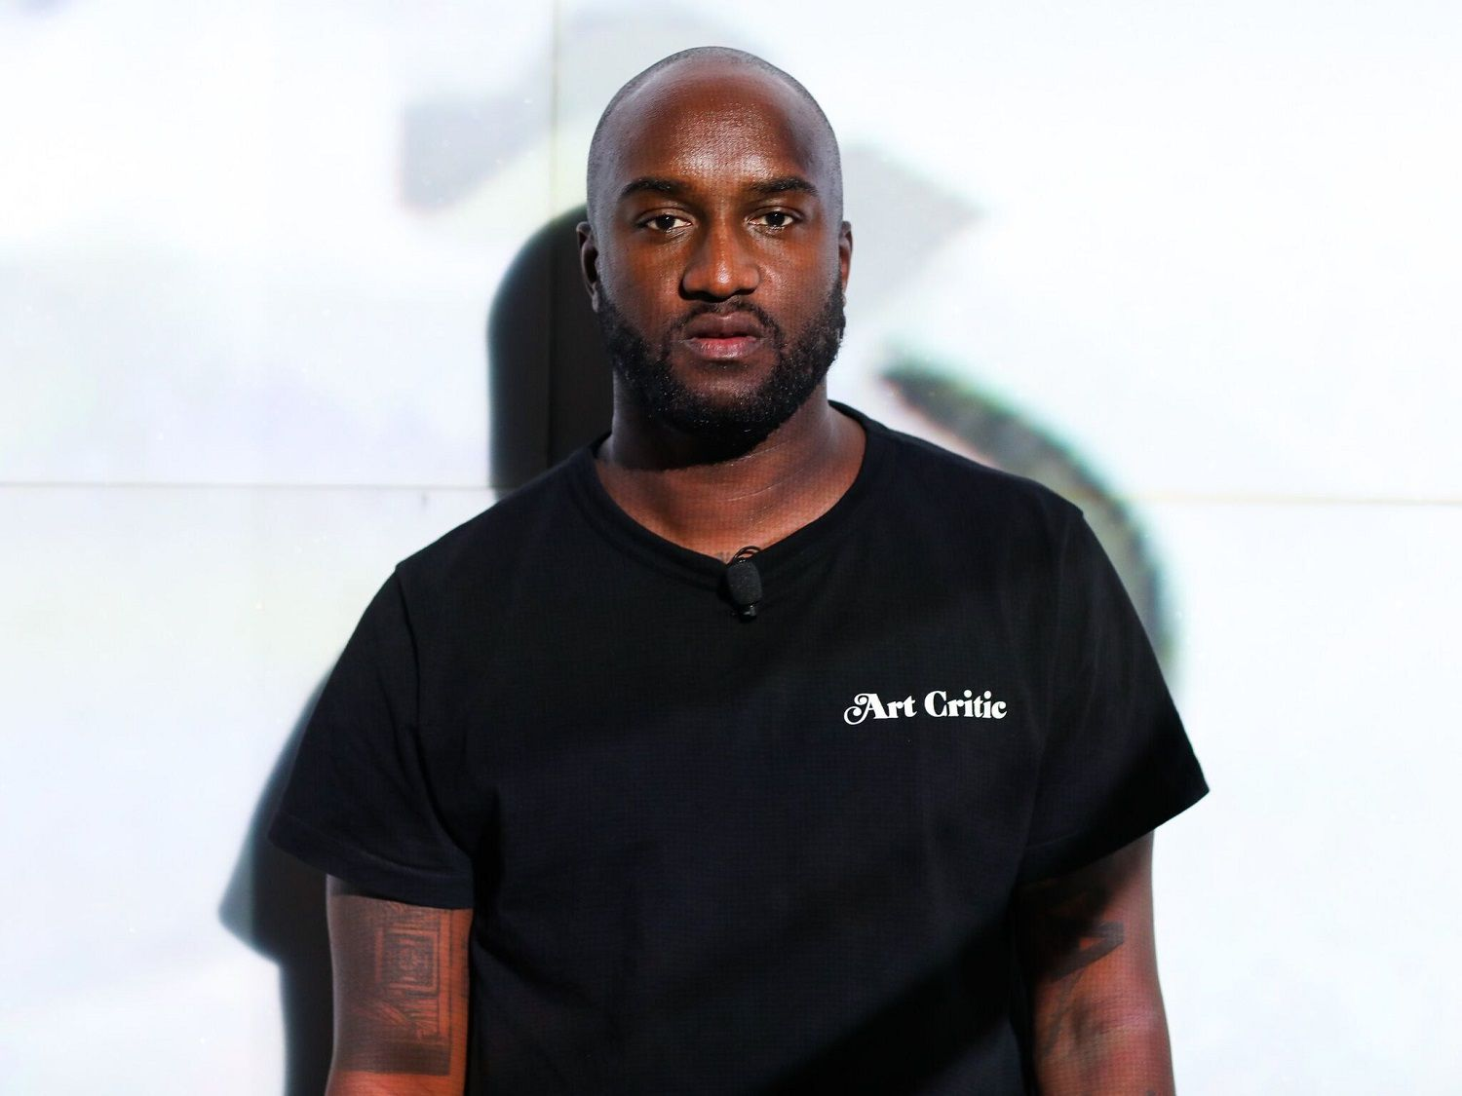
Background
Was born on 1964 in Ise, Mei japan.
Won a fashion contest at age 18.
The godfather of streetwear fashion.
First brand GOODENOUGH 1989.
Designer of fragment design.
Born on 1980 in Rockford Illinois
Designer of Off-White
Artistic director of Louis Vuitton
Bachelor of science degree in
civil engineering and master in architecture

Slide 4
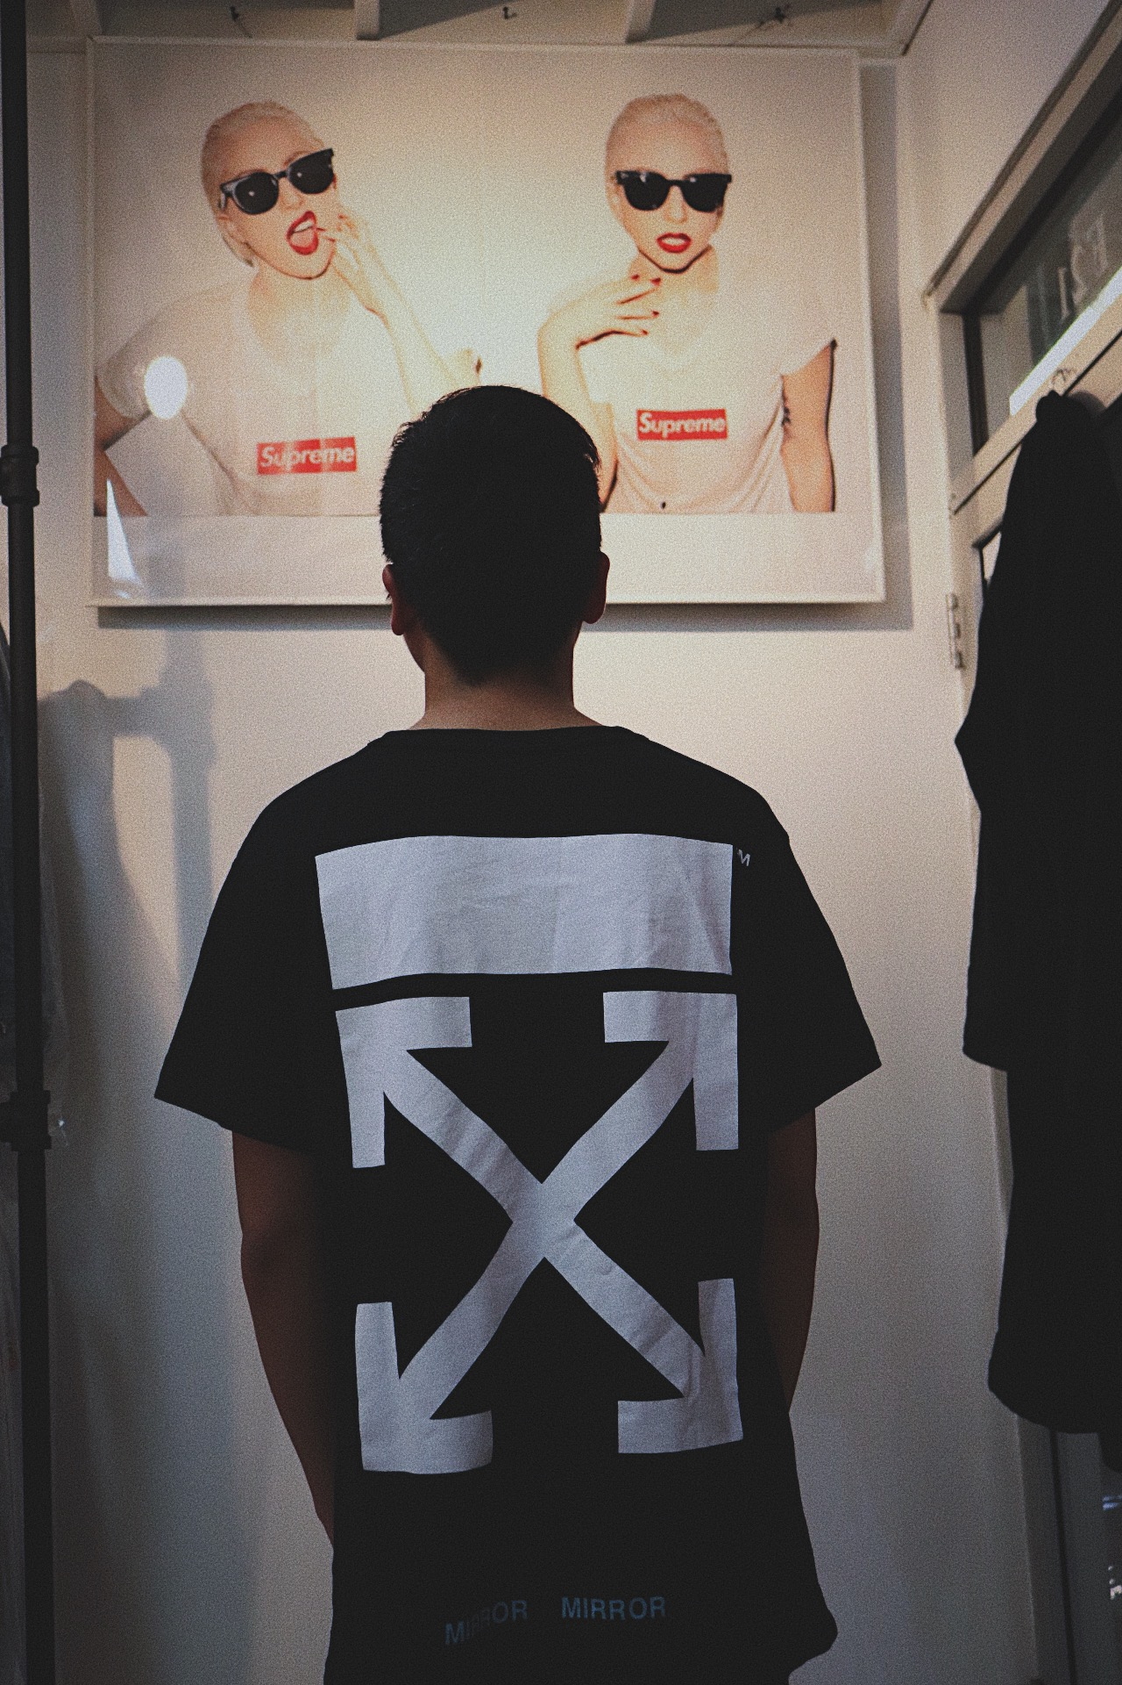
The collection

Slide 5
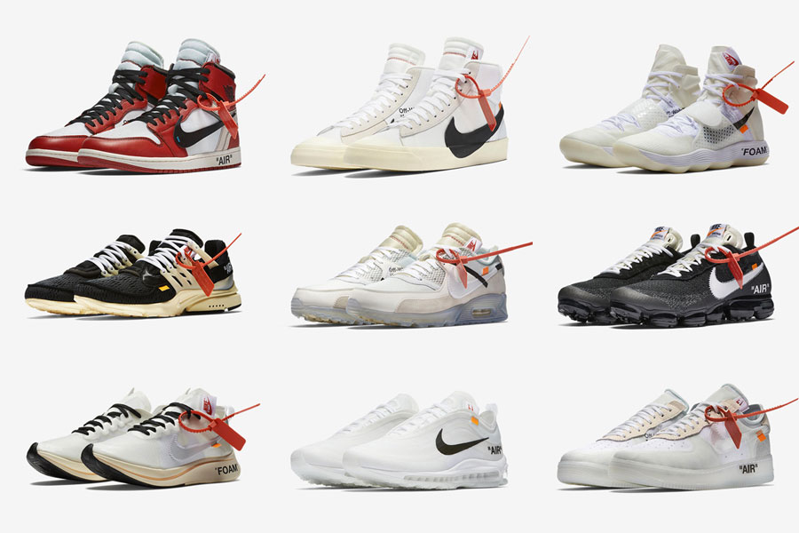

Slide 6
Important
Didn’t just create clothing but also art and music.
Hiroshi helped and mentored NIGO and Takahashi to open up the first store “Nowhere”.
Virgil make street to another level.
Both designer create instantly sold-out products.

Slide 7
Similarities and differences
Similarities
Differences
They all design streetwear
They both are DJs and likes music
They have created “Off-Black”
They have a total different background
Different pricing
Virgil is base in USA Hiroshi is base in Japan
Virgil is creating luxury streetwear

