Slide 1


ENG1101
Library Workshop
Prof. M. Berger :: Fall 2021

Slide 2

Icebreaker
What are you most looking forward to doing when spring comes?
Type into the chat

Slide 3
Goals
  Orientation and overview of library’s services and resources accessible remotely
  Asking a research question
  Evaluating/judging sources
  How to find items in different genres in the library for the reflective annotated bib
  Citations
  Distinctions between internet and library info sources

Slide 4
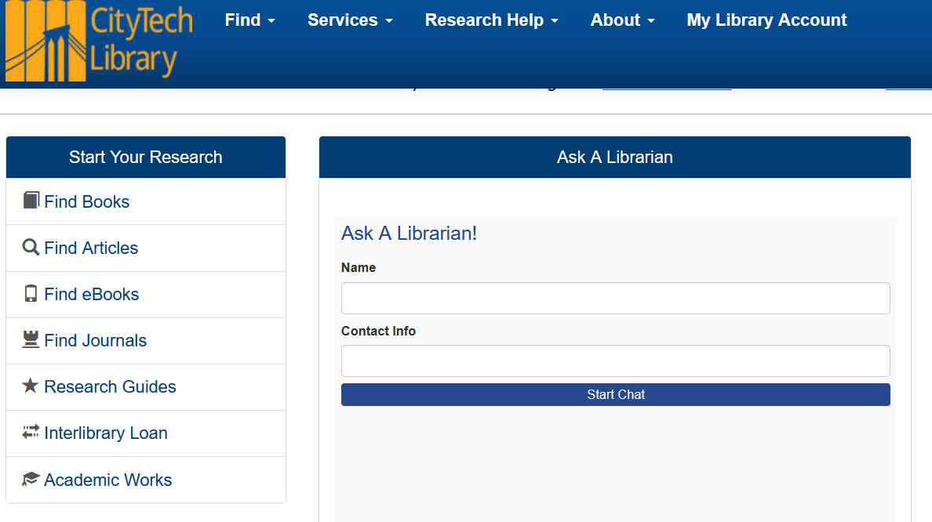
ASK A LIBRARIAN by chat or email

Slide 5
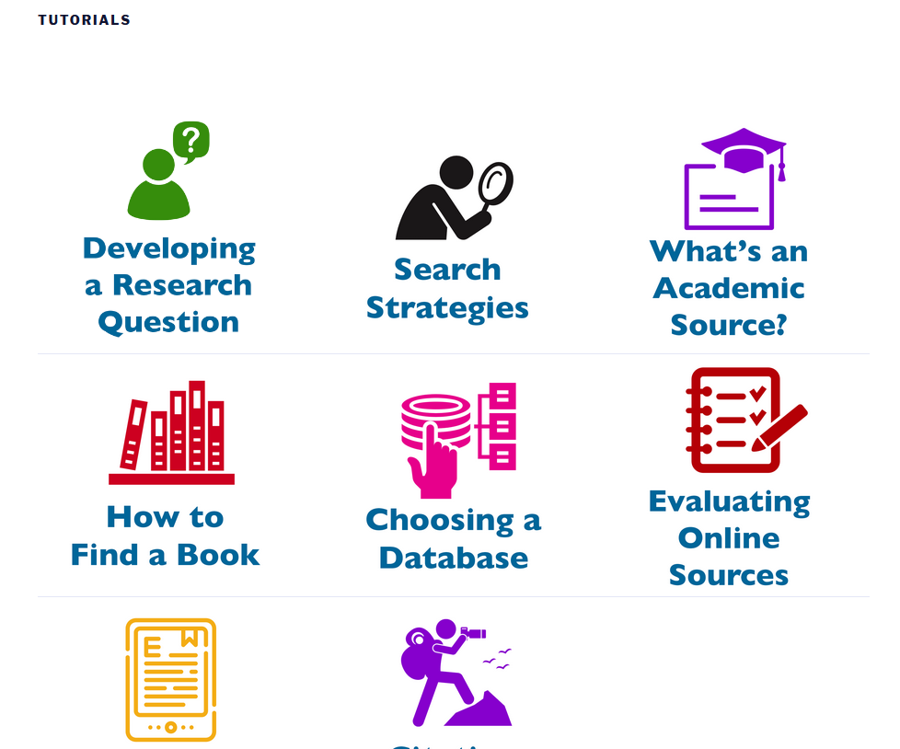
Tutorials

Slide 6
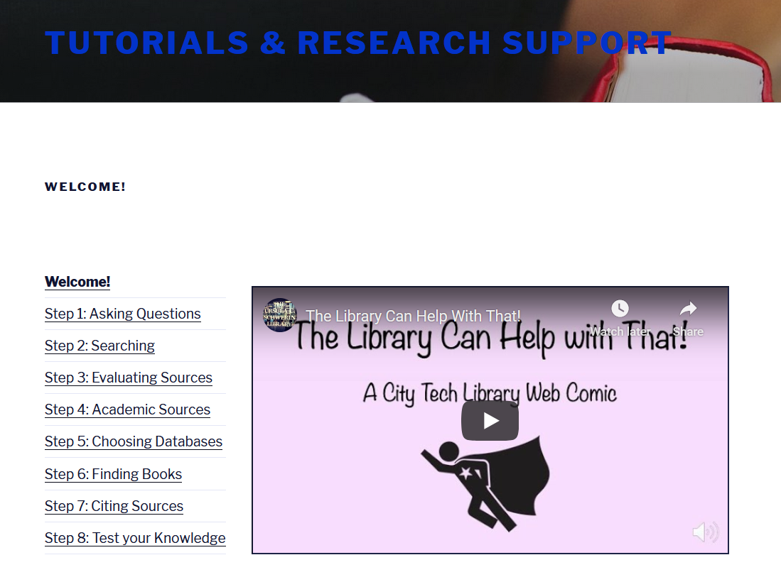
Online library course includes evaluating sources+interactive quiz

Slide 7
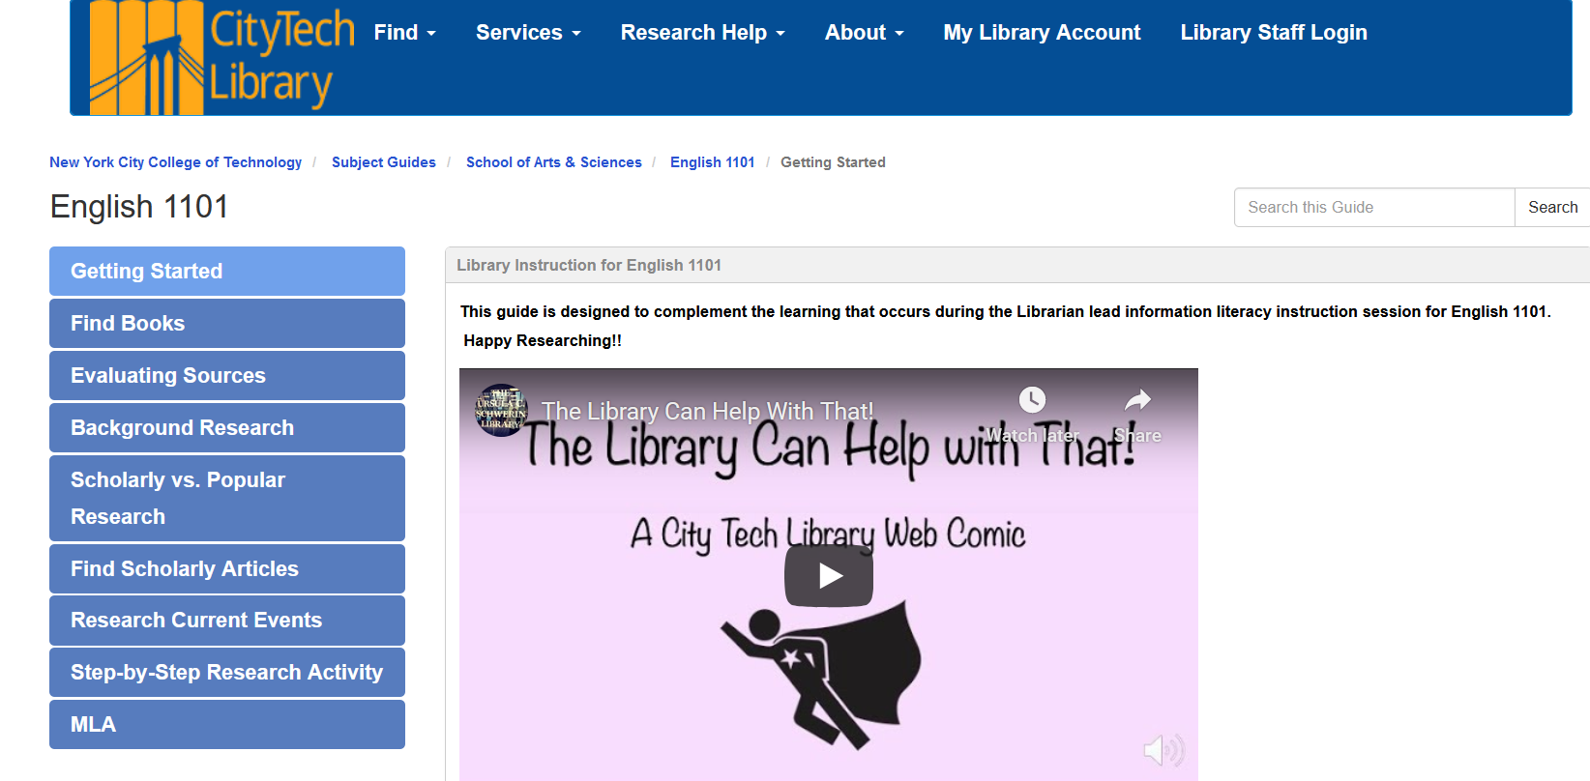
English 1101 guide updated Fall 2020

Slide 8
Your next assignment (Reflective Annotated Bibliography)
An introduction
FOUR sources in four genres (news report, op-ed, audio/visual, personal interview)
w/corresponding bibliographic entry = CITATION OF SOURCE
  Your writing (see your assignment for details)
A conclusion

Slide 9
What is a citation = bibliographic entry?
Ontiveros, Randy J. In the Spirit of a New People: The Cultural Politics of the Chicano Movement. New York UP, 2014. [+ URL if online]
Points back to the source
Minimal information needed to find the source

Slide 10
What is an annotation? [this is a summary annotation]
Alvarez, Nadia, and Jack Mearns. “The benefits of writing and performing in the spoken word poetry community.” The Arts in Psychotherapy, vol. 41, no. 3, July 2014, pp. 263-268. ScienceDirect, doi:10.1016/j.aip.2014.03.004. Spoken word poetry is distinctive because it is written to be performed out loud, in person, by the poet. The ten poets interviewed by these authors describe “a reciprocal relationship between the audience and the poet” created by that practice of performance. To build community, spoken word poets keep metaphor and diction relatively simple and accessible. Richness is instead built through fragmented stories that coalesce into emotional narratives about personal and community concerns. This understanding of poets’ intentions illuminates their recorded performances.

Slide 11
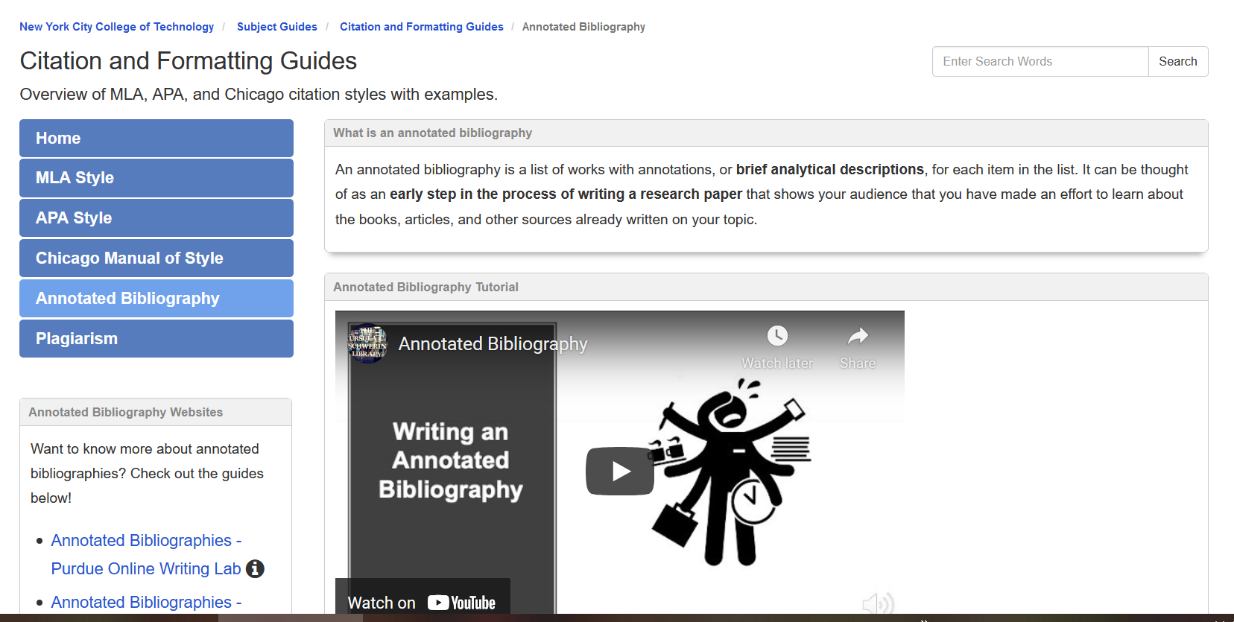
General annotated bibliography resource

Slide 12
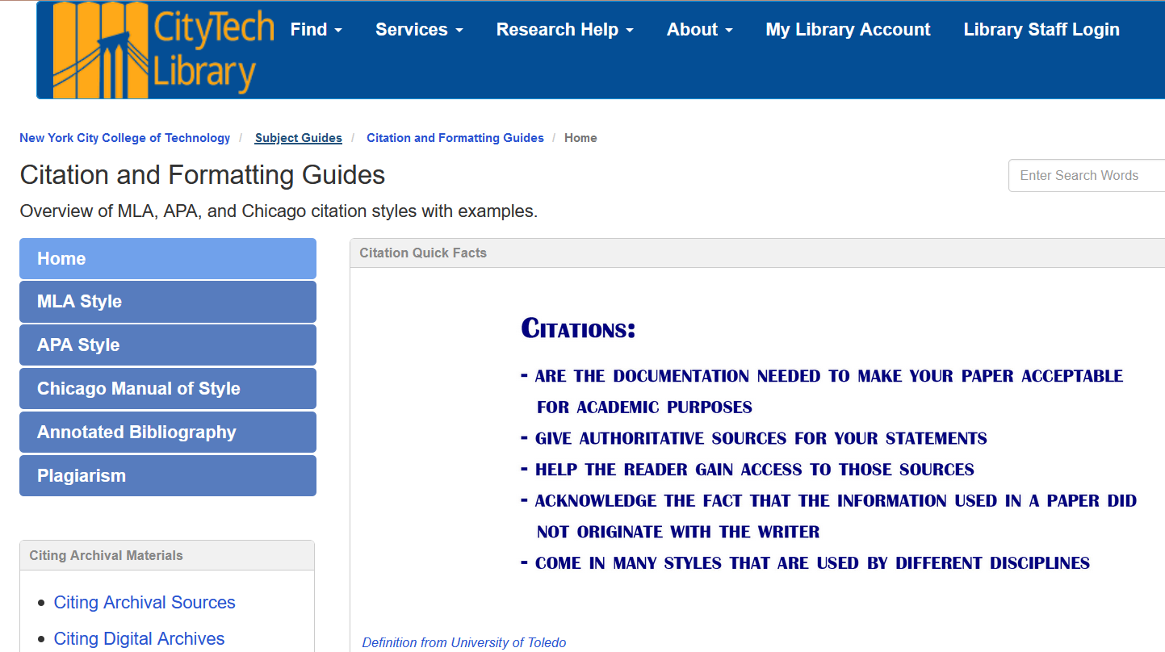

Citations and writing support guide
Get citations from library products
Zoterobib good for websites
Easybib

Slide 13

Why Cite?
Type your answers into the chat box

Slide 14
What is a research question vs. a topic?
Topic → research question
How has the CV pandemic changed _______ ?

Slide 15
Ask yourself
Is the question researchable? Not just yes or no question
  Not too broad
  Not too narrow
Do you already know the answer to your question? You shouldn’t
  Investigate!
Does the question have complexity and depth?
  Multiple viewpoints
  Different facets or subtopics

Slide 16
Your topics or questions? Write into the chat

Slide 17
Background info? How? Why?
Google, Wikipedia, library encyclopedias, newspaper articles

Slide 18
Keep it simple when searching at the beginning of your process

Slide 19
Ask yourself
Is the topic (and eventual) question researchable? Not just yes or no question
  Not too broad
  Not too narrow
Do you already know the answer to your question? You shouldn’t
  Investigate!
Does the question have complexity and depth?
  Multiple viewpoints
  Different facets or subtopics

Slide 20
Can you improve the “researchability” of your topic? Let’s discuss

Slide 21
Add another keyword to your basic topic
What is a keyword?
Notes:
Skip if no one is doing books

Slide 22
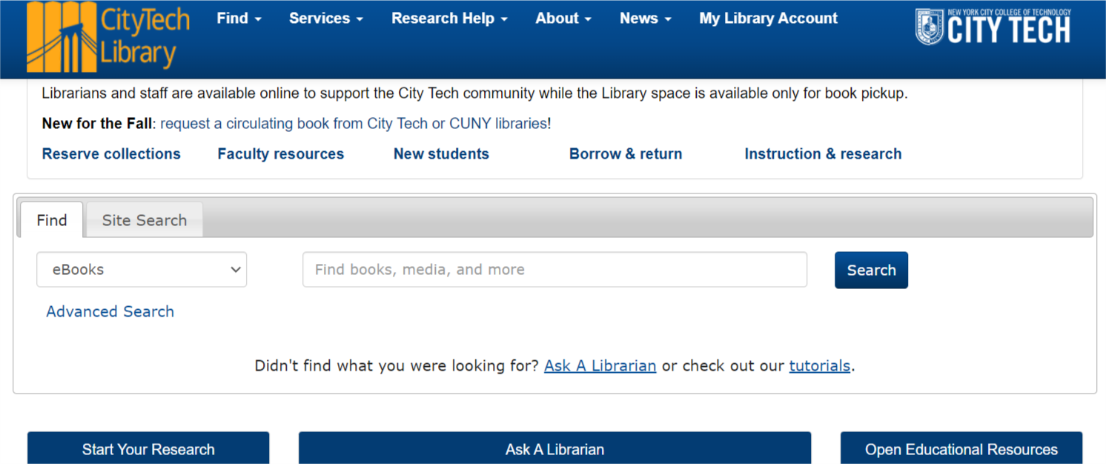
OneSearch library.citytech.cuny.edu
Change the default to EVERYTHING
Searches across library content

Slide 23
Login for full text=your CUNY email (eg CUNY1st) and password

Slide 24
Students search OneSearch for their topic
four genres (news report, op-ed, audio/visual, personal interview)

Slide 25

How did it go?
Student report back

Slide 26
Academic Search Complete https://libguides.citytech.cuny.edu/asc
An all-purpose database of articles and other content
four genres (news report, op-ed, audio/visual, personal interview)

Slide 27
Students search Academic Search Complete for their topic

Slide 28
How did it go?
Student report back

Slide 29
Students search Internet for their topic
four genres (news report, op-ed, audio/visual, personal interview)

Slide 30
How did it go?
Student report back

Slide 31
Discussion (time permitting) Library vs. Google?

Slide 32
One-minute paper http://cityte.ch/12c

Slide 33
ASK A LIBRARIAN by chat or email

Slide 34
Connect with the library!
Follow us @citytechlibrary twitter or Instagram; subscribe to youtube channel

Slide 35
Final questions?
Prof. Monica Berger, Library

