Slide 1
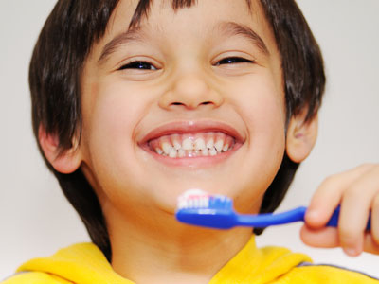
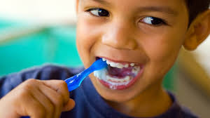

Bright smile for happy kids.

Slide 2

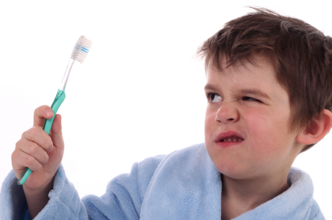

How do you feel when mom says “go brush your teeth!”

Slide 3
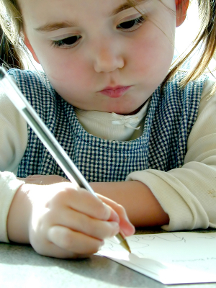
Get ready to take some notes on how to brush your teeth!
https://www.youtube.com/watch?v=Ij_8iM4ybl0
Children colgate video
https://www.youtube.com/watch?v=bKBM_h2gMiM
Young children song video

Slide 4
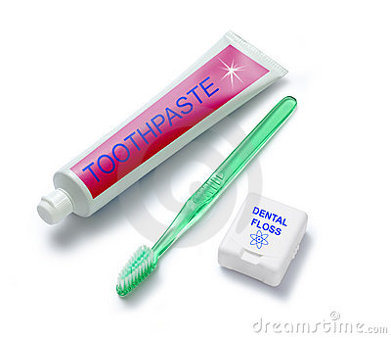
Lets review what we just learned from the video!!
What do we need to brush?
Toothpaste
Toothbrush
Floss

Slide 5
How long do we brush for?
2 minutes!

Slide 6


How many times do we brush a day?
2 times

Slide 7


Can we eat after we brushed at night?
Yes
No

Slide 8
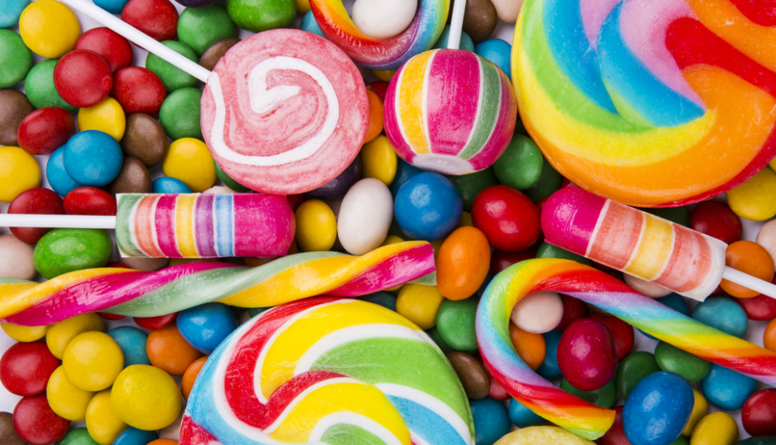
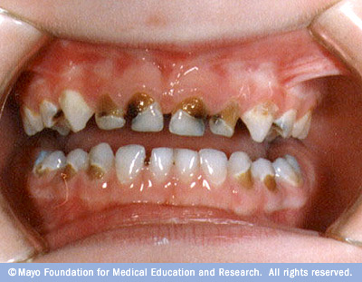
Should we eat a lot of candy?
Yes
No

Slide 9
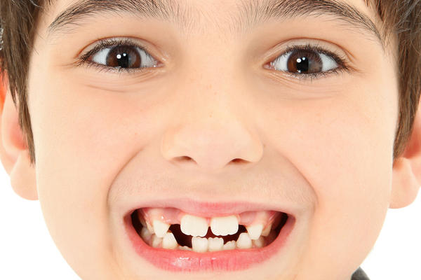
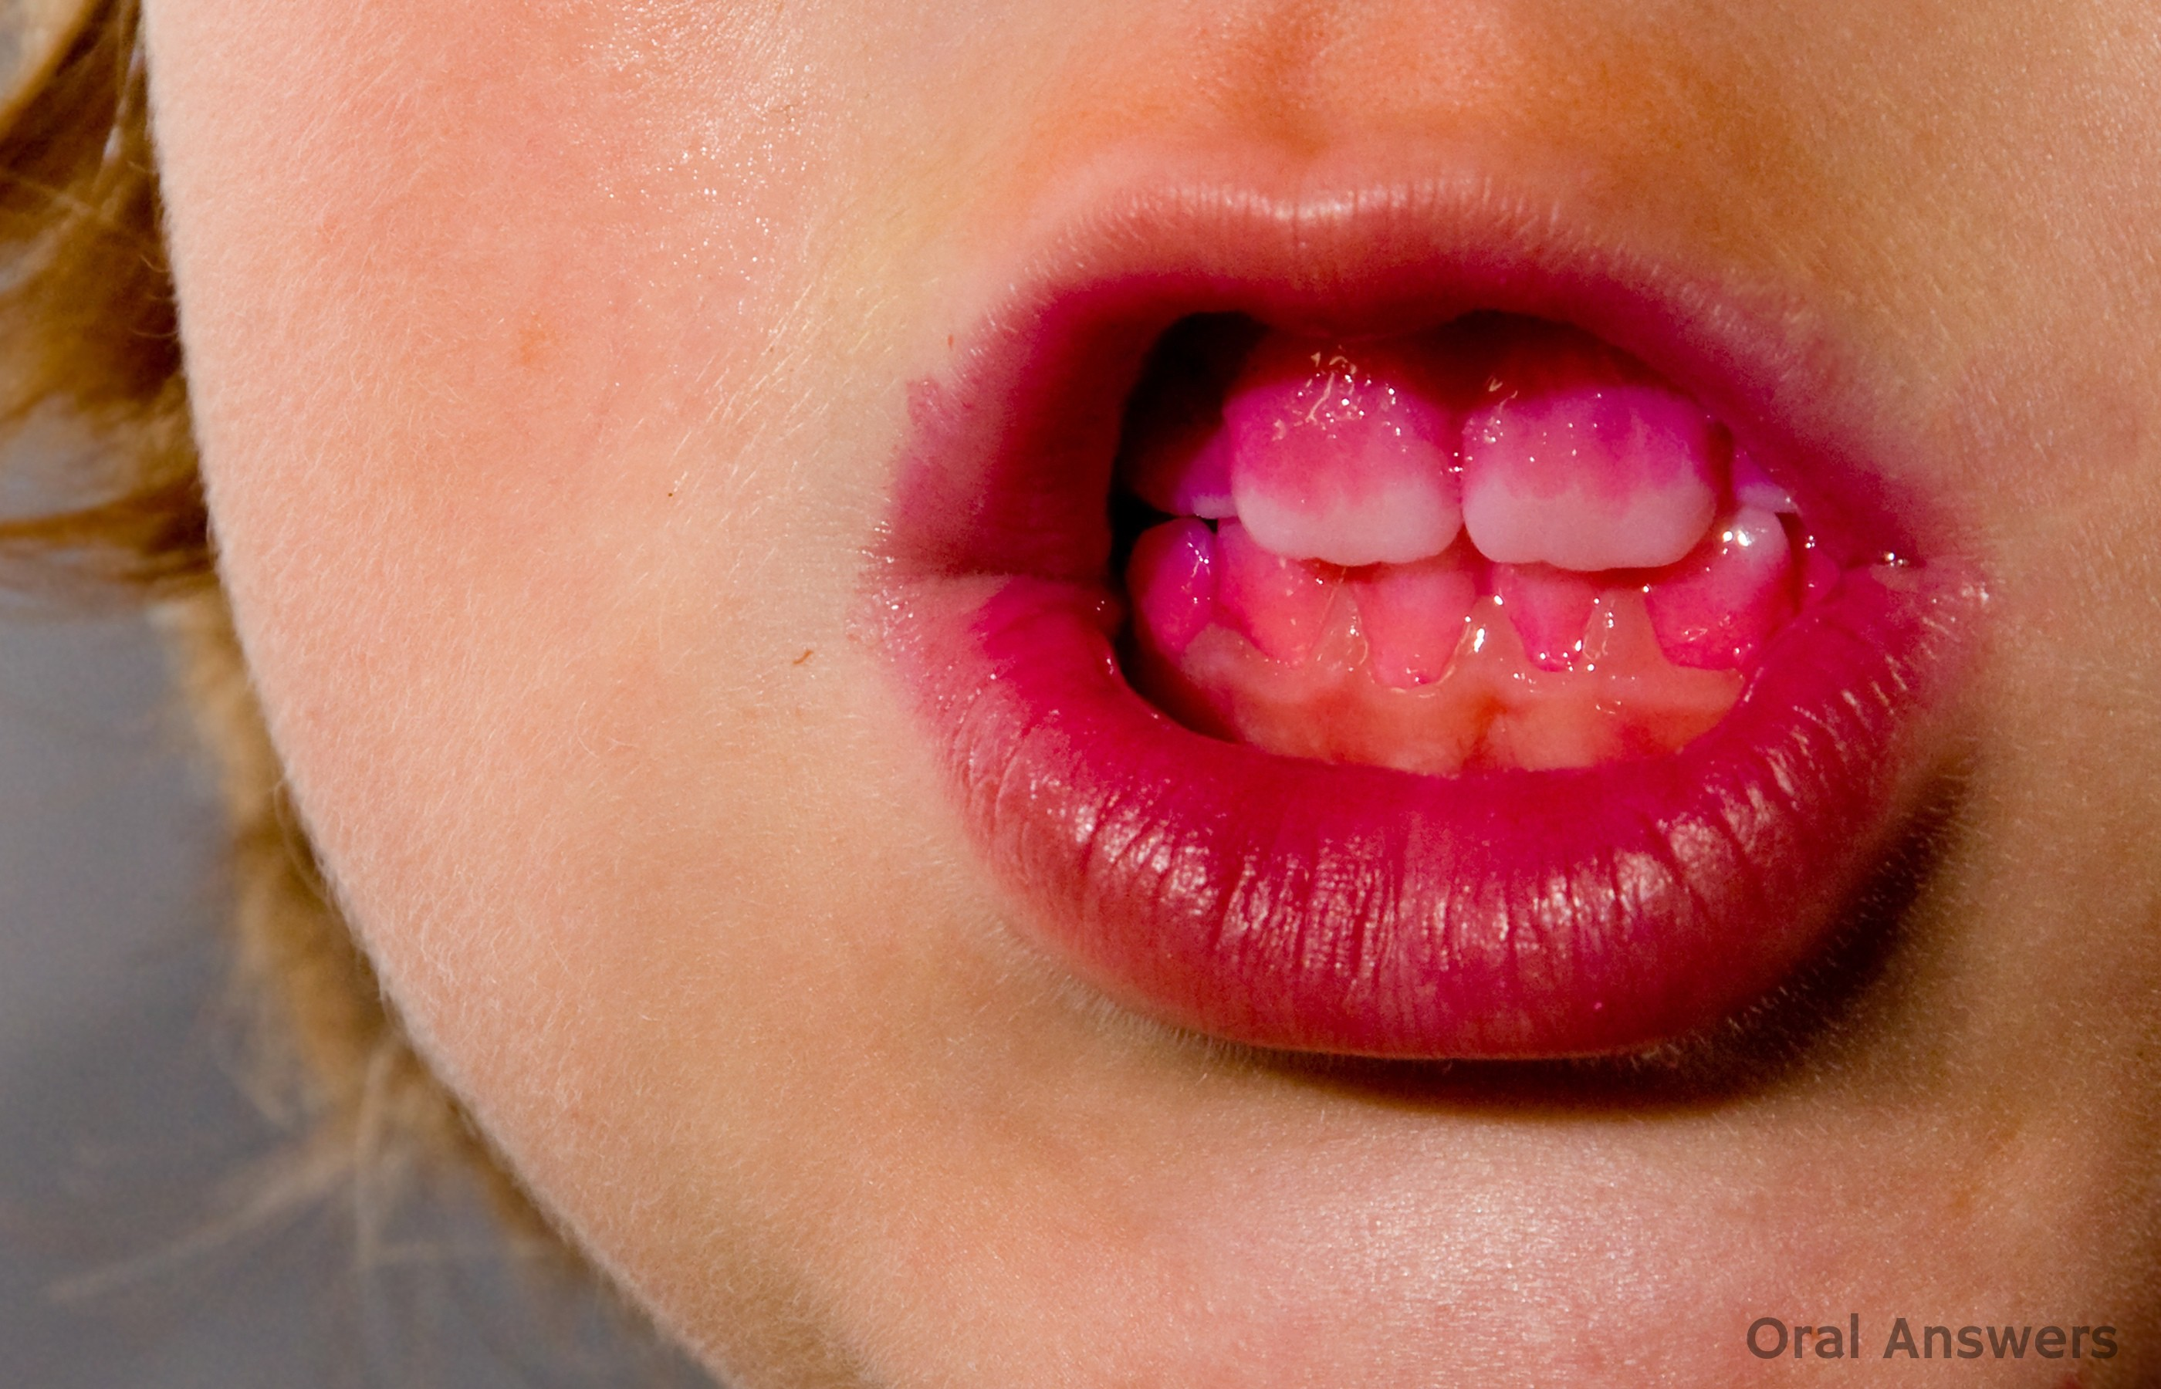


Who brushed their teeth better?
…A or B?

Slide 10
Remember to go visit you dentist!!!
Good bye!!!

