Slide 1
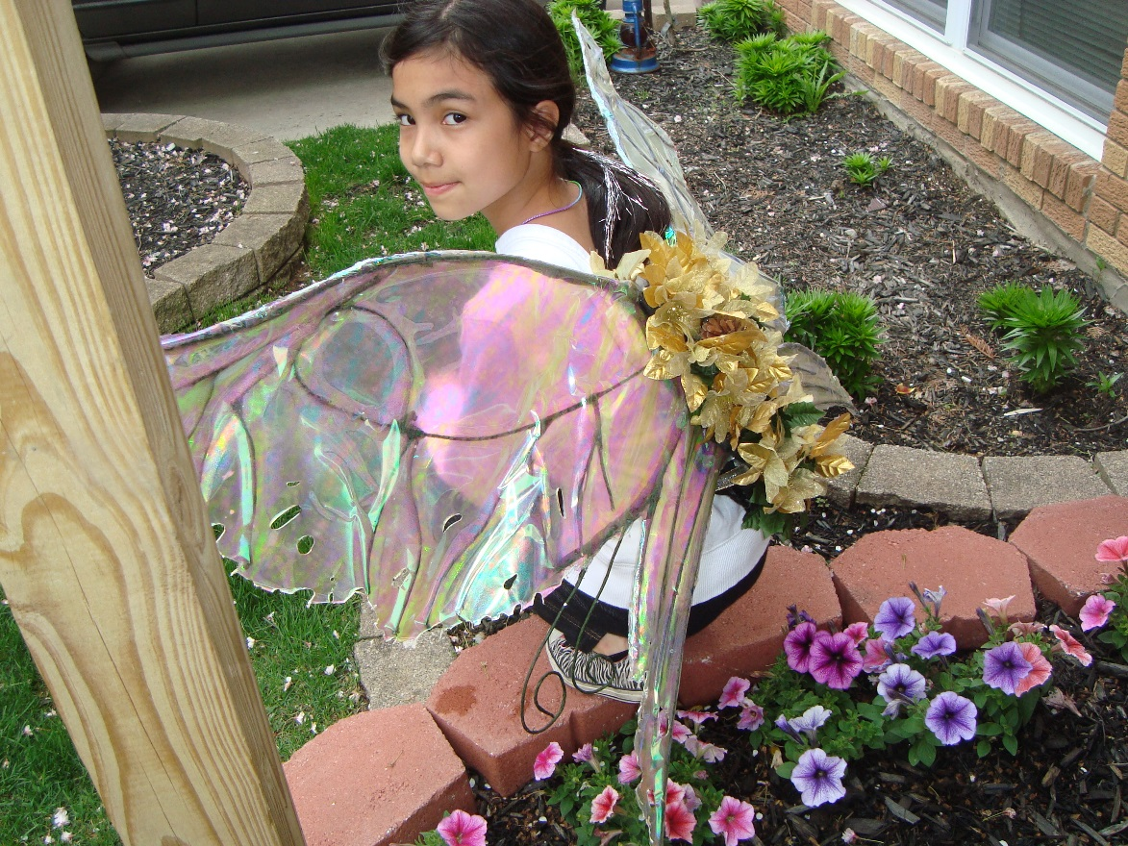
Fantasy Fairy Wings

Slide 2
Proposal
Fairy tales are stories you tell to children to make them dream a little better. Not many can make these dreams come true in reality. My goal for this project is to make a fairy tale come true by recreating the most magical thing of all fairies, their fairy wings.

Slide 3
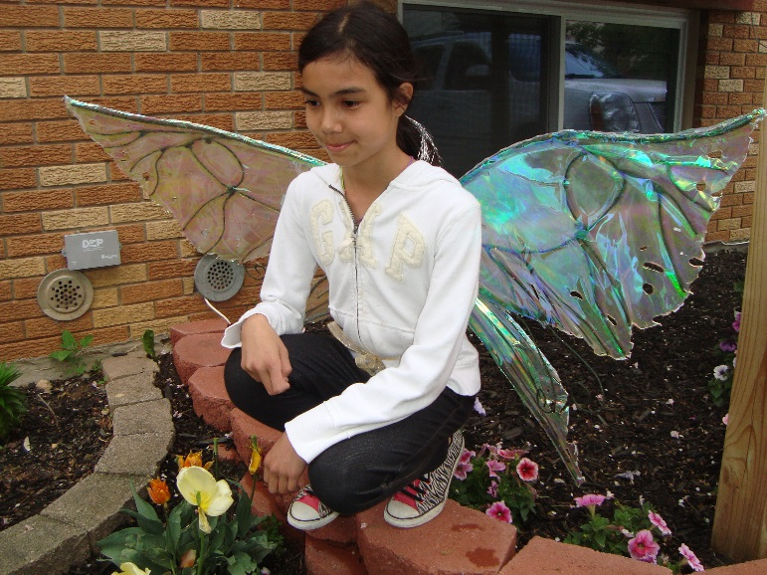
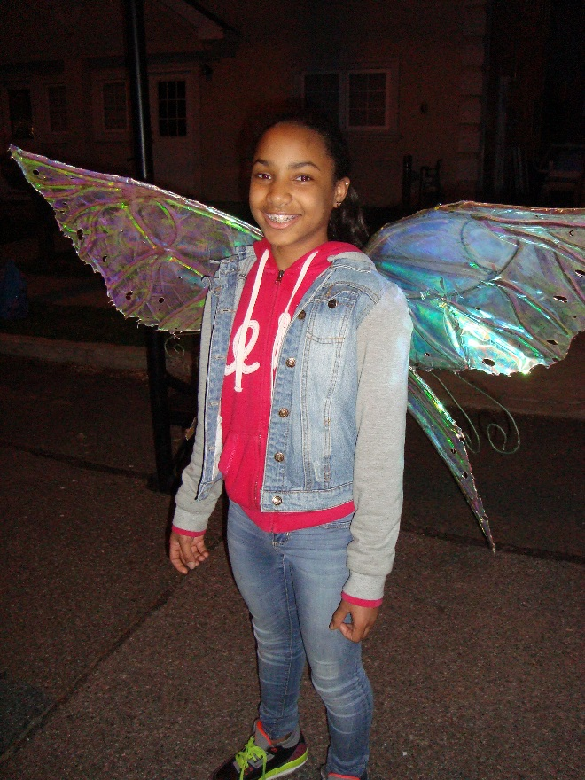
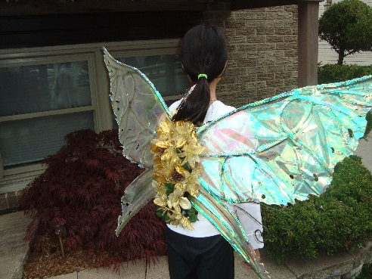
Final Product
This is Christine
These are the Wings

Slide 4
Budget For Wings
# | Materials | Vendor | Qty. | Price | Cost | Man Hours
1 | Irridecent Vinyl | Rose Brand | 1 | $ 112.56
2 | Floral Tape | Michaels | 6 | $ 11.94
3 | Spray Glue | Michaels | 1 | $ 11.99
4 | Aluminum Rod | Home Depot | 5 | $ 21.05
5 | Multi Purpose Wire | Home Depot | 1 | $ 10.98
6 | 3/4 Ply | Home Depot | 1 | $ 9.52
7 | J-B kwik Weld | Home Depot | 1 | $ 5.80
8 | J-B Weld | Home Depot | 3 | $ 18.72
9 | Foam Sheets | Michaels | 2 | $ 1.98
10 | Felt Embossed | Michaels | 3 | $ 2.97
11 | 26 Gauge wire | Michaels | 1 | $ 2.99
12 | Velcro Soft Flex | Michaels | 1 | $ 3.79
13 | Solder Lead Rossin | Harbor Freight | 1 | $ 2.99
14 | Welding Rods | Harbor Freight | 1 | $ 15.99
15
16
17
18
 |  |  |  |  | Total | $ 233.27

Slide 5
LED Budget
# | Materials | Vendor | Qty. | Price
1 | 100 LED Assortment | Maker Shed | 1 | $ 27.07
2 | Arduino Lily Pad | Amazon | 3 | $ 54.00
3 | Power Pack | Radio Shack | 1 | $ 14.99
4 | Wire 3 pack | Radio Shack | 1 | $ 5.99
5 | Sold | Radio Shack | 1 | $ 6.52
6
7
8
9
10
 |  |  | Total | $ 108.57

Slide 6
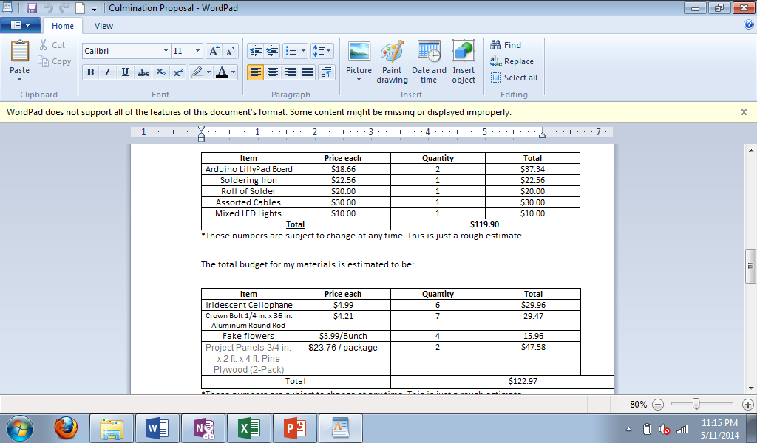
Original Budget

Slide 7
Calendar

Slide 8
Prototype #1
Very first wing ever made
Tested out materials
Determination to make bigger and better wings

Slide 9
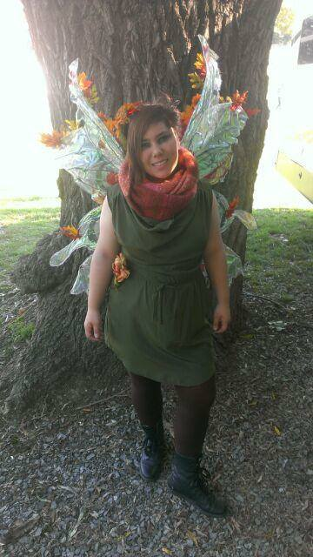
Prototype #2
First wings that were made
Worn to the Renaissance fair.
Made of jewelry wire and cellophane.
Has a wooden harness attached

Slide 10
AutoCAD drawings of Prototype
X-ref drawings from the internet
Printed in full scale
No Jig
Pros and Cons

Slide 11
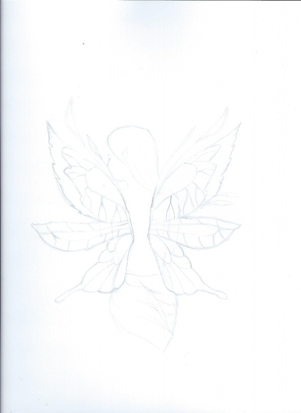
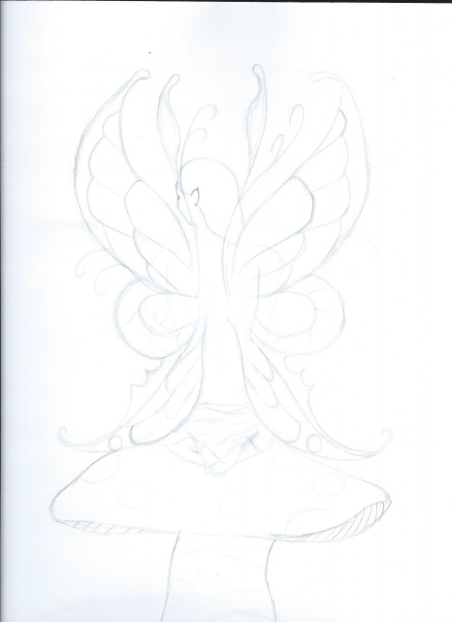
Design Drawings
Drawings of what I wanted the wings to look like
3 different sets
Based off bugs

Slide 12
AutoCAD Application
X-ref of the designer drawings
Colors mean different materials
Used for measurements and template
Printed on full scale

Slide 13
Wooden Jig
Made a wooden Jig
Helped a lot!
Working table where ever I went
Attached the template
Numbered the cut blocks

Slide 14
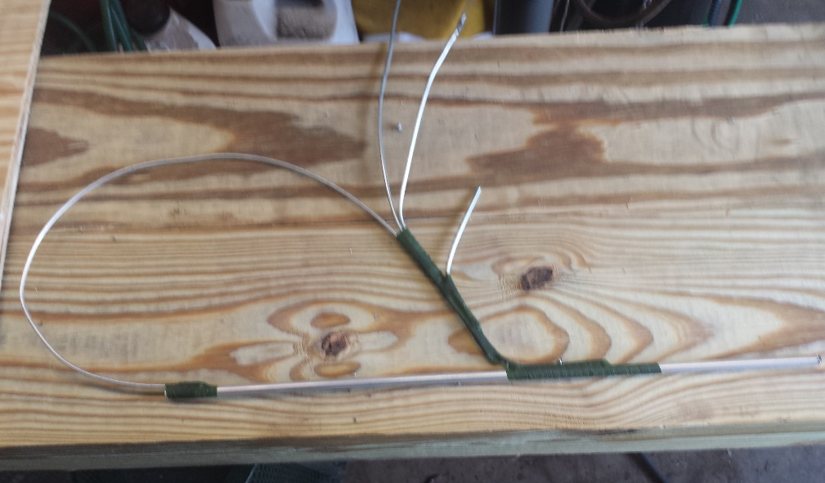
Braising Test
Tried this
Too many little parts
Took a long time
Still not strong enough

Slide 15
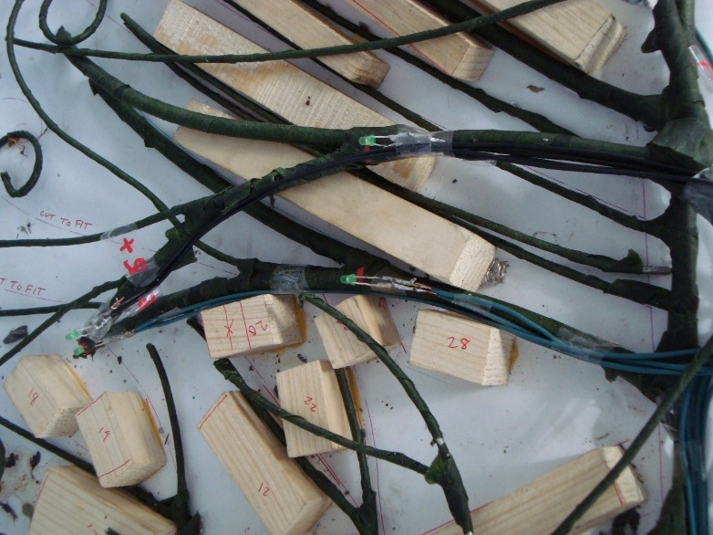
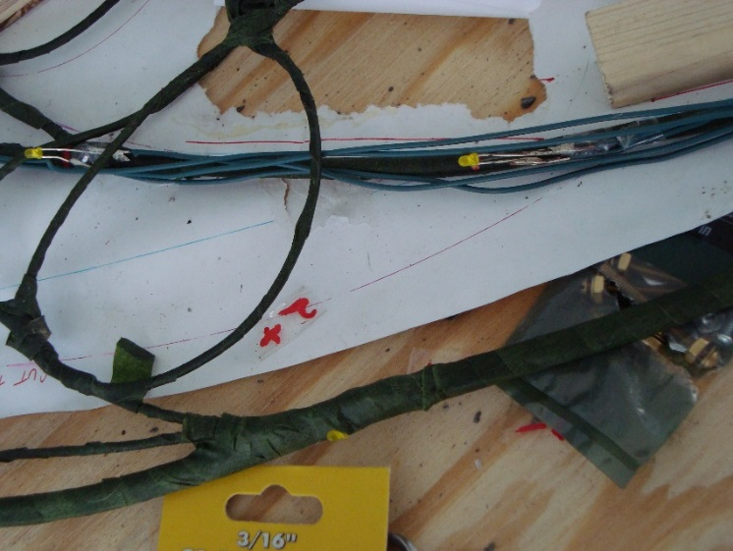
LED Lights Install
Sergio Lombardo Volunteered to program and Arduino
The LED’s were installed
Future application

Slide 16
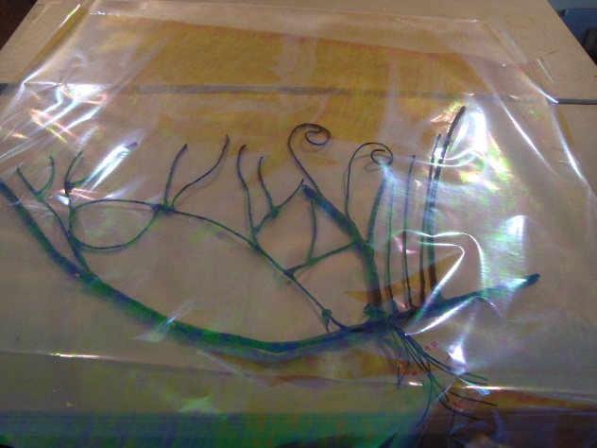
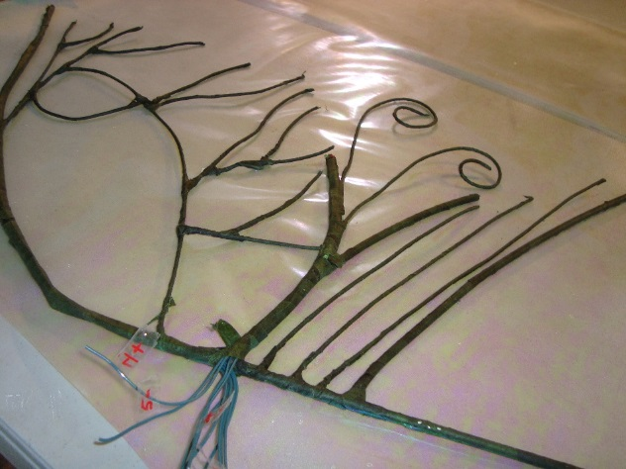
Applying the Glue
Scotch Super 77
Lay the mylar out , Spray the glue
Put the wire down
Spray again
Roll the next layer on top

Slide 17
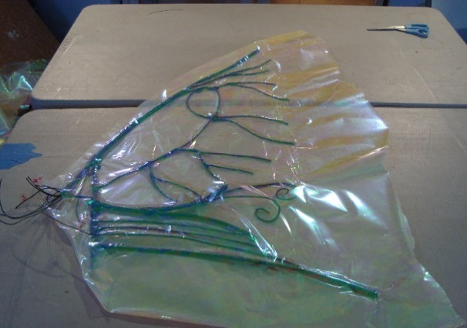
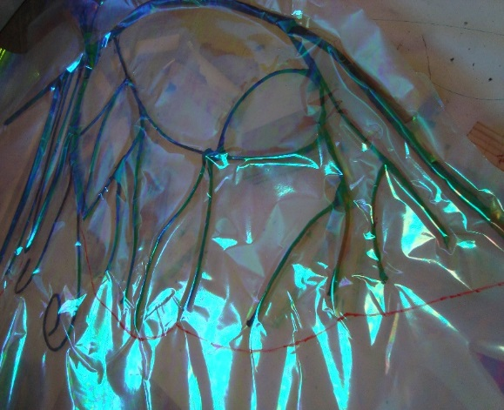
Pinching, Cutting and Pattern tracing
After gluing the mylar Pinch the edges of the wire
Only one chance at this

Slide 18
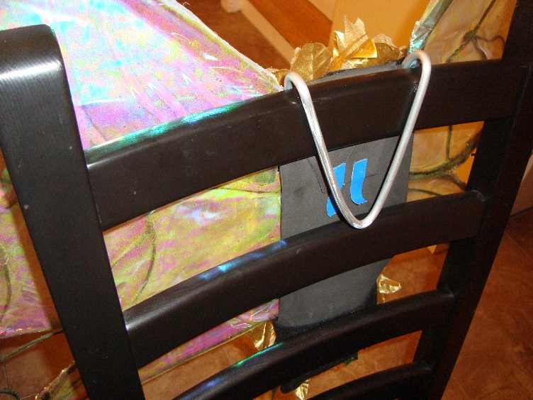
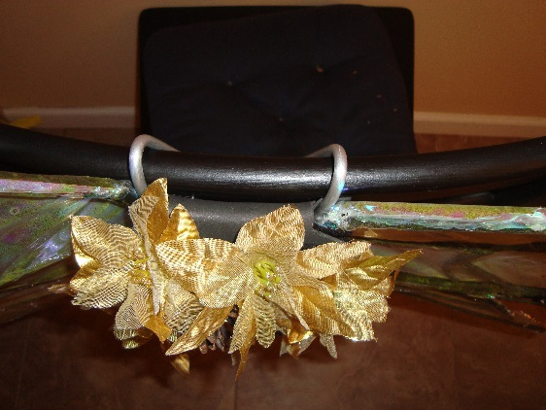
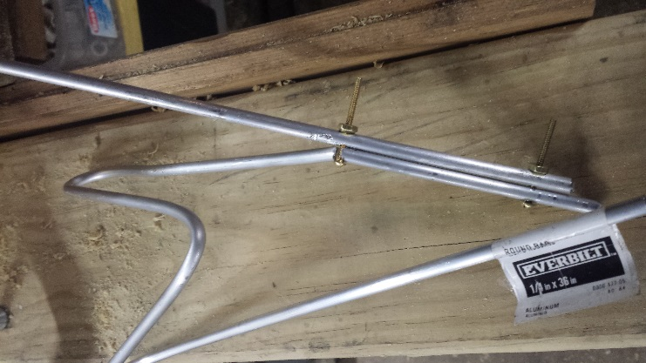
Harness
Ubolts were used to hold the harness to the wings
A “Hook” like method was used
Bolts did not work with the aluminum rod material
Simple, slips into a dress

Slide 19
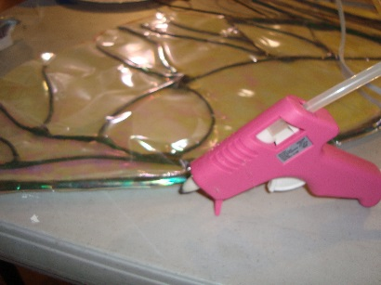
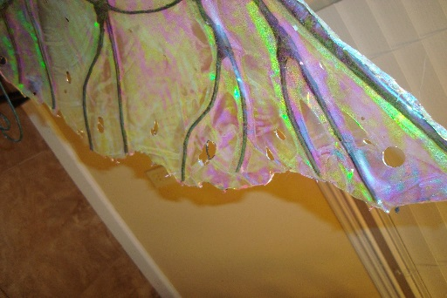
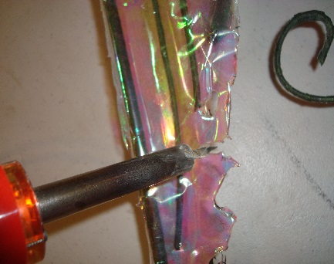
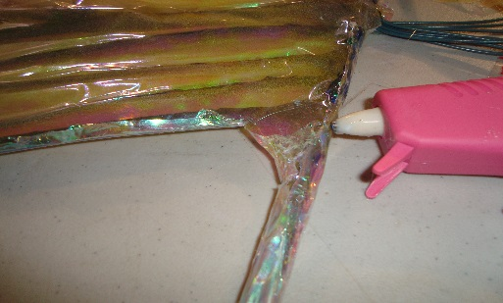
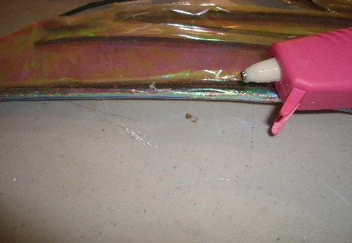
Cutting the shape Burning and Glueing the Edges
Cut the edge on the patern
Hot glues the edges to the frame
Hot glue is hot and burns!!
Soldering iron was used for Texture

Slide 20
What I have Learned
From this project I have learned a few important things:
Stick to the schedule and you will be less stressed for time later.
Annalise all your samples and take notes of your samples to remind you later what you should do and what you shouldn’t do.
If you have a question about something do research and then test those findings on a scaled version of what you are doing.
Do all your research, samples and planning before you start to make the final product. You don’t want to wonder later what are you going to do for the small details.

Slide 21
Thank You
John McCullough
David Smith
Chuck Ederle
Sue Brandt
All the students who helped with this project!

