Slide 1
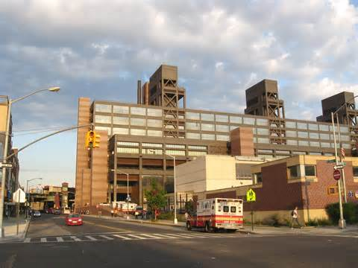
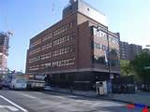
Health Related Facilities
WoodHull Medical Center has Served North Brooklyn for the past 25 years.
Woodhull Medical Center serves the community in Zip Code 11206, Offering Various specialties to treat the community like adult medicine, ER, geriatrics, pediatrics and women’s health.
The New York Department of Mental hygiene Located in Fort Greene, offers the community free Immunizations for adults and children, as well as STD testing.

Slide 2
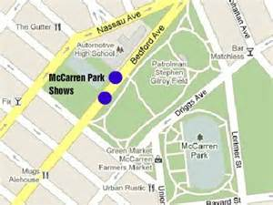
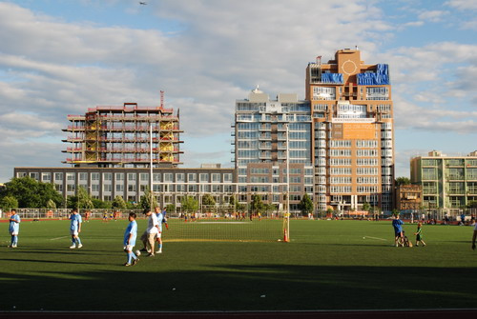
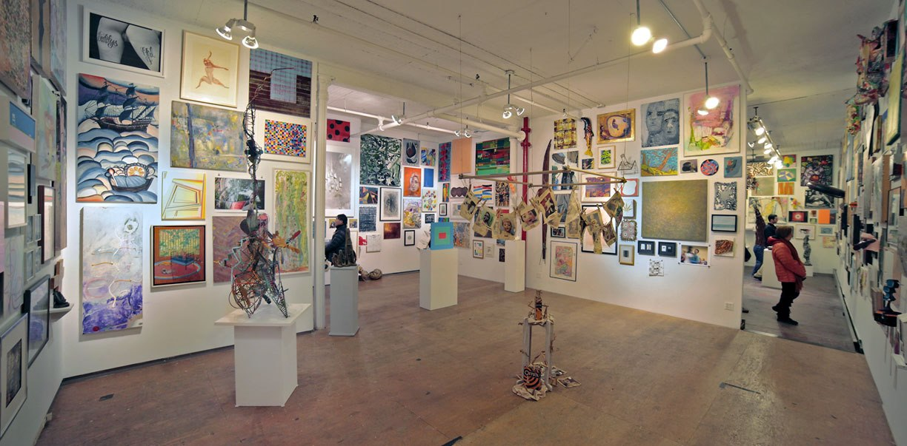
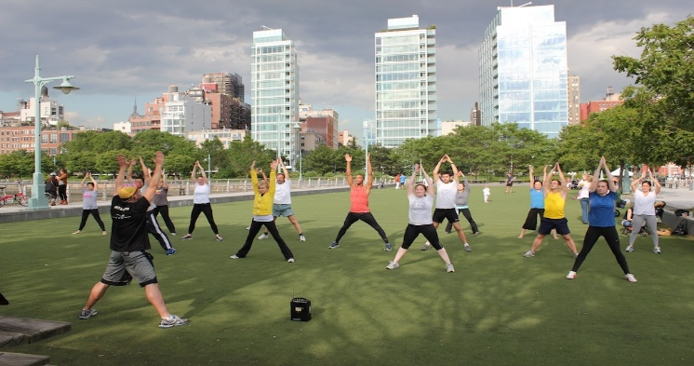
Aesthetics
There are 10 NYC government parks that include baseball fields, handball courts and play grounds for the community in zip code 11206
McCarren Park Recreation center offers music festivals and concerts for the community.
There are over 39 different galleries that cover North Brooklyn which includes Williamsburg, Green point and Bushwick. These art galleries feature traditional art, fine art photography, paintings and other types of visual art.

