Slide 1
GREENING HOSPITALS
LUTHERAN MEDICAL CENTER
(LMC)

Slide 2
PRESENTED BY:
TRACEY-ANN KNIGHT
LOUISE CHARLES
ROSE LI

Slide 3
TABLE OF CONTENTS
INTRODUCTION
RACIAL AND HEALTH DISPARITIES
STAKEHOLDERS
MODEL PROGRAMS
POLICY RECOMMENDATIONS
SUMMARY
SOURCES

Slide 4
INTRODUCTION
According to Practice Greenhealth, hospitals ranks the
largest users of energy,
highest producers of waste,
major consumer of chemicals, paper, water and other resources;
resulting in an industry with a huge environmental footprint. In an effort to reduce the impact on the environment, healthcare organizations are asking for information on best practices, guidance in establishing green practices and methods to measure success”.

Slide 5
Introduction Continued
Hospitals consume energy in: heating,
cooling,
manufacturing,
and transportation.
Health services face the unique problems through the use of pharmaceuticals and biological products.
Environmental waste, toxic bodily byproducts, infectious and radioactive waste can contribute to environmental decline which impacts the community.

Slide 6
Racial and Health Disparities
Environmental practices at major U.S. hospitals have contributed to the increase of pollution as well as environmental costs.
There has been contamination of baby foods, meat, milk, and fish which impacted the health of populations in many U.S. cities.
Toxic emissions, potent carcinogens, mercury, plastic, medications (hormones, narcotics) constitute a major environmental contaminant.

Slide 7
Racial and Health Disparities continued
Human tissue, blood, infectious body material, radioactive agents, laboratory chemicals, and hazardous gas vapors are somewhat regulated and organizations are exploring new ways to protect the environment from further harm.
According to the CDC, only 2 percent of hospital waste needs to be incinerated to protect the public health, but some hospitals incinerate 75 to 100 percent.

Slide 8
Racial and Health Disparities continued
As a result, this has proven to be very costly for hospitals and poses serious risks to the environment and human health; all of which could be avoided.
Pollution impacts our environment, which impacts our health.
Transportation utilizes fuel to deliver goods, material, and people which decreases air quality. With increased air pollution, more people are predisposed to respiratory illnesses.

Slide 9
Racial and Health Disparities continued
Hospital buildings uses energy through heating and cooling which increase air pollution as well. Through the use of coal generated electricity, there is an increase likelihood of cardiovascular disease, cancer and osteoporosis.
Polyvinyl Chloride (PVC) plastic is considered to be a source of toxic compounds in the environment. According to research done by the Minnesota Hospital and Health care Partnership, PVC has been proven to have contributed to 45 percent of total dioxin emissions from the health care industry.

Slide 10
STAKEHOLDERS
Health care establishments
Health care providers
Patients
Community

Slide 11
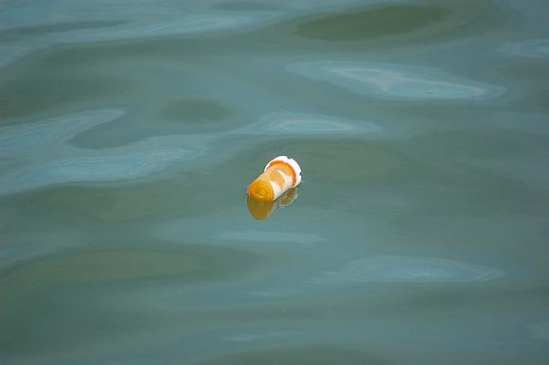
MODEL PROGRAMS AT LMC
Pharmaceutical Waste Collection Program
LMC is now collecting medication in separate container because it is required by agencies such as Federal and State government, Environmental Protection Agency (EPA), and The Joint Commission.
Unfortunately, drug residues have been detected in lakes, rivers, and drinking water supplies caused from waste waters from hospitals, manufacturers, and homes.

Slide 12
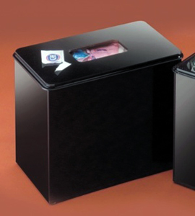
Model Programs at LMC Continued
Nursing Inpatient Units
Partial medications (such as coumadin) are placed in small black containers.
no sharps
empty coumadin containers
nicotine packages/patches

Slide 13
Model Programs at LMC Continued
Nacortics/DEA controlled
substances are disposed in
omnicell return bins.
Inhalers and aerosol are placed
in patient medication cassette for
return to pharmacy.

Slide 14
Biohazard pharmaceuticals (albumin, thrombin) are returned to pharmacy and discarded in biohazard red bags.
Drain or sink disposal are allowed for only IV fluids without medication (normal saline, dextrose solutions), TPN without insulin, IV fluids with electrolytes (potassium chloride, magnesium).

Slide 15
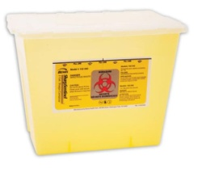
Model Programs at LMC Continued
Trace chemotherapy (empty chemo syringes, vials, IV bags, contaminated personal protective equipment (PPE) are placed in yellow bins.
Chemotherapy with more than 3% must be disposed in “Black flammable/toxic”bins.

Slide 16
Model Programs at LMC Continued
Hazardous Materials and Waste Management Program
Inspection of hazardous material storage areas
Training staff that handles hazardous materials and waste
Conducting risk assessments
Reviewing the waste process

Slide 17
Model Programs at LMC Continued
Testing and inspection of eye wash stations
Assessing effectiveness
Review departmental hazardous material handling, storage, and waste procedures
Monitoring spill procedures and reporting
Reviewing Hazardous Materials shipment manifest logs

Slide 18
REDUCE REUSE RECYCLE PROGRAM
LMC joined the “PlaNYC Mayor’s Challenge,” to reduce greenhouse gas emissions by 2030
Collection and recycling of bottles, cartridges, copier bottles, drum/fuser, inkjet, ribbon, toner, paper, plastics, and cans
Reduced overall CO₂ footprint by nearly 2M pounds

Slide 19
Reduce, Reuse, Recycle Program Continued
Performed lighting retrofit throughout LMC, yielding $180,000 in savings.
Switched to eco-friendly cleaning products
Switched to environmentally safe filters in the HVAC system.

Slide 20
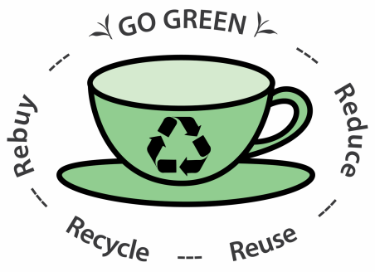
Now using non VOC (volatile organic compounds) paints
Reprocessing medical/surgical instruments/items where appropriate
Using more recycled content paper (ex. In towel dispensers).
Encouraged biking and installed bike racks
Planted 22 trees around the medical campus
Moved from disposable tray ware to reusable tray ware
Installed a natural gas cogeneration facility to produce our own electricity.
Reduced water consumption in sterilization process by 1.5 million gallons

Slide 21
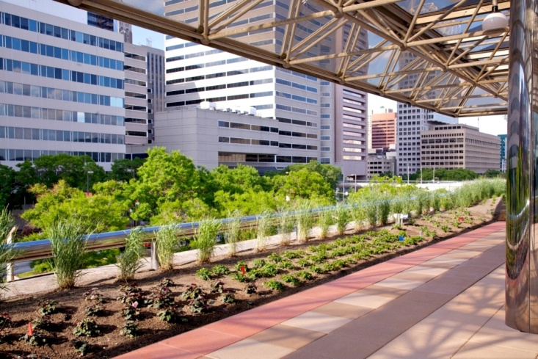
RECOMMENDATIONS for Future
RN on LMC’s green team to collaborate with other disciplines in an effort to continue to protect and preserve the environment
Place recycle bins at strategic points throughout patient care areas
Encourage “Bring your own cup campaign” for coffee, tea, soda e.t.c in the cafeteria or coffee shop
“Green” Lutheran Roof

Slide 22
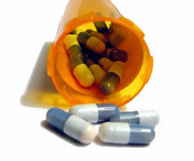
Recommendations Continued
Car-pooling to work
Investigate the use of single-use glass recyclable glass bottles/vials for medication administration
Treating all medications whether hazardous or not as universal hazards

Slide 23
Recommendations Continued
Encourage utilization of employee e-mail as opposed to distribution of information via paper
Fast track total computerized charting in order to eliminate the use of paper charting
Investigate the use of a less strong smelling liquid used by housekeeping for waxing floors

Slide 24
Recommendations Continued
Greener cleaners
Green electronics
In order to conserve energy, encourage employees to turn off non-essential electronics on the weekends when certain departments are closed

Slide 25
SUMMARY
If the earth’s ecosystem is to continue to support human health, each community needs to maintain public health and provide health care in ways that will sustain the earth’s ecosystem. Although the exact amount of dollars saved may never truly be known, green and healthy hospital initiatives have been associated with improved quality of life for patients, their visitors, and medical staff are priceless. So we as part of Lutheran Medical Center, we will continue to go green.

Slide 26
REFERENCES
Wilson DE, MSc, RD, CFE, Garcia A C, PhD, RD, CFE. ‘Going Green’ in Food Services: Can Healthcare Adopt Environmentally Friendly Practices? Canadian Journal of Dietetic Practice and Research, Spring 2011. Vol 72 No1. pp 43-47.
Gillmeister D. Hospitals that go green can see green with effective waste strategies. Healthcare Purchasing News. January 2012. pp 46-47.
Cantrell S, ELS. Go green to avoid seeing, turning red. Healthcare Purchasing News, August 2011. pp 30-34.
Jameton, A., Pierce, J. (2001). Environment and Health: 8. Sustainable Health Care and Emerging Ethical Responsibilities. Canadian Medical Association or its Licensors, 164(3), 365-369.
www.heritage-enviro.com
www.ewg.org/reports/greening
Carpenter D, Hoppszallern S. Greening Up, Hospitals getting savvier on sustainability. Health Facilities Management, July 2008. pp 15-21.

