Slide 1
MY OG Experience
Lucie Mingla

Slide 2
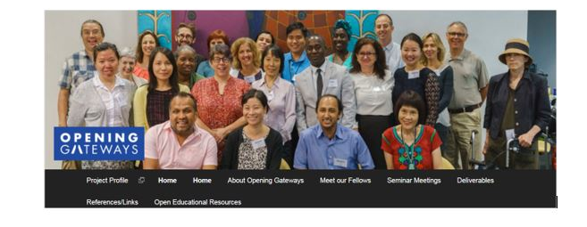
,
Amazing teams each year, and especially amazing Leadership

Slide 3
Thank you, Professors Jonas Reitz, Charlotte Edwards, Marianna Bonanome, and Laura Ghezzi for all the effort and valuable input to this project.
Not to forget the contribution of everyone else especially the Speakers, Andrew Parker for the amazing work in webwork, etc

Slide 4
Exchanging experiences
and ideas about new
Effective approaches and
pedagogies of teaching

Slide 5
How all my qualifications and especially OG have affected my teaching:
1-Creating better structure of my math courses
2- Enriching the content in my courses by creating and using OER-s materials
A- OER courses on Open Lab (Discussions, reflections, information, and more)
https://openlab.citytech.cuny.edu/members/luciemingla/
B- Deliverables, interactive desmos activities, video lessons, etc
C- STEM applications. STEM projects with my students for every class.
3- Increasing the professional collaboration and growth
A- Increasing students’ involvement in making decisions
B- Creating Inclusive syllabus. https://openlab.citytech.cuny.edu/groups/writing-syllabi-that-promote-and-embrace-diversity-and-inclusion/ (TLH)
C- Giving constructive feedback, reflection papers, etc
4- Exchanging experiences and ideas with colleagues about new effective approaches and pedagogies of teaching. Many projects such as OER, OG fellowship, etc
A- Be active in PD that the institution offers such as cohorts, courses, conferences, etc
B- Presenting in conferences and symposiums to deliver creative ideas with others (my presentations).
C OG fellowship wasn’t the last. Only during the Pandemic, I was certified for ACUE Cohort (1 year enrollment. Fall 2020-Spring 2021 ), CUNY Online Essentials winter 21, Inclusive STEM teaching Project Summer 2021.

Slide 6
Presenting and Co-presenting in conferences
An Introduction to Desmos, 30th International Conference on Technology in Collegiate Mathematics, Washington, DC, USA, March 15 – 18, 2018 (joint presentation with Arianne Masuda)
Using Technology for Interactive STEM Applications, MAA Hofstra Metro New York Annual Meeting, New York, USA, May 13, 2018 (Presenter) Link New York City College of Technology, CUNY Program
Creating OER-s and Interactive STEM Applications in Mathematics Higher Education, Global Education Conference, November 2019,
Engaging College Algebra and Trigonometry students with OERs, Joint Mathematics Meetings (JMM), Baltimore, MD, US, January 16-19, 2019 (joint presentation with Arianne Masuda)
Transformative Learning in the Humanities (THL): Writing Syllabi that Promote and Embrace Diversity and Inclusion
Friday, February 26, 2021 from 11:00 am-1:00 pm
MAA NY metropolitan area presentation: Writing Syllabi that Promote and Embrace Diversity (Spring 2021)

Slide 7
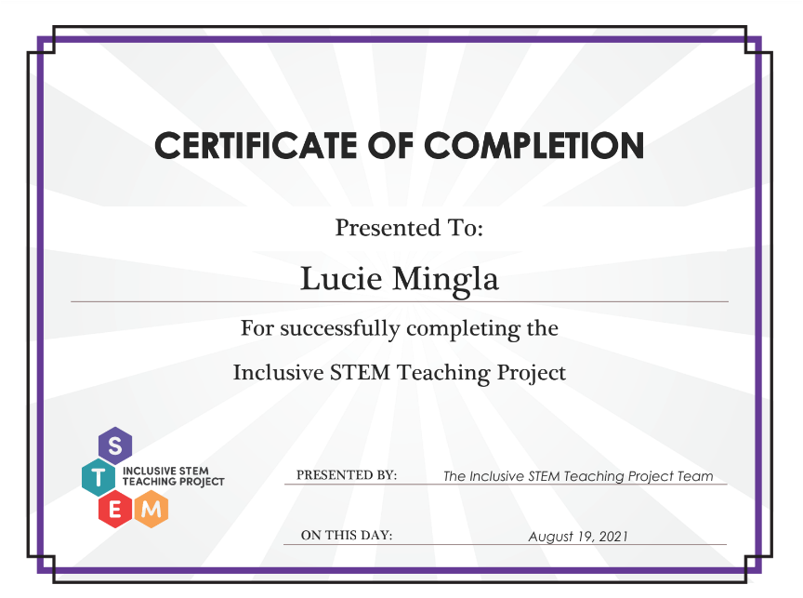

Slide 8
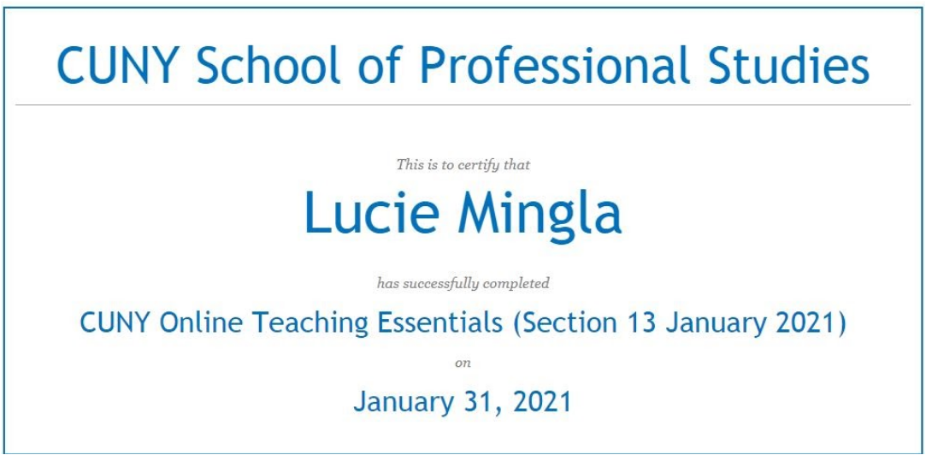

Slide 9
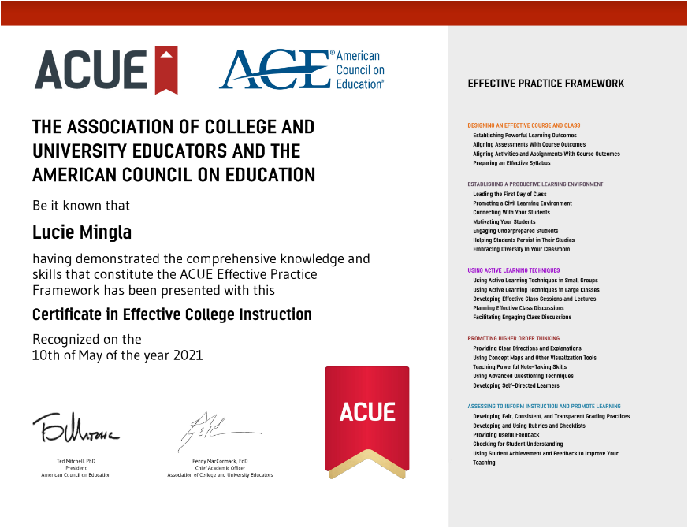

Slide 10
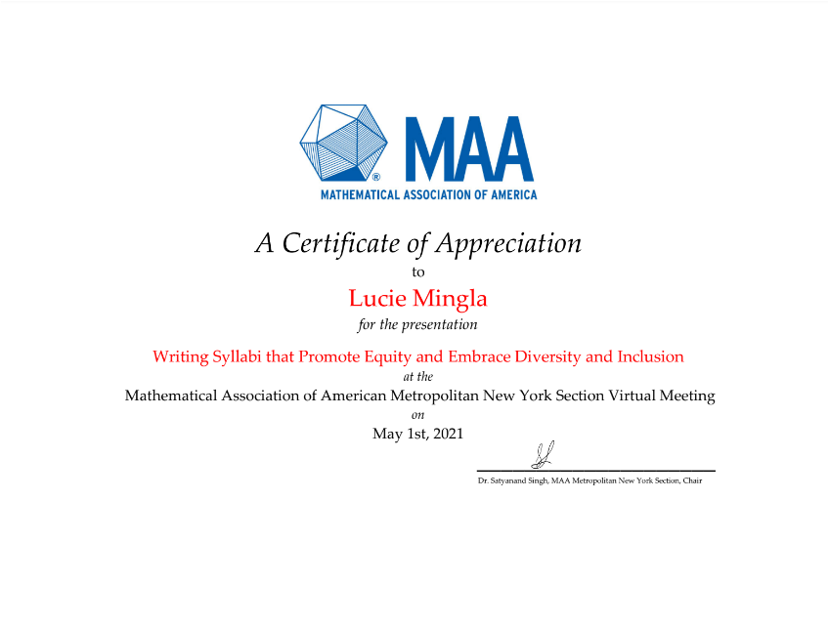

Slide 11
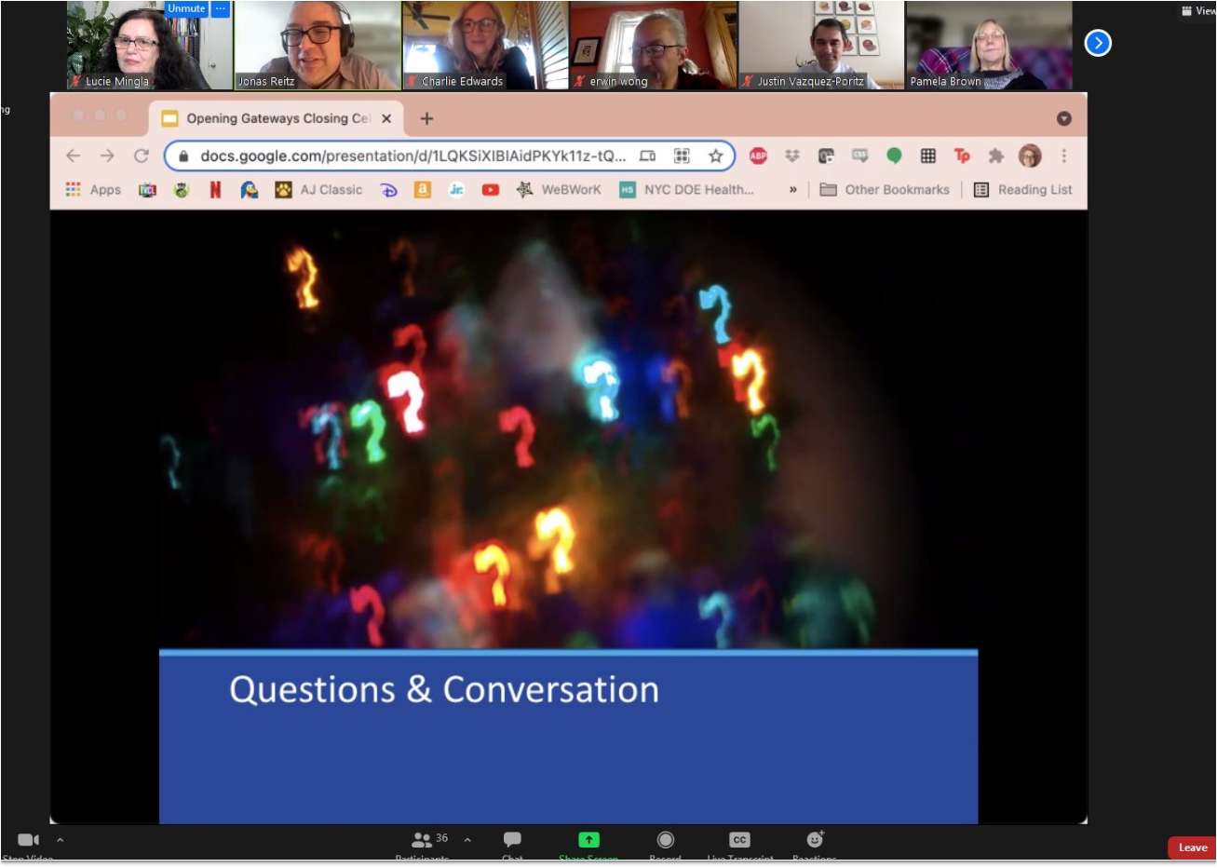

Slide 13
