Slide 1
*One-to-one functions ( or injective) * Inverse functions Instructor: L . Mingla
Session 8/Mat 1375
(Pre-calculus)

Slide 2
Definition of the Function
A function f consists of two sets, a set D of inputs called the domain and a set C of possible outputs called the codomain, and an assignment that assigns to each input x exactly one output y.

Slide 3
One-to-one functions (or injective)
Definition 7.1.
A function f is called one-to-one (or injective), if two different inputs
X1 ≠ X2 always have different outputs f(x1) ≠ f(x2).

Slide 4
Examples of non one - to –one function
Example 7.2. As you know, the function f(x) = x²
is not one-to-one , because, for example, for inputs 2 and −2, we have the same output:
f(-2)=f(2)=4

Slide 5
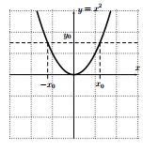
Functions in graphs
X1 ≠ X2 while
f(x1) = f(x2).
For x=2 X=-2
F(2)=4 F(-2)=4
In general:
Y0 = (x0)² =(−x0)²
Not one to one function
(Horizontal line test)

Slide 6
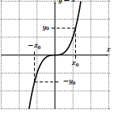
Is a one to one function based on the definition? Discuss in pairs and draw a conclusion
Horizontal Line Test). A function is one-to-one exactly when every horizontal line intersects the graph of the function at most once.

Slide 7
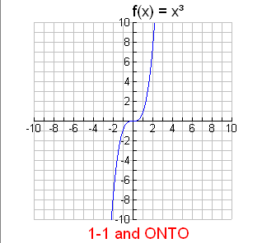
For each value of x there is only value of y & for each y there is only one x : (1-1) & R=(- ∞, ∞): onto
On the other hand, g(x) = x³ is one-to-one, since, for example, for inputs −2 and 2, we have different outputs: g(−2) = (−2)³ = −8, g(2) = 2³ = 8

Slide 8
Horizontal line test
This graph intersects with a horizontal line at some y0 only once. This shows that for two different inputs, we can never have the same output y0, so that the function f is one-to-one.

Slide 9
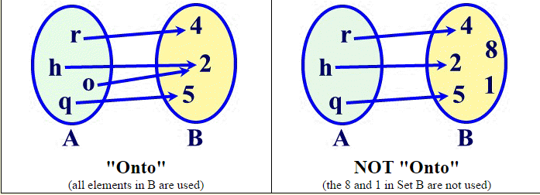
Onto functions and not onto functions A function f from A to B is called onto if for all b in B there is an a in A such that f (a) =b. All elements in B are used.

Slide 10
A function f from A to B is called one-to-one (or 1-1) if whenever f (a) = f (b) then a = b. No element of B is the image of more than one element in A.

Slide 11
One to one functions and onto functions One-to one & onto/one to one-not & onto onto

Slide 12
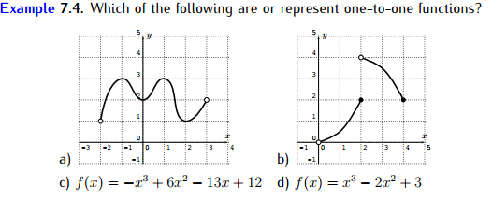
One to one functions (for c and d graph in the graphing calculator and see

Slide 13
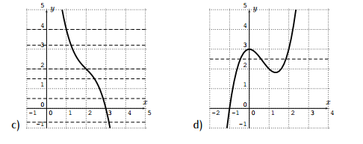
Horizontal line test

Slide 14
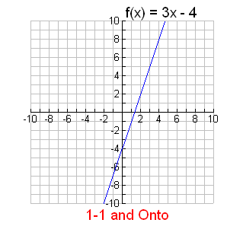
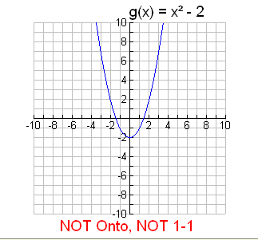
Functions in graphs
For each value of x there is only one value of y & for each y there is only one x ( R=(- ∞, ∞)
Not all values of y are used: R=[-2,∞)

Slide 15
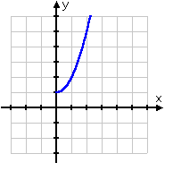
Find the inverse of y = x² + 1, x > 0, and determine whether the inverse is a function.

Slide 16
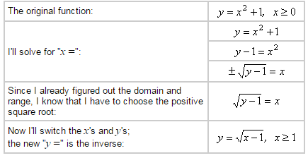
The function's domain is x > 0; the range (from the graph) is y > 1. Then the inverse's domain will be x > 1 and the range will be y > 0.

Slide 17
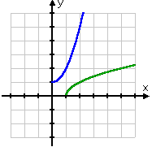
Let’s look at the original graph and its inverse

Slide 18
Inverse functions

Slide 19
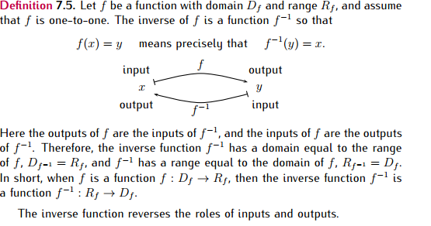
Domain and range

Slide 20
How do we find the inverse functions ?

Slide 21
Solution:

Slide 22
How can we restrict this function to make it one-to-one function

Slide 25
Two inverses of each other undo each other

Slide 26
Work in pairs to check if the pairs of functions are inverse

Slide 27
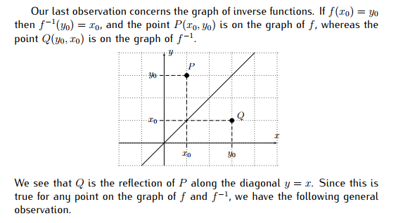
Graph of inverse function symmetrical to y=x line

Slide 28
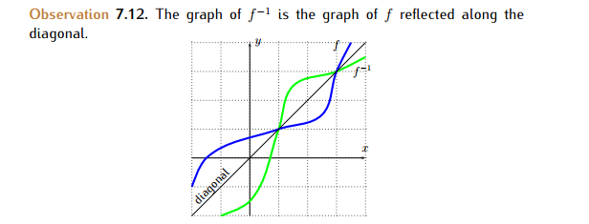
f Reflected along diagonal to its inverse f¯¹

Slide 29
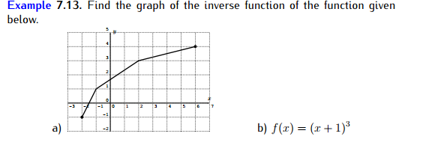
Practice

