Slide 1
Corrections
Test #1

Slide 2
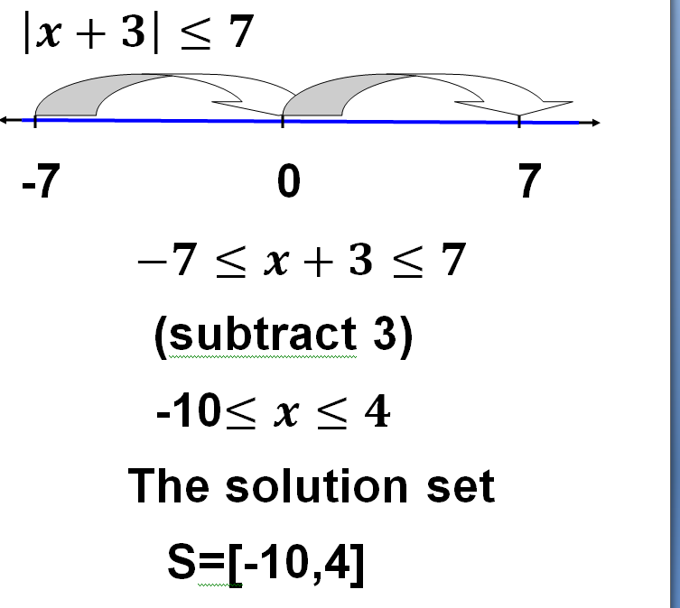

Slide 3
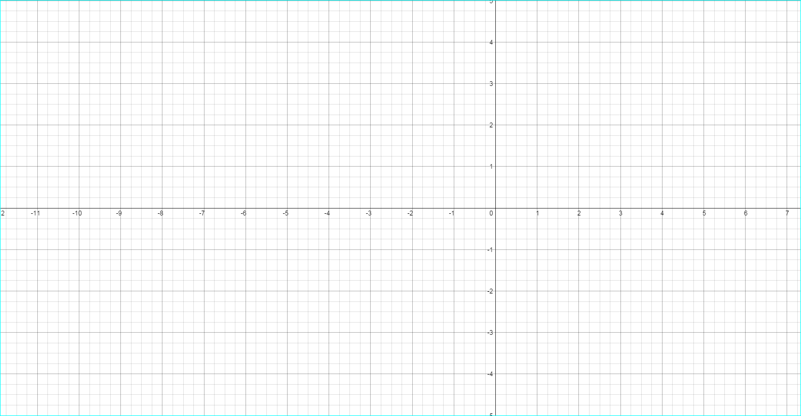

Slide 4
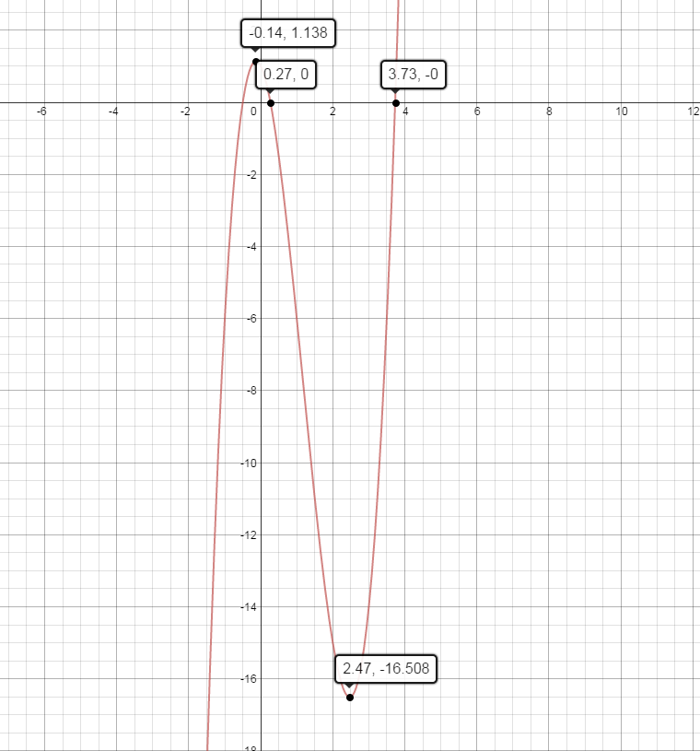

Slide 5
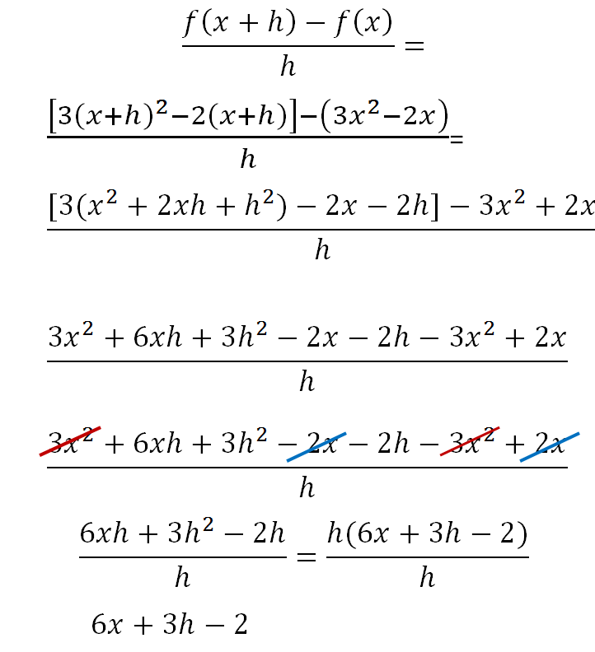
Q.3

Slide 6
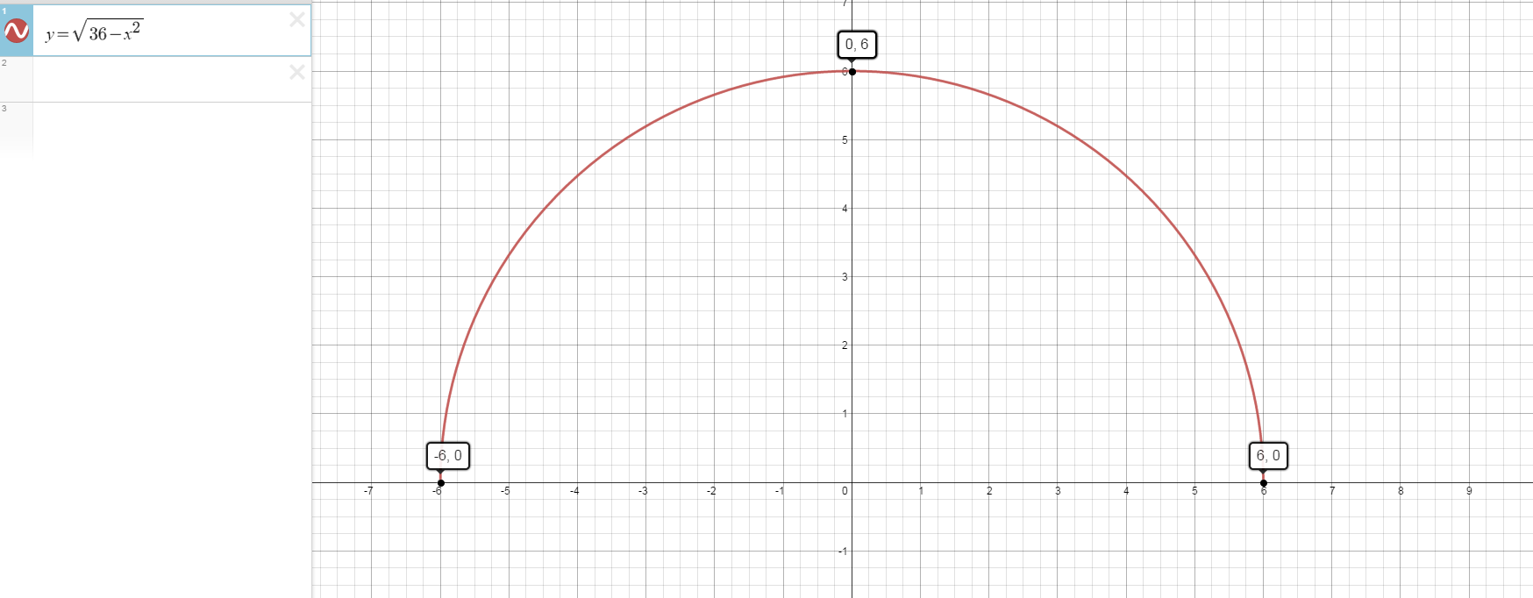
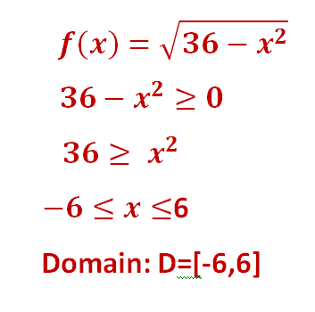
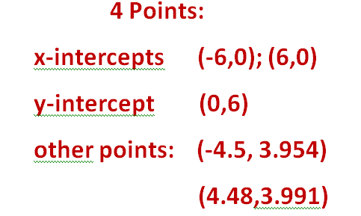
4)
Range: R=[0,6]

Slide 7
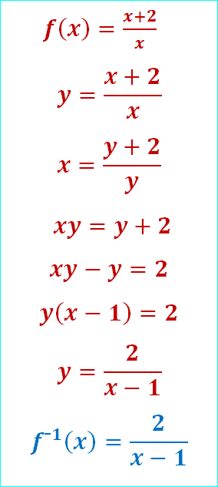
Inverse function function
Mark f(x) as y
Switch x and y
Solve for y
Write y as f¯¹(x)
Check the answer

Slide 8
Question 5

