Slide 1
Exit Ticket on Inverse functions
Question 5 feedback

Slide 2
The question:
5) Find the inverse of function Determine whether the inverse is also a function, and find the domain and the range of the inverse. Draw the inverse function if it exists. Explain the procedure and reasoning.

Slide 3
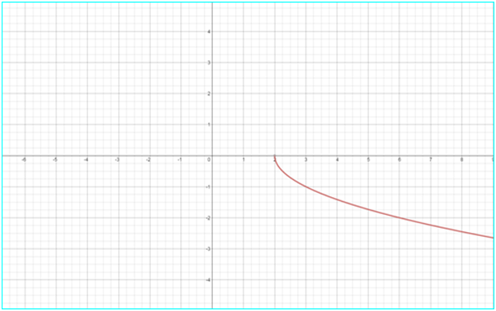
The graph of the original function:

Slide 4
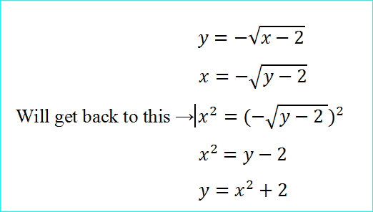
Solution and explanation

Slide 5
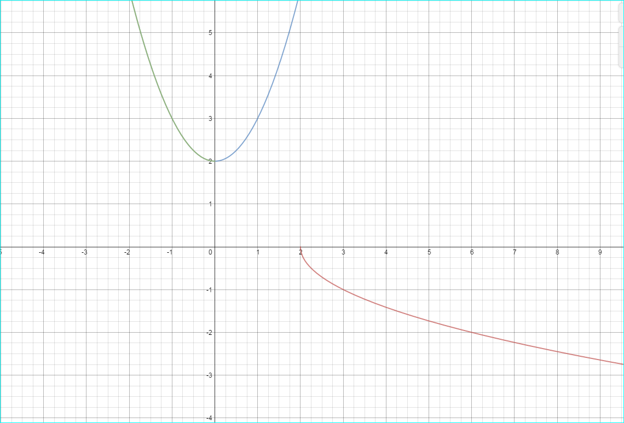
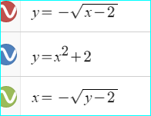

Slide 6
Discussion of what is the graph of the inverse function
As we know the graphs of two inverse functions are always symmetrical to the line y=x. If we graph the two functions the one that is given and its inverse( the first two). As we can see they are not symmetrical to the line y=x. That should make us think about the real inverse function graph.
If we graph the third function ( the function where you switch x and y) before you square both sides you see that the green graph is exactly what we are looking for. (third slide shows with when we gain the other part of the graph ( blue one)

Slide 7
