Slide 1
Homework #2
Do the assigned questions from Lesson 1.4

Slide 2
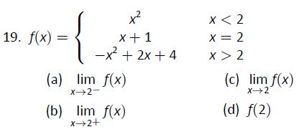
Jayson A. Question#19
Note
X→2- is left hand limit and X→2+ is right hand limit.In these two limits + and - doesn't mean positive or negative .+ means limit approaching from right hand side (positive side) of graph and - means the limit approaching from left hand side (negative side) of graph .When both limits are the same then the limit is also the same for X→2.X→2 is when the certain number or 2 in this case approaches from both sides. also approaching 2 doesnt mean the number is 2.
b)lim f(x) X→2+
rule:{-x² +2x+4,x<2}
lim -x² +2x+4 x→2+
lim -(2)²+2(2)+4=4 x→2+
lim f(x) =4 x→2+
a)lim f(x) X→2-
rule:{x² ,x<2}
lim -x² x→2-
lim (2)²=4 x→2-
lim f(x)=4 X→2-
Also approaching 2 does not mean x value equal 2 because its APPROACHING.it either means x<2 approaching from left or x>2 approaching from right.
As x approaches 2 from the right, we see that f(x) approaches 4. Therefore
As x approaches 2 from the left, we see that f(x) approaches 4. Therefore
lim f(x) =4 x→2+
lim f(x)=4 X→2-
Notes:
Since this is a piecewise function, maybe it would clear if you show the substitution in the specific piece when x→2+, and when X→2-. However it is correct.

Slide 3
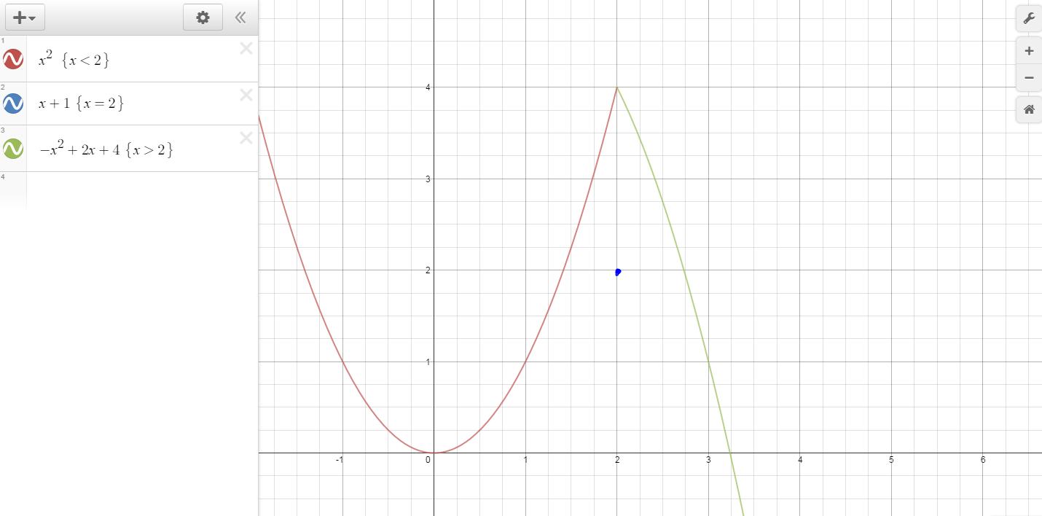
Jayson A.
Question#19
c)lim f(x)
X→2
Since lim f(x) x →2-
has the limit of 4 and lim f(x) x→2+
has limit of 4 then lim f(x) x→2
has limit of 4 because both sides where the 2 approaches x has the same limits.
d)f(2)
rule:{x+1 , x=2}
2+1=3
i am finding the y-value when x = 2.when there is a closed circle at that spot then the graph is defined and that y value is the answer.
lim f(x)=4
X→2
f(2)=3
Notes:
Very good!

Slide 4
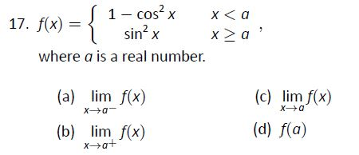
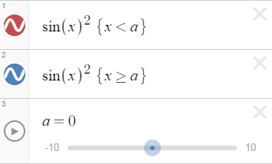
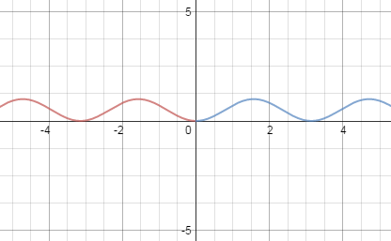
Tarik A. Question #17
X→a⁻ and X→a⁺ are left hand and right hand limits, respectively. Graph depends on the value of a; a is not necessarily 0.
a) lim f(x)
X→a⁻
Rule { 1 - cos² x , x < a }
lim f(x) = 1 - cos² (a⁻) = sin² (a⁻)
X→a⁻
c) lim f(x)
X→a
Since both (a) and (b) both had equivalent limits, (c) has a limit of sin² (a) = 1 - cos² (a)
b) lim f(x)
X→a⁺
Rule { 1 - cos² x , x < a }
lim f(x) = 1 - cos² (a⁺) = sin² (a⁺)
X→a⁻
d) f(a)
Rule { sin² x , x ≥ a }
f(a) = sin² (a) = 1 - cos² (a)
Notes:
Since x approaches the a the substitution is a. the signs can be written only under the limit to show if the x approaches the a from left or the right side. You need to know that because you need to know in which part of the piecewise function you should substitute. (sin² (a⁻) , sin² (a⁺) are diff. way written

Slide 5
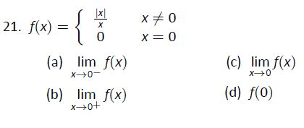
Tarik A. Question #21
a) lim f(x)
X→0⁻
Rule: { ^{|x|}/_{x} , x ≠ 0 }
lim f(x) = ^{|0|}/₀ = ⁰/₀ = undefined
X→0⁻
c) lim f(x)
X→0
Since both (a) and (b) both had equivalent limits, (c) has an undefined limit
b) lim f(x)
X→0⁺
Rule: { ^{|x|}/_{x} , x ≠ 0 }
lim f(x) = ^{|0|}/₀ = ⁰/₀ = undefined
X→0⁺
d) f(0)
Rule { 0 , x = 0 }
f(0) = 0
Notes:
When x→0- means x is negative, ^{|x|}/_{x} is negative 1, when x→0+, ^{|x|}/_{x} is 1. ( |x| and x have the same value it is just the matter of sign. So the limit DNE
^{x|}

Slide 6
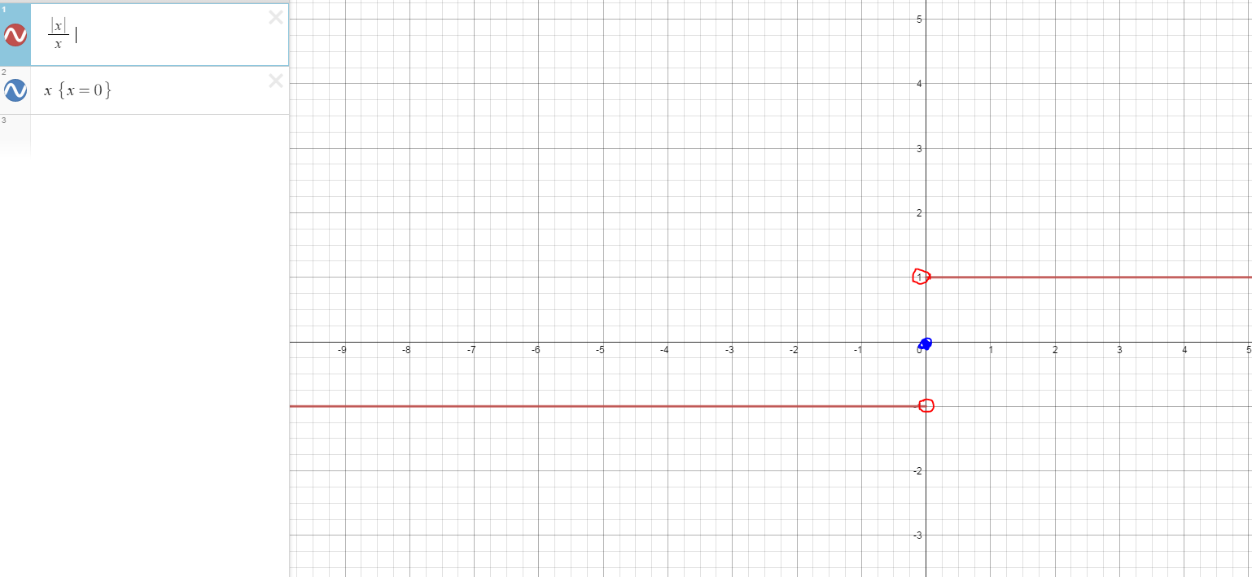
Tarik A. Question #21
Notes:
This graph shows clear that the limit of the function from left and right exist but they are different. So the function approaches to diff. values as x appr.0
Look at next slide(Alvea’s it is first case)

Slide 7
Alviea K. Question#1
The three ways a limit may fail to exist is when :
1.) The function f(x) may approach different values on either side of c
2.) The function may grow without upper or lower bound as x approaches c
3.) The function may oscillate as x approaches c
Notes:
Very good!

Slide 8
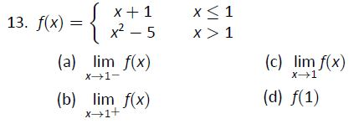
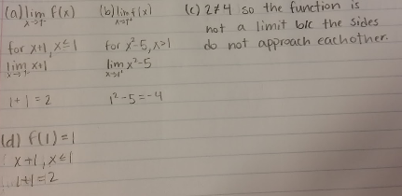
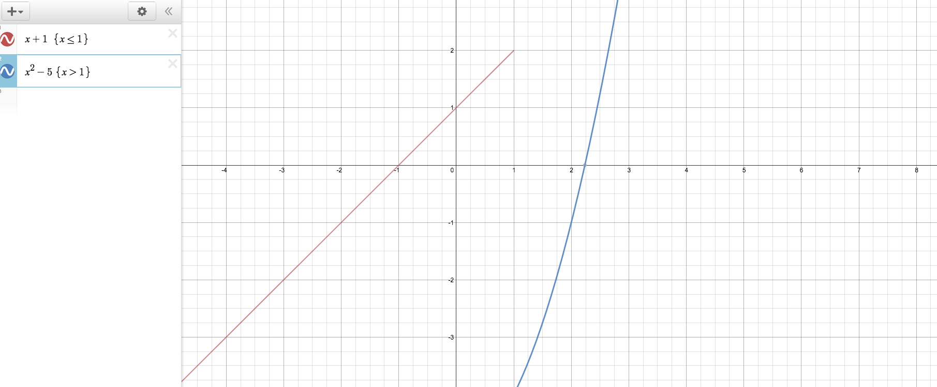
Alviea K. Question#13
Notes:
The function doesn’t have a limit because the sided limits are not the same. Good! ( just a little accuracy)

Slide 9
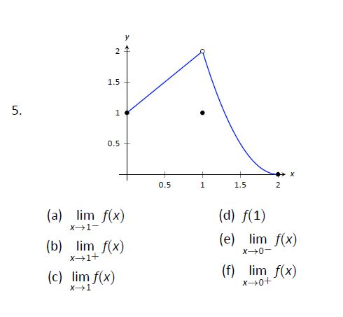
Malik L. Question#5
(a) y=0
(b) y= 2
(c) y=2
(d) y=1
(e) undefined
(f) y= 1
Notes:
The limit from left side of 1 is 2 as well that is the reason why the limit of function when x approaches 1 exist, and it is 2.

Slide 10
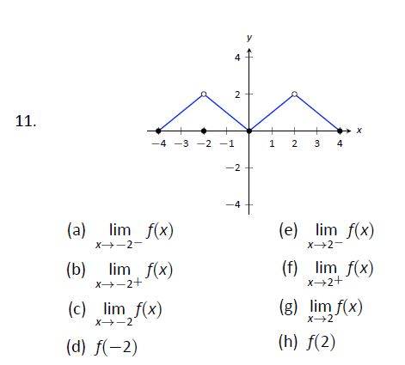
Malik L. Question#11
(a) y= 4) (h) y= 2
(b) y=2
(c) y=2
(d)y= 0
(e)y= 0
(f) y= 4
(g) y=2
Notes:
limit from left side of -2 is 2. So the limit at -2 is 2. similarly at 2.

Slide 11
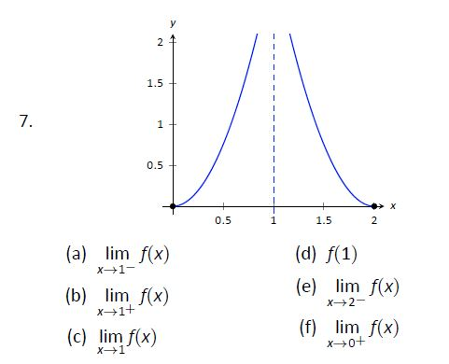
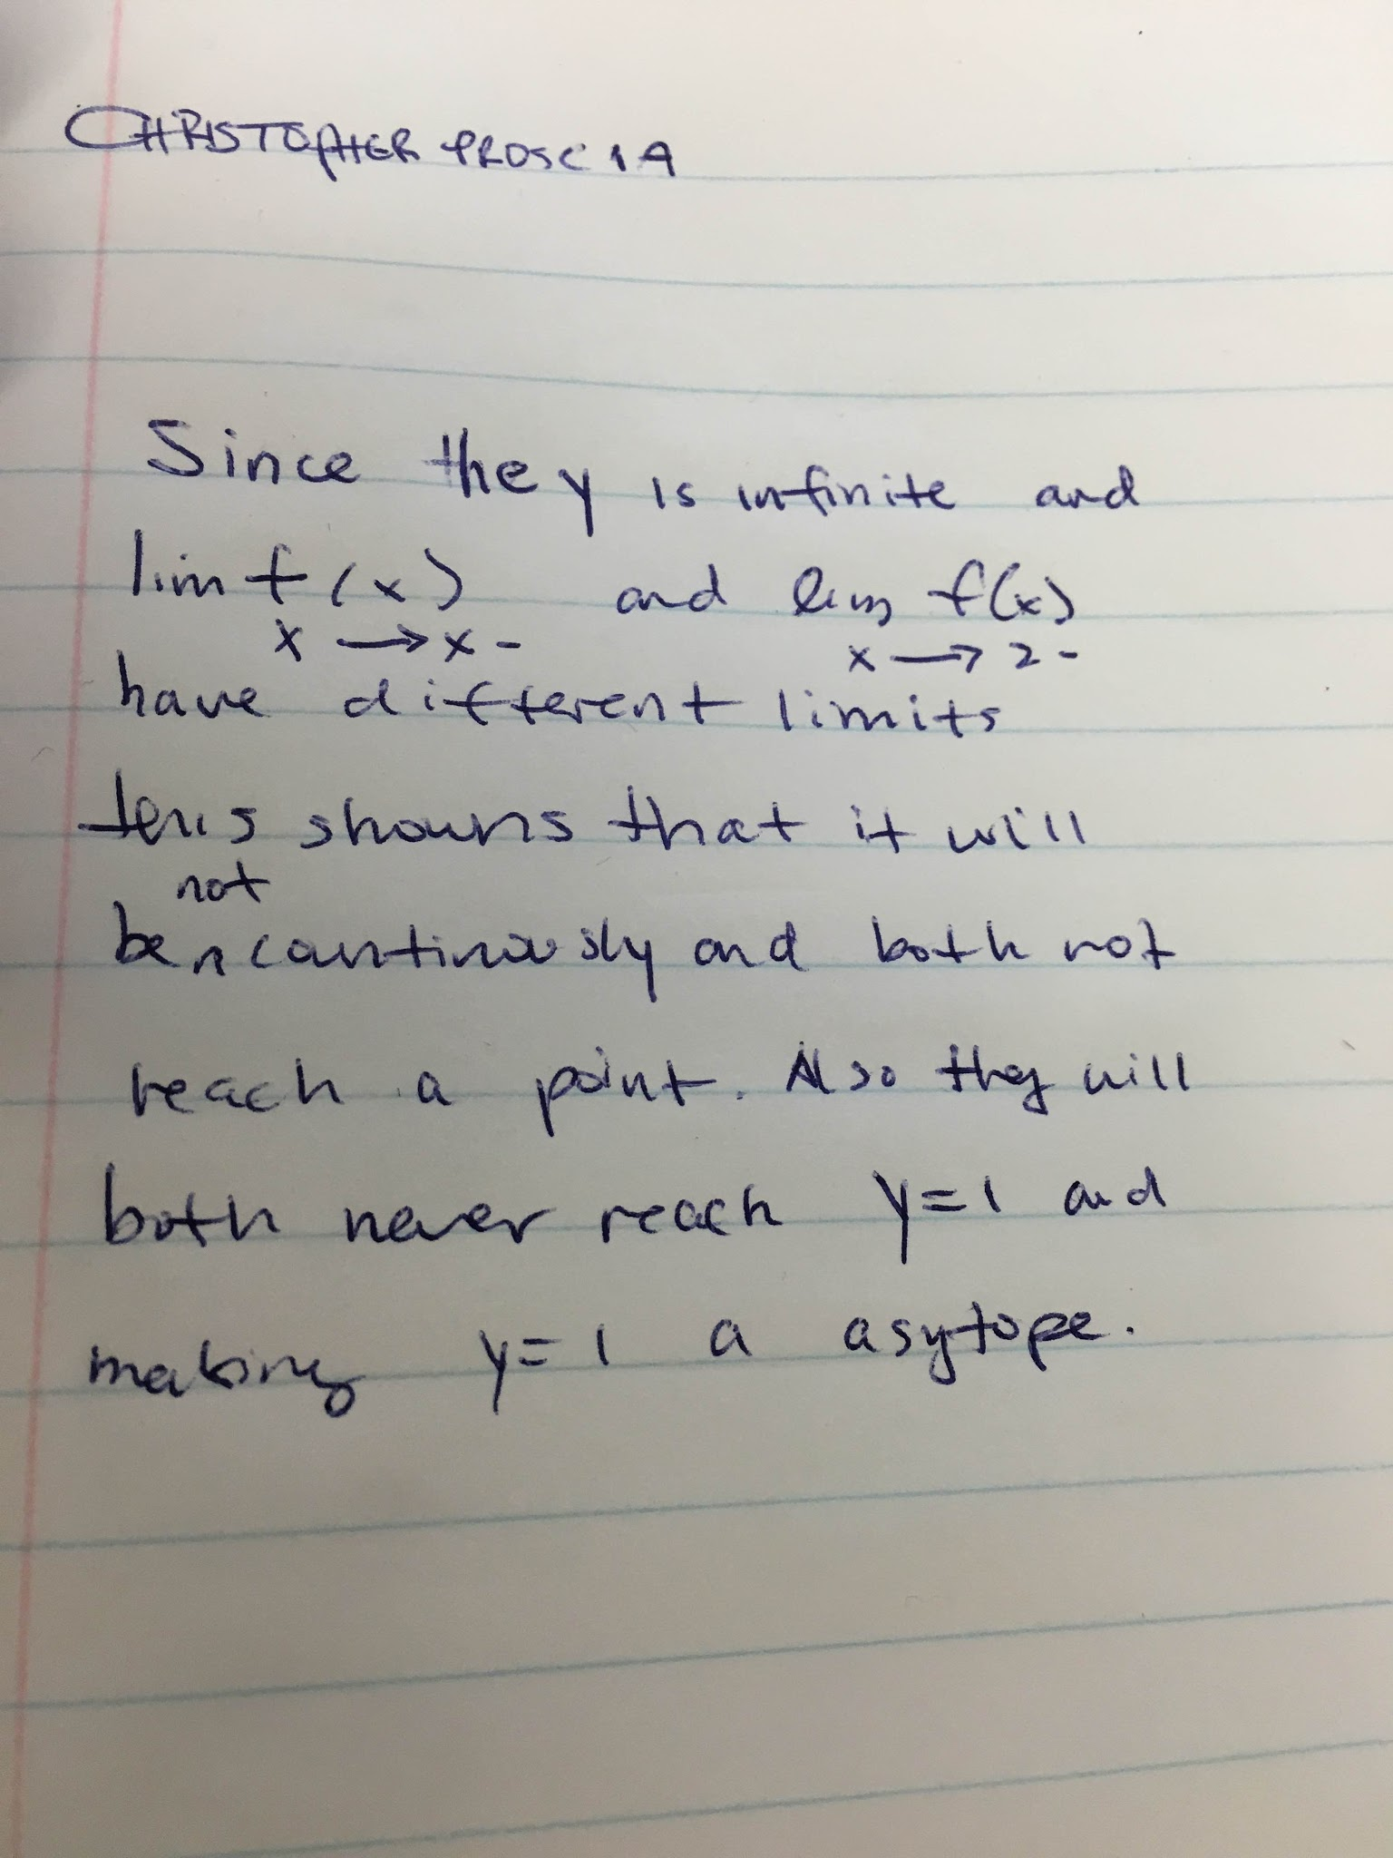
Chris P. Question #7
since lim f(x)dgrt
Notes:
You have the idea of how the function behaves, but you need to answer each question. The first 4 are not defined. The last 2 are 0.

Slide 12
Chris P. Question #3
N/A

Slide 13
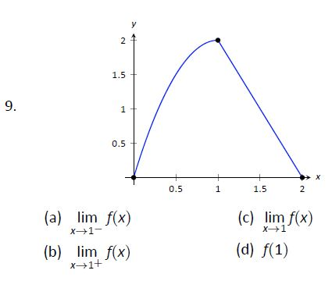
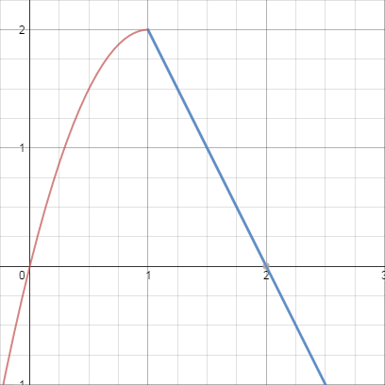
Jevon S. Question #9
a) y = 2
b) y = 2
c) y = 2
d) y = 2
For this problem, I didn’t have to do much work because the graph discontinues at the same point, which is y = 2. When the functions (y = -2x^2+4x and y = -2x+4) have x as 1, the y is always 2.
Notes:
There is no discontinuing here. The function changes the rule at x=1 but since the 2 sided limits are the same so the limit exist. and since the limit at x=1 is equal to f(1) the function is continuous at x=1

Slide 14
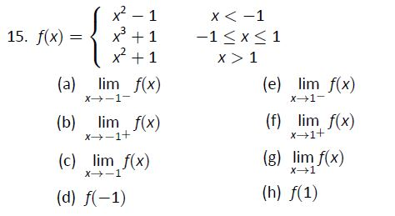
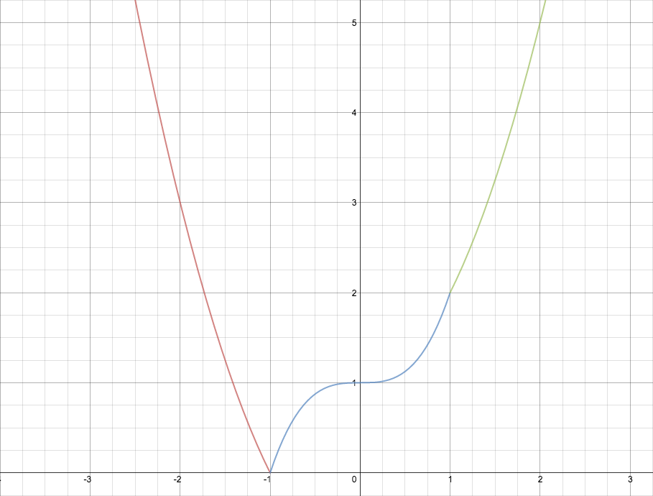
Jevon S. Question #15
a) y = 0
b) y = 0
c) y = 0
d) y = 0
e) y = 2
f) y = 2
g) y = 2
h) y = 2
Notes:
Very good! In general you all did a great job. However there are some little things as I have pointed out for each problem that you need to take care of.
I am grading you with 90 for this time, even though there are some mistakes and misunderstandings.

