Slide 1
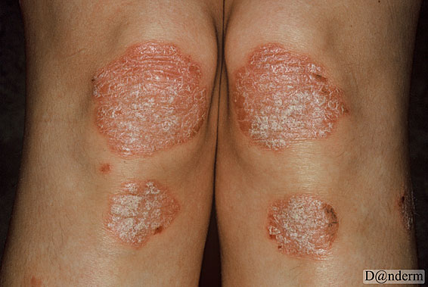
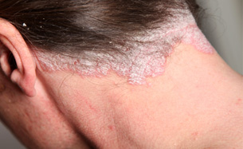
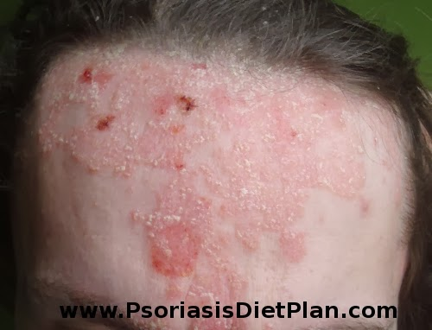
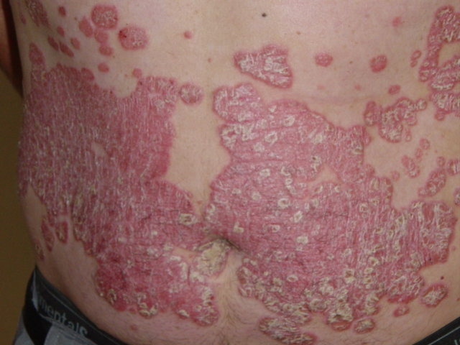
PSORIASIS

Slide 2
What is Psoriasis?
Psoriasis is a chronic, autoimmune skin disease that speeds up the growth cycle of skin cells.
Psoriasis is commonly mistaken as "just a skin condition." But it's actually a chronic (long-lasting) disease of the immune system.
Symptoms of plaque psoriasis
Plaque psoriasis appears on the skin as raised, red patches covered with a silvery buildup of dead skin cells. These patches can be itchy and painful, and most often appear on the knees, elbows, lower back, and scalp.

Slide 3
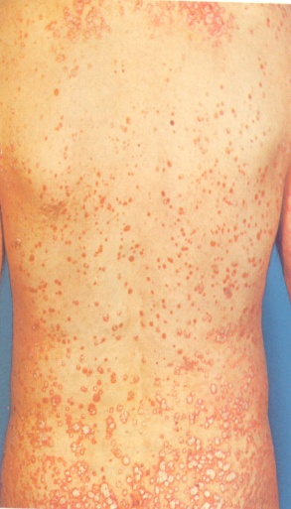
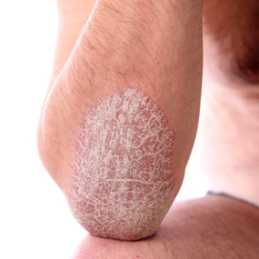
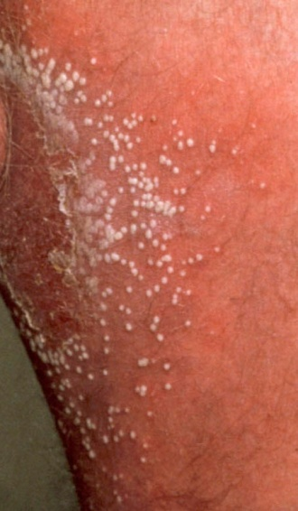
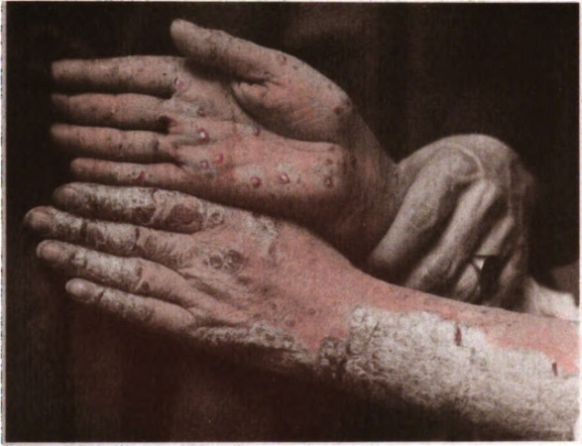
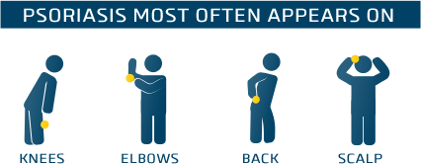
Types of psoriasis
Plaque (also called psoriasis vulgaris).
Guttate.
Inverse (also called flexural psoriasis or intertriginous psoriasis).
Pustular.
Erythrodermic (also called exfoliative psoriasis).

Slide 4
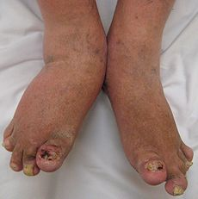
Psoriatic arthritis
a form of chronic inflammatory arthritis frequently occurs in association with skin and nail psoriasis
typically involves painful inflammation of the joints and surrounding connective tissue and can occur in any joint, but most commonly affects the joints of the fingers and toes. This can result in a sausage-shaped swelling of the fingers and toes

Slide 5
Causes and Known Triggers
Genetics
Stress
Lifestyle
Injury to skin
Psoriasis can appear in areas of the skin that have been injured or traumatized. Vaccinations, sunburns and scratches can all trigger.
Medications
Lithium: Used to treat manic depression and other psychiatric disorders. Lithium aggravates psoriasis in about half of those with psoriasis who take it.
Antimalarials: Plaquenil, Quinacrine, chloroquine and hydroxychloroquine may cause a flare of psoriasis, usually 2 to 3 weeks after the drug is taken. Hydroxychloroquine has the lowest incidence of side effects.
Inderal: This high blood pressure medication worsens psoriasis in about 25 percent to 30 percent of patients with psoriasis who take it. It is not known if all high blood pressure (beta blocker) medications worsen psoriasis, but they may have that potential.
Quinidine: This heart medication has been reported to worsen some cases of psoriasis.
Indomethacin: This is a nonsteroidal anti-inflammatory drug used to treat arthritis. It has worsened some cases of psoriasis. Other anti-inflammatories usually can be substituted. Indomethacin's negative effects are usually minimal when it is taken properly. Its side effects are usually outweighed by its benefits in psoriatic arthritis.
Infection
Anything that can affect the immune system can affect psoriasis. In particular, streptococcus infection (strep throat) is associated with guttate psoriasis. Strep infection is known to trigger guttate psoriasis.

Slide 6
Myths about psoriasis
Myth: Psoriasis is contagious. Fact: Psoriasis is an autoimmune disease that affects the skin — often producing patches called plaques that can crack and bleed. Psoriasis is not contagious. You cannot catch it from another person.
Myth: Psoriasis is just a cosmetic condition. Fact: Psoriasis is a serious, chronic, lifelong autoimmune disease. Its symptoms emerge on the skin, and while the thick, flaky scales cause discomfort and embarrassment for some people with psoriasis, they can also cause physical pain and intense itching. In addition, 10 to 30 percent of psoriasis patients may develop psoriatic arthritis. Like other forms of inflammatory arthritis — such as rheumatoid arthritis — psoriatic arthritis causes joint pain, swelling, and stiffness.
Myth: Psoriasis cannot be treated. Fact: Although there is no cure for psoriasis, there are many ways to relieve its symptoms. Treatments may include topical creams or ointments, pills or injections, and UV or light therapy administered by a doctor.
Myth:Psoriasis is temporary
Psoriasis is lifelong, usually with alternating periods of flare-ups and clearing. It most often appears between the ages of 15 and 25.

Slide 7
Treatment options
No cure is available for psoriasis, but some treatments can help to control the symptoms.
Psoriasis can be difficult to treat due to its chronic recurrent nature.
Psoriasis treatments aim to:
Stop the skin cells from growing quickly, which reduces inflammation and plaque formation
Remove scales and smooth the skin, which is particularly true of topical treatments
If you have plaque psoriasis, consider these different treatment options.
Topicals
Topicals are applied to the skin lesions and work directly on the skin’s surface. They are usually the first treatment used for psoriasis.
Phototherapy
Also known as light therapy, phototherapy involves exposing the skin to artificial ultraviolet light. Sometimes, phototherapy is used in combination with oral (by mouth) or topical medicines.
Systemics
Available in the form of an oral or injected medication. One type of systemic is a biologic, which is used to treat moderate to severe plaque psoriasis.

Slide 8
Topical treatments
Can be used alone or combined with oral medications or light therapy. Topical psoriasis treatments include:
Topical corticosteroids. The most frequently prescribed medications for treating mild to moderate psoriasis. They slow cell turnover by suppressing the immune system, which reduces inflammation and relieves associated itching. Long-term use or overuse of strong corticosteroids can cause thinning of the skin and resistance to the treatment's benefits.
Vitamin D analogues. synthetic forms of vitamin D slow down the growth of skin cells.
Calcipotriene (Dovonex) is a prescription cream or solution containing a vitamin D analogue that may be used alone to treat mild to moderate psoriasis .
Calcitriol (Rocaltrol) is equally effective and possibly less irritating than calcipotriene.
Anthralin. This medication is believed to normalize DNA activity in skin cells. Anthralin (Dritho-Scalp) also can remove scale, making the skin smoother. However, anthralin can irritate skin, and it stains virtually anything it touches.
Topical retinoids. These are commonly used to treat acne and sun-damaged skin, but tazarotene (Tazorac, Avage) was developed specifically for the treatment of psoriasis. Like other vitamin A derivatives, it normalizes DNA activity in skin cells and may decrease inflammation. The most common side effect is skin irritation. It isn't recommended when you're pregnant or breast-feeding or if you intend to become pregnant.
Calcineurin inhibitors. Currently, calcineurin inhibitors — tacrolimus (Prograf) and pimecrolimus (Elidel) — are approved only for the treatment of atopic dermatitis, but studies have shown them to be effective at times in the treatment of psoriasis. Calcineurin inhibitors are thought to disrupt the activation of T cells, which, in turn, reduces inflammation and plaque buildup.
Calcineurin inhibitors are not recommended for long-term or continuous use because of a potential increased risk of skin cancer and lymphoma.

Slide 9
Salicylic acid. promotes shedding of dead skin cells and reduces scaling. Sometimes it's combined with other medications, such as topical corticosteroids or coal tar, to increase its effectiveness.
Coal tar. The oldest treatment for psoriasis. It reduces scaling, itching and inflammation. Exactly how it works isn't known. Coal tar has few known side effects, but it's messy, stains clothing and bedding, and has a strong odor.
This treatment isn't recommended for women who are pregnant or breast-feeding.
Moisturizers. Moisturizing creams won't heal psoriasis, but they can reduce itching and scaling and can help combat the dryness.

Slide 10
Light therapy (phototherapy)
Sunlight
UVB phototherapy.
Narrow band UVB therapy.
Goeckerman therapy (combination of UVB treatment and coal tar treatment)
Oral or injected medications
Retinoids. Related to vitamin A, this group of drugs may reduce the production of skin cells. Signs and symptoms usually return once therapy is discontinued, however. Side effects may include lip inflammation and hair loss. can cause severe birth defects, women must avoid pregnancy for at least three years after taking the medication.

Slide 11
Methotrexate. Taken orally,helps by decreasing the production of skin cells and suppressing inflammation. It may also slow the progression of psoriatic arthritis in some peopleused for long periods, it can side effects, including severe liver damage and decreased production of red and white blood cells and platelets.
Cyclosporine. Cyclosporine suppresses the immune system and is similar to methotrexate in effectiveness. Like other immunosuppressant drugs, increases risk of infection and other health problems, including cancer. Cyclosporine also makes you more susceptible to kidney problems and high blood pressure — the risk increases with higher dosages and long-term therapy.
Drugs that alter the immune system (biologics). Several immunomodulator drugs are approved for the treatment of moderate to severe psoriasis. They include etanercept (Enbrel), infliximab (Remicade), adalimumab (Humira) and ustekinumab (Stelara). These drugs are given by intravenous infusion, intramuscular injection or subcutaneous injection and are usually used for people who have failed to respond to traditional therapy or who have associated psoriatic arthritis. Biologics work by blocking interactions between certain immune system cells and particular inflammatory pathways. Although they're derived from natural sources rather than chemical ones, they must be used with caution because they have strong effects on the immune system and may permit life-threatening infections. In particular, people taking these treatments must be screened for tuberculosis.

Slide 12
A List of Drugs used Drugs for treatment of Psoriasis
a synthetic retinoid Acitretin
immunosuppressant Alefacept
topical agent Allantoin
a topical antimitotic Anthralin
corticosteroid Clobetasol Propinate, Desonide
a recombinant monoclonal antibody Efalizumab
a monoclonal antibody Infliximab
an anesthetic and steroidal drug Pramoxine and Hydrocortisone

Slide 13
OTEZLA(APREMILAST)
OTEZLA®(apremilast) tablets, for oral use
Initial US Approval: 2014
Otezla® (apremilast) is a prescription medicine approved for the treatment of patients with moderate to severe plaque psoriasis .Otezla is also approved for the treatment of adult patients with active psoriatic arthritis.
Description: The active ingredient in OTEZLA tablets is apremilast. Apremilast is a phosphodiesterase 4 (PDE4) inhibitor. Apremilast is known chemically as N-[2-[(1S)-1-(3-ethoxy-4-methoxyphenyl)-2-(methylsulfonyl)ethyl]-2,3-dihydro-1,3-dioxo-1H-isoindol-4-yl]acetamide. Its empirical formula is C22H24N2O7S and the molecular weight is 460.5. OTEZLA tablets are supplied in 10, 20, and 30 mg strengths for oral administration. Each tablet contains apremilast as the active ingredient and the following inactive ingredients: lactose monohydrate, microcrystalline cellulose, croscarmellose sodium, magnesium stearate, polyvinyl alcohol, titanium dioxide, polyethylene glycol, talc, iron oxide red, iron oxide yellow (20 and 30 mg only) and iron oxide black (30 mg only).
Mechanism of Action
Apremilast is an oral small-molecule inhibitor of phosphodiesterase 4 (PDE4) specific for cyclic adenosine monophosphate (cAMP). PDE4 inhibition results in increased intracellular cAMP levels. The specific mechanism(s) by which apremilast exerts its therapeutic action in psoriatic arthritis patients and psoriasis patients is not well defined.
Experimental medications. There are a number of new medications currently being researched that have the potential to improve psoriasis treatment. Some of the treatments being looked at include A3 adenosine receptor agonists; anti-interleukin-17, anti-interleukin-12/23 and anti-interleukin-17 receptor agents; Janus kinase (JAK) inhibitors; and phosphodiesterase 4 inhibitors.

Slide 14
SAFETY INFORMATION
Contraindications: You must not take Otezla® (apremilast) if you are allergic to apremilast or to any of the ingredients in Otezla.
Otezla is associated with an increase in adverse reactions of depression. In clinical studies, some patients reported depression and suicidal behavior while taking Otezla. Some patients stopped taking Otezla due to depression.
Some patients taking Otezla lost body weight. Your doctor should monitor your weight regularly.
Side effects of Otezla were diarrhea, nausea, upper respiratory tract infection, tension headache, and headache.
These are not all the possible side effects with Otezla. Ask your doctor about other potential side effects.
Drug Interactions
Some medicines may make Otezla less effective, and should not be taken with Otezla.
Use with strong cytochrome P450 enzyme inducers
(e.g.rifampin, phenobarbital, carbamazepine, phenytoin) is not recommended because loss of efficacy may occur

Slide 15
Psoriasis is contagious
True
False

Slide 16
FALSE
You can't catch psoriasis from someone else. The red, scaly patches are the result of a disorder of the immune system - not some germ that can be passed from person to person.

Slide 17
IS PSORIASIS CURABLE?

Slide 18
UNFORTUNATELY NO
However, the disease can generally be controlled via a variety of treatments, including lotions, shampoos, pills or injection, and phototherapy

Slide 19
COULD YOU NAME ANY 3 TRIGGERS OF PSORIASIS?

Slide 20
1. Genetics
2. Stress
3.Infection

Slide 21
IS PSORIASIS JUST A SKIN PROBLEM?

Slide 22
NO!
The condition can also cause pain and intense itching, as well as skin infections. Some people with psoriasis develop a condition known as psoriatic arthritis, which causes joint pain, stiffness, and swelling. And then there's the risk of skin cancer that comes from the light therapy sometimes used to treat psoriasis.

Slide 23
References:
1.http://www.medilexicon.com/drugs/stelara.php#MechanismOfAction
2.http://globalrph.com/drug_apremilast.htm#CLINICAL_PHARMACOLOGY
3. http://www.drugs.com/pro/otezla.html
4. http://www.medindia.net/drugs/medical-condition/psoriasis.htm
5. http://www.rxlist.com/otezla-drug/clinical-pharmacology.htm
6. http://www.otezla.com/wp-content/uploads/2014/05/otezla-prescribing-information.pdf
7. http://www.otezla.com/about-plaque-psoriasis/?tac=10&protac=61&utm_source=bing&utm_medium=cpc&utm_term=about%20psoriasis&utm_content=about%20psoriasis&utm_campaign=PsO%20General&ENG=2&CAMP=15&BRD=2
8. http://emedicine.medscape.com/article/1108220-overview
9. http://www.nlm.nih.gov/medlineplus/ency/article/000822.htm
10. http://www.cdc.gov/psoriasis/
11. http://www.psoriasis.org/
12. https://www.psoriasis.com/living-with-psoriasis.aspx
13. http://www.webmd.com/skin-problems-and-treatments/psoriasis/features/advances
14.http://www.stelarainfo.com/stelara-psoriasis/what-is-psoriasis?utm_source=bing&utm_medium=cpc&utm_campaign=2014+Psoriasis+Only&utm_term=psoriasis&utm_content=Psoriasis|mkwid|pU6Pv3ah|pcrid|4240556184
15. https://www.aad.org/dermatology-a-to-z/diseases-and-treatments/m---p/psoriasis
16. http://www.mayoclinic.org/diseases-conditions/psoriasis/basics/treatment/con-20030838

