Slide 1
Hutchinson Incisors & Mulberry Molars
By Luis Marquez P.
DEN 1218
March 2020

Slide 2
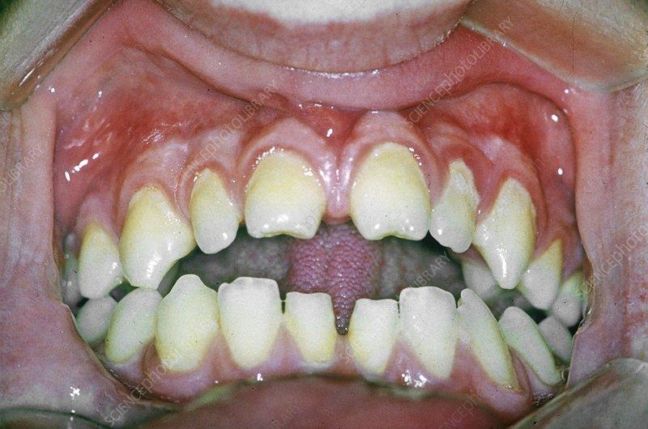
Hutchinson’s Incisors
Hutchinson Incisors are a manifestation of congenital syphilis. Usually on maxillary central incisors they appear as peg shaped with a notched enamel. It is part of the characteristic Hutchinson’s triad which apart from hutchinson incisors includes interstitial keratitis and eighth nerve deafness.
https://www.ncbi.nlm.nih.gov/pmc/articles/PMC3139286/
https://casereports.bmj.com/content/2011/bcr.11.2011.5130

Slide 3
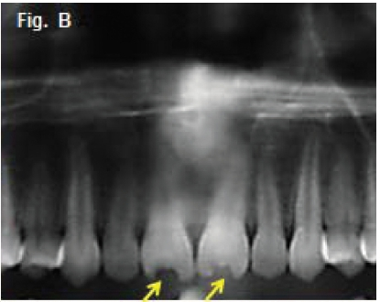
Hutchinson’s Incisors Radiographic Appearance

Slide 4
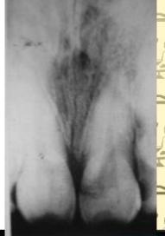
Hutchinson’s Incisors Radiographic Appearance

Slide 5
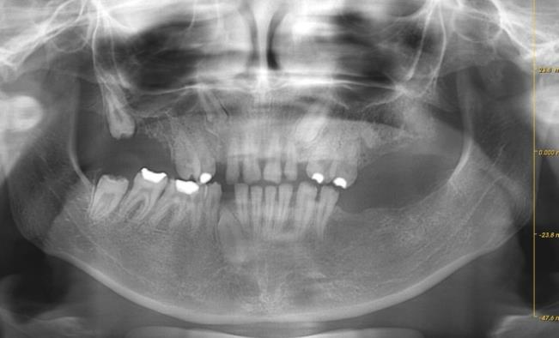
Hutchinson’s Incisors Radiographic Appearance

Slide 6
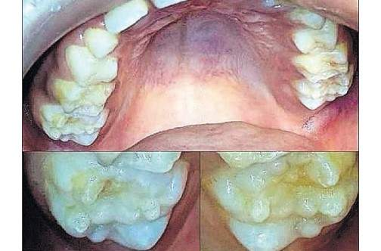
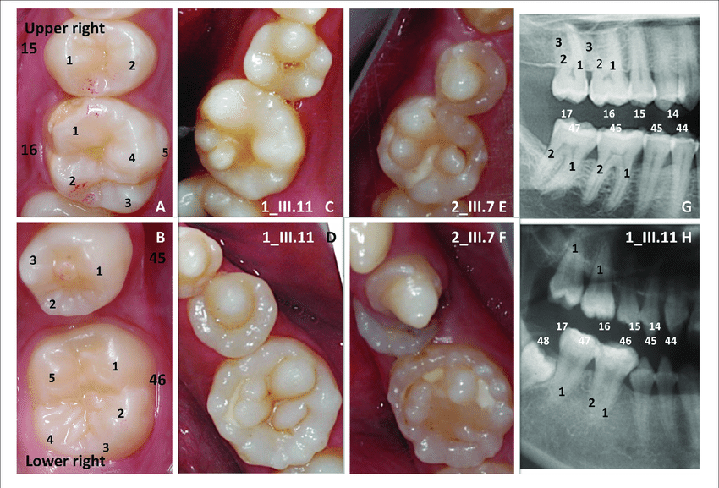
Mulberry Molars
Mulberry molars are also a key manifestation of congenital syphilis. They appear as abnormally shaped molars presenting multiple small bumps, similar to the mulberry fruit.
https://sdm.blogs.rutgers.edu/2017/11/as-syphilis-rate-increases-providers-learn-to-identify-oral-symptoms/?_ga=2.264666060.2130060824.1584539786-1663331311.1584539786

Slide 7
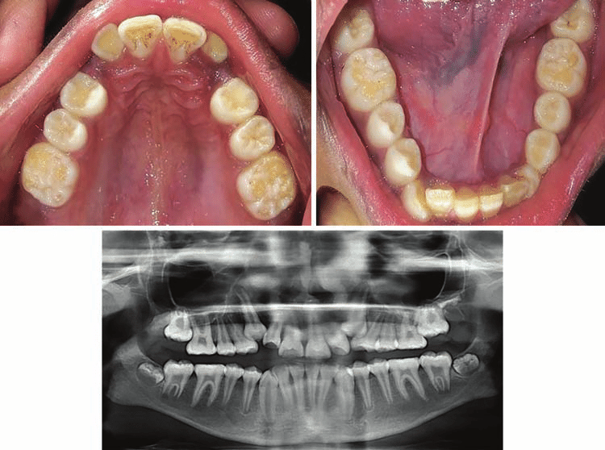
Mulberry Molars Radiographic Appearance

Slide 8
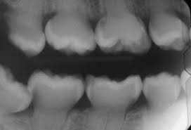
Mulberry Molars Radiographic Appearance

Slide 9
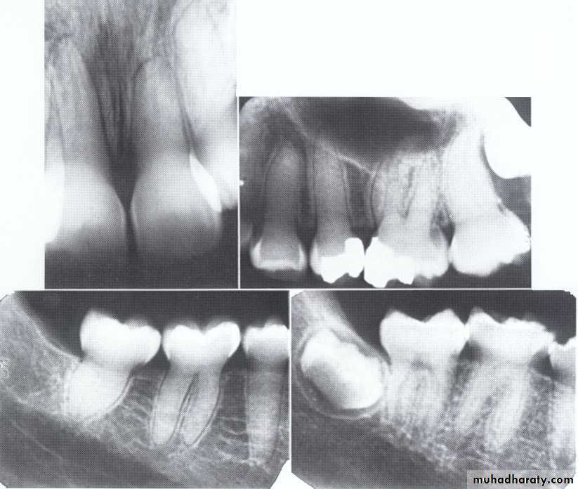
Mulberry Molars Radiographic Appearance

Slide 10
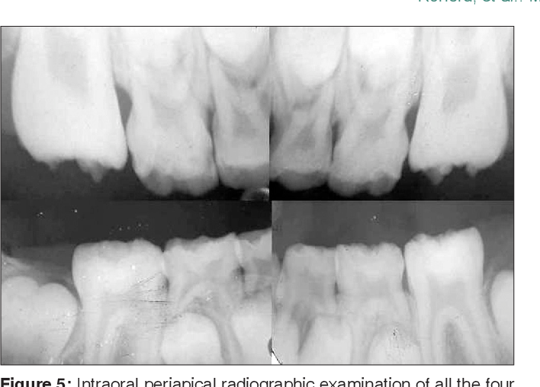
Mulberry Molars Radiographic Appearance

Slide 11
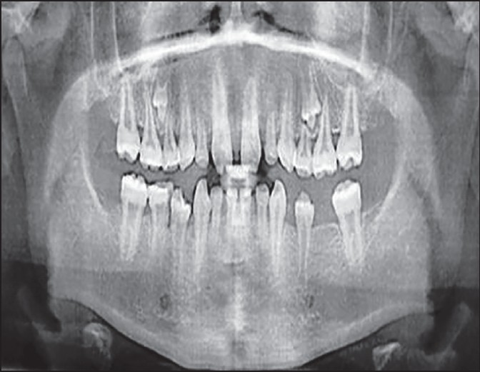
Hutchinson’s incisors & Mulberry Molars
In this image of a patient with Congenital syphilis, both Hutchinson Incisors and Mulberry Molars can be observed.
http://medind.nic.in/jao/t14/i4/jaot14i4p333.htm

