Slide 1
PANS
Parasympathetic Nervous System
Nicotinic Receptor
Muscarinic Receptor
Cranial Nerves: III, VII, IX, X
Spinal Nerves: (S2-S4)
Pre-ganglionic Fiber
Post-Ganglionic Fiber
Effector Organ
Increases Pancreas Secretion.
Miosis (Constriction of the pupil.)
Decrease in Heart Rate.
Neurotransmitter ACH (Acetylcholine)
Bronchoconstriction (smooth muscle.)
Neurotransmitter ACH (Acetylcholine)
Contraction of G.I Muscle.
By Luis Marquez P

Slide 2
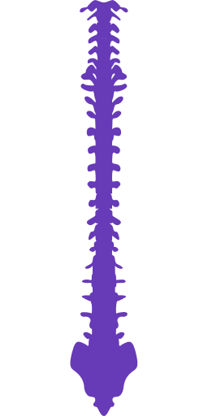
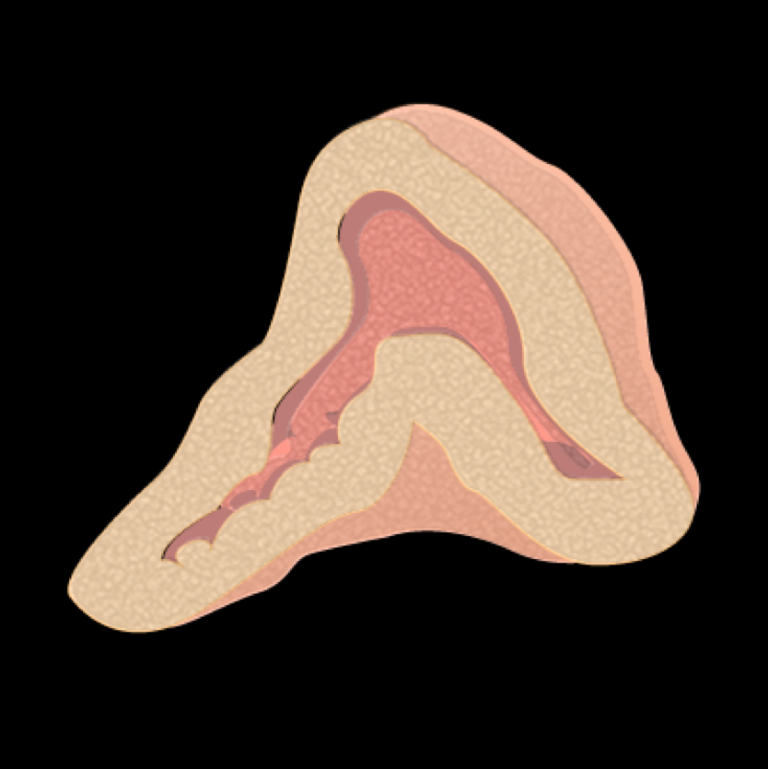
SANS
Sympathetic Nervous System
Decreases Pancreas Secretion.
Mydriasis
Spinal Nerves: T1 to L2
Increases Cardiac Output, HR and BP
Receptors:
⍺- Vasoconstriction
β1- Increase HR and BP
β2- Bronchodilation and Vasodilation
Adrenal Medulla: Epinephrin, Norepinephrine
Nicotinic Receptor
Bronchodilation
Relaxation of G.I smooth muscle
Pre-ganglionic Fiber
Post-Ganglionic Fiber
Effector Organ
Remember
We have one heart (β1).
We Have two lungs (β2)
Neurotransmitter ACH (Acetylcholine)
Neurotransmitters:
Epinephrin (⍺ and β)
Norepinephrine (Mostly ⍺)
By Luis Marquez P

