Slide 1
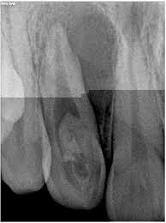
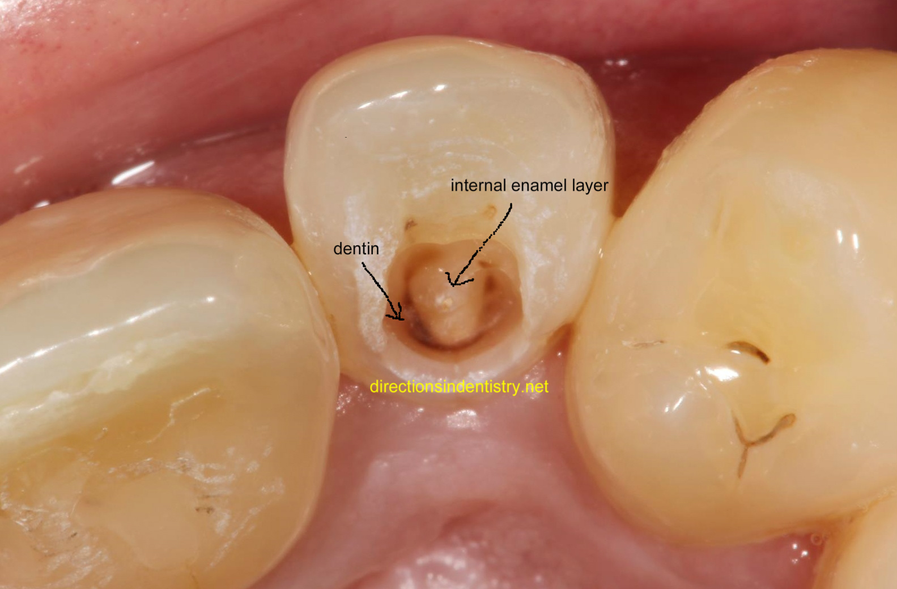
Dens In Dente
By Luis Marquez

Slide 2
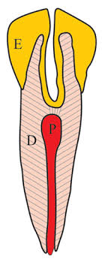
Definition
Rare tooth malformation where there is an infolding of enamel into the dentin.
Also known as “Dens Invaginatus” or “Tooth Within a Tooth”
Low prevalence, 0.3 to 10% of the population.
Maxillary lateral incisors are the most affected followed by central incisors. Very rare on premolars.
Men are three times more likely to be affected than women.

Slide 3
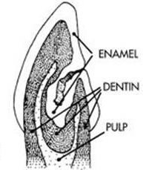

Slide 4
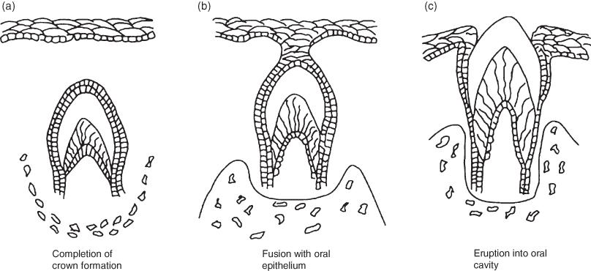
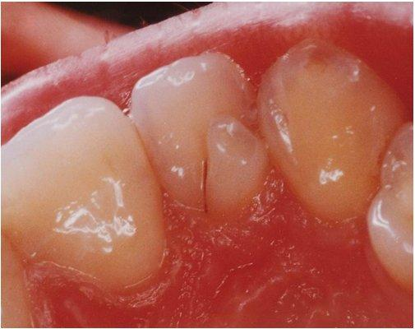
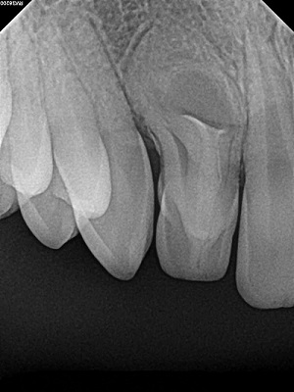
Etiology
Dens in Dente is a developmental anomaly that occurs during tooth formation. It can be due to:
Rapid proliferation of the internal enamel epithelium invading dental papilla. (Genetic factor).
Retardation of a focal group cells with the surrounding ones proliferating normally.
Growth pressure from adjacent tooth germs.
Infections.
Trauma.

Slide 5
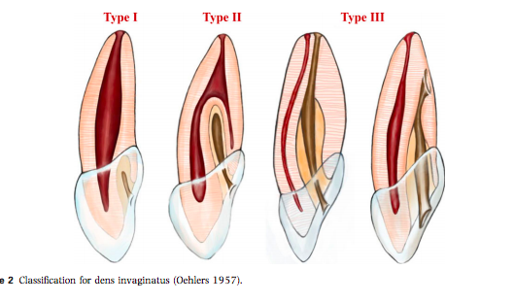
Classification
Type I: Partial invagination. It is limited to the crown of tooth. The lesion does not extend past the cementoenamel junction (CEJ) or the pulp.
Type II: Partial invagination. It extends beyond the crown and CEJ. Pulp may be involved but remain within the root anatomy. There is no communication of the lesion with periodontal ligament (PDL)
Type III a: Complete invagination. It extends through root and communicates with PDL. It usually does not involve the pulp but can cause anatomical malformation.
Type III b: Complete invagination. It extends through the root and communicates with PDL through apical foramen. Pulpal anatomy may not be directly involved but can cause disruption to the dental anatomy.

Slide 6
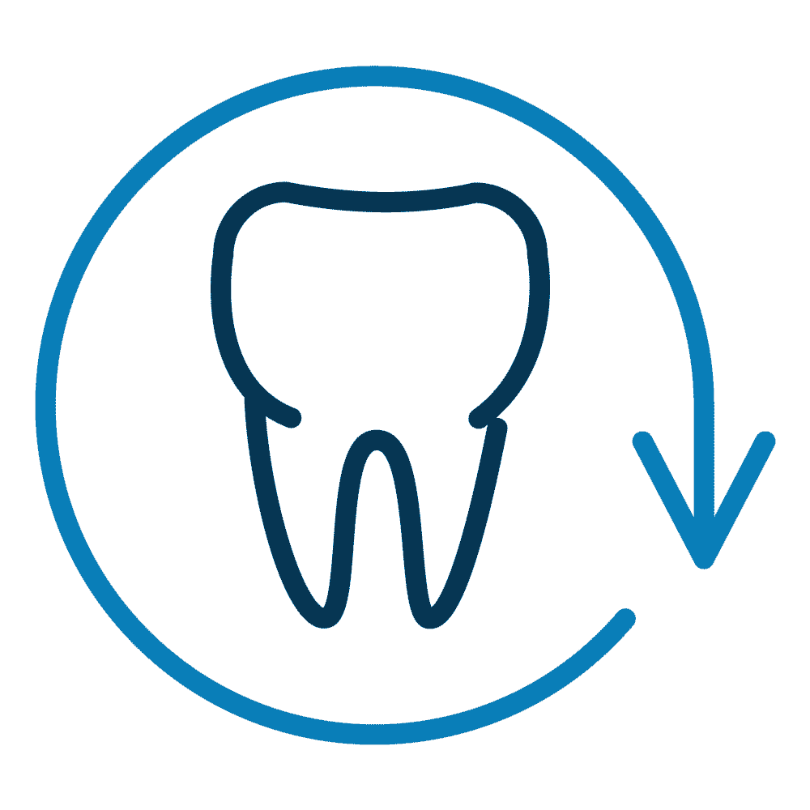
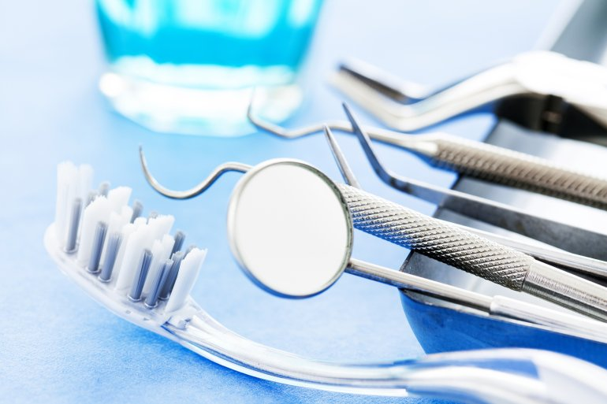
Role of the Dental Team
As Dental Hygienists we have a crucial role in detecting tooth structure anomalies as we are the first clinical point of contact with patients in the Dental Office.
X Rays and clinical examination are the main tools to diagnose Dens In Dente.
Patients must be made aware of the condition and the possible causes.
Depending of the extent and involvement of the pulp, treatment may include conservative measures like Sealants or composite fillings to more involved procedures like Root Canal Treatments, crowns and extractions.

Slide 7
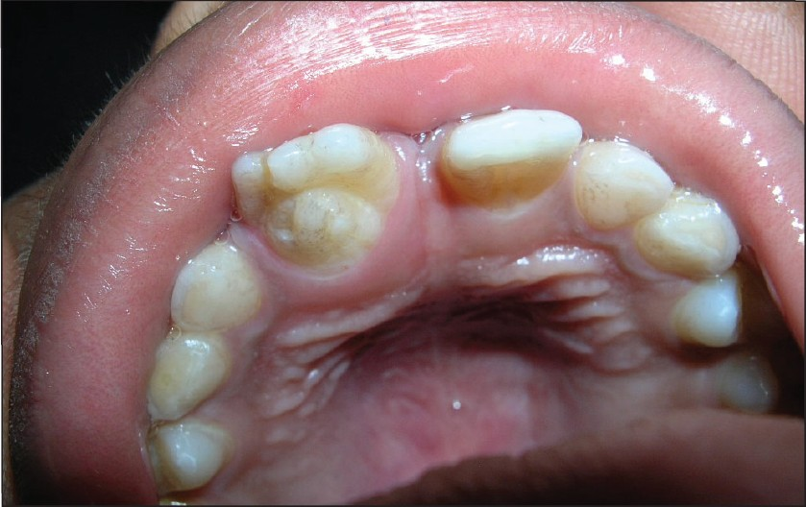
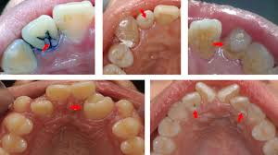
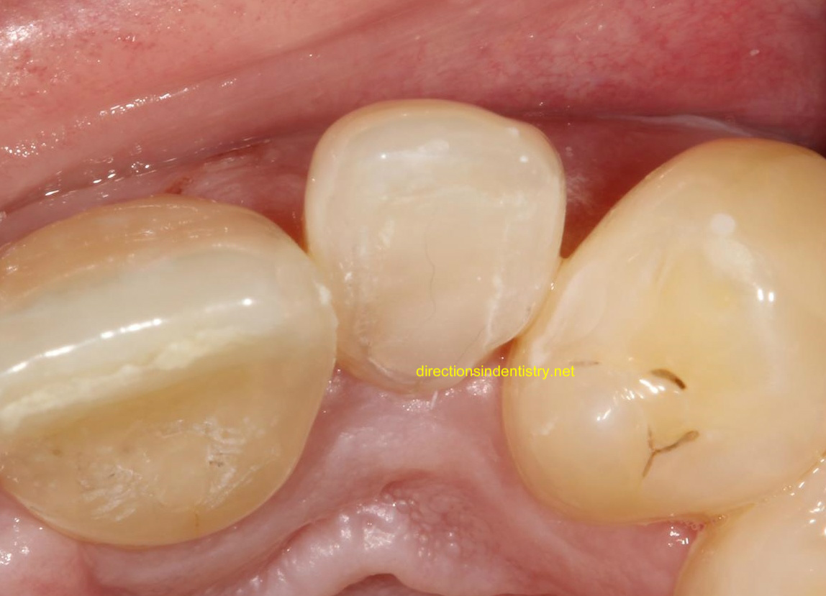
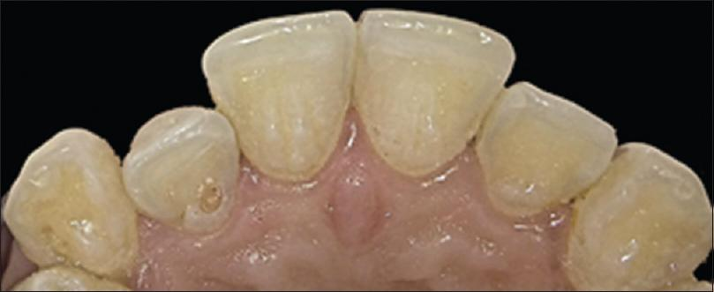
Clinical Findings

Slide 8
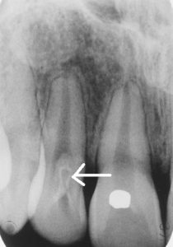
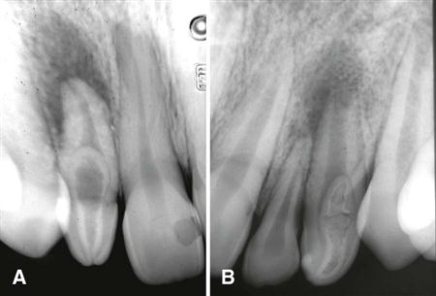
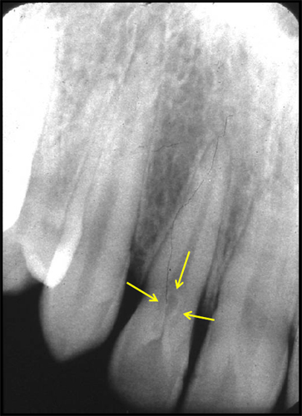
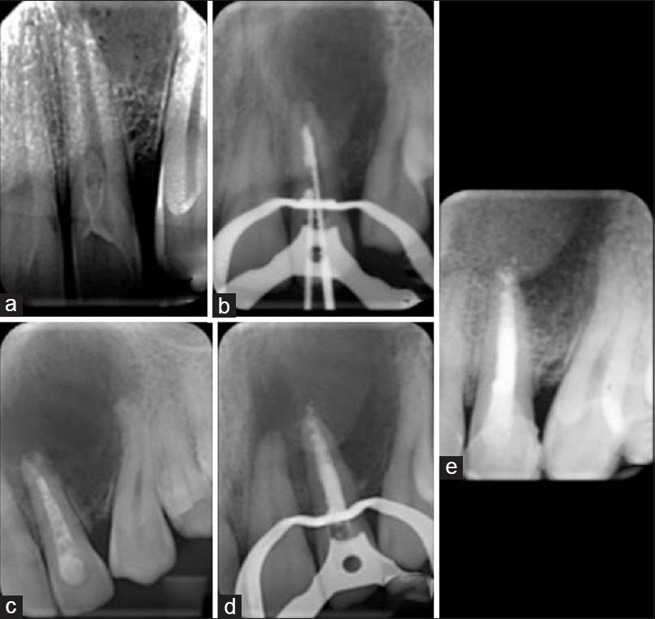
Radiological Findings

Slide 9
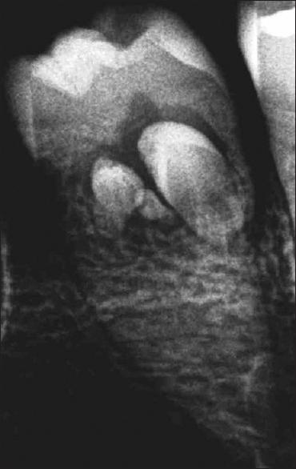
Triple Dens In Dente on second mandibular premolar.
From Indian Journal of Dental Research

