Slide 1
MBP
The massage back back
By: Laquan Leardo

Slide 2
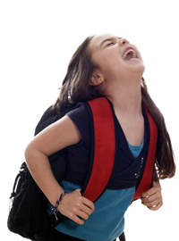
What I want to do
What my objective is for this product is to make something for students(mostly college students) to enjoy carrying a book bag and relieve the stress and pain that a regular book bag causes.
This bag will be able to massage your back when you want, either while you are sitting or walking.

Slide 3
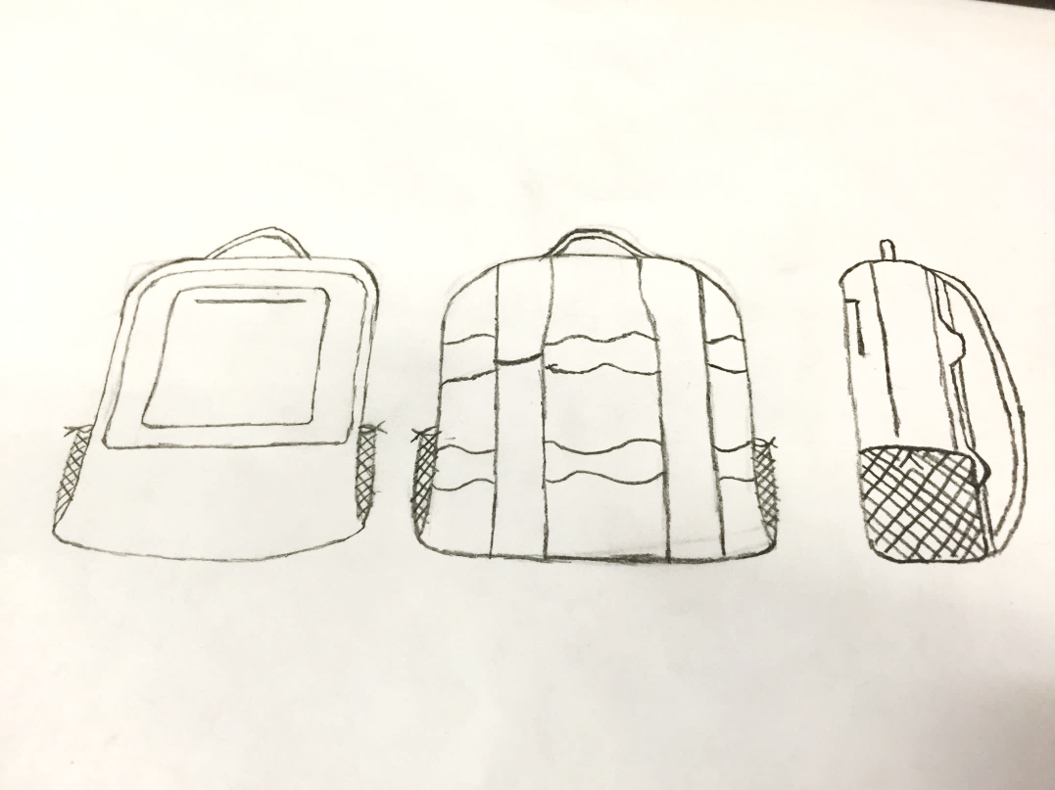
Design
This sketch shows the design from the front back and side

Slide 4
The concept
The concept of this bag is to make carrying a bag less stressful and less painful.
Students carry textbooks and notebooks all day and statistics show that you can harm your back by doing this.
You wont be using the massage feature of the bag all the time but it will be pleasant when you are walking and start to feel your back aching
there are two half circle arms that squeeze together like someone is giving you a massage, these arms go all the way across the back of the book bag

Slide 5
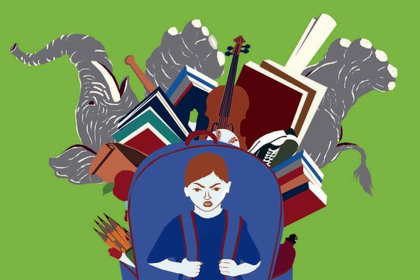
Concept continued…
The two arms can reach every part of your back that the bag touches, even your lower back
The straps are to be designed flexible enough to relieve some of the weight so the bag wont be as heavy

Slide 6
How it’s used
This bag will be used the same as a simple massage chair it will have a remote wired inside the bag and connected to a power source.
The power source I wanted to use is a lithium ion battery so that can easily be recharged and last for a while
There will be a USB port to charge your phone inside the bag and connect your phone to the product and can control it from your phone.

Slide 7
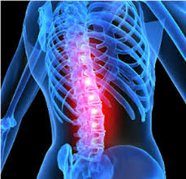
Inspiration
I was inspired by years of carrying heavy book bag and having back pains… also constantly wanting a massage
The number of back problems for students.
The thought of enjoying having something to look forward to while commuting to school

