Slide 1
Literograph
A Literary Cartographical Experience

Slide 2
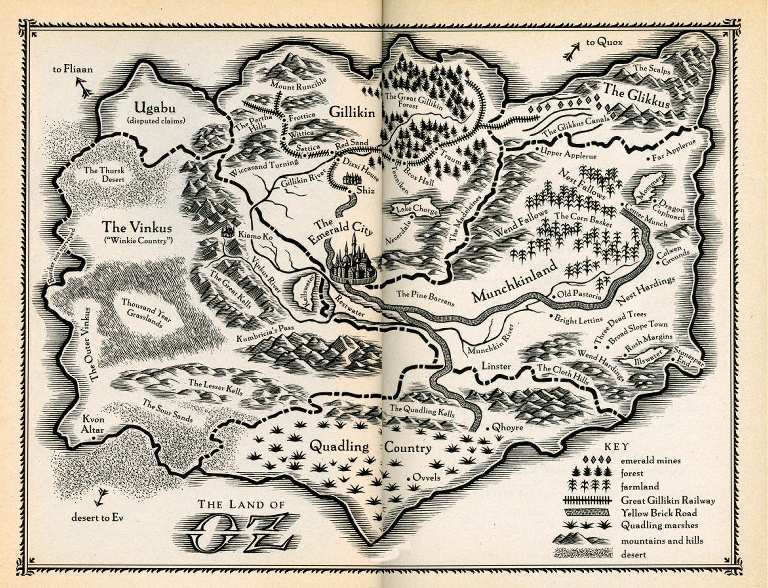
Stories and Maps
What is it?
How I built it
Bugs & Future Versions

Slide 3
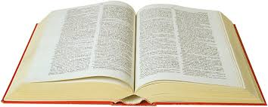
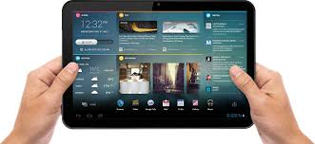
Are you satisfied?

Slide 4
What is it?
A Web App that works as tool to enrich the process of reading and writing stories.
PRINTED TEXT ———>>> HYPERTEXT
CHRONOLOGICAL ———>>> CARTOGRAPHICAL

Slide 5
How I built it
TECH SPEC:
1. DJANGO
2. SQLITE
3. GOOGLE MAPS JAVASCRIPT API
4. HEROKU (+ POSTGRES)
UI and UX

Slide 6
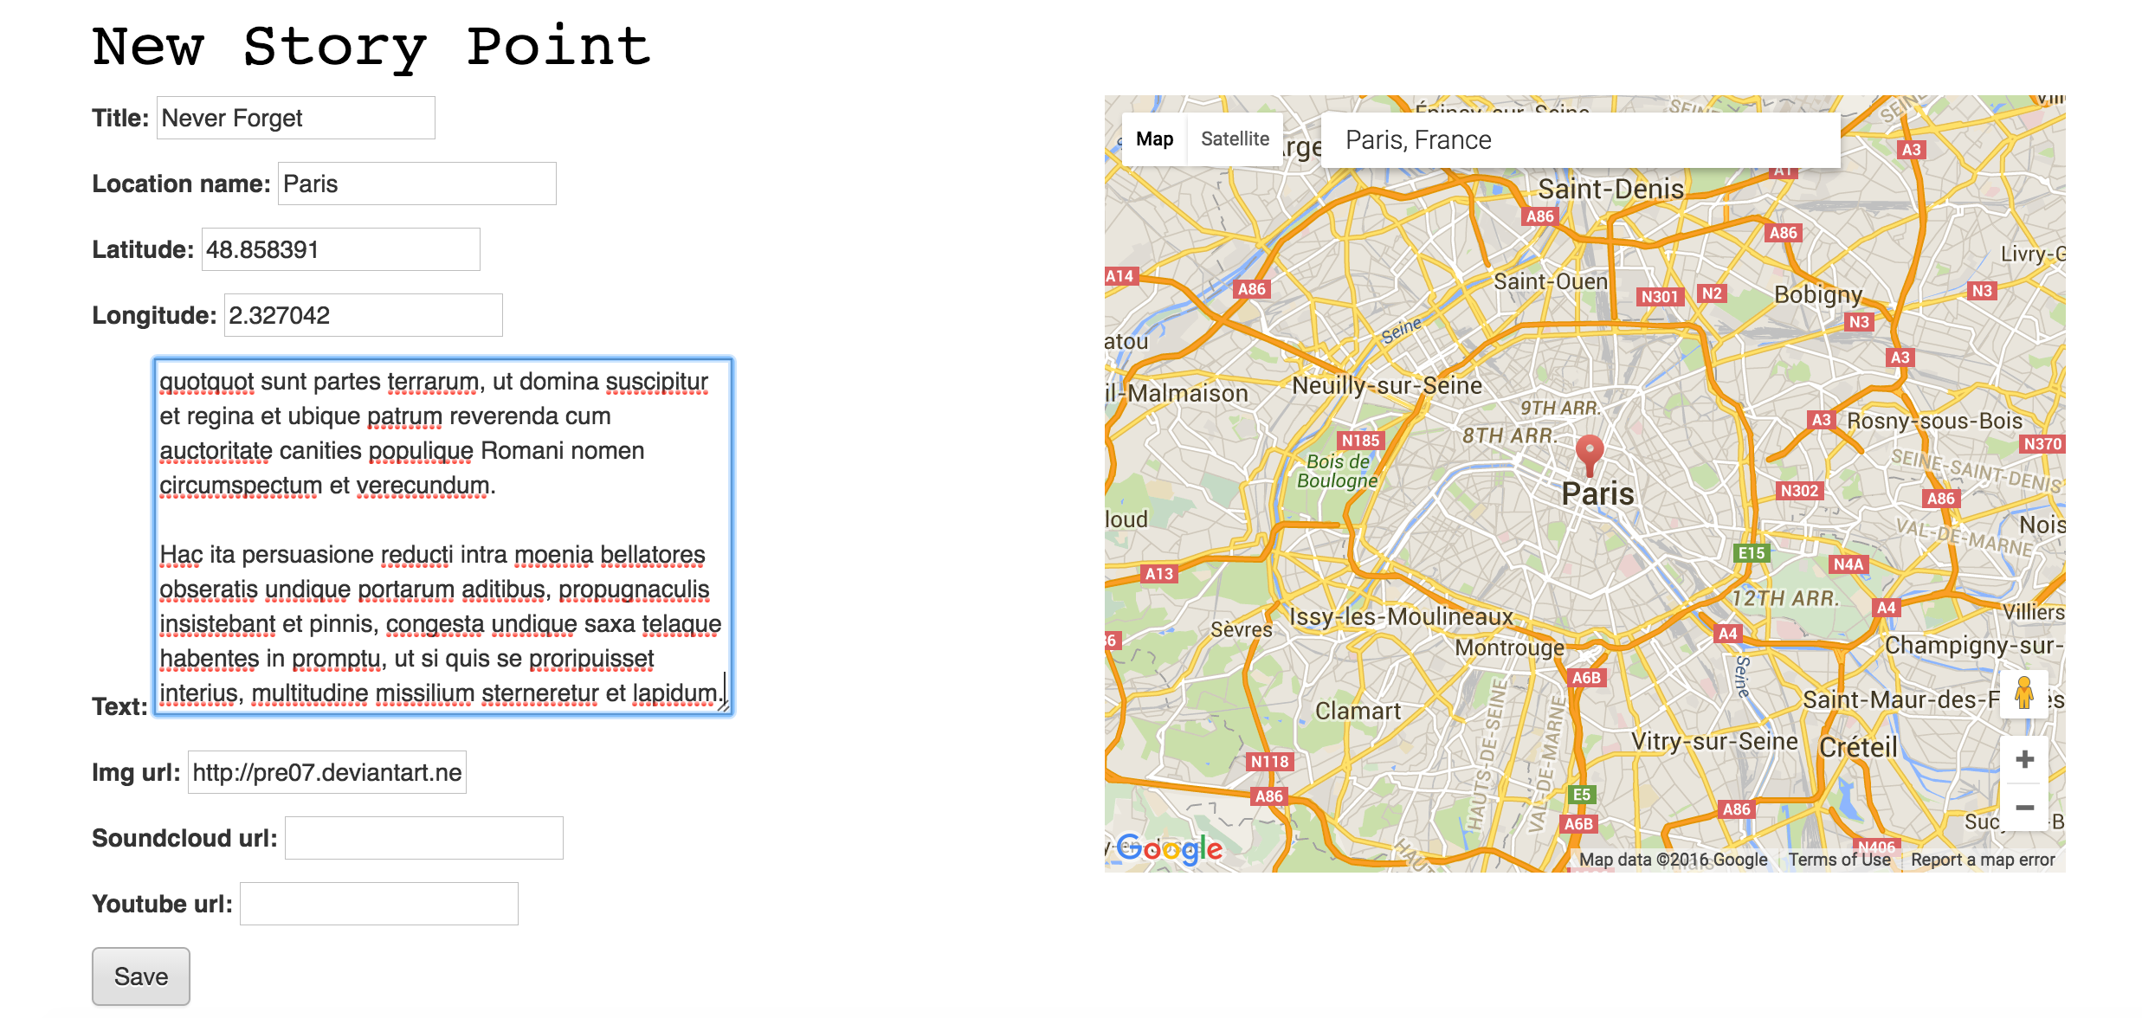
Interface
Writer’s View

Slide 7
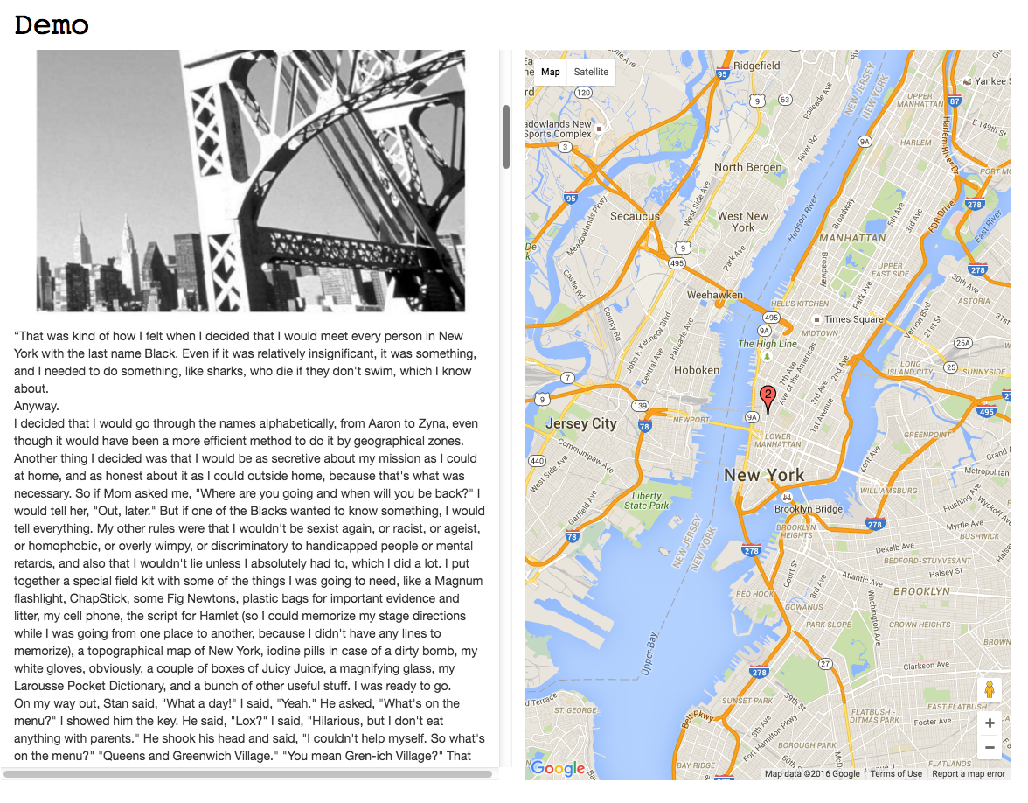
Interface
Reader’s View

Slide 8
Bugs
[X] SQLITE | POSTGRES
[ ] MAP’S ZOOM & ANIMATION
[ ] URL INSECURE
SHARE FRUSTRATIONS ABOUT THE DESIGN

Slide 9
Future Versions
Language (Etymology)
School (Geography, History, Literarure)
Related Facts (Art, History, Politics, Natural Facts)
Testimonial videos
Cameras & Microphones
Fictional Maps
Reading Modes
Chronological
Topographic
Perspective

Slide 10
CONCLUSION
1- Transform the experience of reading and writing stories
2- Fullstack project
3- Issues and further
By: Daiane Bushey

