Slide 1
Lymphadenopathy
Lili Wu
DEN 1114/SEC D216

Slide 2
What is Lymphadenopathy?
When a patient has an active disease process, e.g. infection, inflammatory conditions, an abscess, or cancer, in a specific region of the body, the region’s lymph nodes respond.
The resultant increase in size and change in consistency of the lymphoid tissue is considered lymphadenopathy.

Slide 3
Etiology
Each lymph node consists of organized lymphoid tissue and lymphocytes that actively filter toxic products from the lymph.
Lymphadenopathy is a result from an increase in both the size of each individual lymphocyte and the overall cell count in the lymphoid tissue.
The lymphoid tissue becomes better able to fight the disease process with more larger lymphocytes and increased numbers.

Slide 4
How is lymphadenopathy diagnosed?
Extraoral examination
Inraoral examination

Slide 5
Extraoral Examination * Healthy lymph nodes are usually not palpable.
Infected lymph nodes:
Firm
Tender
Enlarged and warm
Bilateral
Freely movable
Feel a bit like a swollen grape
Malignancies(cancer):
Firm
Nontender
Stuck to each other
Fixed and attached to underlying tissue.
Unilateral

Slide 6
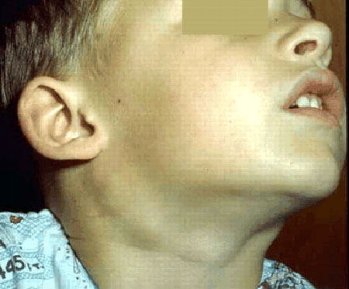
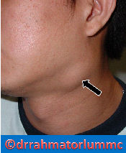
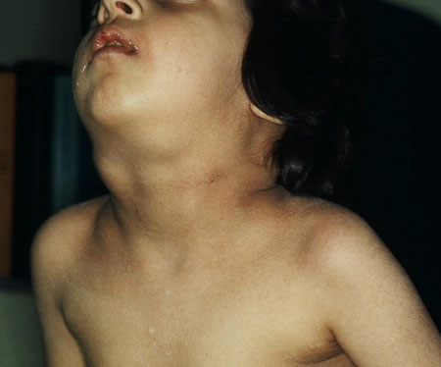
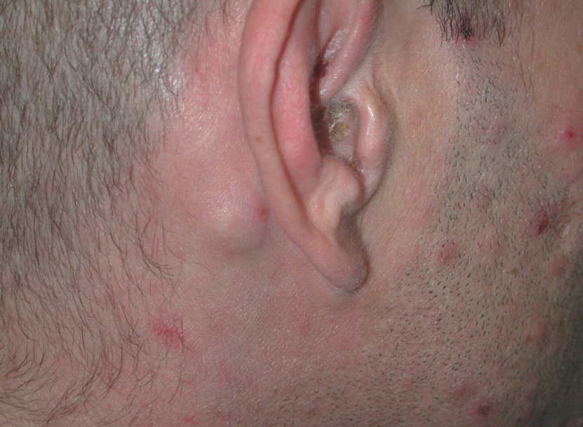
How does it look like?

Slide 7
Intraoral Examination
Lymphadenopathy can also occur in the intraoral tonsillar tissues, causing tissue enlargement that can be detected during intraoral examination.
The intraoral tonsils may be tender when palpated.
The condition may cause airway obstruction and lead to infection of the tonsillar tissue.

Slide 8
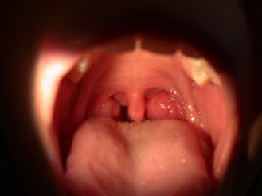
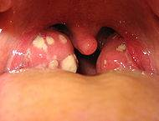
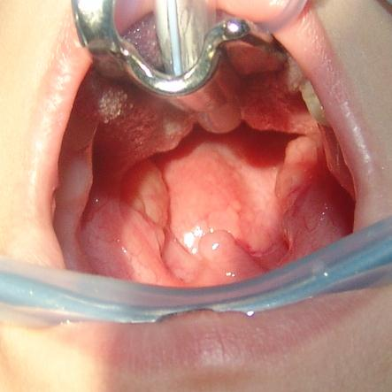
How does it look like?

Slide 9
Role of the Dental Team
Dental professionals must understand the relationship between node location and node drainage patterns throughout the head and neck.
Perform routine extraoral and intraoral examinations on patients.
Record and document any susceptible findings and palpable lymph nodes.
A medical referral may be needed.

