Slide 1
Atlantic Yards
Midterm Presentation
Jean-Pierre Demerieux Gomez

Slide 2
Summary
Barclays Center is a building that stands strong at the intersection that connects all of Brooklyn. But like all major construction projects in Brooklyn that affects major areas there is always opposition from the public. The development of Atlantic Yards is a good example where the public pressure forced developers into making changes with a major project.

Slide 3
Question
How can we begin to draw comparisons with the past and the present and our future when it pertains to gentrification and how developers gain support on projects in Brooklyn?

Slide 4
Methods
Interviewing developers to see how much they care and try to accommodate the public.
Researching articles and newsletters to see how developers have responded to public retaliation as it pertains to Atlantic yards and present day projects.

Slide 5
Research
Developer Said to Cut Size of Brooklyn Project
$4 Billion housing, arena proposal approved in Brooklyn
Current Projects and How developers are responding to public perception.

Slide 6
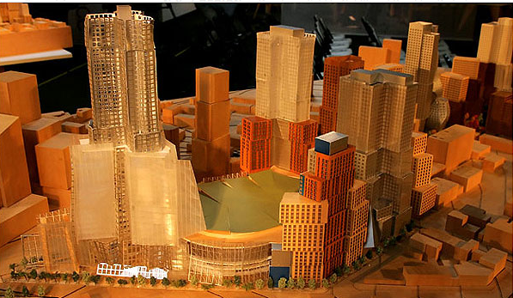
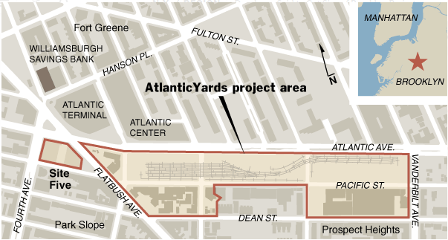
Developers Decisions in the Past
"Developer cutting size of New York project."
American City & County, 5 Sept. 2006. Business Collection, http://link.galegroup.com/apps/doc/A150928379/ITBC?u=cuny_nytc&sid=ITBC&xid=1db5ebe8. Accessed 22 Oct. 2018.

Slide 7
Research
"$4 Billion housing, arena proposal approved in Brooklyn." Building Design & Construction, 1 Jan. 2007, p. 14. Business Collection, http://link.galegroup.com/apps/doc/A158316759/ITBC?u=cuny_nytc&sid=ITBC&xid=362c0229. Accessed 23 Oct. 2018.

