Slide 1
Management & Treatment of Hypercholesterolemia
Roxanne Jimenea☺☻
Amy Li☺☻

Slide 2
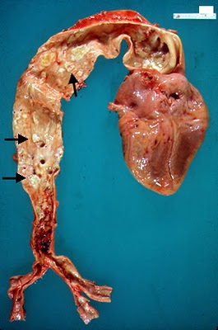
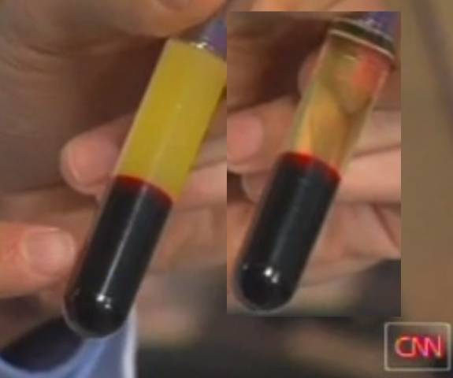
What is cholesterol?
Waxy
Soft
Oily
Fat-like
HDL=Good
LDL=Bad
Notes:
Cholesterol is a fatty substance that is waxy and exists as small molecules within the human body. It is found in all cells of the body.
Cholesterol is an essential component that makes hormones, bile acids, vitamin D, and substances that help in the digestion of food.
The cholesterols in the body are also important for cell structures, nerves, brain, liver and other organs as well.
HDL cholesterol is called “good” cholesterol. This is because it carries cholesterol from other parts of the body and brings them back to the liver for breakdown and removal or for reuse.

Slide 3
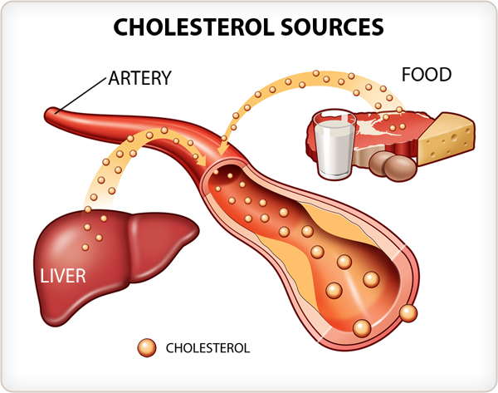
Notes:
The body is able to synthesize all the cholesterol it needs. The liver produces about 1,000 milligrams of cholesterol a day and this can meet the needs of the body. Cholesterol is also found in the foods that one consumes.

Slide 4
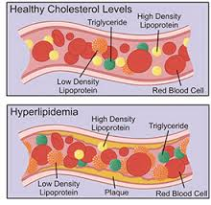
Hypercholesterolemia
low-density lipoprotein (LDL) cholesterol levels and/or triglycerides
Dyslipidemias may also be present

Slide 5
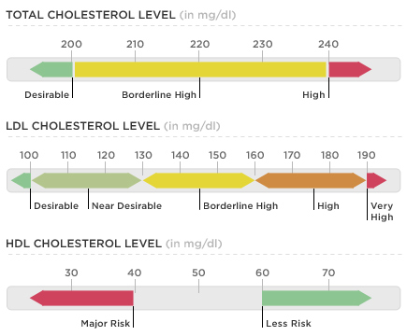

Slide 6
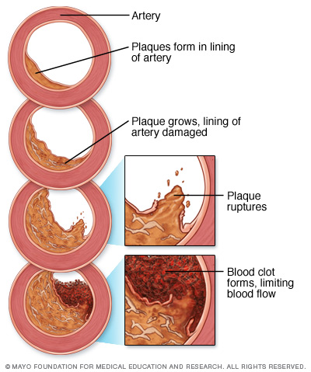
Hypercholesterolemia
may lead to the presence of cardiovascular disease associated with atherosclerosis of the arterial vessel wall and thrombosis
Notes:
LDL cholesterol sometimes is called “bad” cholesterol.
A high level of LDL cholesterol in the arteries can lead to a build-up within the walls leading to narrowing and blockages. This is called atherosclerosis.
In vital arteries of the heart (coronary arteries), brain and other organs, atherosclerosis can cause major life-threatening problems.
Some of these include angina, heart attacksand strokes.

Slide 8
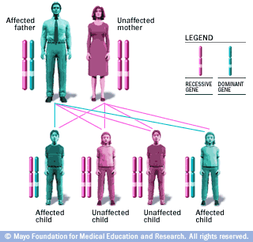
Types of Hypercholesterolemia
Primary Hypercholesterolemia
Familial Hypercholesterolemia (FH)
mutations in LDL receptors
LDL receptors cannot remove LDL
LDL
Autosomal dominant inheritance

Slide 9
Familial Combined Hyperlipidemia (FHCL)
increased total cholesterol and/or triglycerides with an increased risk of premature cardiovascular disease
Common lipid disorder
often present in premature myocardial infarction patients
Exact defect is unknown but is thought to be polygenetic

Slide 10
Autosomal Recessive Hypercholesterolemia (ARH)
failure of internalization of LDL receptor
buildup of LDL receptor proteins
Rare monogenic lipid disorder
very responsive to drug therapy

Slide 11
Sitosterolemia (Phytosterolemia)
mutations in ABCG5 or ABCG8
Results in impairment of plant sterol excretions from enterocytes and hepatocytes leading to buildup of these sterols
Extremely rare disorder
Autosomal recessive inheritance

Slide 12
Secondary Hypercholesterolemia
Type I Diabetes Mellitus (DM1)
levels of atherogenic and cholesterol enriched apolipoprotein B due to hyperglycemia
Glycemic control is extremely important in maintaining total cholesterol and/or triglyceride levels

Slide 13
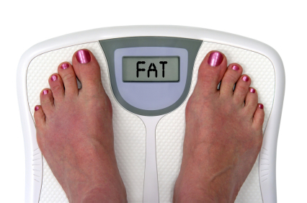
Obesity & Metabolic Syndrome
high density lipoprotein (HDL)
triglycerides
Increased childhood body mass index increases chances of dyslipidemia as well as cardiovascular disease in adulthood

Slide 14
Clinical symptoms
no major clinical manifestations
silent killer along with hypertension
Some experience dizziness, short-sighted.

Slide 15
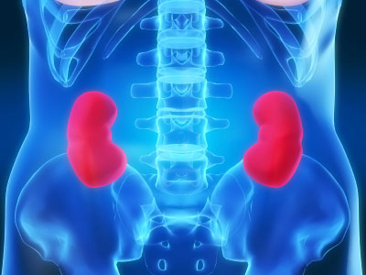
Nephrotic Syndrome & Chronic Kidney Disease
Hyperlipidemia is characteristic of nephrotic syndrome
Increased risk of atherosclerotic cardiovascular disease
Proteinuria increases hepatic synthesis of lipoproteins
Hypertriglyceridemia is characteristic of chronic kidney disease
Results from:
impaired removal of cholesterol
side effects of certain medication (e.g., corticosteroids)

Slide 17
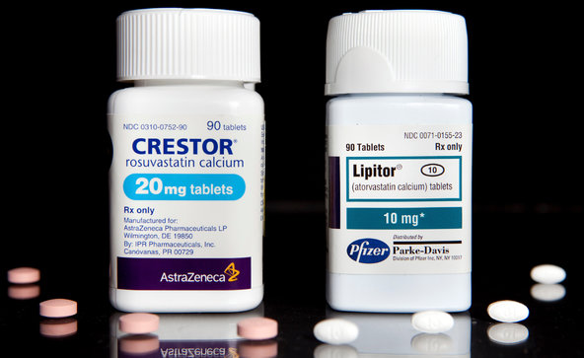
HMG-Co-A Reductase Inhibitors
e.g., Simvastatin, Lovastatin, Atorvastatin
LDL + triglycerides
Increases HDL
Adverse Effects:
Myopathy
Rhabdomyolsis
Hepatotoxicity
Mechanism of Action:
Inhibits cholesterol synthesis
Drug interaction:
Grapefruit, cyclosporine, macrolide antibiotics, and antifungal agents.
Notes:
Contraindicated in pregnancy and hepatic dysfunction

Slide 18
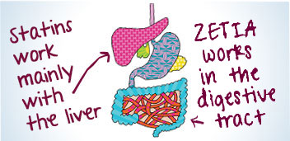
Cholesterol Absorption Inhibitor
Ezetimibe
LDL
Adverse Effects:
Gastrointestinal discomfort
Mechanism of Action:
Inhibiting intestinal cholesterol absorption

Slide 19
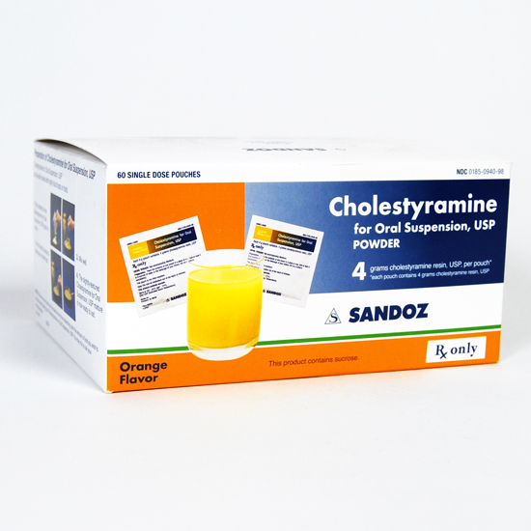
Bile Acid Binding Resins
Cholestyramine, Colestipol
LDL
Increases HDL+ triglycerides
Adverse Effects:
Gastrointestinal discomfort
Mechanism of Action:
Binds to bile acids
Drug interaction:
tetracycline, thiazide diuretics, aspirin, phenobarbital, pravastatin and digoxin.
Notes:
Since bile acids are biosynthesized from cholesterol, disruption of bile acid reabsorption will decrease cholesterol levels (ldl). Therefore, they may be used for the treatment of hypercholesterolemia
Bile acid sequestrants are indicated for the treatment of hypercholesterolemia in patients who do not adequately respond to dietary modifications. They may be used either alone or in combination with HMGRIs or niacin.

Slide 20
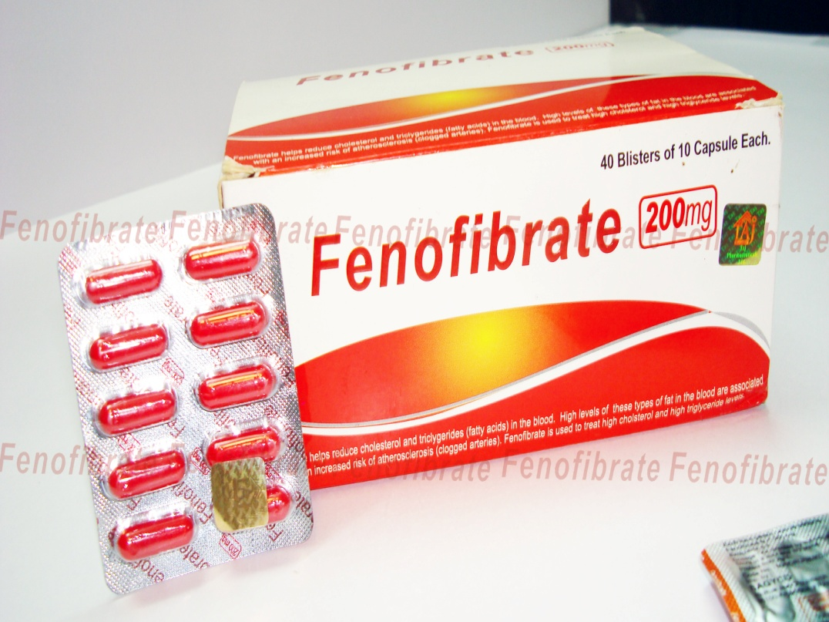
Fibrates
e.g., Fenofibrate, Gemfibrozil, Bezafibrate
Variable effect on LDL
Increases HDL
Decreases triglycerides
Adverse Effects
Myopathy
Rhabdomyolsis
Hepatotoxicity
Mechanism of Action
unclear

Slide 21
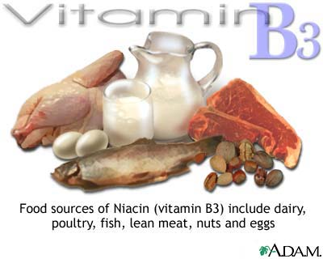
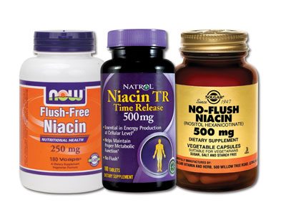
Niacin
LDL + triglycerides
Increases HDL
Adverse Effects
Flushing
Hepatic Failure
Glucose Intolerance
Mechanism of Action
unclear

Slide 22
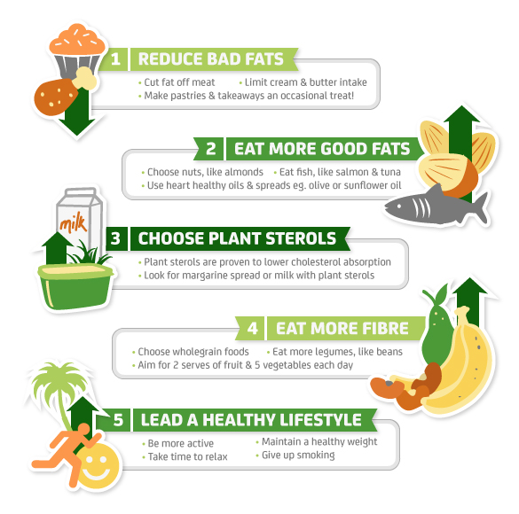
Notes:
Food does not contain cholesterol per se.
There is very little cholesterol in foods.
The main culprits are eggs, offal and shellfish.
However, foods that are rich is saturated fats are dangerous because when ingested the liver turns this fat into cholesterol.

Slide 23
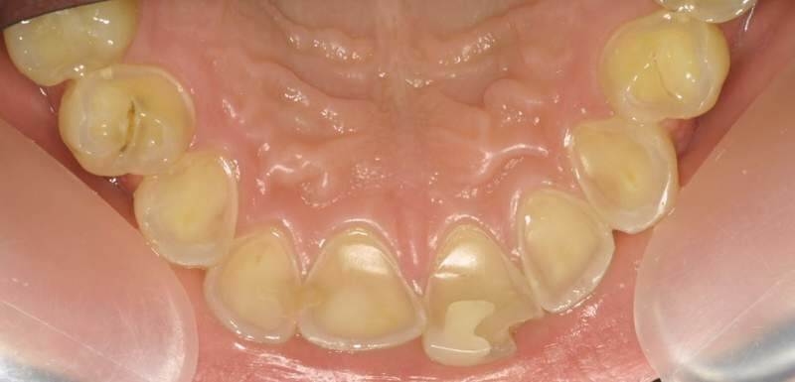
Things to keep in mind…
Orthostatic hypotension
seat the patient up slowly
let them sit for a couple of minutes before dismissing them.
Upset stomach
screen patients for erosion due to vomiting
Recommend Proenamel

Slide 24
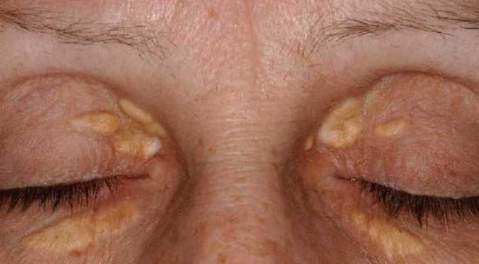
Clinical symptoms
Xanthoma
white or yellow patches around the eyelids
Notes:
Xanthoma is a deposition of yellowish cholesterol-rich material in tendons or other body parts in various disease states.
They are cutaneous manifestations of lipidosis in which there is an accumulation of lipids in large foam cells within the skin.

Slide 25
Review Questions
What is the optimal level of LDL?
<100
Which hyperlipidemic agent is known to have drug interactions with grapefruit?
HMG Co-A reductase inhibitors (Statins)
What is one adverse effect of Niacin that we can see on a patient?
Flushing

Slide 26
References
Grundy, S. M., et al. "Implications of recent clinical trials for the National Cholesterol Education Program Adult Treatment Panel III guidelines." Circulation 110.2 (2004): 227-239.
http://www.heart.org/HEARTORG/Conditions/Cholesterol/AboutCholesterol/What-Your-Cholesterol-Levels-Mean_UCM_305562_Article.jsp#

