Slide 1
Dental Fluorosis
Presented by: Amy Li

Slide 2
Benefits of fluoride on dentition
Caries control
Reverse the carious process
Increasing level of mineralization of any demineralized regions of the tooth surface
Reduce enamel destruction by oral bacteria
interfering with microbial acid production to reduce potential enamel destruction

Slide 3
How is fluoride incorporated in the dentition?
Enters the crystalline formation of enamel during tooth development
Produces:
Differences in morphology
More caries-resistant
Occlusal surfaces are smaller
Shallower pit and groove patterns

Slide 4
How is fluoride incorporated in the dentition?
Preeruptive Method
Enters enamel through blood supply of developing teeth
Posteruptive Method
Enters enamel topically on exposed teeth surfaces

Slide 5
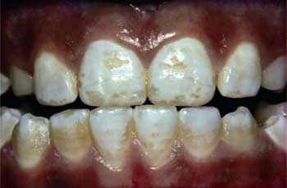
What is dental fluorosis?
Enamel dysplasia
abnormal development of the enamel
excess of systemic fluoride during tooth development
Intrinsic staining
Mottled discoloration

Slide 6
Causes of dental fluorosis
Ingestion of excess amounts of fluoride
From water system
From tooth paste
Prescription

Slide 7
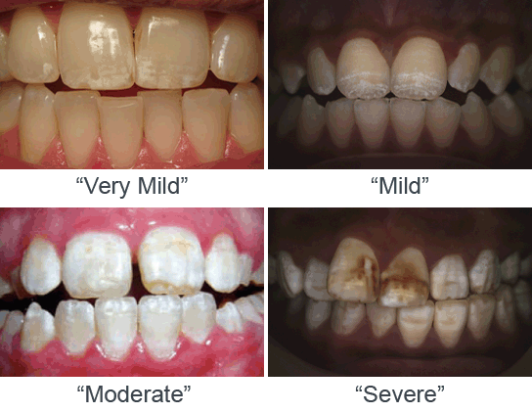

Slide 8
Treatments and Role of the dental team
Recognition
identify the abnormality
Education
address the abnormality to the patient
help them understand the importance of regular cleanings and checkups
Treatment
esthetic treatments such as veneers are optional

