Slide 1
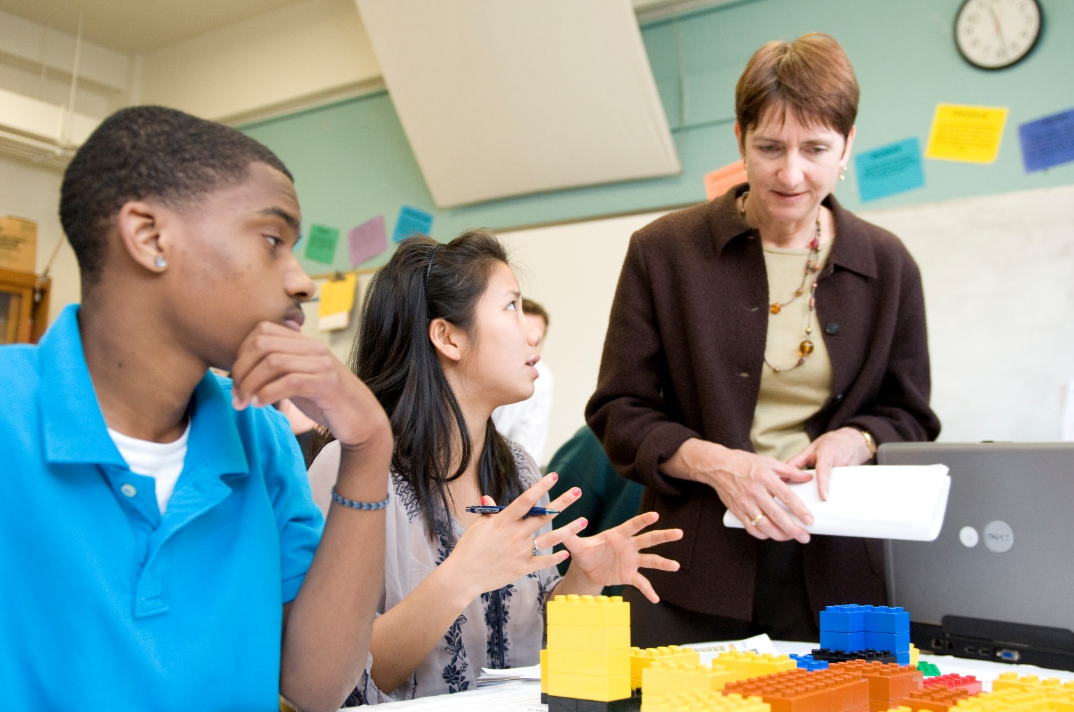
The Vision Statement

Slide 2
Craft a Vision Statement
Before your team starts building, you need to develop a distinctive vision for Elmwood
Each team is required to write a vision statement that paints the picture of the district – the “look and feel” you want to create and the activities and outcomes you want to enable.

Slide 3
Tips for Creating Your Vision Statement
The Vision Statement is your project’s aspirational “mission statement”
The VS is to UrbanPlan as the “thesis” is to a paper for your English or History class
It is the unifying concept around which all argument and exposition is developed

Slide 4
Tips for Creating Your Vision Statement
Do imagine a vibe or theme for your new Elmwood
Do not talk about building types
Vision articulates the intended ACTIVITIES OUTCOMES, and CONDITIONS created by your decisions.

Slide 5
Vision Statement = Benefits & Sense of Place
Talk about activities created as a consequence of the vision
Use verbs when describing what is going on in Elmwood
If you use adjectives, back them up with detailed descriptions

Slide 6
Buildings = Activities
Outcomes – “What do you intend to happen as a result of the product types you selected, the amount you selected and where you placed them?”
Buildings enable, mitigate, or prevent, activities and behaviors.
Exactly what kind of people do you intend to live, work & shop there?
Notes:
If you want 28-year-old business professionals walking on 9th Avenue at 7:30pm on a Thursday night, what should you build? How much of it? Where should you put it?
What if you want families with young children on 9th on Saturday from 11am-2pm, what should you build?

Slide 7
Vision Statement Example
“Our Vision is revitalization without gentrification - developing inclusive square footage that brings new life to the neighborhood without pricing anyone out.”
Notes:
Here is a sample vision statement

Slide 8
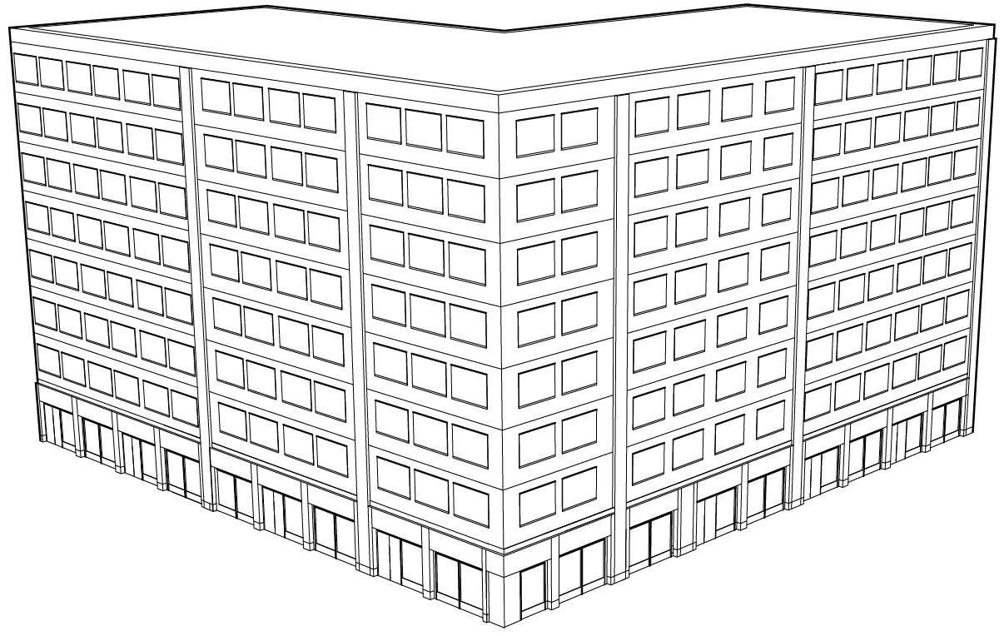
Questions to Ask About Every Use & Adjacency
If you see a Mid-rise office, what are the behaviors and activities created by that use?
When are the workers arriving? How? Where
In the early evening when workers leave?
What happens around noon as a consequence of having the mid-rise?
Notes:
Here is an example to understand the behaviors and activities created by a use. In this case, a Mid-Rise Office building.
If you see a Mid-rise office, what are the behaviors and activities created by that use?
When are the workers arriving? How? Where?
In the early evening when workers leave?
What happens around noon as a consequence of having the mid-rise?
(ANSWER: Office workers go to lunch and activate the street where lunch places are located.)
Students should ask themselves this type of questions about every use and every adjacency.

Slide 9
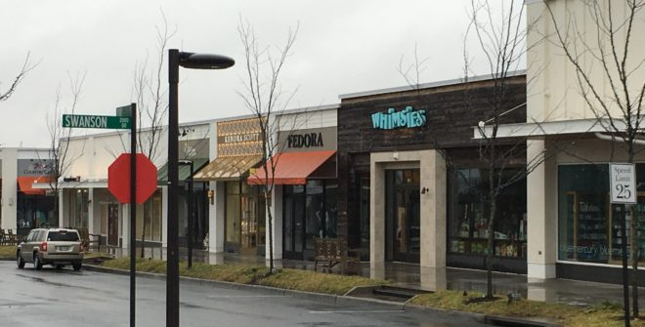
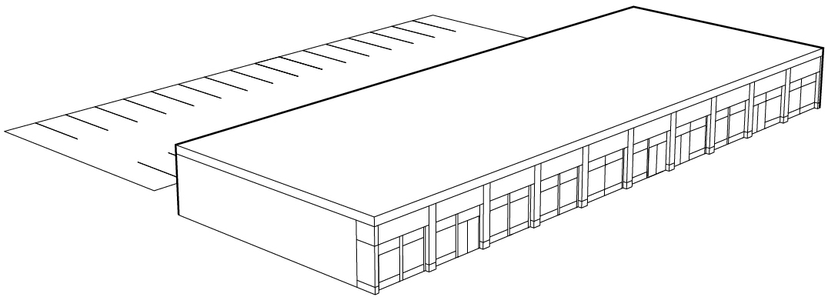
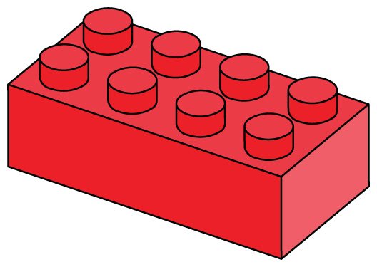
A Red DUPLO Is Not Just Retail
When you see a red piece of LEGO which represents 10,000 sf of Neighborhood Retail (4-6 stores), what is created by that use?
Notes:
Are you creating jobs: What type of jobs?
Is that retail making people walk on the sidewalk every day and most times of day and evening, or is it a retail that people go in and out?
If the retail is a tire store…what behaviors and activities are created? Are the behaviors and activities the same if you have a café or a bookstore instead?
What do people look like, what pace are they moving at, how are they dressed as a result of the retail you decide to include?
Is your choice of retail providing a place for people to get together or not?
Is your choice making the surrounding area feel safer or not?

Slide 10
Different Uses Create Different Behaviors and Activities
When you see Neighborhood Retail (4-6 stores):
What type of jobs are being created?
Is that retail creating foot traffic? At what time of the day?
Who are the people on the street? At what pace are they moving? How are they dressed?
Is the choice of retail providing a place for people to gather? Is it creating a sense of place?
Notes:
New slides about different types of stores. Hardaware, paint, tire stores, vs. boutique, café, bookstore.

Slide 11
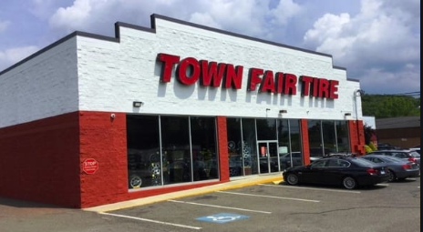
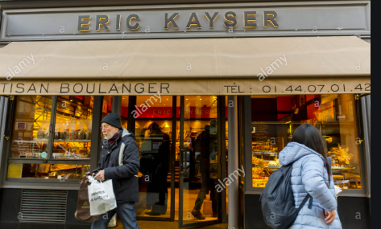
Consider the effects of one choice vs. another
What activity is generated by:
Grocery store vs. bookstore
Hardware store vs. Café
Tire store vs. bakery

