Slide 1
Inferential Statistics
11.3 Chi-Square Tests: Independence
Ezra Halleck, City Tech (CUNY), Fall 2023

Slide 2
Review of 11.2 A Goodness-of-Fit Test
A multinomial experiment consists of n identical, independent trials (repetitions).
Each trial results in one of k possible outcomes (or categories), where k > 2.
Probabilities of various outcomes remain constant for each trial.
We denote with p the probability of a particular category.
Expected frequency $E=np$ must be at least 5 for each category
The degree of freedom $df=k−1$
The chi-sq TS is
where for each category, O is observed & E is expected.

Slide 3
11.3 A Test of Independence
Often, we have information on more than one variable for each element in the sample.
Such information can be summarized and presented using a two-way classification table, which is called a contingency table or cross-tabulation.
Blank | Full-Time | Part-Time
Male | 6768 | 2615
Female | 7658 | 3717
Students who are male and enrolled part-time

Slide 4
A Test of Independence
$H_{0}$: two attributes of a population are not related.
$H_{1}$: two attributes of a population are related.
The degree of freedom is
where R and C are the number of rows and the number of columns, respectively, in the given contingency table.
The value of the test statistic is
where O and E are the observed and expected frequencies, respectively, for a cell.

Slide 5
School discipline
Lack of discipline has become a major problem in schools in the United States.
A random sample of 300 adults were asked if they favor giving more freedom to schoolteachers to punish students.
Here is a two-way classification of the responses:
Blank | In Favor (F) | Against (A) | No Opinion (N)
Men (M) | 93 | 70 | 12
Women (W) | 87 | 32 | 6
Does the sample provide sufficient information to conclude that the two attributes, gender and opinions of adults, are dependent? Use a 1% significance level.

Slide 6
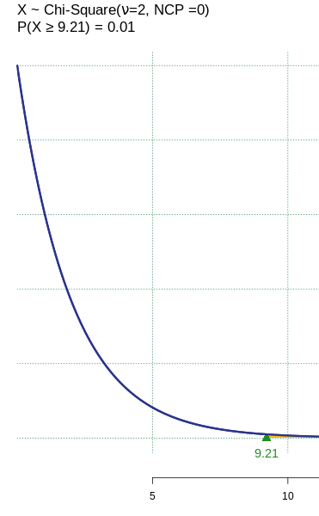
School discipline: solution (1 of 5)
Step 1:
H₀: Gender and opinions are independent
H₁: Gender and opinions are dependent
We will use the chi-square distribution and the critical value approach.
Step 2: $α=0.01$
$$df=\left(R−1\right)\left(C−1\right)=\left(2−1\right)\left(3−1\right)=2$$
The critical value is $χ^{2}$
= CHISQ.INV(1 - 0.01,2) [Excel]
Using on online tools such as Rgurro we display the graph and critical region $→$

Slide 7
School discipline: solution (2 of 5)
Step 3: To calculate the expected frequencies assuming the two attributes are independent, we add marginal totals to the table
Blank | In Favor (F) | Against (A) | No Opinion (N)
Men (M) | 93 | 70 | 12
Women (W) | 87 | 32 | 6
Blank | In Favor (F) | Against (A) | No Opinion (N) | Row Totals
Men (M) | 93 | 70 | 12 | 175
Women (W) | 87 | 32 | 6 | 125
Column Totals | 180 | 102 | 18 | 300

Slide 8
School discipline: solution (3 of 5)
Blank | In Favor (F) | Against (A) | No Opinion (N) | Row Totals
Men (M) | 93 105 | 70 59.5 | 12 10.5 | 175
Women (W) | 87 75 | 32 42.50 | 6 7.5 | 125
Column Totals | 180 | 102 | 18 | 300
Working just with the marginals, the expected frequency E (in blue) for a cell is calculated as
For example, $\frac{(175)(180)}{300}=105$

Slide 9
School discipline: solution (4 of 5)
Step 4: Calculation of chi-square test statistic
We ignore the marginals and focus on the joint (interior) frequencies.
Blank | F | A | N
M | 93 105 | 70 59.5 | 12 10.5
W | 87 75 | 32 42.50 | 6 7.5

Slide 10
School discipline: solution (5 of 5)
Step 5:
The value of the test statistic
It is less than the critical value of
Hence, it falls in the nonrejection region
and we fail to reject the null hypothesis.
There is not enough evidence at the 1% level to conclude that the two characteristics
gender;
opinion regarding giving teachers more ability to discipline;
are dependent.
On the next 2 slides are a p-value solution using Excel & a critical value solution using an online tool/TI84.

Slide 11
Critical value solution using a TI84
Step 1:
H₀: Gender and opinions are independent
H₁: Gender and opinions are dependent
We will use the chi-square distribution and the critical value approach.

Slide 12
Critical value solution using a TI84
Step 2:
Before we perform the test, will need to create two matrices.
One Matrix for Observed Values
One Matrix for Expected Values
How to create a matrix
Press 2nd, MATRIX, $→$EDIT

Slide 13
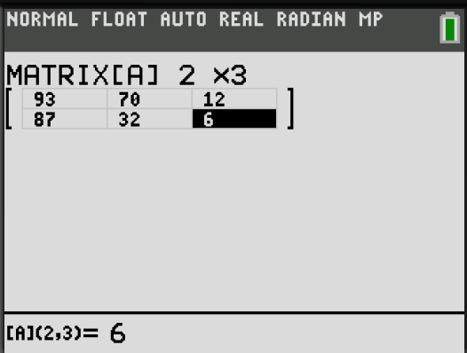
Critical value solution using a TI84
Step 2 (continued):
One Matrix for Observed Values
How to create a matrix
Press 2nd, MATRIX, $→$EDIT $↓$ 1:[A], Enter
Fill in the values of the “Observation” table
Note: Observe that the table had
2 horizontal rows and 3 vertical columns.
You must first set the matrix to $2×3$
Blank | In Favor (F) | Against (A) | No Opinion (N)
Men (M) | 93 | 70 | 12
Women (W) | 87 | 32 | 6

Slide 14
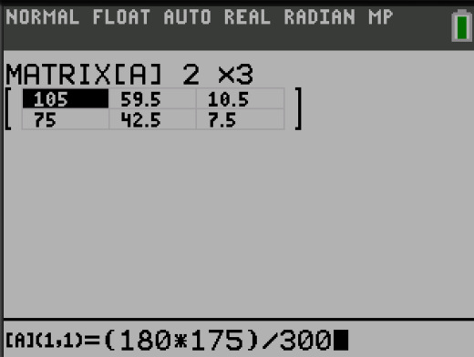
Critical value solution using a TI84
Step 2 (continued):
One Matrix for Expected Values
How to create a matrix
Press 2nd, MATRIX, $→$EDIT $↓$ 2:[B], Enter
Fill in the values of the “Expected” table
pec
Blank | In Favor (F) | Against (A) | No Opinion (N)
Men (M) | 105 | 59.5 | 10.5
Women (W) | 75 | 42.5 | 7.5
Note: You can also fill each cell by typing in
$$\left(Row Total\right)⋅\left(Column Total\right)÷(Total)$$
for each specific row and column combination.

Slide 15
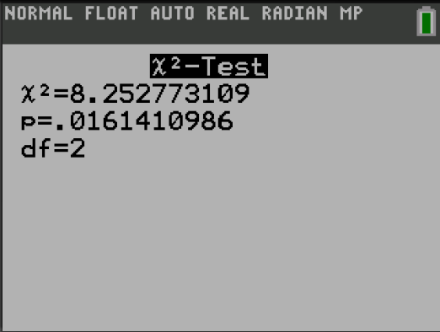
Critical value solution using a TI84
Step 3: Run the $χ^{2}$ Test for Independence
Press STAT $→$ Tests $↓$ C: $χ^{2}$- Test…
*To use Matrix [A] or [B]
Press 2nd, Matrix
1 for [A], 2 for [B]
Observe:
The results provide us with a $χ_{test}^{2}$ value.
A p-value
And the Degree of Freedom.

Slide 16
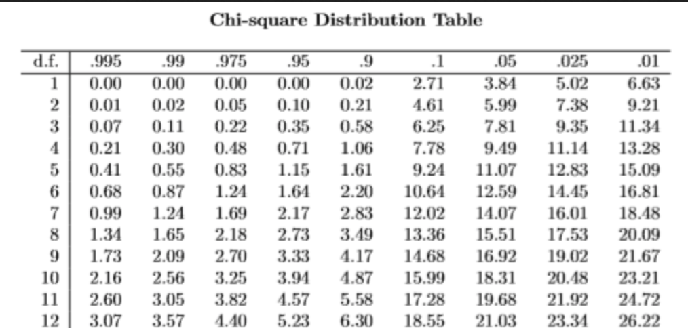
Critical value solution using a TI84
Step 4: Finding $χ_{crit}^{2}$ value.
With $α=0.01$ and $df=2$
The critical value must be found on the $χ^{2}$ distribution table.$χ_{crit}^{2}=9.21$

Slide 17
Critical value solution using a TI84
Step 4: Finding $χ_{crit}^{2}$ value.
With $α=0.01$ and $df=2$
The critical value must be found on the $χ^{2}$ distribution table.$χ_{crit}^{2}=9.21$

Slide 18
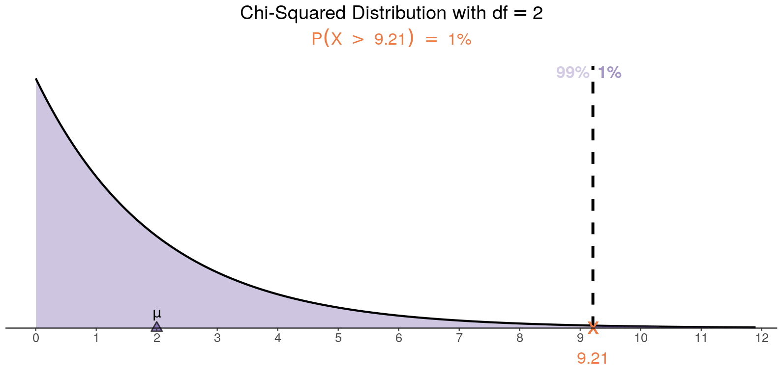
Critical value solution using a TI84
Step 5:
The value of the test statistic
It is less than the critical value of
Hence, it falls in the nonrejection region
and we fail to reject the null hypothesis.
There is not enough evidence at the 1% level to conclude that the two characteristics
gender;
opinion regarding giving teachers more ability to discipline;
are dependent.
On the next 2 slides are a p-value solution using Excel & a critical value solution using an online tool/TI84.
Critical value

Slide 19
P-value solution using a TI84
Step 4:
$p=0.016$ and $α=.01$
Since $p>α$ “ $p$ is greater than $α$”, we fail to reject the null hypothesis.
There is not enough evidence at the 1% level to conclude that the two characteristics
gender;
opinion regarding giving teachers more ability to discipline;
are dependent.

Slide 20
What-do-kids-value observed
In the dataset popular, students in grades 4-6 were asked whether good grades, athletic ability, or popularity was most important to them.
A two-way table separating the students by grade and by choice of most important factor is shown below.
Do these data provide evidence to suggest that goals vary by grade at a 5% significance level?

Slide 21
What-do-kids-value hypotheses
H₀: Grade and goals are independent. Goals do not vary by grade.
H₁: Grade and goals are dependent. Goals vary by grade.

Slide 22
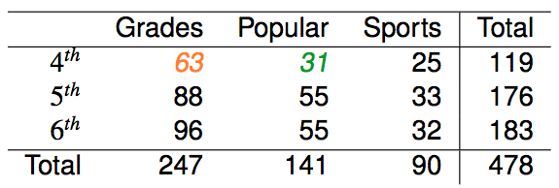
Expected counts in two-way tables
Recall that the first computational step is to find the marginal totals:
Using the marginals, we calculate each of the expected counts using:
Here are the calculations for the for the first entries in row 1:
The two expecteds differ from their corresponding
observeds, but not by relatively large amounts.

Slide 23
Expected counts in two-way tables
What is the expected count for the highlighted cell?
176 x 141 / 478
119 x 141 / 478
176 x 247 / 478
176 x 478 / 478

Slide 24
Expected counts in two-way tables
What is the expected count for the highlighted cell?
176 x 141 / 478
119 x 141 / 478
176 x 247 / 478
176 x 478 / 478
which is 52.
The difference between the observed and expected #’s for 5th graders who value being popular is $55−52=3$:
not a relatively large amount;
can be ascribed to random variation.

Slide 25
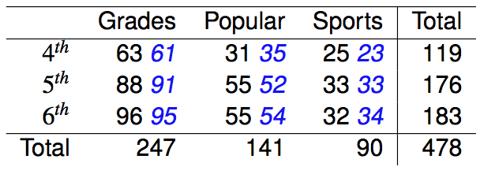
A matchup of observed and expected
Observed counts are shown in black next to the expected counts (blue).
Note:
the 61, 35 and 52 we had calculated on the previous slides;
that there is discrepancy between the black and blue numbers but the discrepancy is relatively never large (<15%).
Do you think the differences are statistically significant (not easily ascribed to random variation)?

Slide 26
Calculating the test statistic and df
Observed counts are shown in black next to the expected counts (blue).
Having gotten the expected counts, we can now ignore the marginals.
Using the matchup and the formula:
we calculate the chi-square statistic:
Chi-square is a family of distributions with the df as its single parameter:

Slide 27
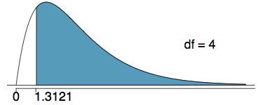
Calculating the p-value
Which of the following is the correct p-value for this hypothesis test?
χ²_{df} = 1.3121 df = 4
more than 0.7
between 0.7 and 0.5
between 0.5 and 0.3
between 0.3 and 0.1
less than 0.1

Slide 28
Calculating the p-value
Which of the following is the correct p-value for this hypothesis test?
χ²_{df} = 1.3121 df = 4
more than 0.7
between 0.7 and 0.5
between 0.5 and 0.3
between 0.3 and 0.1
less than 0.1
Excel: 1 - CHISQ.DIST(1.3121,4) = 0.8593
TI-84: $χ^{2}\text{cdf}\text{(}$lower, upper, df )=$χ^{2}$cdf(1.3121, 1E99, 4)

Slide 29
Conclusion for what-do-kids-value
Recall that our hypotheses are:
H₀: Grade and goals are independent. Goals do not vary by grade.
H₁: Grade and goals are dependent. Goals vary by grade.
We calculated a p-value of 0.86.
At 5% significance level, what is the conclusion of the hypothesis test?
Reject H₀, data provide convincing evidence that the values vary by grades.
Reject H₀, data provide convincing evidence that values do not vary by grades.
Fail to reject H₀, data do not provide convincing evidence that the values vary by grades.
Fail to reject H₀, data provide convincing evidence that values do vary by grades.

Slide 30
Conclusion of the hypothesis test for what-do-kids-value
Recall that our hypotheses are:
H₀: Grade and goals are independent. Goals do not vary by grade.
H₁: Grade and goals are dependent. Goals vary by grade.
We calculated a p-value of 0.86.
At 5% significance level, what is the conclusion of the hypothesis test?
Reject H₀, data provide convincing evidence that the values vary by grades.
Reject H₀, data provide convincing evidence that values do not vary by grades.
Fail to reject H₀, data do not provide convincing evidence that the values vary by grades.
Fail to reject H₀, data provide convincing evidence that values do vary by grades.

Slide 31
Restatement of Conclusion for what-do-kids-value
Do the data provide strong enough evidence to say that goals vary by grade?
No, the data does not provide convincing evidence that grade and goals are dependent.
It doesn't appear that goals vary by grade.

Slide 32
Smoking and cholesterol
A random sample of 160 patients at a health maintenance organization yielded the following information about their smoking status and blood cholesterol counts:
H₀: blood cholesterol count and smoking status are independent.
H₁: blood cholesterol count and smoking status are dependent.
Do we reject H₀ at the 1 percent level of significance?
From TI-84, we find:
TS is 18.7 & p-value is 0.01%
So, we will reject at 1 percent levels and conclude:
A person’s smoking status is related to their cholesterol count.
 | Blood cholesterol count
Smoking status | Low | Moderate | High
Heavy | 6 | 14 | 24
Light | 12 | 23 | 15
Nonsmoker | 23 | 32 | 11

Slide 33
Smoking and cholesterol notes
This problem is a simplification, as there is both good and bad cholesterol.
However, even if we assume that the cholesterol referred to is the “bad” cholesterol, then there is still the issue that “correlation is not causation”.
Smoking could be associated with other behavior that leads to high (bad) cholesterol, such as an unhealthy diet and lack of exercise. (Mayo clinic)
However, Reuters reported in 2010 that one study indicates that “A boost in ‘good’ cholesterol comes with quitting despite weight gain after putting out the last cigarette.”

